Slide 1
Federal State Budgetary Educational Institution of Higher Education “Professor V.F. Voino-Yasenetsky Krasnoyarsk State Medical University” of the Russian Federation Ministry of Health Department of Biology and Ecology
Topic: Mendel's Laws
Interaction of Allelic and
Non-allelic Genes.
Discipline: Biology
Lecture № 4
for 1st year students studying in the specialty
31.05.01 - General Medicine
Associate Professor, Olga Pavlovna Gorlova
Krasnoyarsk, 2020

Slide 2
Plan of the Lecture
Mendel is the Founder of Actual Genetics
Mendel's Hypotheses
Monohybrid Crossing. The first and second Laws of Mendel.
Interaction of Allelic Genes
Dihybrid Crossing Mendel's third Law.
Interaction of Non-allelic Genes

Slide 3
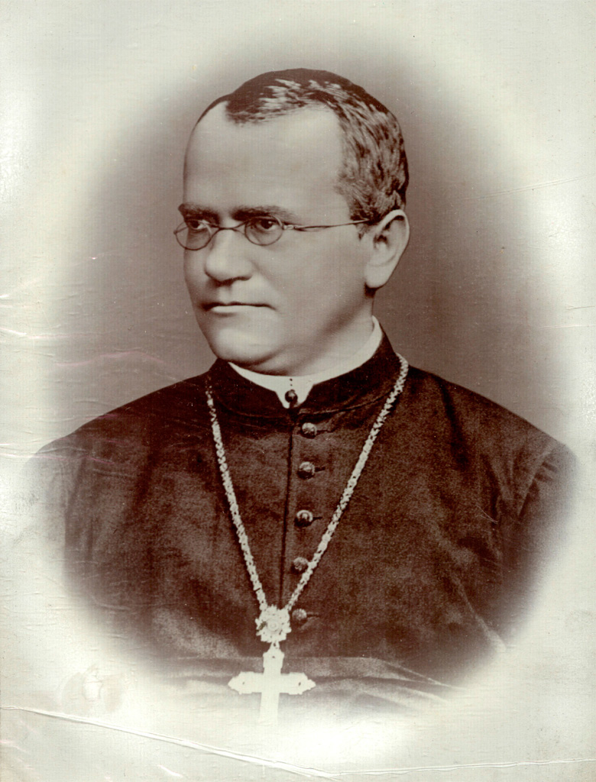
Gregor Johann Mendel (1822 – 1884)—
Austrian Biologist and Botanist, Augustinian Monk, Abbot.
The Founder of the Doctrine of Heredity.

Slide 4
There were several Reasons for Choosing Peas to Study the Mechanisms of Transmission of Hereditary Traits.
Peas were a Widespread Plant.
It is not Demanding to the Growing Conditions.
It Grows quickly and Produces large Offspring.
Peas have a Number of Contrasting Morphological Features.
This Plant is Characterized by Self-pollination.

Slide 5
Two Hypotheses were Formed Based on Mendel's Observations
Factorial Hypothesis :
"Each Individual Ttrait Corresponds to a Discrete Hereditary Factor."
Hypothesis of Gamete Purity:
"The Pair of Allelic Genes that Define a Trait is Never Mixed. Each Gamete Contains only one Gene from the Allele Pair."

Slide 6
You need to Know a few Terms to Understand Further Material.
Homologous Chromosomes are a Pair of Chromosomes with the Came Gene Composition and Similar Morphology in the Karyotype of a Diploid Organism.
Genotype - the Integrated System of Interacting Genes.
Phenotype is a Set of Characteristics Inherent in an Individual at a Certain Stage of Development. Monohybrid Crossing. The first and second Laws of Mendel

Slide 7
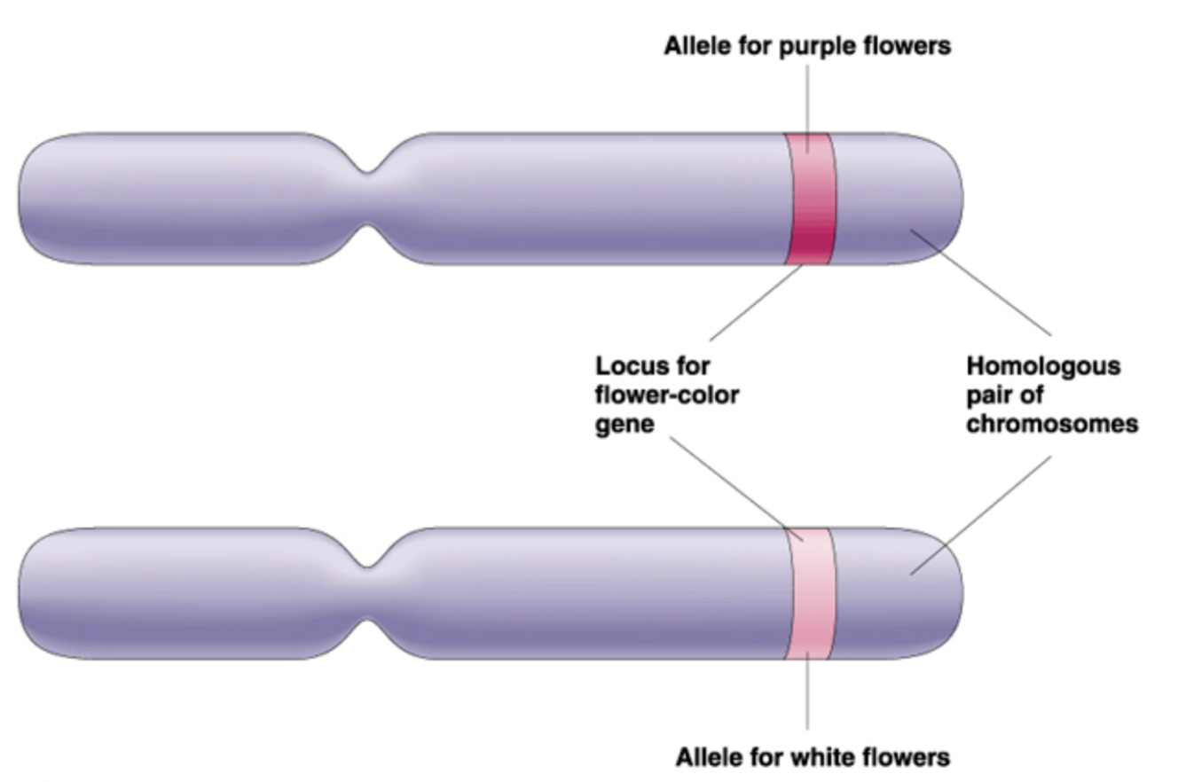
Allelic Genes are Located in the same Loci (Sections) of Homologous chromosomes.

Slide 8
Pure Line is a Group of Organisms that have Certain Characteristics that are Fully Transmitted to Offspring due to the Genetic Uniformity of all Individuals.
Hybrid is an Organism or Cell, Resulting from the Crossbreeding of Genetically Different Forms.
Monohybrid Crossing is the Crossing of two Homozygous Organisms that Differ in one Pair of Alternative Traits.
Mendel Justified the Hybridological Research Method (the Main Method of Genetics), which Makes it Possible to Explore the Genetic Structure of Ancestors by Analyzing offspring.

Slide 9
The First Mendel’s Law. The Law of Uniformity of the First Generation Hybrids or Law of Dominance
“When Parents with Pure, Contrasting Traits are Crossed Together, only one Form of Trait Appears in the Next Generation. The Hybrid Offsprings will Exhibit only the Dominant Trait in the Phenotype.”

Slide 10
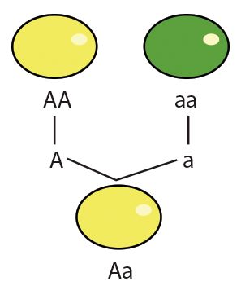
YY
yy
Y
y
Yy

Slide 11
The second law of Mendel or the law of independent combination
It low say that during meiosis, alleles of one trait are sorted independently of alleles of another trait, and they are combined during fertilization in daughter nuclei with equal probability. Interaction of allelic genes.

Slide 12
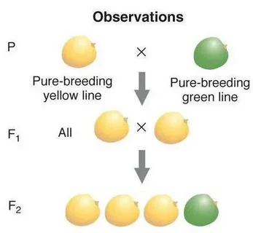
3 : 1

Slide 13
There are seven Types of Interaction of Allelic Genes:
1 Complete Dominance
in this Case, one Gene is Dominant, Completely Suppresses the other Gene - Recessive.
At the Same Time, the Phenotype of Homozygous Dominant Individuals and Heterozygous Hybrids Completely Coincides.

Slide 14
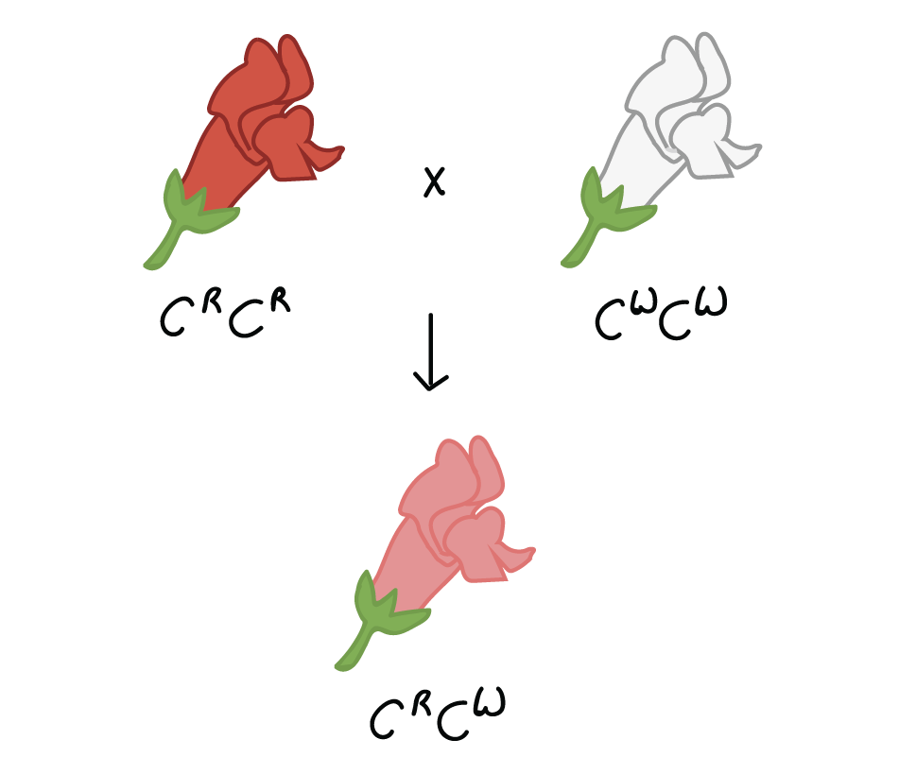
2. Incomplete Dominance
is a Type of Interaction of Allelic Genes in which the Dominant Gene does not Completely Suppress the Expression of the Recessive Gene. In the second Generation, Splitting by Phenotype and Genotype is the same 1:2:1 (the dose of Gene Action is Shown).

Slide 15
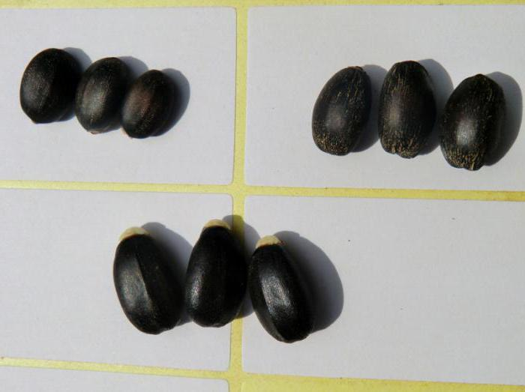
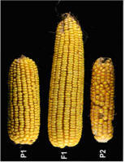
3. Overdomination
aa
AA
is a Type of Interaction of Allelic Genes in which the Trait is more Pronounced in the Heterozygote than in the Dominant Homozygote. In this Case, there is a Splitting by Phenotype and Genotype in the Ratio 1:2:1
Aa

Slide 16
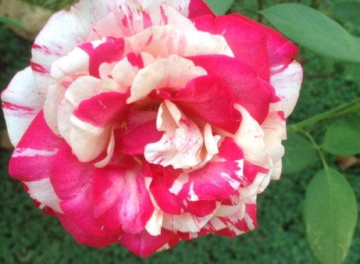
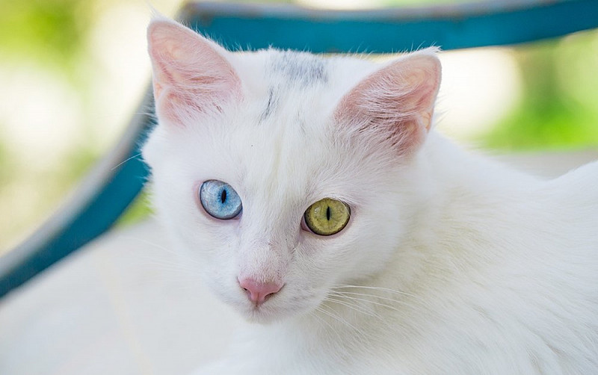
4 codomination
Is a Type of Interaction of Allelic Genes, in which the Genes of one Allelic Pair are Equivalent, neither of them Suppresses the actions of the other. They both Show their Effect If they are in the Genotype at the Same Time.

Slide 17
5. Multiple Allelism
It is a Type of Interaction of Allelic Genes in which Some Genes in a Population are Represented by three or More Alleles. For Example, a Human Blood Group Gene has three Alleles, JO, JA, and JB.
Their Combinations Give four Types of Blood Groups: JOJO is the first, JAJA and JAJO are the Second, JBJB and JBJO are the third, and JAJB is the fourth.
The JA and JB Genes are Dominant for JO, but Equal in Relation to each other.

Slide 18
6 Interallel Complementation
Is a Type of Interaction of Allelic Genes, in which it is Possible to Form a Normal (Dominant) Trait in an Organism that is Heterozygous for two Mutant (recessive) Alleles of this Gene
A
a
a’
a’’
a’ + a’’ = A

Slide 19
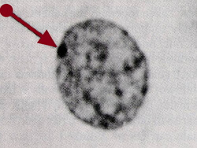
7 Allelic Exclusion
It is a Type of Allelic Gene Interaction in which only one Allele of a Gene is Expressed in a Diploid Cell, while the Expression of the other Allele is Suppressed.
An example of Allelic Exclusion is Inactivation of one of the Human X Chromosomes.
Formation of Sexual Chromatin or Barr's Body

Slide 20
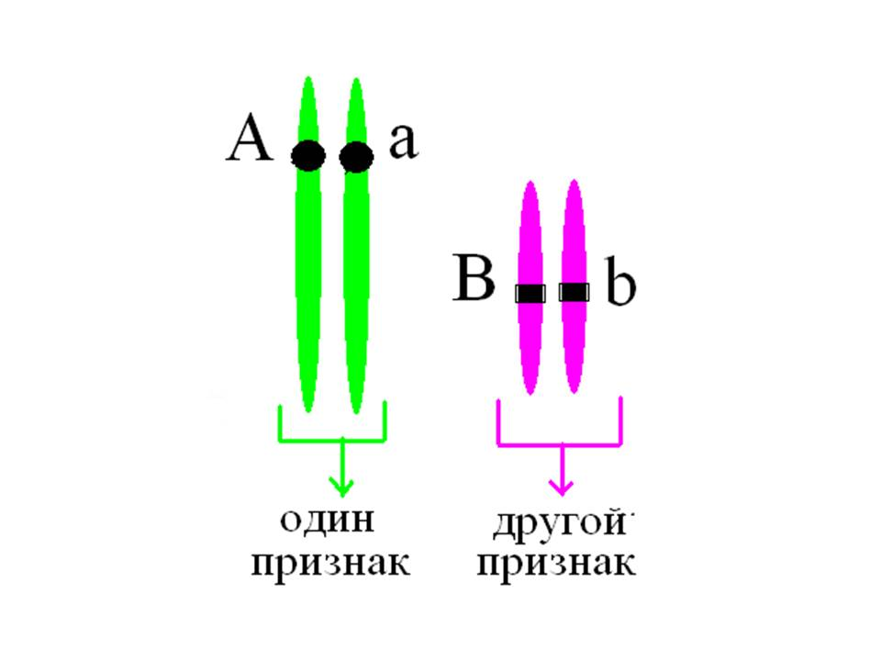
Non-allelic Genes Encode Information About Different Traits. They are Located in Different Chromosomes
one
trait
second
trait

Slide 21
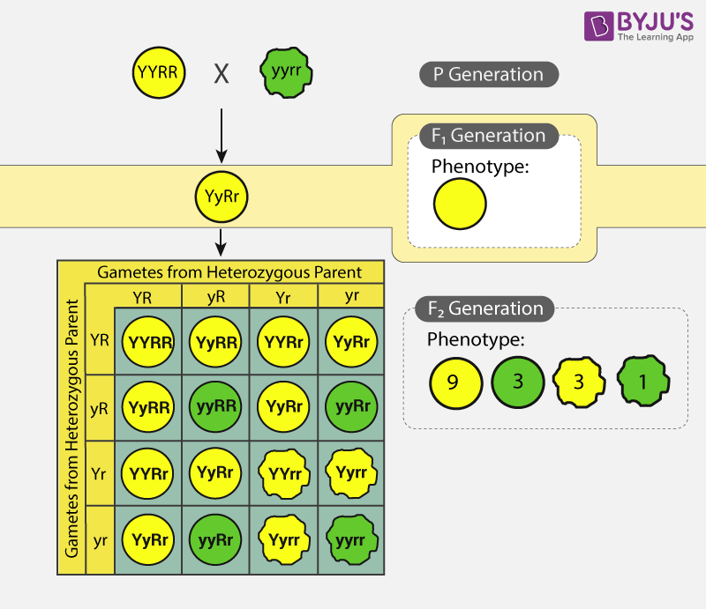
the Law of Independent Inheritance of traits
When Homozygous Organisms that Differ in two or more Pairs of Traits are Crossing, in the second Generation, there is a Combination of Genes and Traits in all Possible Combinations.

Slide 22
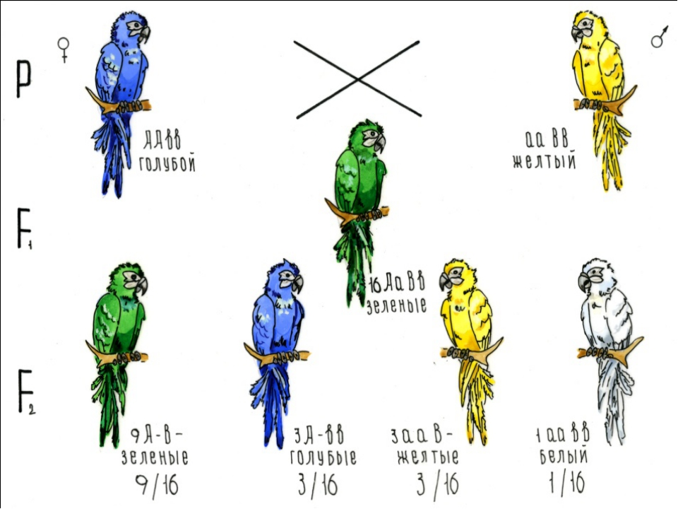
Types of Interaction of Non-allelic Genes
Сomplementarity is the Interaction of Non-allelic Genes, in which the Combination of two Dominant non-allelic Genes in a Zygote Causes the Development of a new Trait.
blue
yellow
new trait
green

Slide 23
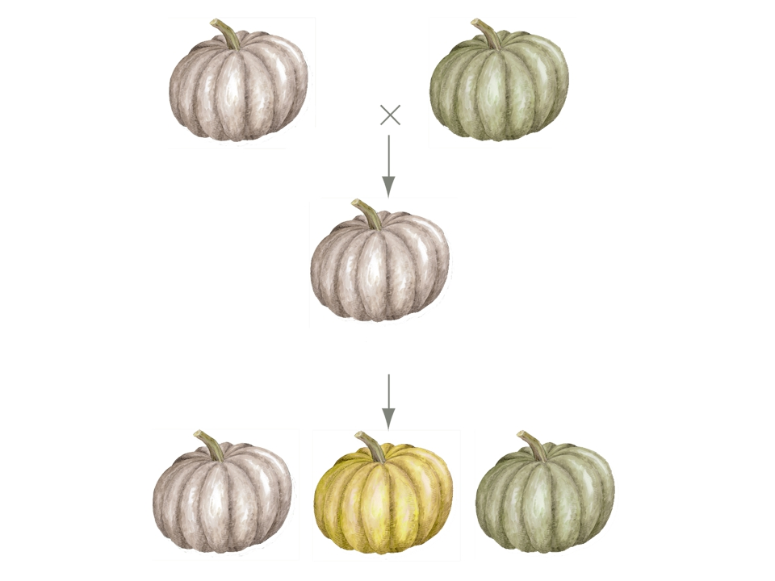
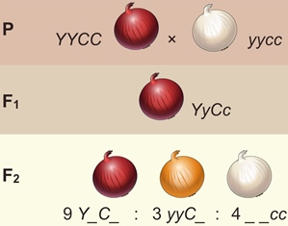
Epistasis is a Type of Interaction of Non-allelic Genes in which the Genes of one Allelic Pair Suppress the Expression of the Genes of another Allelic Pair.
dominant
recessive
White
AABB
Green
aabb
White
AaBb
White
_ _B_
Green
aabb
12/16
3/16
1/16
yellow
A_bb

Slide 24
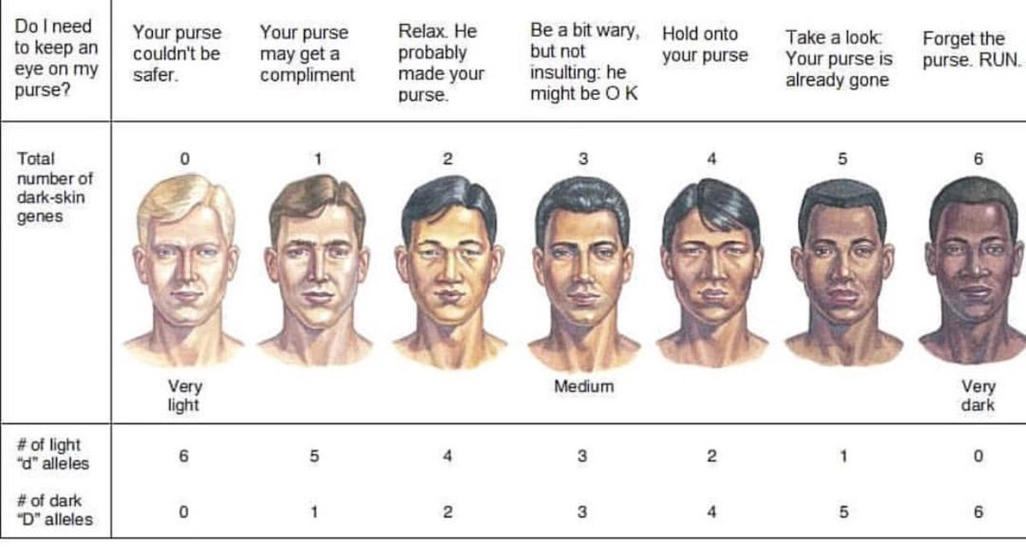
Polymery or Polygenic Inheritance
It is the Interaction of Non-allelic Multiple Genes that Unidirectionally Affect the Development of the same Trait.

Slide 25
Conclusions
Mendel is the Founder of Modern Genetics
Allelic Genes Exhibit the seven Types of Interaction Between
Nonallelic Genes may Influence the Expression of each other in three Ways.
The Considered Types of Interaction of nonallelic Genes Appear only if they are Located in Different Pairs of Chromosomes.

Slide 26
Tests for the lecture
1. The Following is most Accurately Called a "Clean Line":
1) phenotypically identical organisms;
2) genetically identical organisms;
3) organisms that are homozygous for different pairs of alleles;
4) organisms that, when crossed with their own species, do not split in the first generation according to the analyzed characteristics

Slide 27
2. Interaction of Allelic Genes that do not Differ Phenotypically from Dominant Homozygotes in Heterozygotes is Called:
1) complete dominance;
2) incomplete dominance;
3) intercellular Supplement;
4) allelic exclusion;

Slide 28
Thank you for your attention!

