Slide 1
Education in Brazil
Zababura Valery

Slide 2
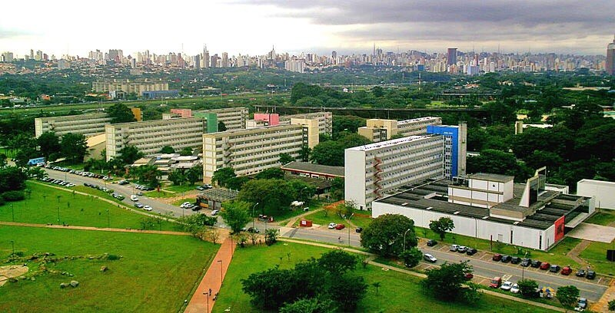
Two main and inalienable conditions for entering a Brazilian university are: (1) perfect and fluent Portuguese, both written and oral (2) excellent knowledge of all subjects of the Brazilian secondary school program (pay attention to those who are not in Russia). Admission to Brazilian universities, no benefits are granted to foreigners, and all are acting on general grounds. A Russian applicant should come to Brazil as a tourist, take exams, return to Russia and wait for results.

Slide 3
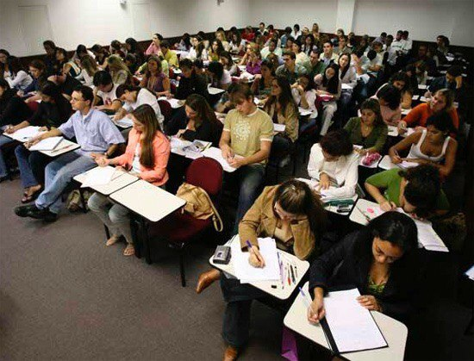
Continuing study in Brazil implies the fact that you enroll in a Brazilian university on the basis of a general competition and study here until the end, having received a Brazilian diploma. Then you can continue your education in Brazil or in another country.

Slide 4
The academic year in Brazilian universities begins in February. Education at the university lasts 11 years.

Slide 5
Thank you for attention.

