Slide 1
Federal State Budgetary Educational Institution of Higher Education «Prof. V.F. Voino-Yasenetsky Krasnoyarsk State Medical University» of the Ministry of Healthcare of the Russian Federation
Digestive physiology
Department of Physiology named after Professor A.T. Pshonika
Physiology 2021

Slide 2
Lecture plan:
Definition of digestion.
Kinds of digestion.
Functions of Gastrointestinal Tract.
Physiology of digestion in the oral cavity.
Role of the tongue in digestion.
The Salivary Glands.
Regulation of Salivation.
Passage of Food through the Esophagus.

Slide 3
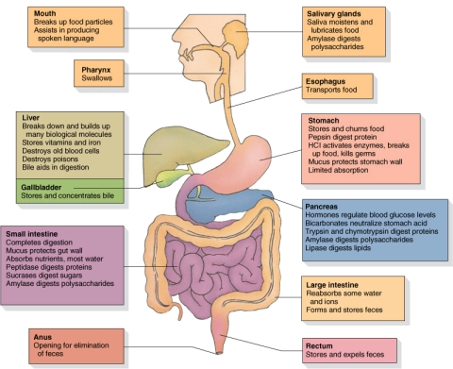
Digestion is a complex of physical, chemical and physiological processes, which break down foodstuffs and convert them into chemical compounds capable of being absorbed by body cells. These processes occur in a strictly defined sequence in all parts of the gastrointestinal tract (the mouth, pharynx, esophagus, stomach, duodenum, small and large intestine) with participation of the liver, gallbladder and pancreas, and are controlled by regulatory mechanisms of different levels. This chain of processes which ends in a complete breakdown of food into monomers capable of being absorbed, is called a digestive conveyor.

Slide 4
Depending on the origin of the hydrolytic enzymes, three types of digestion are distinguished: digestion proper, symbiontic digestion and autolytic digestion.
Digestion proper is carried out by enzymes synthesized by digestive glands of humans and animals.
Symbiontic digestion is carried out by enzymes synthesized by symbionts (microorganisms) present in the digestive tract of a macroorganism. In this way cellulose is digested in the colon. This type of digestion is mostly used by herbivores.
Autolytic digestion is performed by enzymes present in the foodstuffs. For example, breast milk contains enzymes which cause its curdling.

Slide 7
Functions of Gastrointestinal Tract
1. Secretory function is associated with production of digestive juices: saliva, gastric, pancreatic, intestinal juices and bile by glandular cells.
2. Motor function, or motility, is realized by musculature of the digestive apparatus at all stages of the digestive process, and includes chewing (mastication), swallowing, mixing, propelling food through the digestive tract and removing indigested residues from the organism. Motility also includes movements of villi and microvilli of the gastrointestinal epithelium.
3. Absorption function is carried out by mucous membrane of the gastrointestinal tract. Products of cleavage of proteins, fats and carbohydrates (amino acids, glycerol, fatty acids and monosaccharides), water, salts, medical drugs are absorbed into the blood and lymph from the lumen of a digestive organ.
4. Incretory, or intrasecretory function consists in release of hormones that regulate motility, secretion and absorption in the gastrointestinal tract. These hormones are: gastrin, secretin, cholecystokinin-pancreozymin, motilin, etc.
5. Excretory function consists in release into the gastrointestinal tract of metabolites by digestive glands (urea, ammonia, bile pigments), water, heavy metal salts, medical drugs to be further removed from the body.

Slide 9
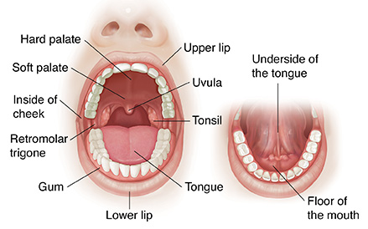
The pocket-like part of the mouth that is framed on the inside by the gums and teeth, and on the outside by the cheeks and lips is called the oral vestibule. Moving farther into the mouth, the opening between the oral cavity and throat (oropharynx) is called the fauces (like the kitchen “faucet”). The main open area of the mouth, or oral cavity proper, runs from the gums and teeth to the fauces.

Slide 10
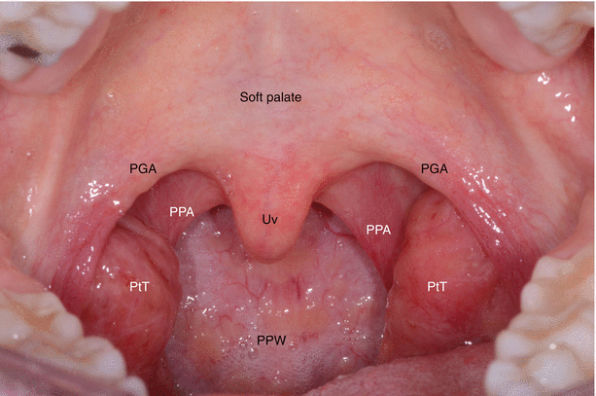
When you are chewing, you do not find it difficult to breathe simultaneously. The next time you have food in your mouth, notice how the arched shape of the roof of your mouth allows you to handle both digestion and respiration at the same time. This arch is called the palate. The anterior region of the palate serves as a wall (or septum) between the oral and nasal cavities as well as a rigid shelf against which the tongue can push food. It is created by the maxillary and palatine bones of the skull and, given its bony structure, is known as the hard palate. If you run your tongue along the roof of your mouth, you’ll notice that the hard palate ends in the posterior oral cavity, and the tissue becomes fleshier. This part of the palate, known as the soft palate, is composed mainly of skeletal muscle.

Slide 11
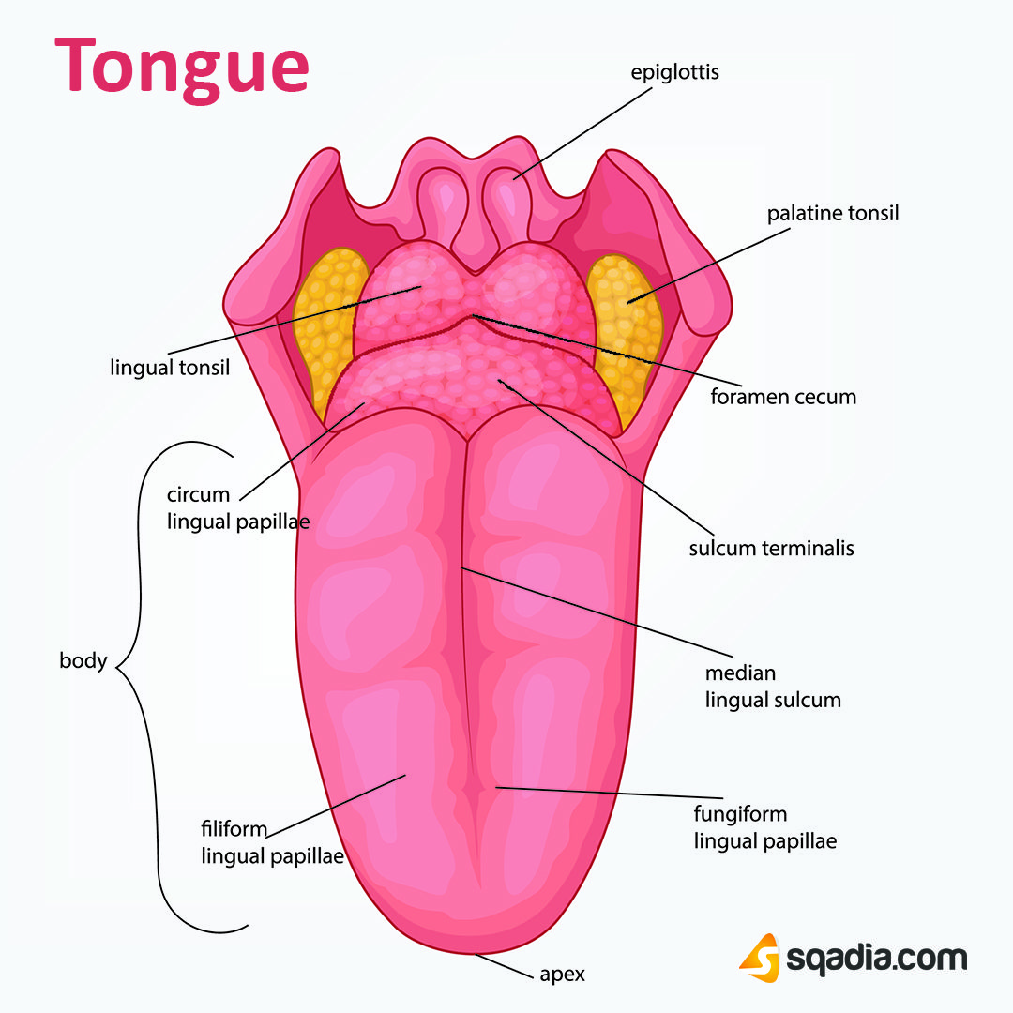
Perhaps you have heard it said that the tongue is the strongest muscle in the body. Those who stake this claim cite its strength proportionate to its size. Although it is difficult to quantify the relative strength of different muscles, it remains indisputable that the tongue is a workhorse, facilitating ingestion, mechanical digestion, chemical digestion (lingual lipase), sensation (of taste, texture, and temperature of food), swallowing, and vocalization.
The tongue is attached to the mandible, the styloid processes of the temporal bones, and the hyoid bone. The hyoid is unique in that it only distantly/indirectly articulates with other bones. The tongue is positioned over the floor of the oral cavity. A medial septum extends the entire length of the tongue, dividing it into symmetrical halves.

Slide 12
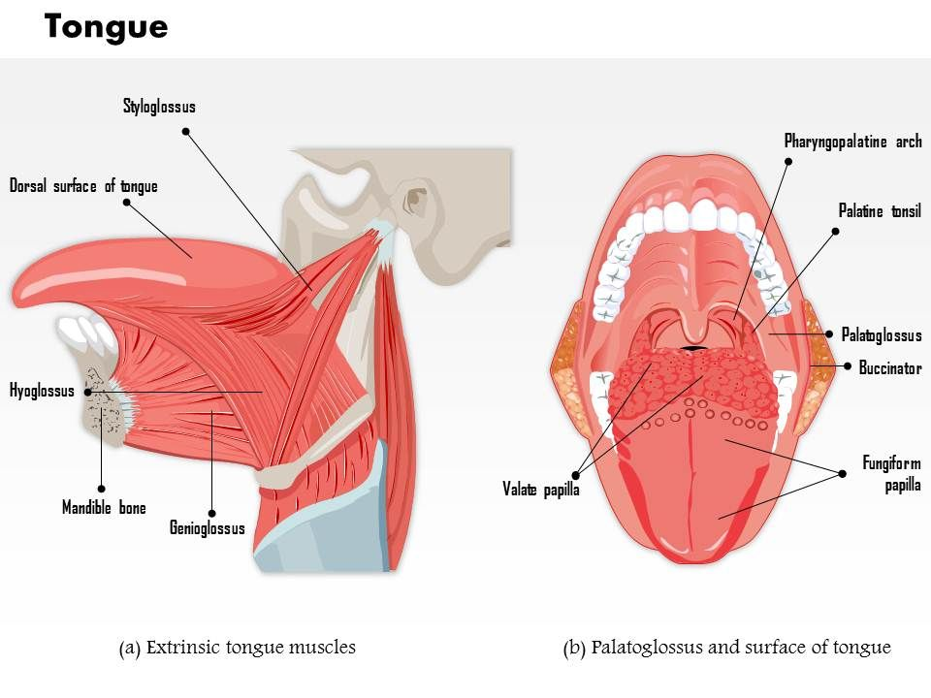

Slide 13
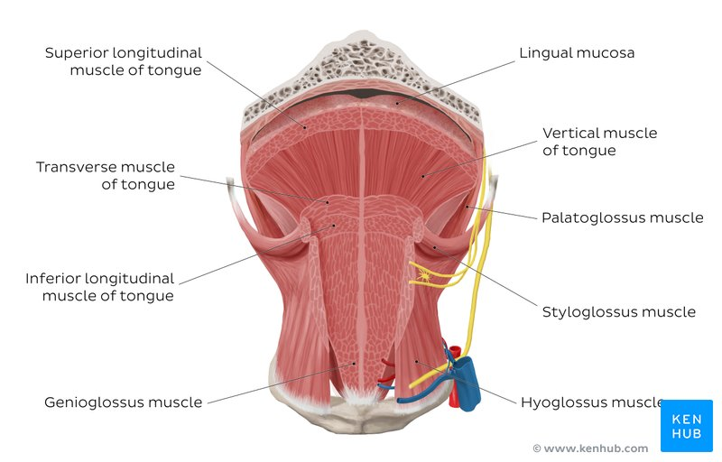
The muscles perform three important digestive functions in the mouth:
position food for optimal chewing,
gather food into a bolus (rounded mass),
position food so it can be swallowed.

Slide 14
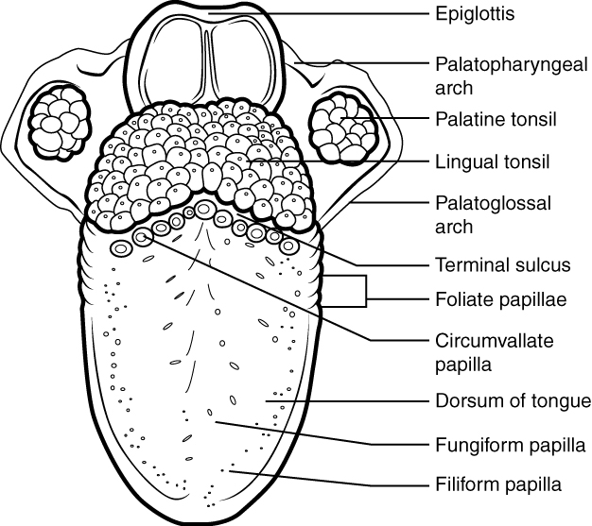
This superior view of the tongue shows the locations and types of lingual papillae
The top and sides of the tongue are studded with papillae, extensions of lamina propria of the mucosa, which are covered in stratified squamous epithelium. Fungiform papillae, which are mushroom shaped, cover a large area of the tongue; they tend to be larger toward the rear of the tongue and smaller on the tip and sides. Circumvallate papillae are much fewer in number, only 8 to 12, and lie in a row along the posterior portion of the tongue anterior to the lingual tonsil. In contrast, filiform papillae are long and thin. Fungiform and circumvallate papillae contain taste buds, and filiform papillae have touch receptors that help the tongue move food around in the mouth. The filiform papillae create an abrasive surface that performs mechanically, much like a cat’s rough tongue that is used for grooming. Lingual glands in the lamina propria of the tongue secrete mucus and a watery serous fluid that contains the enzyme lingual lipase, which plays a minor role in breaking down triglycerides but does not begin working until it is activated in the stomach. A fold of mucous membrane on the underside of the tongue, the lingual frenulum, tethers the tongue to the floor of the mouth.

Slide 16
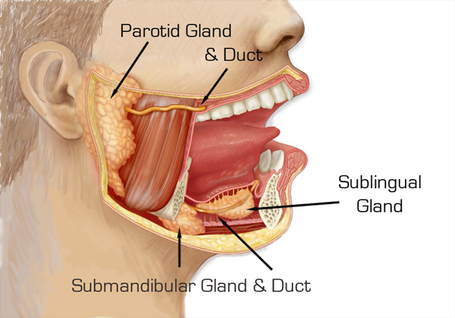
Outside the oral mucosa are three pairs of major salivary glands, which secrete the majority of saliva into ducts that open into the mouth:
1. The submandibular glands, which are in the floor of the mouth, secrete saliva into the mouth through the submandibular ducts.
2. The sublingual glands, which lie below the tongue, use the lesser sublingual ducts to secrete saliva into the oral cavity.
3. The parotid glands lie between the skin and the masseter muscle, near the ears. They secrete saliva into the mouth through the parotid duct, which is located near the second upper molar tooth.

Slide 19
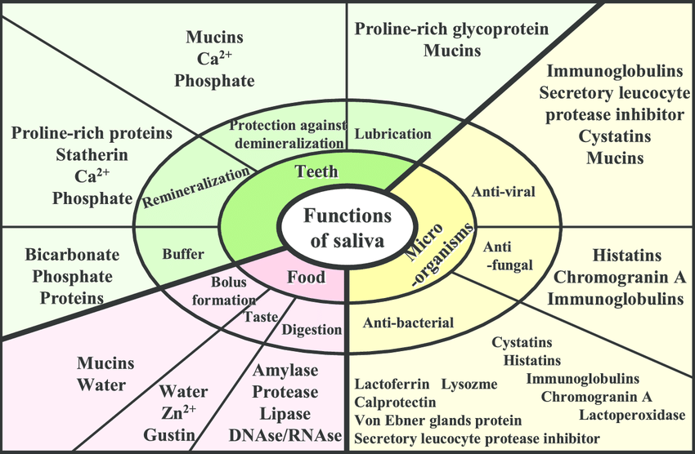

Slide 20
Saliva functions
1. Lubricant. Saliva coats the oral mucosa mechanically protecting it from trauma during eating, swallowing, and speaking. Mouth soreness is very common in people with reduced saliva (xerostomia) and food (especially dry food) sticks to the inside of the mouth.
2. Digestion. The digestive functions of saliva include moistening food and helping to create a food bolus. The lubricative function of saliva allows the food bolus to be passed easily from the mouth into the esophagus. Saliva contains the enzyme amylase, also called ptyalin, which is capable of breaking down starch into simpler sugars such as maltose and dextrin that can be further broken down in the small intestine. About 30% of starch digestion takes place in the mouth cavity. Salivary glands also secrete salivary lipase (a more potent form of lipase) to begin fat digestion. Salivary lipase plays a large role in fat digestion in newborn infants as their pancreatic lipase still needs some time to develop.
3. Role in taste. Saliva is very important in the sense of taste. It is the liquid medium in which chemicals are carried to taste receptor cells (mostly associated with lingual papillae). People with little saliva often complain of dysgeusia (i.e. disordered taste, e.g. reduced ability to taste, or having a bad, metallic taste at all times). A rare condition identified to affect taste is that of 'Saliva Hypernatrium', or excessive amounts of sodium in saliva that is not caused by any other condition (e.g., Sjögren syndrome), causing everything to taste 'salty'.

Slide 21
Other functions of saliva.
1. Saliva maintains the pH of the mouth. Saliva is supersaturated with various ions. Certain salivary proteins prevent precipitation, which would form salts. These ions act as a buffer, keeping the acidity of the mouth within a certain range, typically pH 6.2–7.4. This prevents minerals in the dental hard tissues from dissolving.
2. Saliva secretes carbonic anhydrase (gustin), which is thought to play a role in the development of taste buds.
3. Saliva contains Epidermal Growth Factor. Epidermal Growth Factor results in cellular proliferation, differentiation, and survival. Epidermal Growth Factor is a low-molecular-weight polypeptide first purified from the mouse submandibular gland, but since then found in many human tissues including submandibular gland, parotid gland. Salivary Epidermal Growth Factor, which seems also regulated by dietary inorganic iodine, also plays an important physiological role in the maintenance of oro-esophageal and gastric tissue integrity. The biological effects of salivary Epidermal Growth Factor include healing of oral and gastroesophageal ulcers, inhibition of gastric acid secretion, stimulation of deoxyribonucleic acid synthesis as well as mucosal protection from intraluminal injurious factors such as gastric acid, bile acids, pepsin, and trypsin and to physical, chemical and bacterial agents.

Slide 22
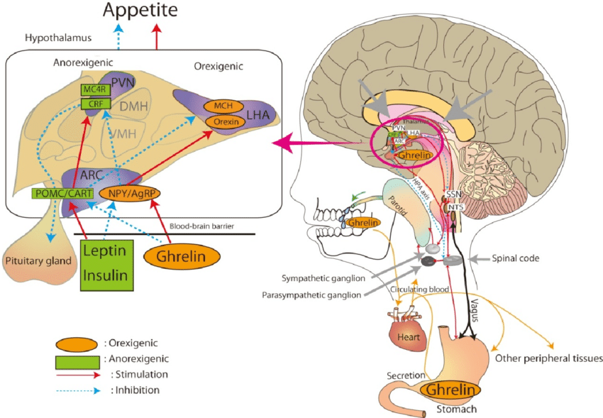
Regulation of Salivation

Slide 23
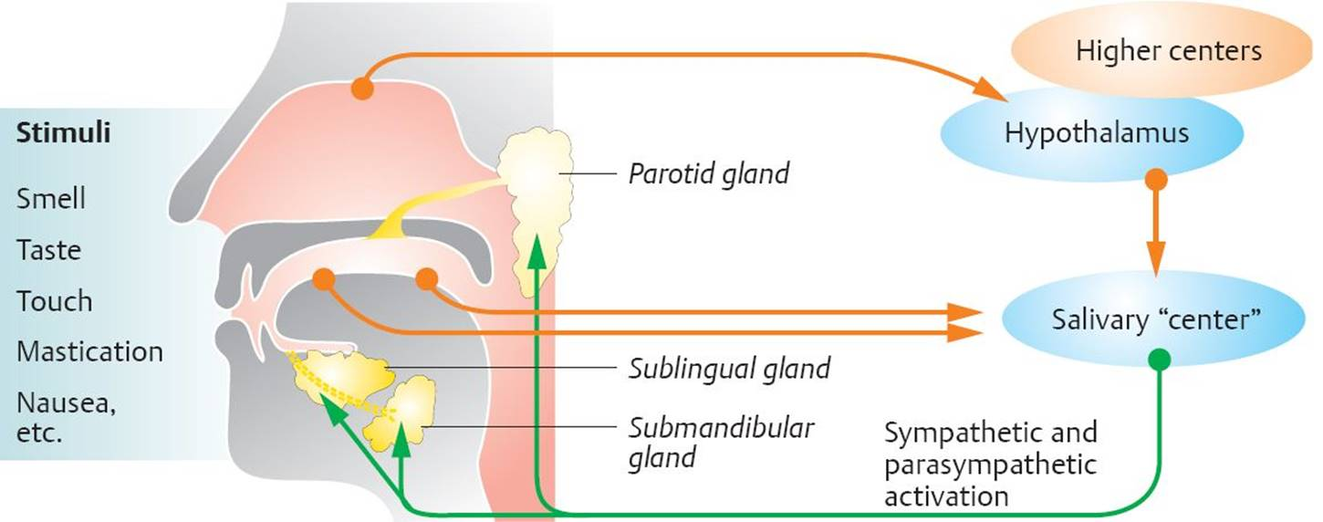
Regulation of Salivation

Slide 25
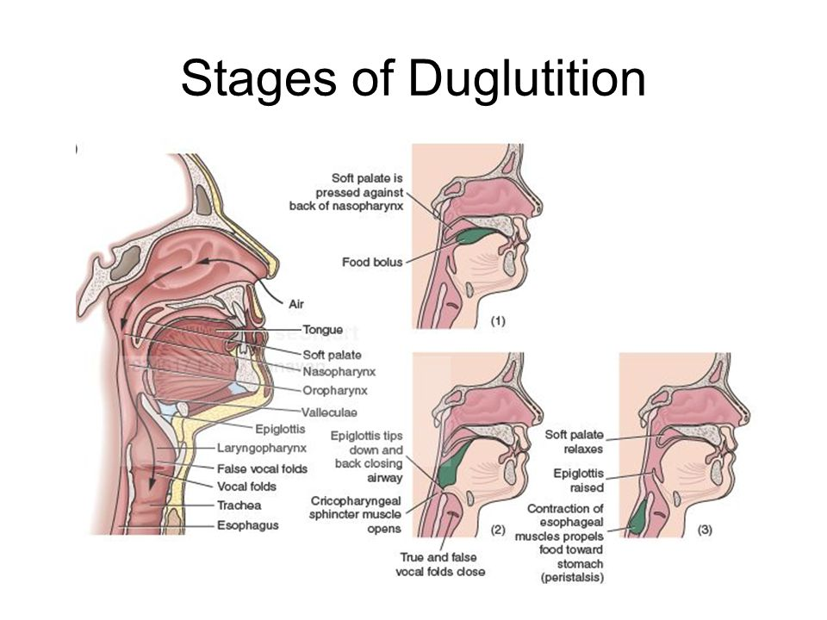

Slide 26
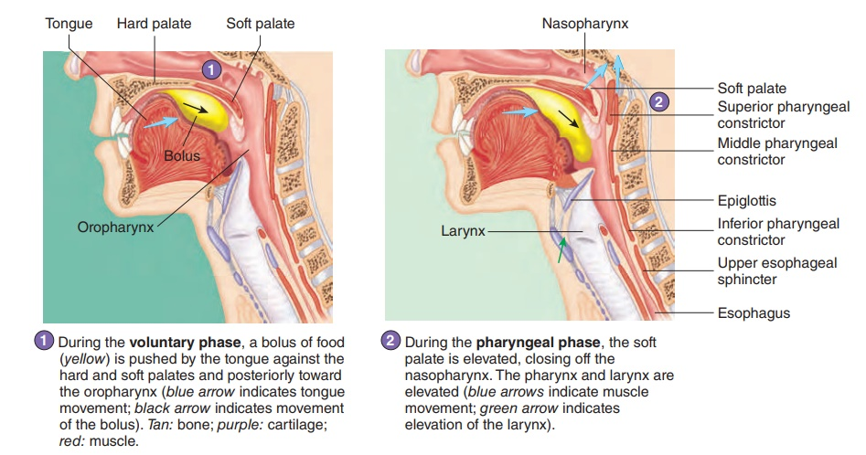

Slide 27
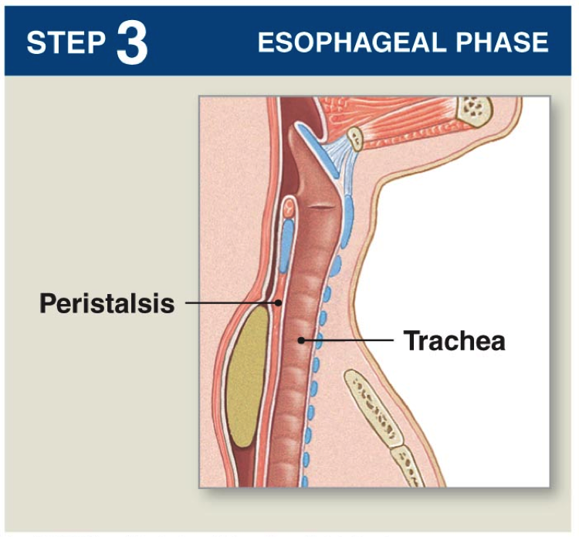
The entry of food into the esophagus marks the beginning of the esophageal phase of deglutition and the initiation of peristalsis. As in the previous phase, the complex neuromuscular actions are controlled by the medulla oblongata. Peristalsis propels the bolus through the esophagus and toward the stomach. The circular muscle layer of the muscularis contracts, pinching the esophageal wall and forcing the bolus forward. At the same time, the longitudinal muscle layer of the muscularis also contracts, shortening this area and pushing out its walls to receive the bolus. In this way, a series of contractions keeps moving food toward the stomach. When the bolus nears the stomach, distention of the esophagus initiates a short reflex relaxation of the lower esophageal sphincter that allows the bolus to pass into the stomach. During the esophageal phase, esophageal glands secrete mucus that lubricates the bolus and minimizes friction.

Slide 28
Lesson assignment:
Lauralee Sherwood. Fundamentals of Human Physiology: On the website of the department
Pages: 437 – 447.
Questions:
General characteristics of the digestive system: the importance of digestion for the body, the essence of digestion.
Digestive system functions.
Features of digestion in the oral cavity.
Composition and amount of saliva.
Saliva functions.
The adaptive nature of the work of the salivary glands.
Regulation of salivation.
Passage of Food through the Esophagus.

Slide 29
Internet Addresses and Literature used in the preparation of the lecture
Selected Lectures / M.M. lapkin, E.A. Trutneva; M.: GEOTAR-Media, 2017. – 237 pp.
Dunn R.B., Daugherty S.R. Physiology. USMLE Step 1.-Becker. Professional Education, 2013.-440 pp.
Non-respiratory functions of the lungs
https://derangedphysiology.com/main/cicm-primary-exam/required-reading/respiratory-system/Chapter%20016/non-respiratory-functions-lungs
Human Physiology
https://en.wikibooks.org/wiki/Human_Physiology
PHYSIOLOGY & RELATED SCIENCES - A SHORT GLOSSARY
https://www.ucl.ac.uk/lapt/glossph.htm

Slide 30
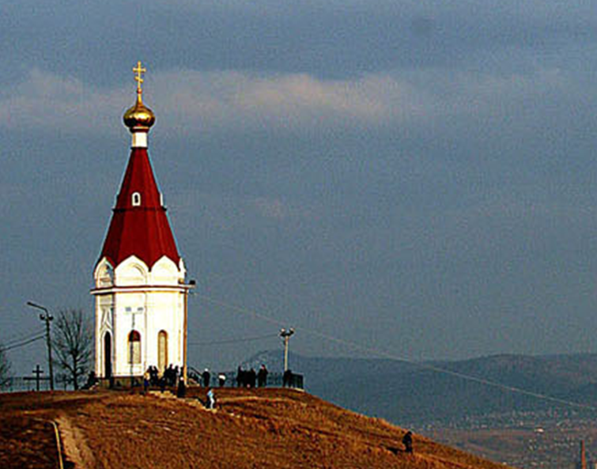
Thank you for attention

