Slide 1
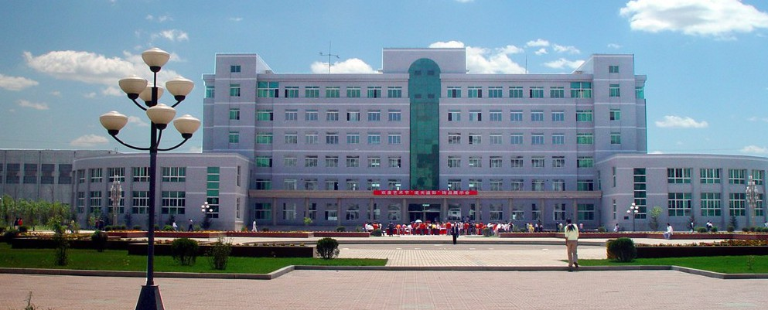
China Medical University

Slide 2
The teaching of medicine is conducted in English. You can enter a higher education institution only at the age of 18, at the end of the so-called "full" secondary school, and wean 7 more years there. The cost of training is 2/3 of the total payment.

Slide 4
Bachelor students can study in Chinese, English and Japanese. Master's programs are taught in Chinese. There is a university in Shenyang, the largest city in northeast China. The University consists of three large modern hospitals, where students are interned. One of them The Shengjing Hospital is widely known in China and abroad for its gynecology and obstetrics department. And also the university has its own dental clinic.

