Slide 1
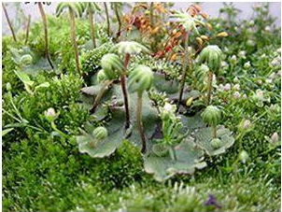
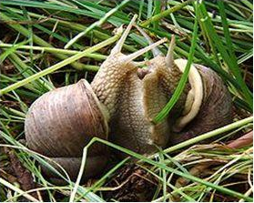
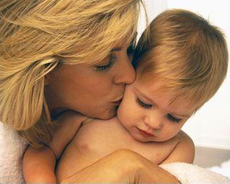
Topic: Reproduction is the fundamental feature of life
Krasnoyarsk State Medical University named after
professor V.F. Voino-Yasenetsky
Department of Biology and Ecology
Candidate of biological sciences, associate professor
Zubareva Ekaterina
Vladislavovna
Krasnoyarsk 2020

Slide 2
Lecture plan:
1. The concept of "reproduction", types, characteristics.
2. Meiosis, cytological and cytogenetic characteristics.
3. Gametogenesis.
4. The structure of the sex cells.

Slide 3
The purpose of the lesson is
Study of reproduction as a property of a living organism, its methods and significance for the species.

Slide 4
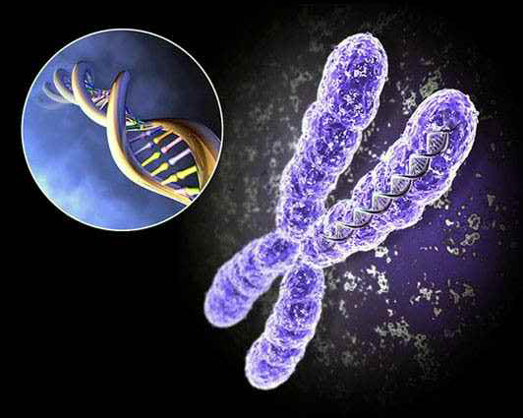
Размножение – свойство живых организмов, процесс увеличения числа особей вида благодаря способности к воспроизведению.
Reproduction is the ability of all living things to reproduce similar ones. There are two types of reproduction:
Asexual
Sexual
Notes:
Размножение - фундаментальная черта Жизни: все известные организмы являются результатом процесса воспроизводства. Размножение - это способность всех живых существ воспроизводить себе подобных. Различают два типа размножения: бесполое и половое.

Slide 5
Asexual reproduction is carried out by a single cell or a single parent individual without gametes producing.
Descendants emerge from one or several somatic cells of the parental organism by mitosis.
In this case, parents and offsprings are genetically copies.
Asexual reproduction enhances stabilizing selection, supports ﬁtness (adaptability) to environmental factors.
Notes:
Бесполое размножение осуществляется отдельной клеткой или единственным родителем без образования гамет (таблица 18). Потомки возникают из одной или нескольких соматических клеток родительского организма путем митоза. В этом случае родители и потомки являются генетическими копиями.
Бесполое размножение широко распространено у прокариот, грибов и растений (рис. 42). Бесполое размножение усиливает стабилизирующий отбор, поддерживает приспособленность (приспособляемость) к факторам окружающей среды.

Slide 6
Reproduction
Asexsual
Sexual
No gamete formation
With the formation of gametes
1. Simple division
2. Fragmentation
Conjugation
No
fertilization
With fertilization
3 Budding
4. Polyembryony
Parthenogenesis
Copulation
5. Vegetative
6. Sporulation
Androgenesis
Isogamy
Ginogenesis
Oogamy
Heterogamy
7. Cloning

Slide 7
Asexual reproduction
Simple division:
It is typical for unicellular organisms: one mother cell divides into two or more daughter cells. There are:
binary ﬁssion (for prokaryotes);
mitotic binary division (Protozoa, unicellular algae);
schizogony or multiple division (malaria plasmodium). A nucleus divides into two or more, which are surrounded by the layer of the cytoplasm. Then new organisms form.

Slide 8
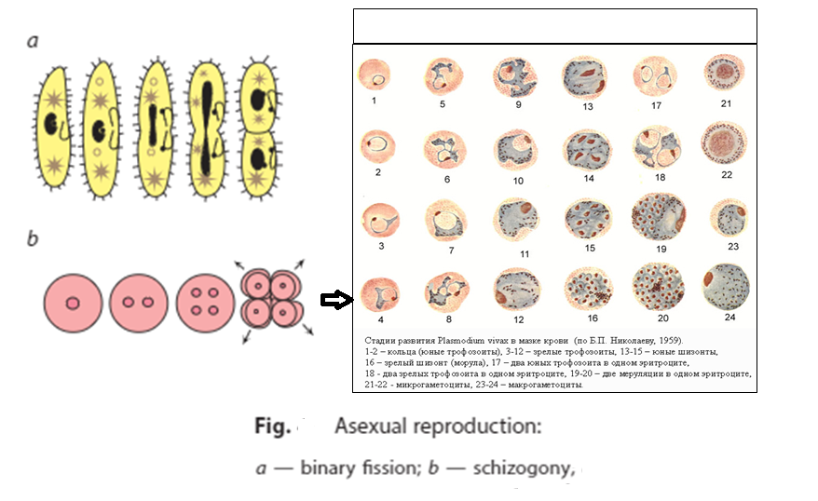
schizogony or multiple division (Protozoa, unicellular algae)

Slide 9
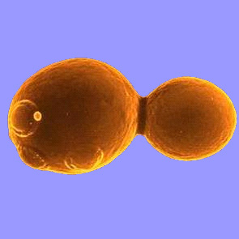
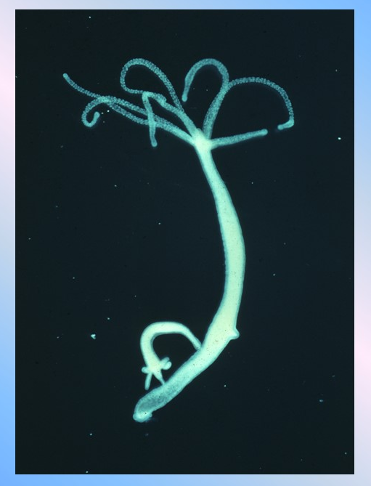
Budding
Yeast budding
Hydra budding

Slide 10
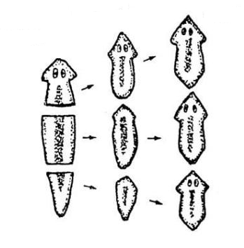
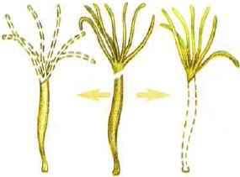
Fragmentation
Hydra fragmentation
Flatworm fragmentation

Slide 11
Polyembryony - new individuals emerge from the fragments of the split embryo (armadillo, monozygotic human twins).

Slide 13
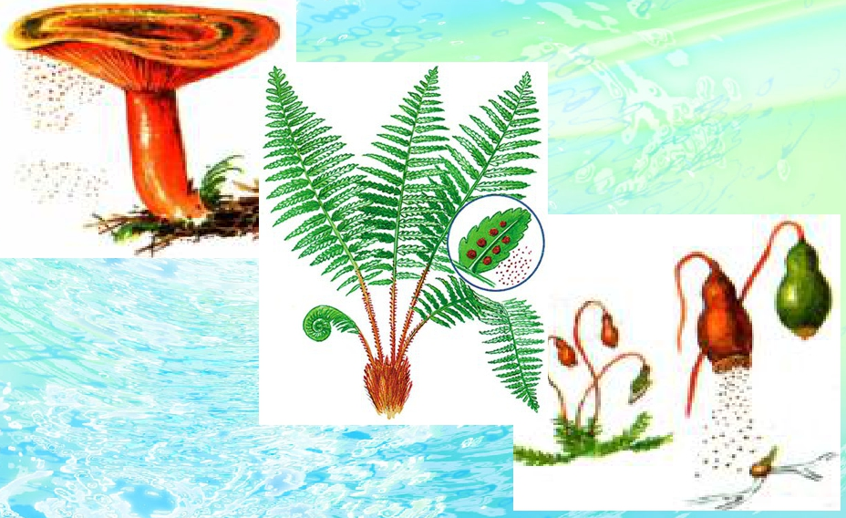
Sporulation. The reproduction by spores. It is typical for plants (algae, mosses, ferns), protozoa (Apicomplexa) and fungi (Penicillium, mushrooms).

Slide 14
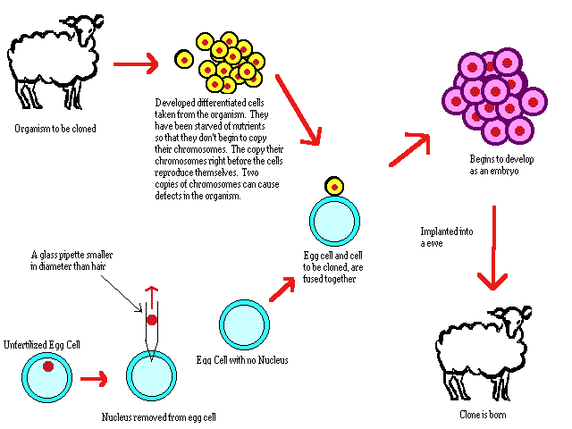
Cloning
Video “Cloning”

Slide 15
Sexual reproduction
Sexual reproduction is the type of reproduction, carried out by two individuals (parents) by fusion of two haploid sex cells (gametes). This type of reproduction is associated with the sexual process. Newformed organisms obtain traits from parents. They differ from each other genetically. That leads to new combinations of genetic material.
From the evolution viewpoint, sexual reproduction has an advantage, compared to asexual reproduction, because in this case, the new organism would be more ﬁtted to environmental conditions.

Slide 16
Reproduction
Asexsual
Sexual
No gamete formation
With the formation of gametes
1. Division
2. Fragmentation
Conjugation
No
fertilization
With fertilization
3 Budding
4. Polyembryony
Parthenogenesis
Copulation
5. Vegetative
6. Sporulation
Androgenesis
Isogamy
Ginogenesis
Oogamy
Heterogamy
7. Cloning

Slide 17
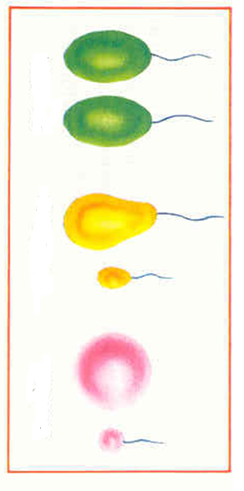
Depending on the gamete’s structure, there are several types of sexual reproduction:
Isogamy (from Greek iso — equal and gamos — marriage) in sizes and mobile gametes fuse. A primitive type of sexual reproduction when two equal Typical for Chlorophyceae, green algae and Chytridiomycota.
Heterogamy (from Greek heteros —different and gamos —marriage). A primitive type of the sexual process when two unequal in sizes, mobile ﬂagellated cells fuse. The type of reproduction of green algae and Chytridiomycota
Oogamy (from Greek oon — egg and gamos —marriage). The most common form sexual reproduction. Female gametes (ova) are large and immobile. Male gametes, sperms, are small and mobile. Oogamy is typical for multicellular animals, fungi, algae, higher plants.

Slide 18
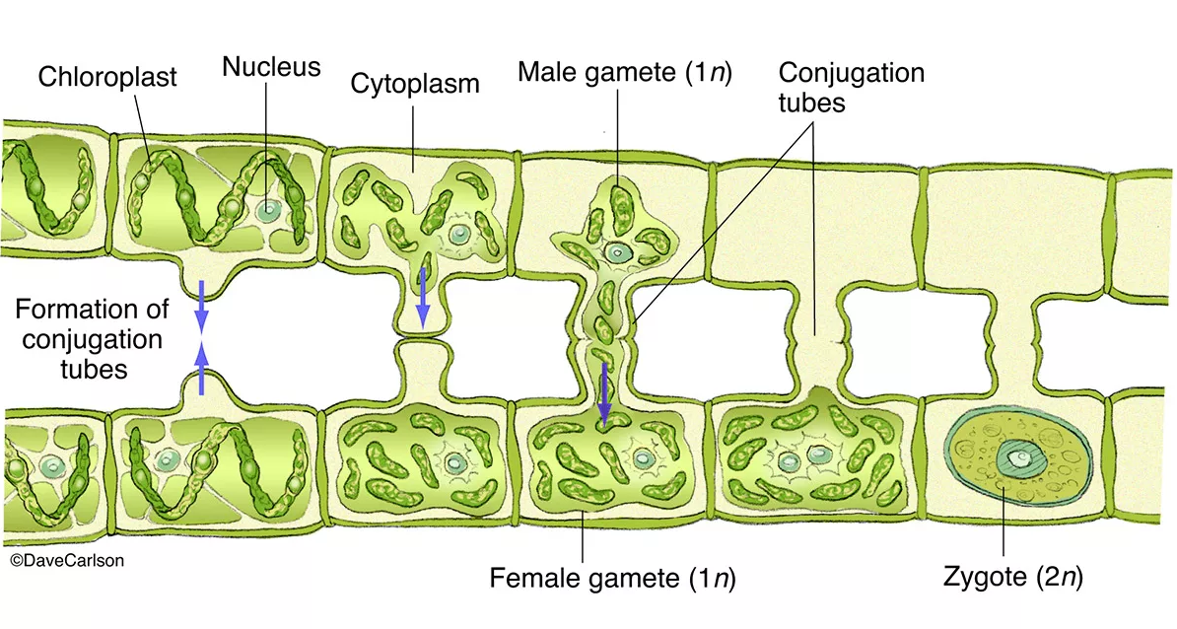
Conjugation (from Latin The process of two individuals’ joining with the genetic coniugatio — joining)material exchange. New organisms that genetically differ from parental forms appear (infusoria, bacteria). There is no population increase because of conjugation.

Slide 20
Reproduction
Asexsual
Sexual
No gamete formation
With the formation of gametes
1. Division
2. Fragmentation
Conjugation
No
fertilization
With fertilization
3 Budding
4. Polyembryony
Parthenogenesis
Copulation
5. Vegetative
6. Sporulation
Androgenesis
Isogamy
Ginogenesis
Oogamy
Heterogamy
7. Cloning

Slide 21
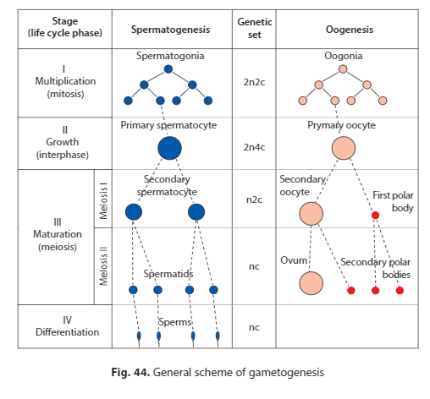
Gametogenesis

Slide 22
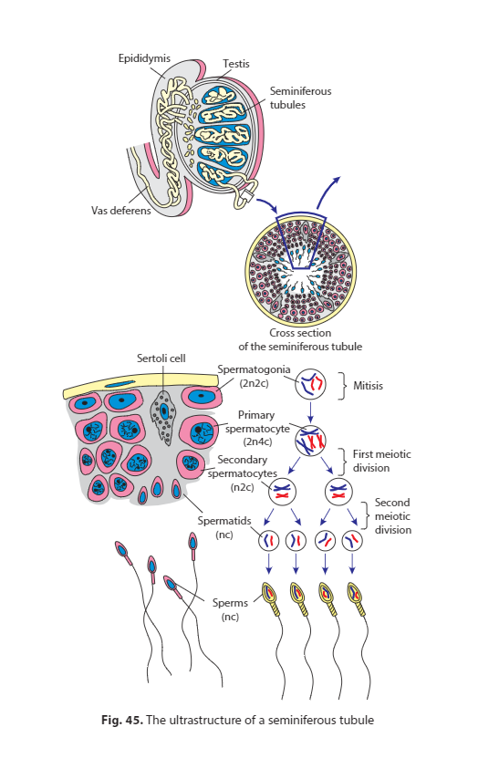

Slide 23
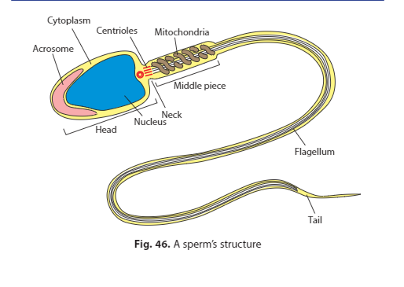
Mature sperm has a head, a connecting piece, including a neck and a middle part, and a tail with an end piece (ﬁg. 46). The head contains a haploid nucleus and acrosome (transformed Golgi apparatus, containing special proteolytic enzymes to come through the ovum envelope). There are two centrioles within the neck and mitochondria inside the middle part. The tail is composed of one or several ﬂagella. ATP energy is used to supply ﬂagella. The cytoplasm is thin and lies on a periphery of the nucleus.

Slide 24
Gametogenesis

Slide 25
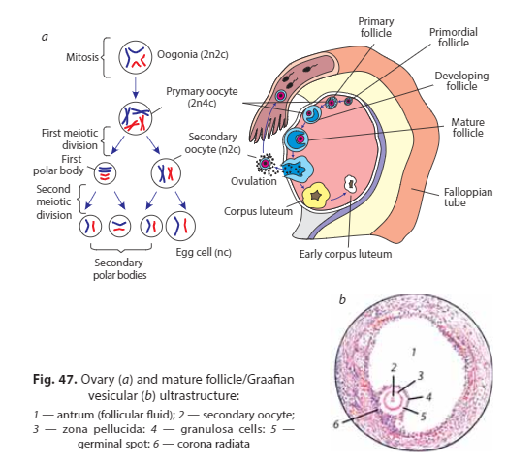

Slide 26
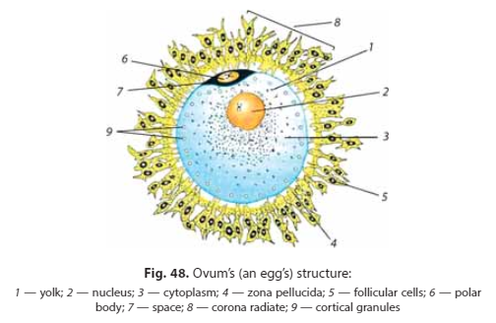
Ovum is surrounded by three envelopes: the primary layer produced by the egg itself, the secondary envelope produced by follicle cells, and the tertiary layer that surrounds the egg while moving down the oviduct.

Slide 28
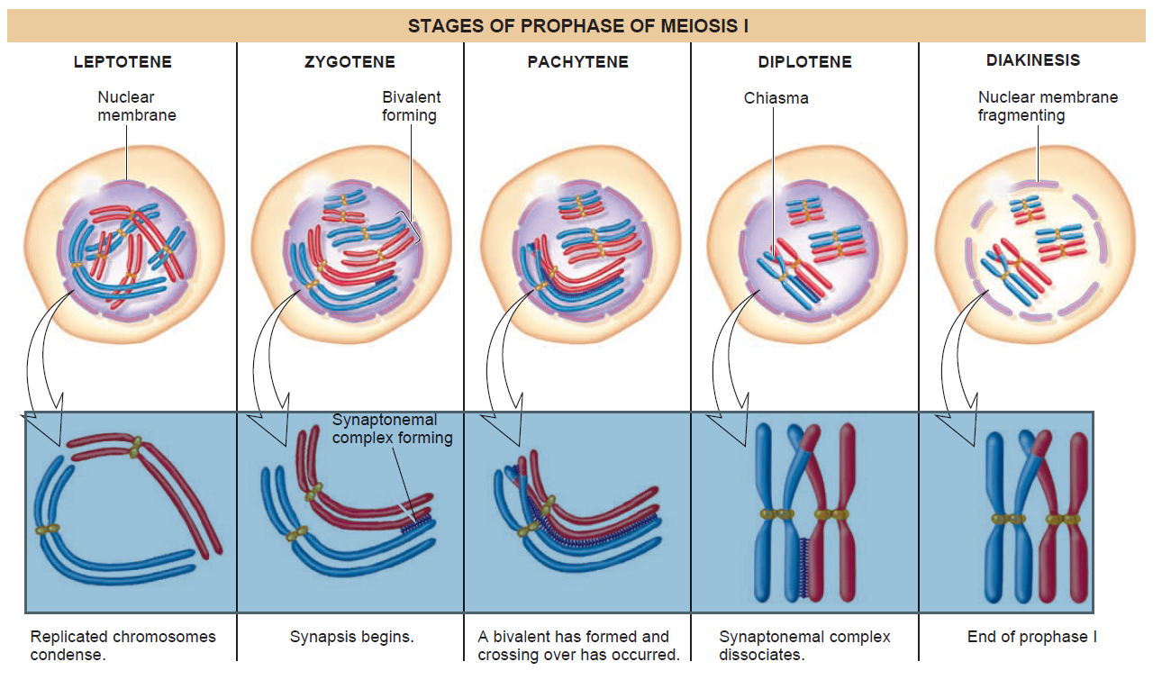
Prophase I (2n4c)

Slide 29
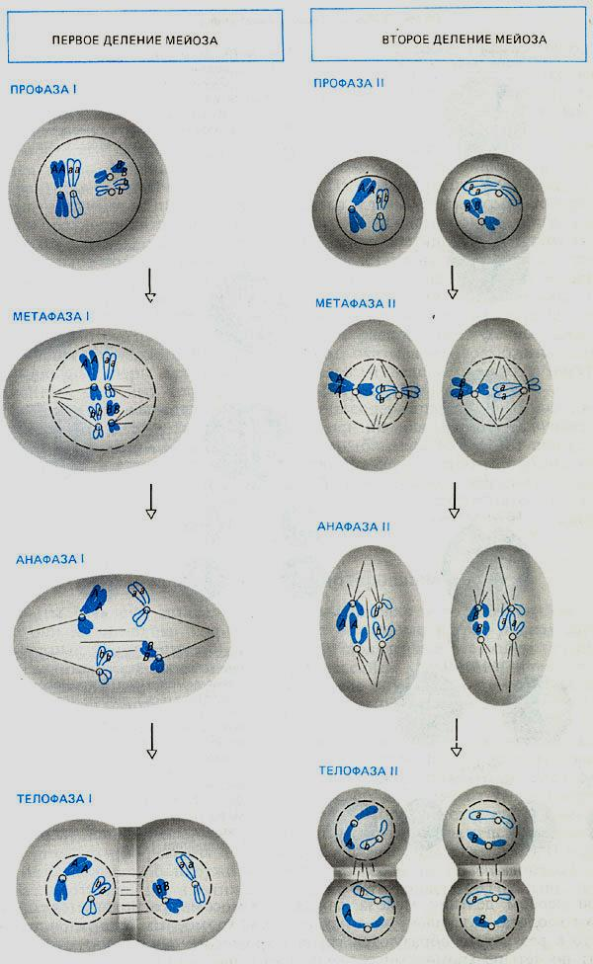
2п4с
п 2с
2п4с
п 2с
п 2с
п 2с
п с
п с
Video Meiosis
п 2с
пс
пс
п 2с
пс
пс
пс

Slide 30
RECOMBINATIONS - the formation of new combinations of genes as a result of the fusion of the germ cells of two parents.

Slide 31
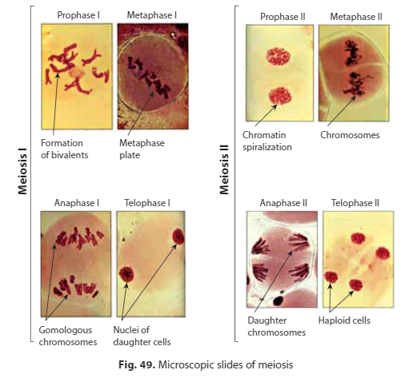

Slide 32
Answer questions in writing:
What is the name of reproduction, in which an individual develops from an unfertilized egg?
1. Hologamy
2. Genogenesis
3. Androgenesis
4. Ovogenesis
5. Merogamy

Slide 33
Thank you for your attention!

