Slide 1
Prof. V.F. Voino-Yasenetsky Krasnoyarsk State Medical University
Topic: Introduction to metabolism. Biological oxidation stages. Krebs cycle
Lecture No. 3 on the discipline "biochemistry" for 2nd year students
Lecturer: Panina Yu.A.
Krasnoyarsk, 2023

Slide 2
Lecture plan:
Relevance of the topic.
Metabolism and general information about it.
Stages of catabolism.
Oxidative decarboxylation of pyruvate.
The Krebs cycle, its meaning and regulation.
Enzymes of the class of oxidoreductases.
Substrate and oxidative phosphorylation.
Macroergs. Use of ATP energy.
Conclusion

Slide 3
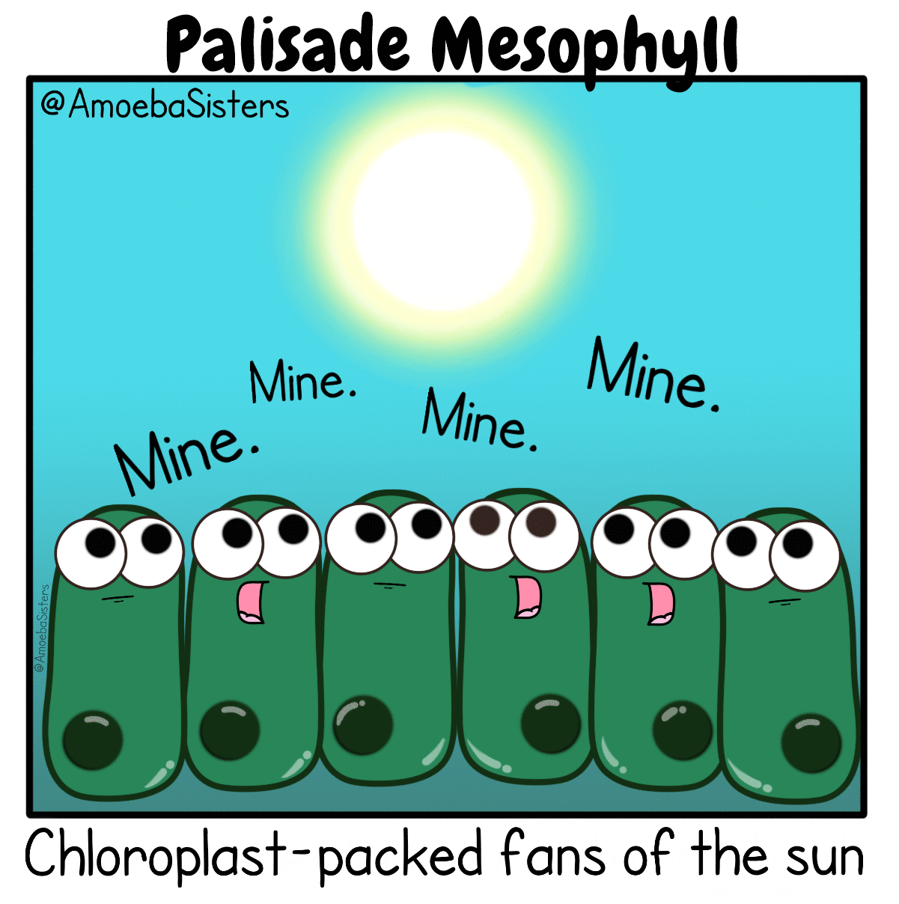

Slide 4
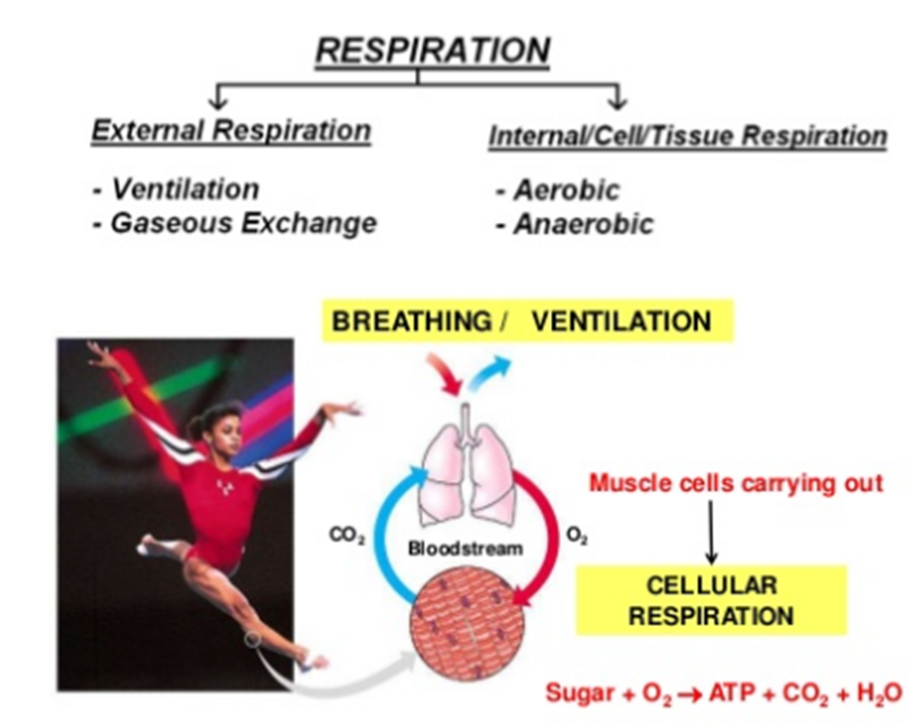
RELEVANCE OF THE TOPIC
Biomedical significance
life of an animal eukaryotic cell is impossible without cellular respiration

Slide 5
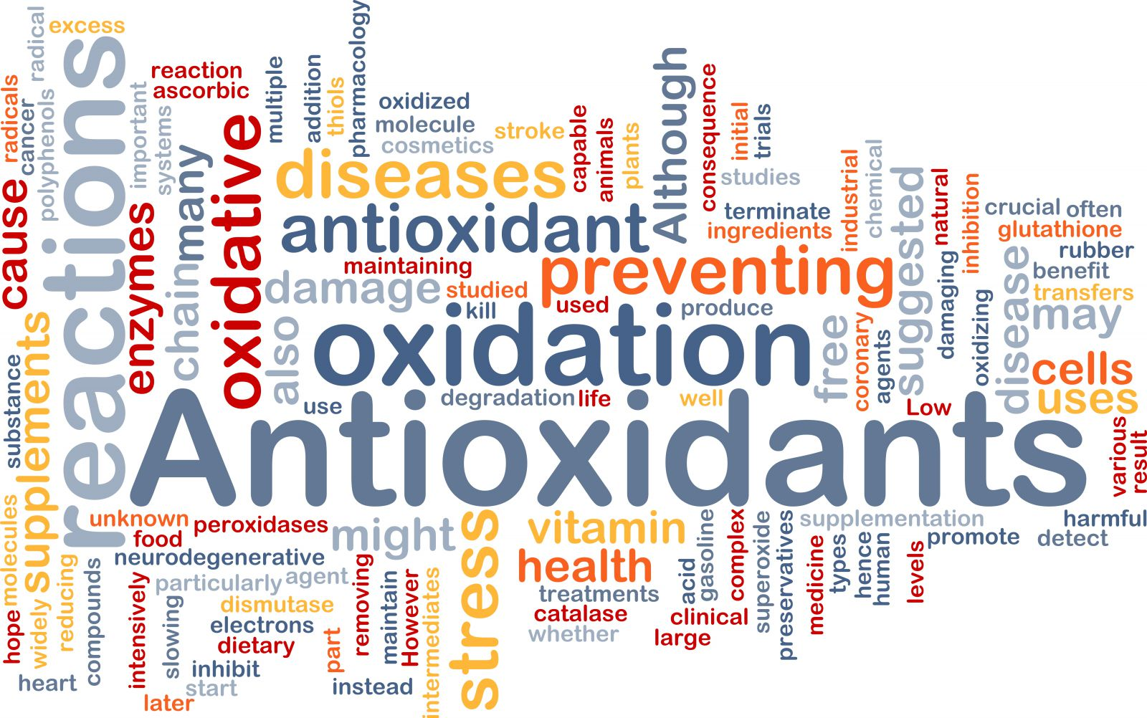
RELEVANCE OF THE TOPIC
Biomedical significance

Slide 6
RELEVANCE OF THE TOPIC
Bioenergy of living systems
The essence of life is an endless flow of energy
in a cell, from one cell to another or from one organism to another
Living cells have complex and efficient systems for converting one type of energy into another.
Energy transformations occur mainly in two structures
Chloroplasts (in green plants)
Mitochondria (in plants and animals)
Bioenergy
Science that studies energy conversion in living organisms

Slide 7
RELEVANCE OF THE TOPIC
Enzymes in an animal cell

Slide 8
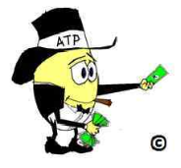
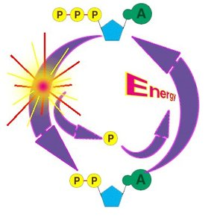
ATP is the universal “money" of cells
http://present5.com/download/presentacia.php?id=1113096
http://image.wikifoundry.com/image/1/2ovKPYeebneL9xCw47eDUw26644/GW291H291

Slide 9
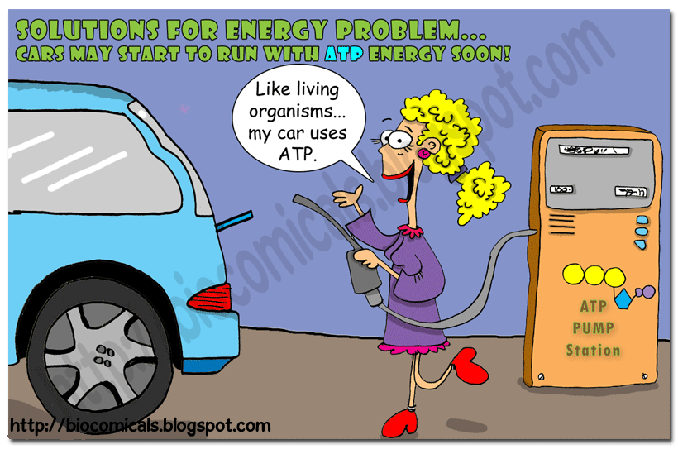
http://present5.com/presentation/271823201_443792434/image-3.jpg

Slide 10
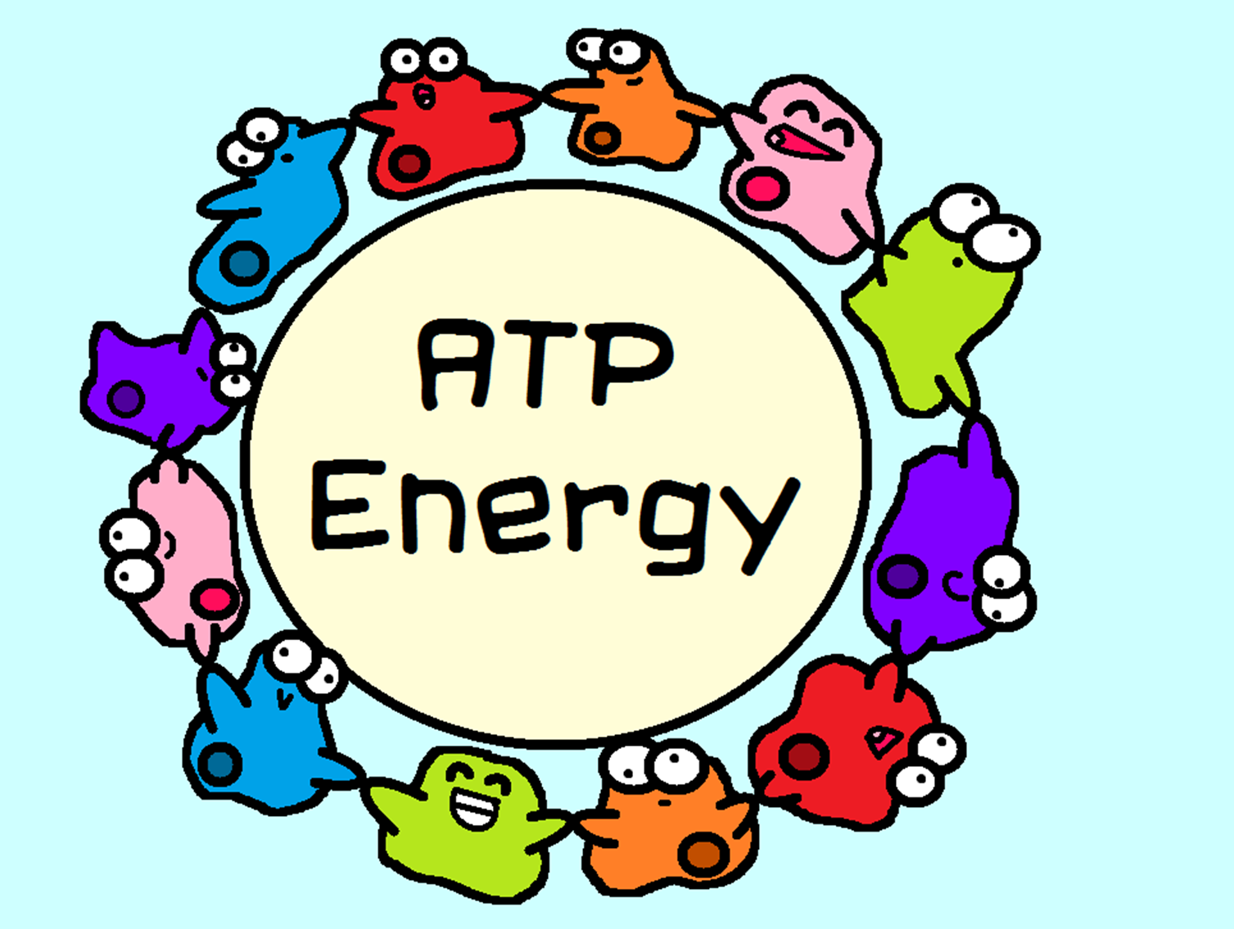

Slide 12
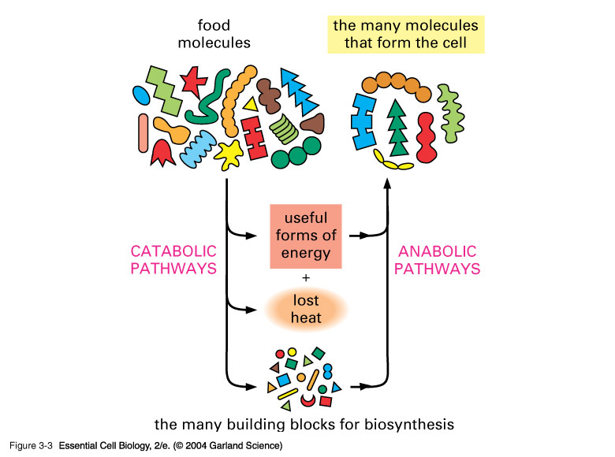
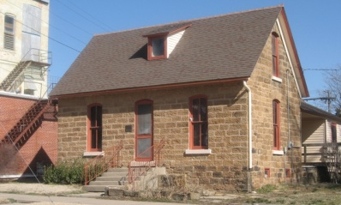
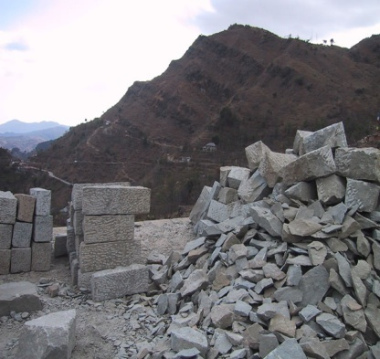
Catabolism and Anabolism

Slide 13
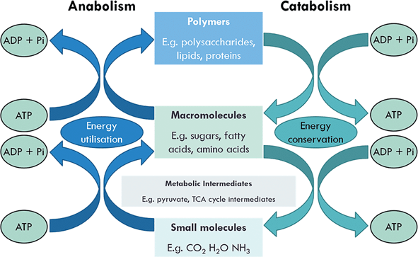

Slide 15
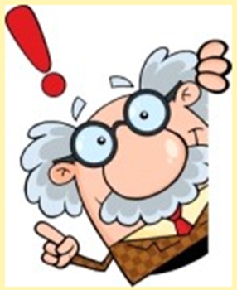
General information
Metabolism is a set of reactions in the body
Catabolism is the breakdown of complex organic compounds into simpler ones with energy realising
Anabolism is the synthesis of complex compounds from simpler ones with the use of energy

Slide 16
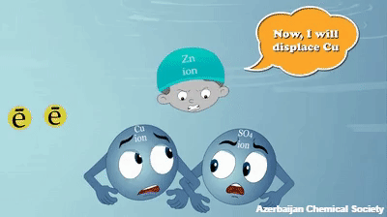

Slide 17
General information
Oxidation is the process of donating (splitting off) electrons.
Reduction is the process of attaching electrons.
Biological oxidation is a set of redox reactions in the body.

Slide 19
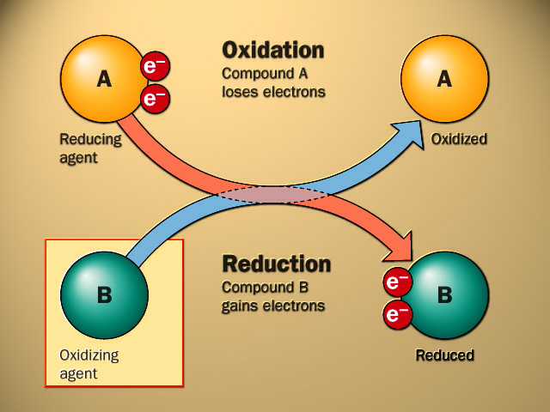
oxidation vs reduction

Slide 20
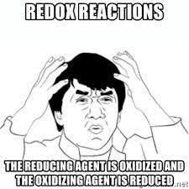

Slide 21
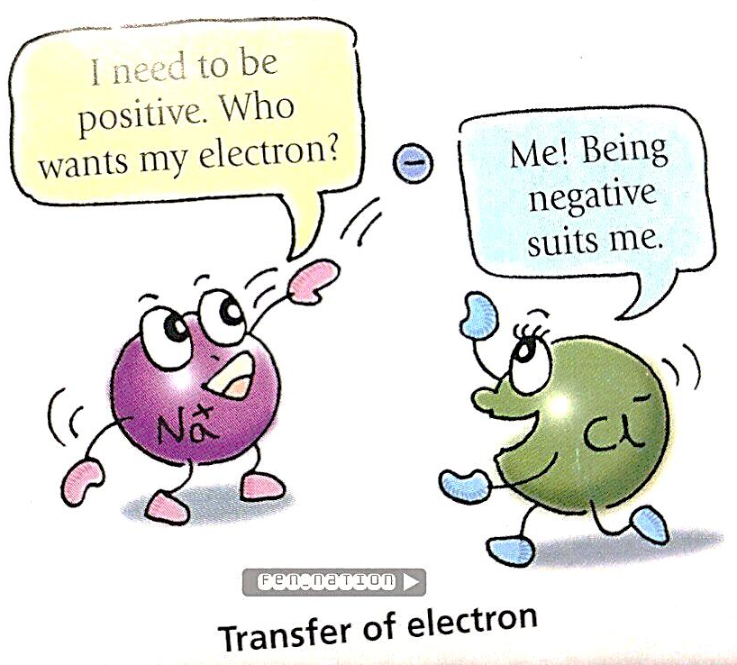
Which of these parts is an oxidizing agent and which is a reducing agent?

Slide 22
oxidation vs reduction

Slide 23
ELECTRON TRANSMISSION METHODS
1. Direct transfer between members of the redox pair
Fe²⁺ + Cu²⁺  Fe³⁺ + Cu⁺
2. As part of hydride ion (Нˉ) (NAD- (nicotine-) dependent dehydrogenases)
Н-substrate-Н + NAD⁺substrate + NADН + Н⁺
Red. s coenzyme ox. S coenzyme
ox. red.
З. Transfer in the H atom (flavin-dependent dehydrogenases)
Substrate-Н₂ + FAD  substrate + FADН₂
reducing agent oxidative agent oxidative agent reducing agent
4. Direct interaction of matter with oxygen
R – СН₃ + 1/2 О₂  R - СН₂ОН

Slide 24
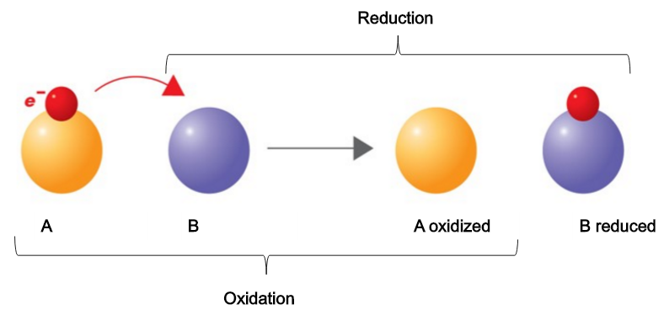
Direct transfer between members of the redox pair

Slide 25
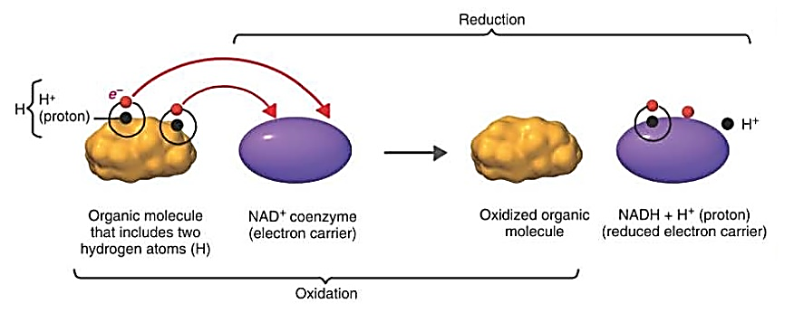
Transfer as part of a hydride ion

Slide 26
How to write correctly -
NADH2 or NADH + H +?
meet almost twin brothers

Slide 27
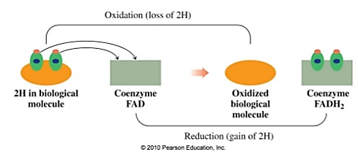
Transfer in the composition of the H atom

Slide 28
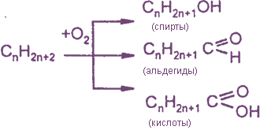
Direct interaction of matter with oxygen

Slide 29
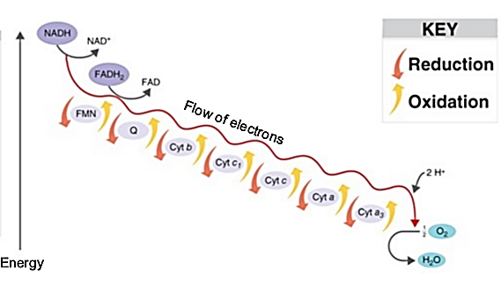
Indirect transfer to oxygen

Slide 30
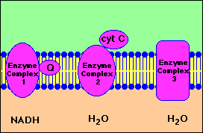
Indirect transfer to oxygen

Slide 31
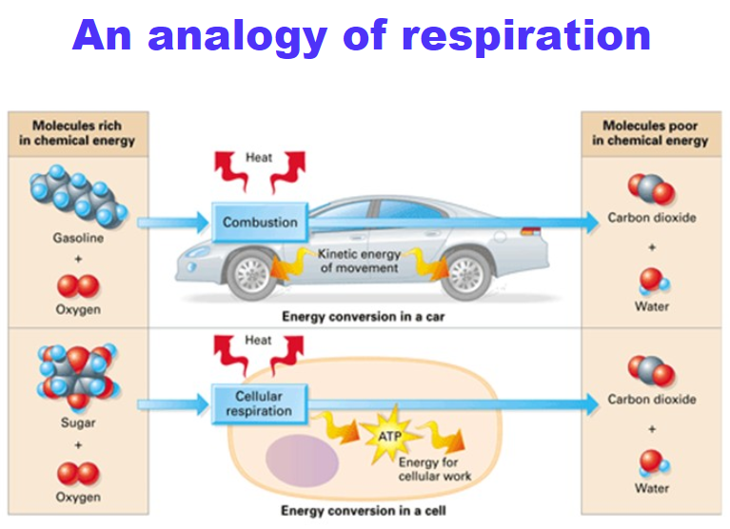
General information

Slide 32
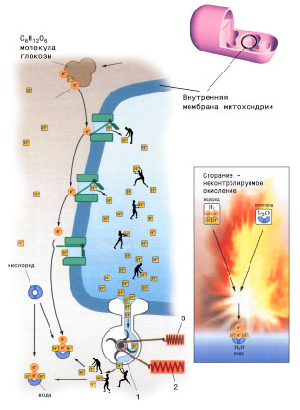
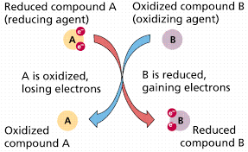
General information
Biological oxidation is a set of redox reactions in the body.
https://www.rlsnet.ru/Patient/images/Color/P1_04_11.jpg

Slide 33
Biological oxidation functions
Energy
oxidative processes supply other biological processes with energy
Biosynthetic
through oxidative reactions, new substances necessary for the body can be synthesized
Neutralizing (detoxifying)
through oxidative reactions, many substances are deprived of their toxicity

Slide 34
DIFFERENCES OF BIOLOGICAL OXIDATION AND OXIDATION IN NONLIVING NATURE
The process of transferring H2 to O2 is of a stepwise nature, that is, there are intermediate acceptors between O2 and H2.
Most of the energy released during oxidation is used for the synthesis of ATP, less is dissipated in the form of heat.
Biological oxidation reactions are catalyzed by enzymes and proceed under mild conditions.
Biological oxidation reactions are regulated.

Slide 35
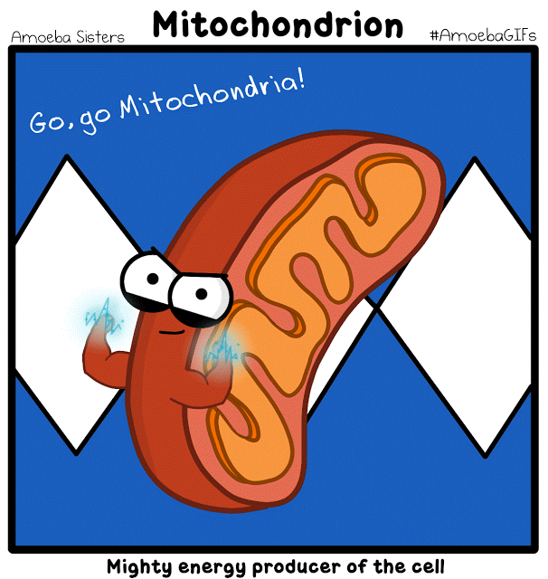
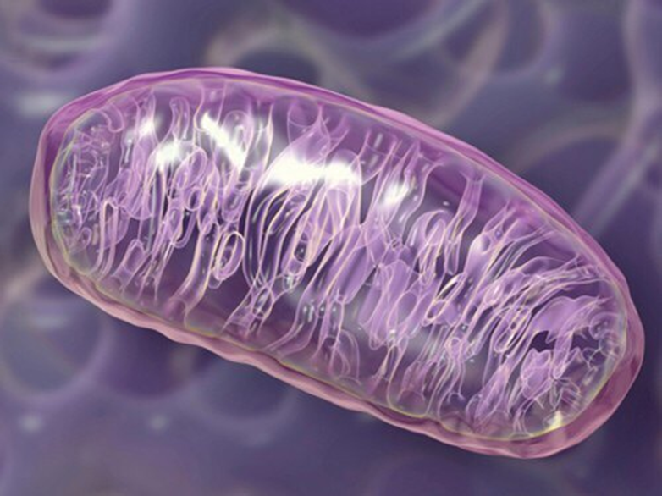

Slide 36
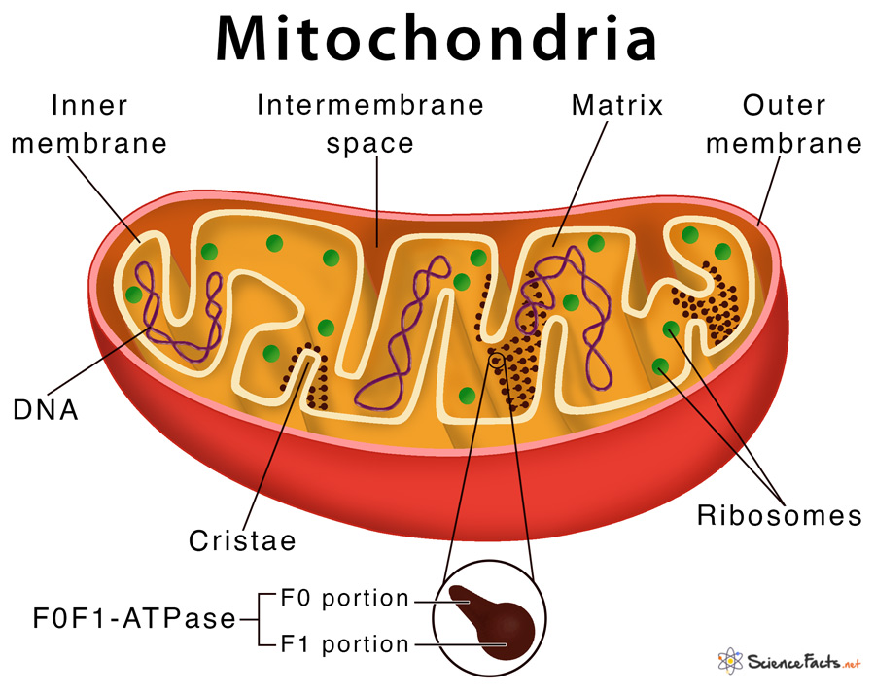

Slide 37
Macroergi
nucleoside triphosphates
adenine
ribose
Р
Р
Р
ATP (universal)
guanine
ribose
Р
Р
Р
GTP (Krebs cycle)
cytosine
ribose
Р
Р
Р
CTP (lipid metabolism)
UTP (carbohydrate metabolism)
uracil
ribose
Р
Р
Р
TTP (macroerg of nervous tissue, amino acid metabolism)
thymine
ribose
Р
Р
Р

Slide 38
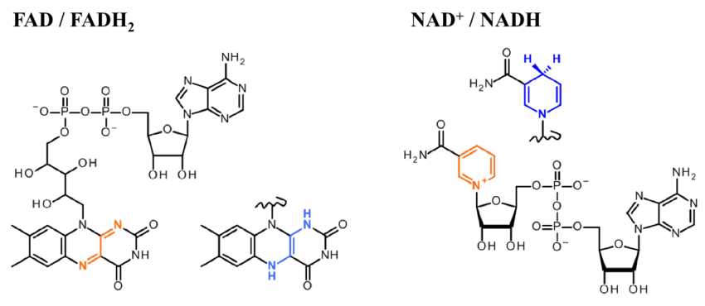
Cofactors

Slide 39
Cofactors
Prosthetic group
Coenzyme

Slide 40
Energy metabolism
Catabolism (dissimilation)
Anabolism (assimilation)
a set of processes for the splitting of complex molecules into simpler substances with the formation of energy
a set of processes of biosynthesis of organic substances
Krebs cycle - amphibolic path

Slide 41
Catabolism

Slide 42
Catabolism
Catabolism is the breakdown of complex organic substances into simpler ones. The process is carried out in 3 stages.
At the first stage, macromolecules are cleaved to their monomers (or building blocks):
Lipids
Polysaccharides
Proteins
Fatty acids
Glycerol
Monosaccharides
Amino acids
This stage is specific, because each macromolecule (polymer) is cleaved to monomers by its own set of enzymes. The 1st stage is catalyzed by enzymes of the hydrolase class.
The first stage of catabolism is localized in the digestive tract for food (exogenous) macromolecules, and for endogenous (located in the cells of the body) - mainly in lysosomes.

Slide 43
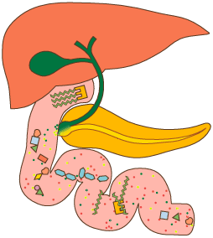

Slide 44
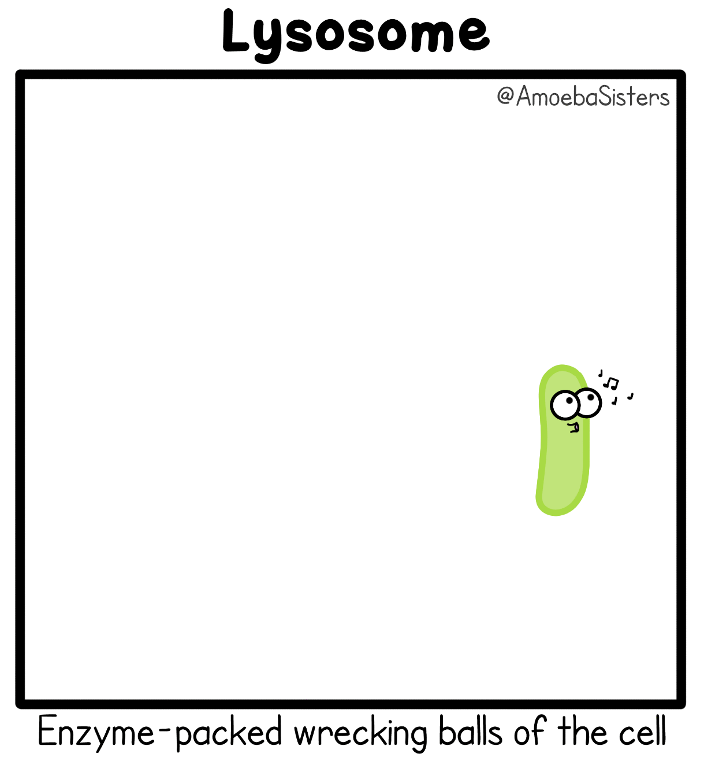

Slide 45
2nd stage. It is also a specific pathway of catabolism. At this stage, the decomposition products of the 1st stage are converted in their own way into one of the carboxylic acids.
Fatty acids
Glycerol
Monosaccharides
Amino acids
pyruvate
Acetyl-CoA
oxaloacetate
2-oxoglutarate
Stage 2 occurs in the mitochondria and the cytosol of cells. The resulting energy is released in the form of heat and used for the synthesis of ATP.

Slide 46
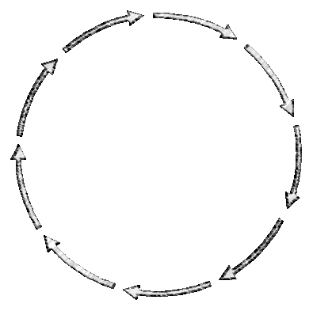
3rd stage. It is a common catabolic pathway for different classes of substances. At this stage, pyruvate is converted to acetyl-CoA during oxidative decarboxylation.
Acetyl-CoA, oxaloacetate and 2-oxoglutarate are oxidized in the Krebs cycle
oxidative decarboxylation
pyruvate
oxaloacetate
2-oxoglutarate
Acetyl-CoA
HS-КоА
Krebs Cycle
АТP
АТP
CO₂
H₂
Electron transport chain
H₂O
The end products of the stage are АТP, СО₂ и Н₂О

Slide 47
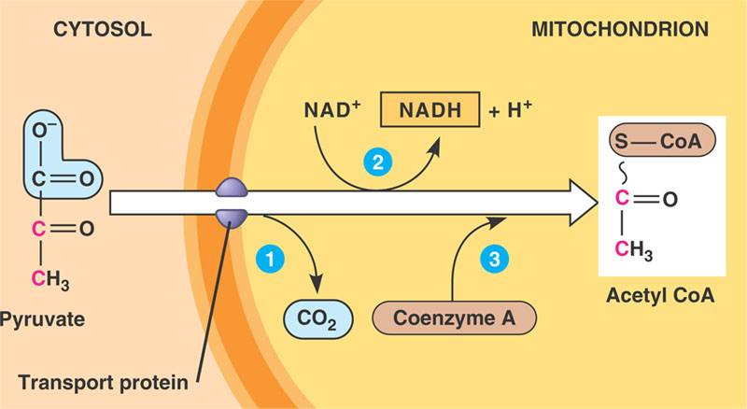
OXIDATIVE DECARBOXYLATION OF PIRUVATE

Slide 50
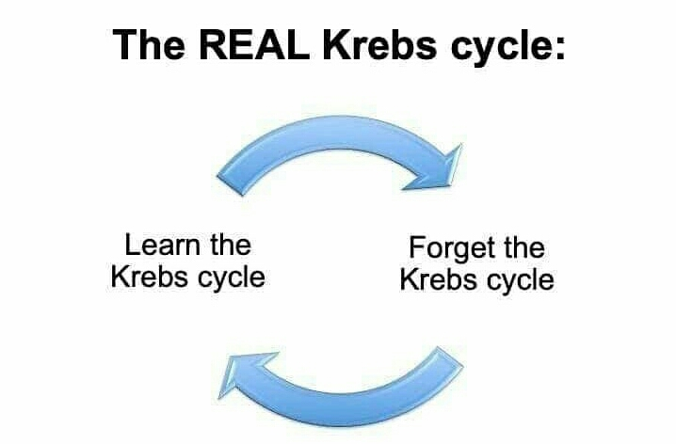

Slide 51
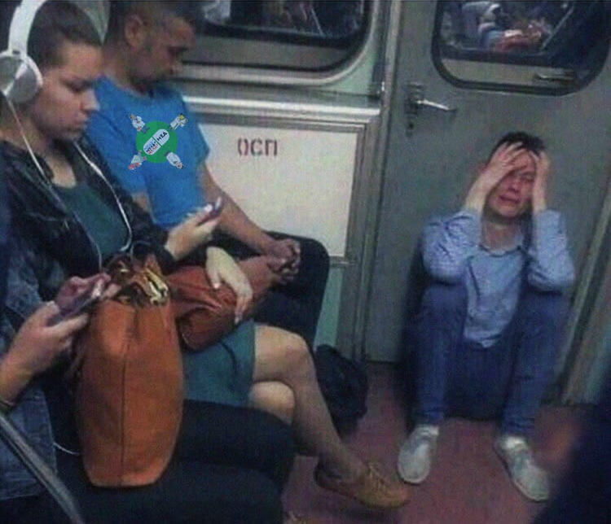
it's great when people put their cell phones down and start remembering the Krebs cycle

Slide 52
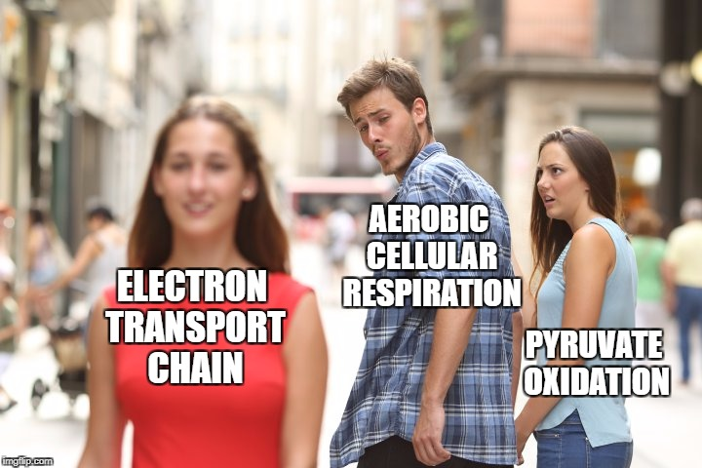

Slide 53
Oxidative decarboxylation of pyruvate: preparatory reaction before the Krebs cycle
~
Pyruvate dehydrogenase complex
Pyruvate
You need 5 coenzymes to work:
TDF, FAD, NAD +, lipoic acid, pantothenic acid (HS-CoA)
In prokaryotes, it is localized in the cytoplasm, in eukaryotes - in the mitochondrial matrix

Slide 54
Biochemical memos
Decarboxylation
(cleavage of the carboxyl group in the form of CO2):
СО₂
https://vk.com/topic-38399383_28800070

Slide 55
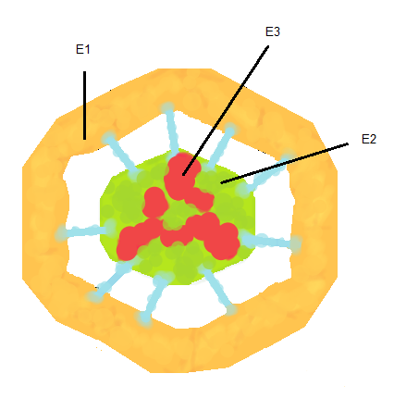
THREE-DIMENSIONAL MODEL OF THE PIRUVATE DEHYDROGENASE COMPLEX
Schematic representation of PDH showing enzymes (E1, E2, E3).
The core part is highlighted in green, the E2 lipoyl domain, which continues forward until it comes into contact with the active centers of the E1 molecules (yellow), is highlighted in blue. Several E3 subunits (red) are also associated with the cortex.

Slide 56
PIRUVATE DEHYDROGENASE COMPLEX INCLUDES:
E1 - decarboxylating pyruvate dehydrogenase.
The cofactor is the active form of vitamin B1 - thiamine pyrophosphate.
E2 - dihydrolipoylacetyltransferase.
The cofactor is a vitamin-like substance - lipoic acid, which, having attached 2 hydrogen atoms, can be converted into dihydrolipoyl.
The coenzyme is the active form of pantothenic acid - HS-CoA, it takes the acetyl residue from lipoic acid.
E3 - dihydrolipoyl dehydrogenase.
The cofactor is flavin adenine dinucleotide (FAD), the active form of vitamin B2.
The coenzyme is the active form of vitamin PP - nicotinamide adenine dinucleotide (NAD +).
PDH: Molecular weight about 6 million; contains 2 regulatory units;
can undergo chemical modification by phosphorylation (inactivation) and dephosphorylation (activation)

Slide 59
PRODUCTS OF THE PIRUVATE DEHYDROGENASE REACTION AND THEIR FURTHER TRANSFORMATIONS
СО₂
excreted in exhaled air;
used for carboxylation of substrates.
Acetyl-CoA
splits in the Krebs cycle to CO2 and H2
used for the synthesis of fatty acids, ketone bodies and cholesterol.
NADН + Н⁺
oxidized in the electron transport chain to NAD + with the formation of 3 ATP molecules.

Slide 60
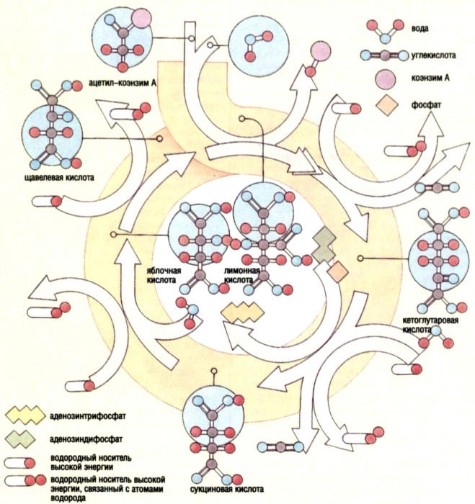
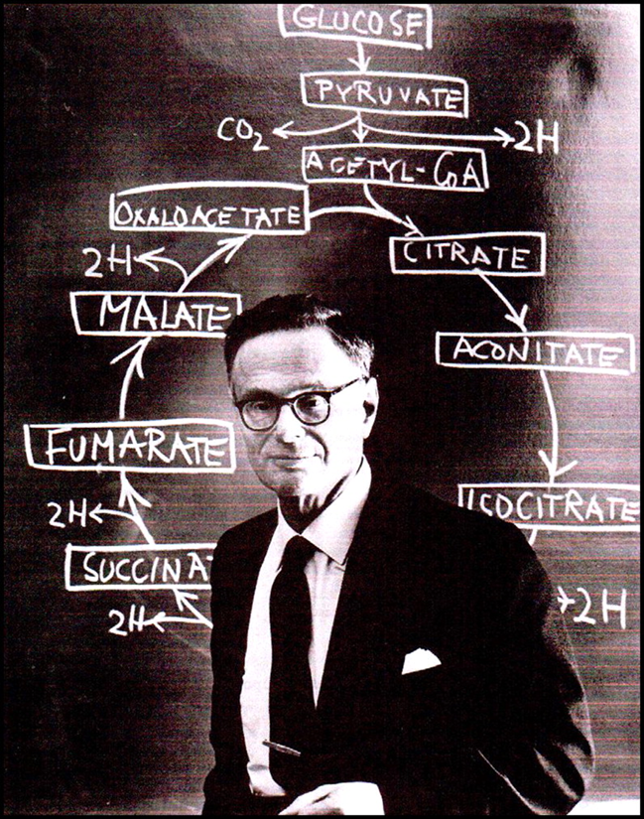
Krebs cycle
was discovered and studied by the German biochemist Hans Krebs, for this work he (together with F. Lipmann) was awarded the Nobel Prize (1953)

Slide 61
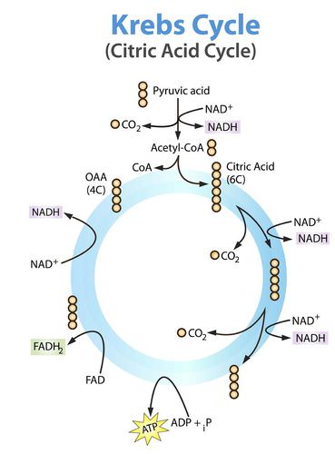
Why is it also called the citrate cycle and the tricarboxylic acid cycle?
Citric acid

Slide 62
1 reaction
*
Citrate synthase
Acetyl-CoA
Oxaloacetate
Citrate
(oxalic acetic acid)
(lemon acid)
Citrate synthase (2.3.3.1) - acetyltransferase - currently belongs to the class of transferases (formerly - lyases), which transfers the remainder of acetic acid (acetyl-) from coenzyme A to oxaloacetate. At the same time, for the formation of a covalent bond between acetyl and oxaloacetate, the energy released during the hydrolysis of the high-energy bond in acetyl-CoA is used

Slide 63
2 reaction
aconitate hydratase
aconitate hydratase
(Aconitase)
(Aconitase)
Citrate
cis aconitate
Isocitrate
(cis-aconitic acid)
Aconitase (aconitate hydratase, 4.2.1.3) is an enzyme of the class of lyases that catalyze water addition reactions with the breaking of a double bond. Since many enzymatic reactions are reversible, the same enzymes are involved in the dehydration reaction (the elimination of water with the formation of a double bond).

Slide 64
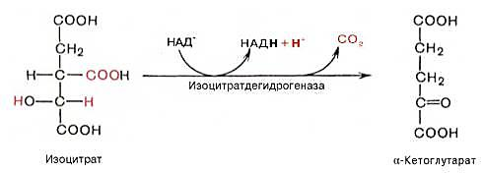
3 reaction
*
isocitrate dehydrogenase
Isocitrate
α-ketoglutarate
(2-oxoglutarate,
α-ketoglutaric acid)
Isocitrate dehydrogenase (1.1.1.41) is an enzyme of the class of oxidoreductases that catalyze redox reactions.
Oxidizing agent - NAD +, reducing agent - isocitrate.
In addition to oxidation, decarboxylation (elimination of the carboxyl group in the form of CO2) occurs here.

Slide 65
3 reaction
isocitrate
dehydrogenase
isocitrate
dehydrogenase
isocitrate
oxalosuccinate
α-ketoglutarate
(oxalic succinic acid)

Slide 66
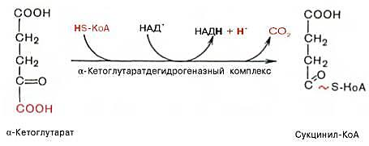
4 reaction
α-ketoglutarate dehydrogenase complex
*
α-ketoglutarate
Succinyl-Coa
α-ketoglutarate dehydrogenase complex includes 3 enzymes:
α-ketoglutarate decarboxylase
Dihydrolipoylsuccinyltransferase
Dihydrolipoyl dehydrogenase
And 5 coenzymes: TDF, FAD, NAD +, lipoic acid, HS-CoA.

Slide 67
5 reaction
GТP + АDP
GDP + АТP
substrate phosphorylation
succinate thiokinase
GDP
GTP
Succinyl-CoA-synthetase
Succinyl-CoA
Succinate
(succinic acid)
Succinyl-CoA synthetase (succinate thiokinase, 6.2.1.4) - more often referred to the class of ligases, less often - transferases; hydrolysis of the high-energy bond of the substrate leads to the release of energy, which is used to form a new high-energy bond, but already in the GTP molecule (analogue of ATP).
The reactions in which the energy of the high-energy bonds of the substrate is used to synthesize ATP (or GTP) are called substrate phosphorylation.

Slide 68
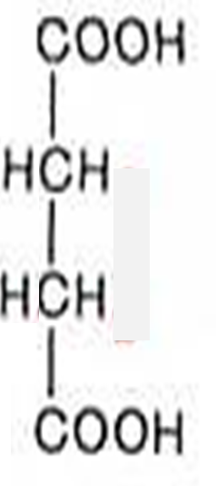
6 reaction
FAD
FADH2
Succinate dehydrogenase
(trans isomer)
(fumaric acid)
Succinate
Fumarate
Succinate dehydrogenase (1.3.5.1) is an enzyme that catalyzes a redox reaction.
Oxidizing agent - FAD, reducing agent - succinate.
FAD is a prosthetic group (always covalently linked to the active center of the enzyme). Succinate dehydrogenase is the only enzyme of the Krebs cycle located NOT in the matrix, but on the inner surface of the inner mitochondrial membrane. It is the "Complex II" of the respiratory chain.

Slide 69
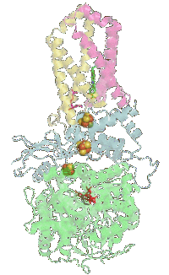
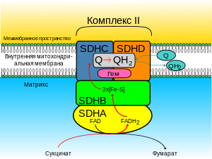
The same enzyme - complex 2 of the electron transport chain
https://upload.wikimedia.org/wikipedia/commons/thumb/8/8f/Succinate_Dehydrogenase_Cofactors_1NEK.gif/200px-Succinate_Dehydrogenase_Cofactors_1NEK.gif

Slide 70
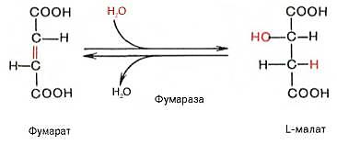
7 reaction
(fumarate hydratase)
Fumarase
Fumarate
L-Malate
(Malic acid)
Fumarase (fumarate hydratase, 4.2.1.2) is an enzyme of the class of lyases that catalyze hydration reactions (addition of water through a double bond).

Slide 71
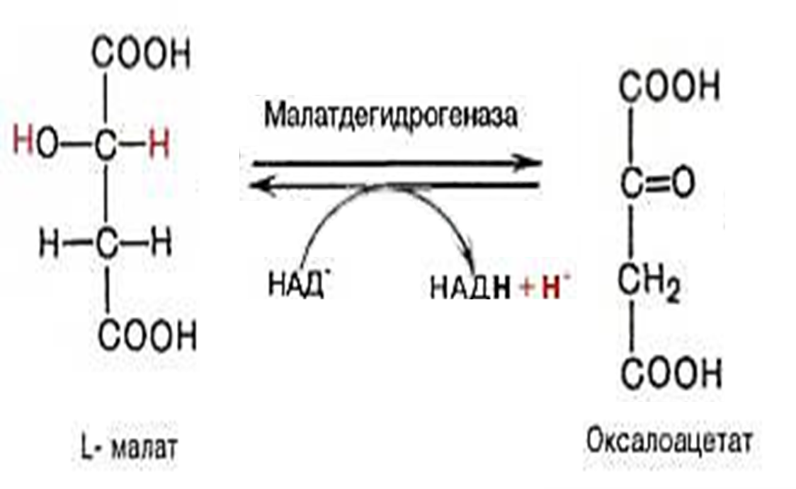
8 reaction
Malate dehydrogenase
NAD+
NADH + H+
L-Malate
Oxaloacetate
Malate dehydrogenase (1.1.1.37) is an enzyme of the class of oxidoreductases that catalyze redox reactions.
Oxidizing agent - NAD +, reducing agent - malate.

Slide 72
SUMMARY EQUATION OF THE CREBS CYCLE
Acetyl-CoA + 3NAD⁺ + FAD + 2Н₂О + ADP + Н₃РО₄

2 СО₂ + 3(NADН + Н⁺) + FADН₂ + АТP

Slide 75
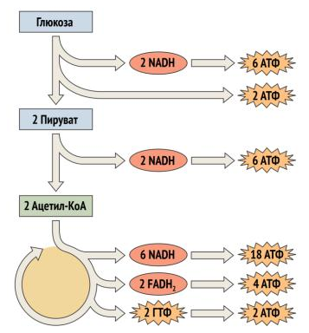
https://studfiles.net/preview/6659678/page:40/

Slide 76
Regulation
Enzymes | Cofactor | Activators | Inhibitors
Citrate synthase (initial) | - | Oxaloacetate, Acetyl-CoA | АТP, NADН, succinyl-CоА, long chain acyl-CoA
Aconitase | Fe²⁺ | Fe²⁺ | Fluoracetyl
Isocitrate degydrogenase (limiting) | NAD⁺ | АDP, АMP, cAMP, Са²⁺, citrate | АТP, NAD(P)Н
α-keto(2-oxo)glutarate dehydrogenase (On the fork) | ТDP, LA-S₂, FAD, NAD⁺, HS-КоА | cAMP, Са²⁺ | Succinyl-CoA, arsenate
Succinyl-CoA synthetase | - | Mg²⁺
Succinate dehydrogenase | FAD, non-heme Fe⁺ |  | oxaloacetate, malonate
Fumarase | -
Malate dehydrogenase | NAD⁺

Slide 77
HORMONAL REGULATION OF THE KREBS CYCLE
Regulatory Mechanism of Key Enzymes: Allosteric
Activate the Krebs cycle:
insulin
catecholamines
glucagon
iodothyronines

Slide 79
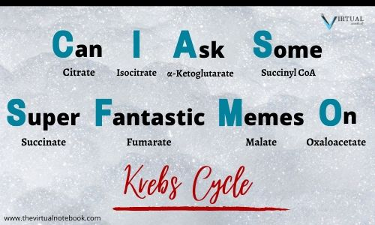

Slide 80
The significance of the Krebs cycle
catabolic or energetic (the Krebs cycle is a common final pathway for metabolites of all classes of compounds):
it forms ATP as a result of substrate phosphorylation;
it is the main supplier of hydrogen for the electron transport chain);
anabolic or biosynthetic (intermediate metabolites of the Krebs cycle are used for the synthesis of other compounds):
amino acids are formed from oxaloacetate, 2-oxoglutarate and succinate;
from oxaloacetate - glucose and other carbohydrates;
succinyl-CoA is used for the synthesis of heme);
carbon dioxide is used in the carboxylation reaction;
regulatory (metabolites - citrate and ATP are regulators of other processes):
They activate the synthesis of fatty acids and inhibit glycolysis.

Slide 81
CYCLE OF KREBS

Slide 82
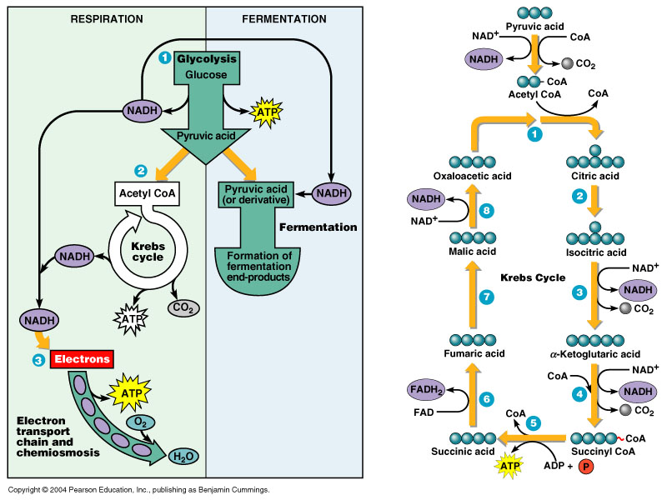
Hydrogen-donor function of the Krebs cycle

Slide 83
The Krebs BiCycle
https://i.pinimg.com/originals/5c/dd/bd/5cddbd2c481dd8b7004c38f1ccf856ef.jpg
https://media.nature.com/m685/nature-assets/nrm/journal/v1/n3/images/nrm1200_225a_f1.gif
http://www.deconstructingthetour.group.shef.ac.uk/wordpress/wp-content/uploads/krebscycle1-1024x783.png

Slide 84
WAYS OF USING ATP
mechanical work (muscle contraction, movement of sperm, leukocytes);
osmotic work (active transport, i.e. movement against the concentration gradient);
chemical work (the use of ATP energy in biosynthetic processes and for the activation of substrates);
electrical work (generation of biocurrents);
hormonal signal transmission (ensuring the work of adenylate cyclase and protein kinase)

Slide 85
WAYS OF USING ATP

Slide 86
Conclusion
Biological oxidation differs from oxidation in inanimate nature by the stepwise nature of oxidation, the accumulation of most of the energy in the form of ATP, enzymatic catalysis under mild conditions, and controllability.
Catabolism consists of three stages, the first two of which are specific, and the third is nonspecific (the Krebs cycle in conjunction with the respiratory chain).
The Krebs cycle has amphibolic significance, playing a role in the reactions of both catabolism and anabolism.
During the Krebs cycle, 1 ATP molecule is formed by substrate phosphorylation, and when coupled with the respiratory chain (by oxidative phosphorylation), 11 more ATP molecules are formed, or another 14 if we count the NADH yield during o-decarboxylation of pyruvate)

Slide 87
THANK YOU FOR THE ATTENTION!

Slide 88
How many ATPs are produced in the Krebs cycle?

