Slide 1
Federal State Budgetary Educational Institution of Higher Education «Prof. V.F. Voino-Yasenetsky Krasnoyarsk State Medical University» of the Ministry of Healthcare of the Russian Federation
Physiology of sensory systems
Part 2
Department of Physiology named after Professor A.T. Pshonik
Physiology 2021

Slide 2
Lecture plan:
1. Vestibular apparatus and equilibrium.
2. The ears and hearing.
3. Concept of pain. Classification of pain.

Slide 3
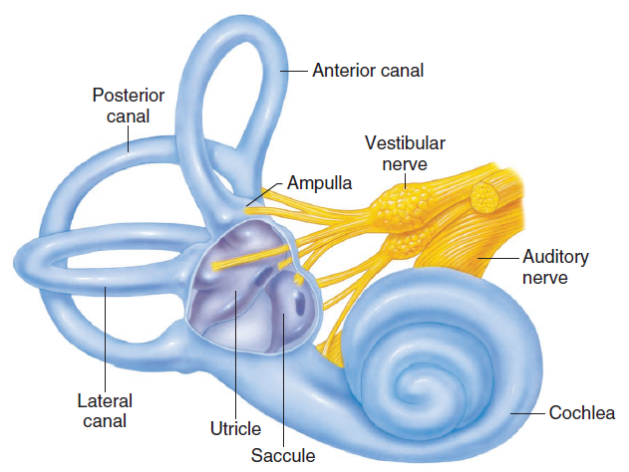
The cochlea and vestibular apparatus of the inner ear. The vestibular apparatus consists of the utricle and saccule (together called the otolith organs) and the three semicircular canals. The base of each semicircular canal is expanded into an ampulla that contains sensory hair cells.
The vestibular apparatus consists of two parts:
the otolith organs, which include the utricle and saccule,
the semicircular canals.

Slide 4
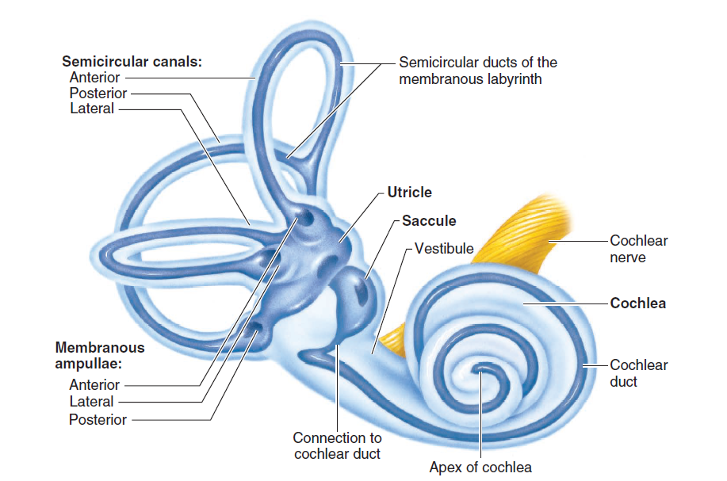
The labyrinths of the inner ear.
The membranous labyrinth (darker blue) is contained within the bony labyrinth

Slide 5
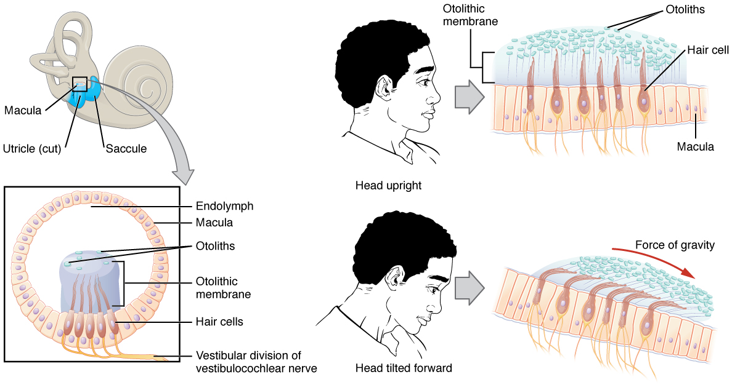

Slide 6
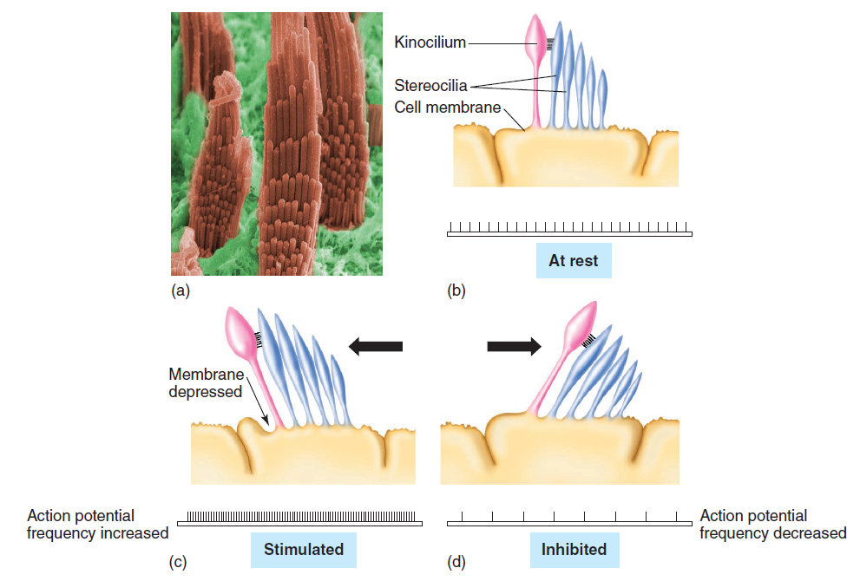
Sensory hair cells within the vestibular apparatus. ( a ) Colored scanning electron micrograph of stereocilia within the vestibular apparatus. ( b ) Each sensory hair cell contains a single kinocilium and several stereocilia. ( c ) When stereocilia are displaced toward the kinocilium ( arrow ), the cell membrane is depressed and the sensory neuron innervating the hair cell is stimulated. ( d ) When the stereocilia are bent in the opposite direction, away from the kinocilium, the sensory neuron is inhibited.

Slide 7
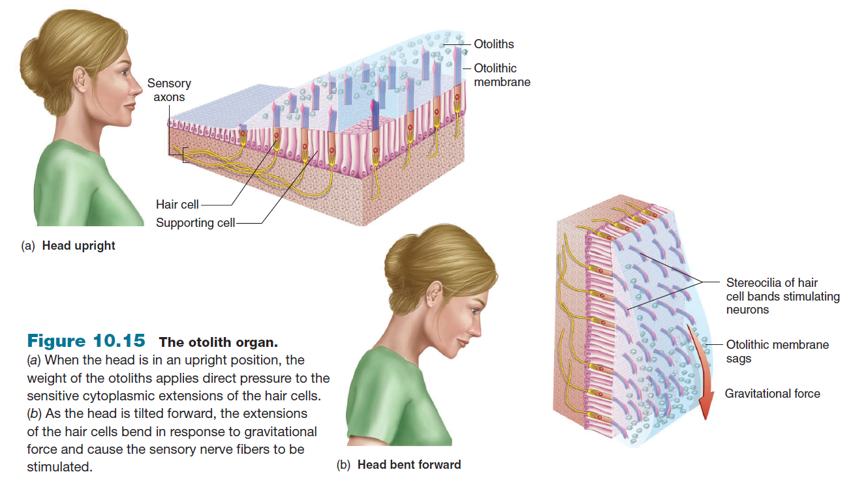

Slide 9
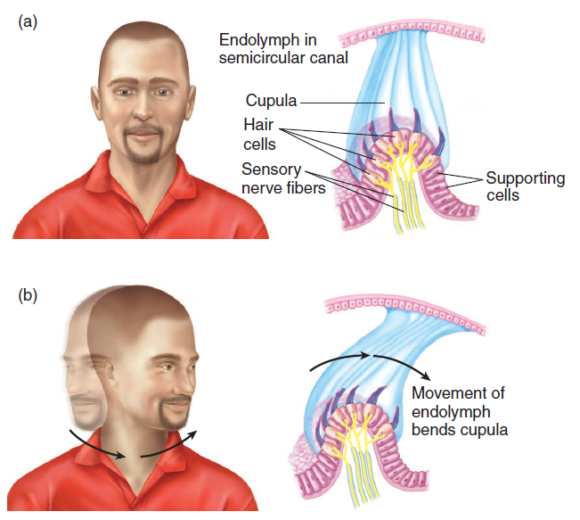
The cupula and hair cells within the
semicircular canals.
( a ) Shown here, the structures are at rest or at a constant velocity.
( b ) Here, movement of the endolymph during rotation causes the cupula to bend, thus stimulating the hair cells.

Slide 10
2-Minute Neuroscience_ Vestibular System

Slide 11
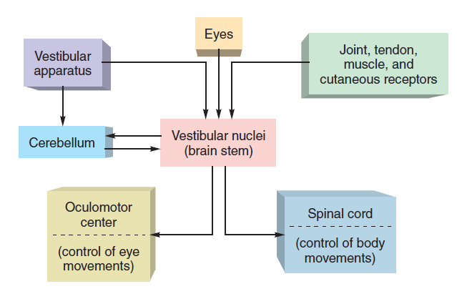
Neural pathways involved in the maintenance of equilibrium and balance.
Sensory input enters the vestibular nuclei and the cerebellum, which coordinate motor responses.

Slide 12
INSTANT NEURO - Vestibular Pathways

Slide 15
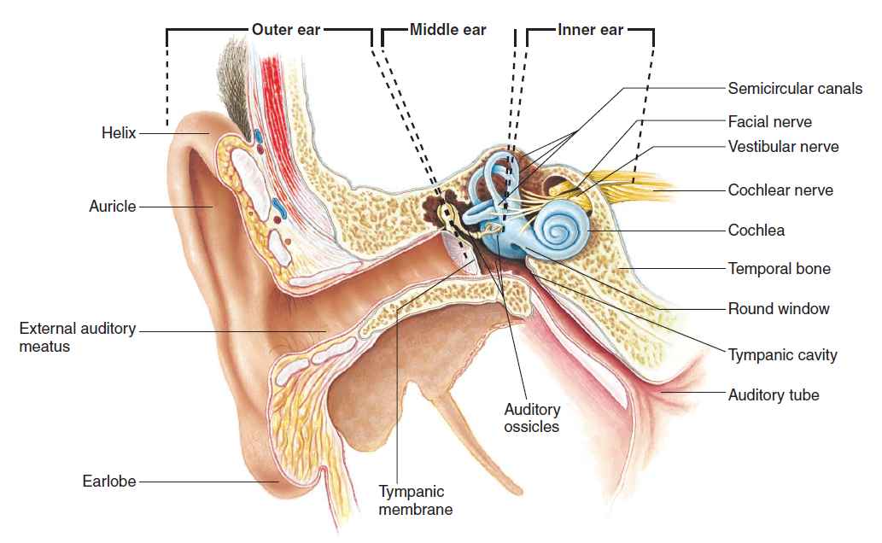
The ear. Note the structures of the outer, middle, and inner ear

Slide 16
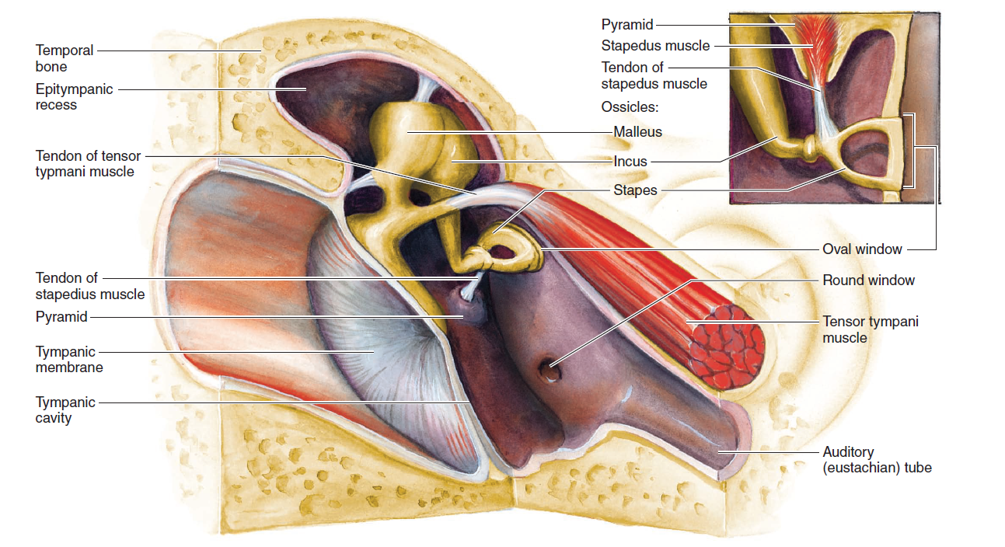
A medial view of the middle ear. The locations of auditory muscles, attached to the middle-ear ossicles, are indicated.

Slide 17
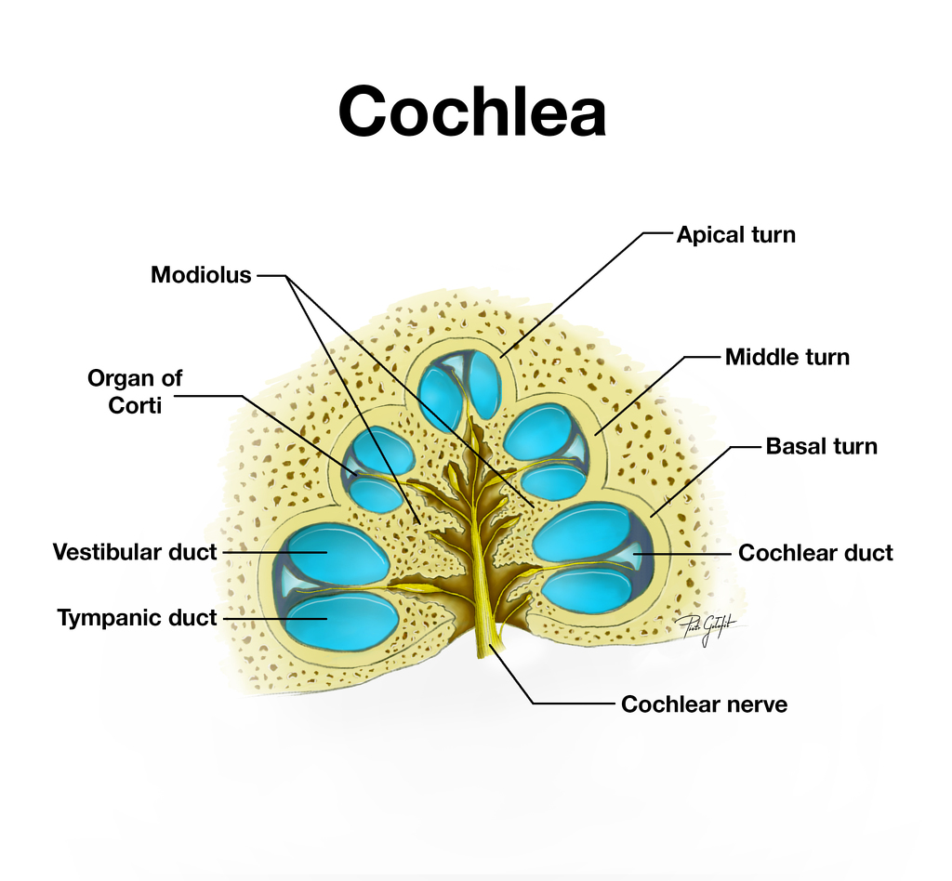

Slide 19
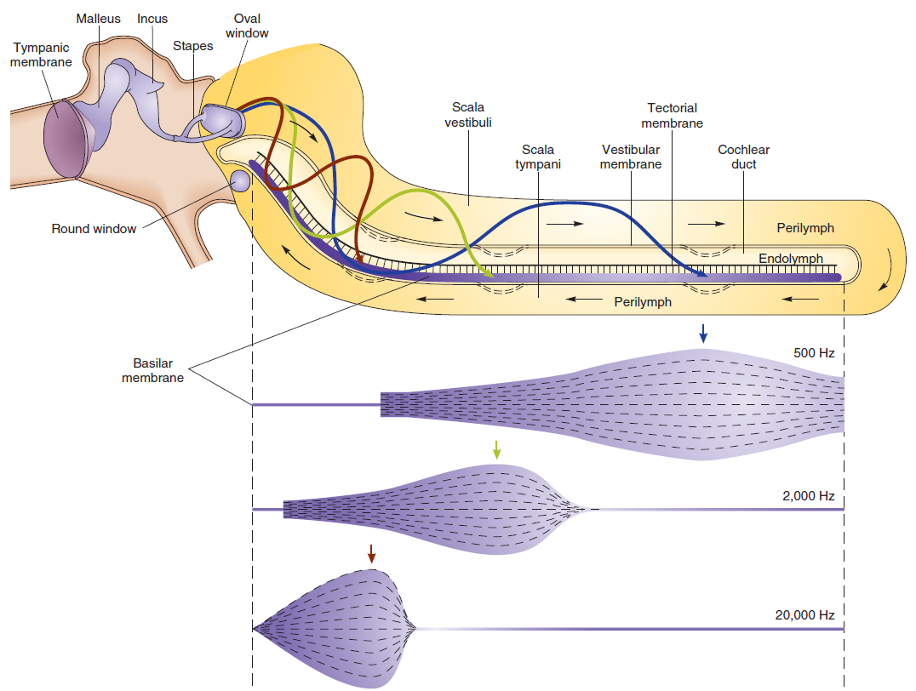
Effects of different sound pitches on the basilar membrane. Sounds of different pitch cause peak
vibrations of the basilar membrane in different regions. Low-frequency (pitch) sounds, such as at 500 Hz, cause peak vibrations of the basilar membrane more toward the apex of the cochlea (to the right in this figure). High frequencies, such as 20,000 Hz, cause peak vibrations more toward the base of the cochlea (toward the left in the figure).

Slide 20
2-Minute Neuroscience_ The Cochlea

Slide 21
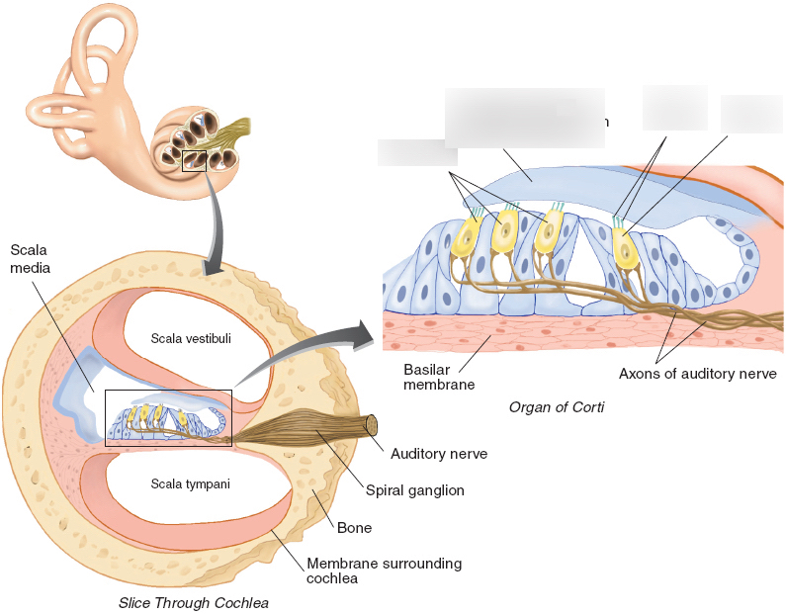

Slide 22
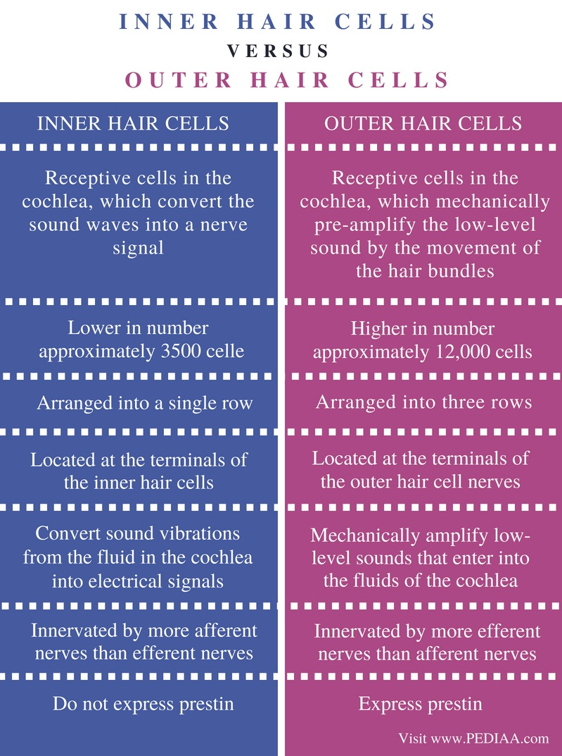
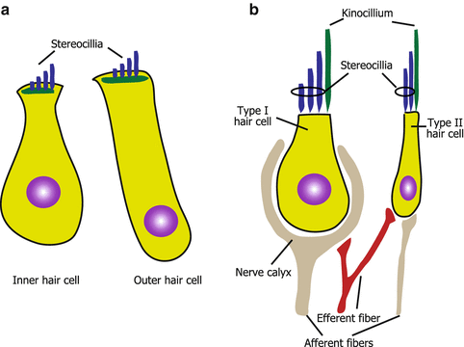

Slide 23
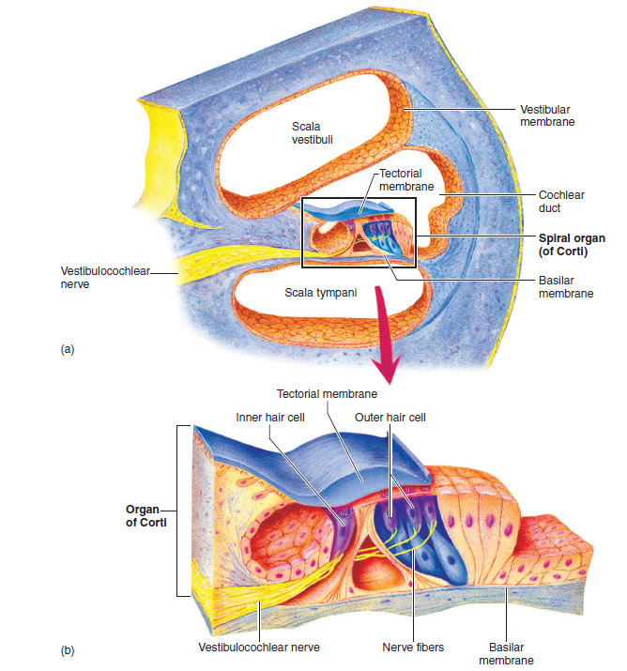
The spiral organ (organ of Corti).
This functional unit of hearing is depicted
( a ) within the cochlear duct and
( b ) isolated to show greater detail.

Slide 24
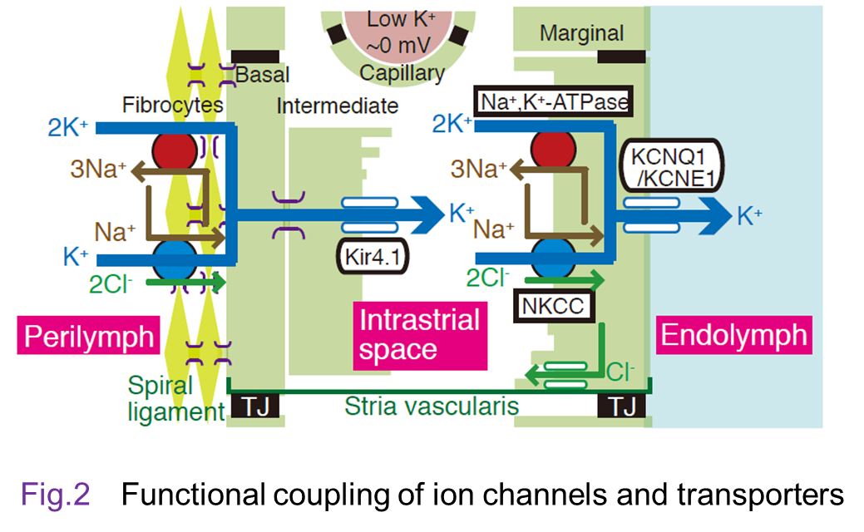

Slide 25
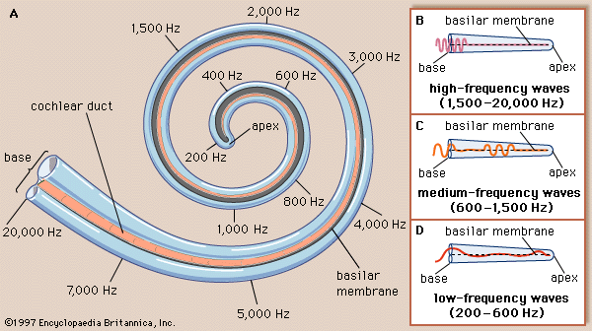

Slide 26
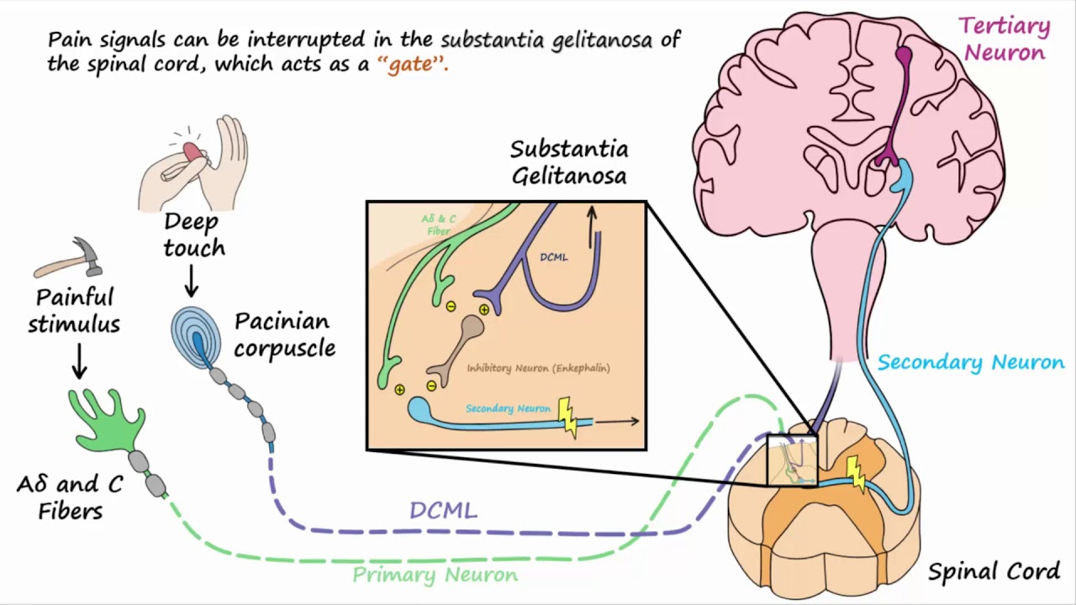

Slide 27
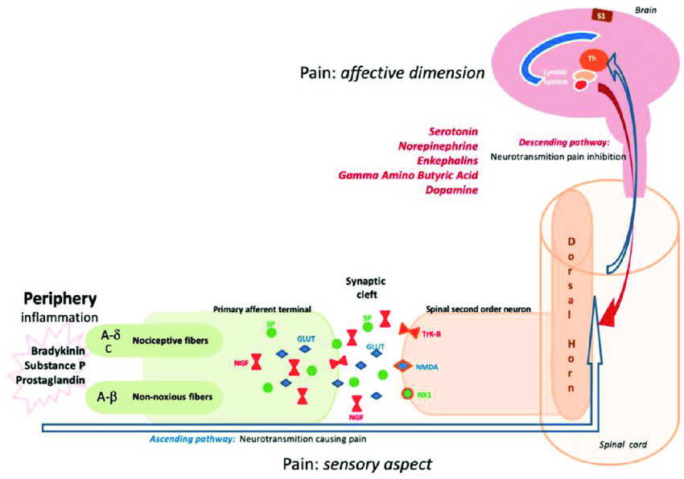

Slide 28
Physical pain is classified into three categories:
1. Pain caused by external factors (except for pain caused by excessive adequate stimulations of sensory organs, for example, of vision, of audition). Such pain is characterized by the following features: it is superficial, brief except for the cases associated with breakage of the integrity of skin. Such pain can be easily localized and its cause identified. The external factor can be eliminated. The nervous system remains undamaged, its peripheral apparatus and central mechanisms remain intact.
2. Pain caused by internal processes. This kind of pain is associated with stimulation of any kind of receptors by different mechanisms. The resultant train of afferent impulses is perceived as pain. Skin usually does not participate in initiation of this pain, unless it is damaged or reflects pain. It is often impossible to localize this pain, identify its cause, and eliminate it partly or fully. It is of much longer duration. Here, the nervous system remains undamaged, because the focus of the pathological process is distal from receptors. Besides, afferent fibers retain the normal conduction, and pain modulating mechanisms function normally. By the type of the involved tissue, this kind of pain is categorized into ectodermal,
mesodermal, endodermal pain, and also pain caused by excessive loads on muscles.
3. Pain associated with damage to the nervous system, in particular to its afferent part. Although such pain is often accompanied by sensations on skin, it is nevertheless difficult or impossible to correctly identify the external causes and to localize the source of pain. This pain is long-term, may persist for years, and elimination of its source is impossible. The nervous system is damaged: defects in the conducting peripheral or central pathways are noted, as well as disturbances in pain modulating mechanisms. Damages causing this pain are proximal to receptors of peripheral nerves, spinal cord or higher nervous centers. This kind of pain may be local or systemic (neuralgia, causalgia, phantom pain, thalamic syndrome).

Slide 29
Physical pain may be:
Primary, or epicritic (rapid, acute, piercing) for example, pain caused by pricking the skin with a needle; it has a precise localization, persists for some time after elimination of the stimulus, does not elicit emotional response;
Secondary, or protopathic, pain (slow, intolerable, burning), which appears in 0.5-1 s after the primary pain, has no distinct localization, persists for some time after elimination of the stimulus, is accompanied by alteration in the functions of the cardiovascular and respiratory systems, may affect the personality, way of thinking (secondary pain also includes dull pain in the visceral organs and in deep somatic structures);
Chronic pain (physical pain, persisting for a long time in some patients with chronic diseases) is characterized by complex nervous mechanisms at the emotional, affective and behavioral levels manifested by reactive depression, which makes an individual disabled and radically changes his/her life.

Slide 31
It follows from the above that the concept of “pain” includes:
- painful stimulus informing an individual about a past or a forthcoming damage to tissues;
- personal, or individual perception of a harmful factor;
- complex of responses aimed at protection of an organism against a noxious factor;
- category of experience based on numerous events accompanied by sensory and emotional conditions.

Slide 32
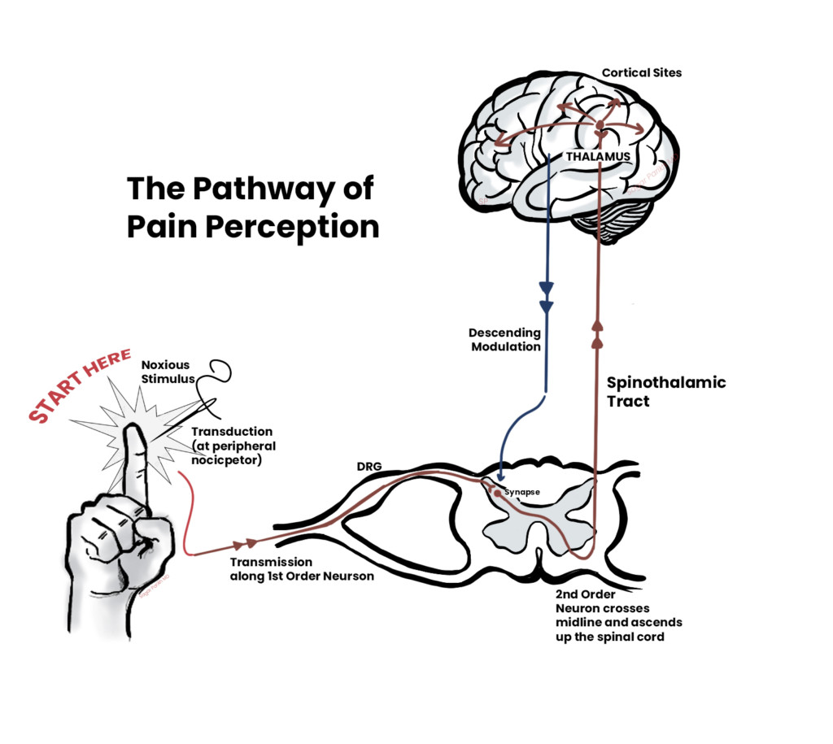

Slide 33
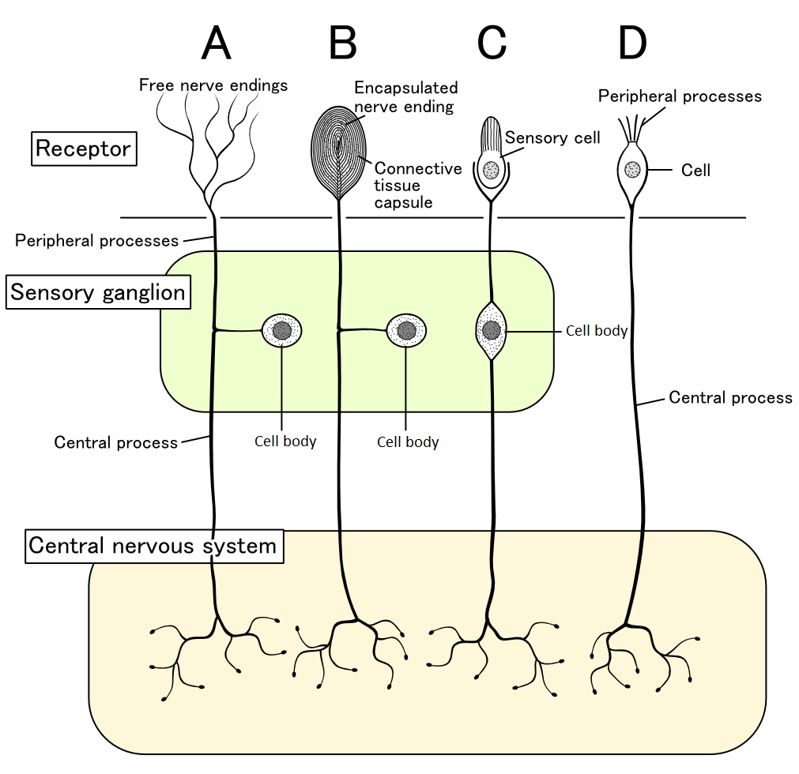

Slide 34
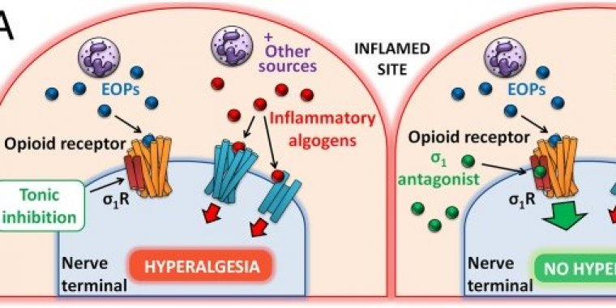

Slide 35
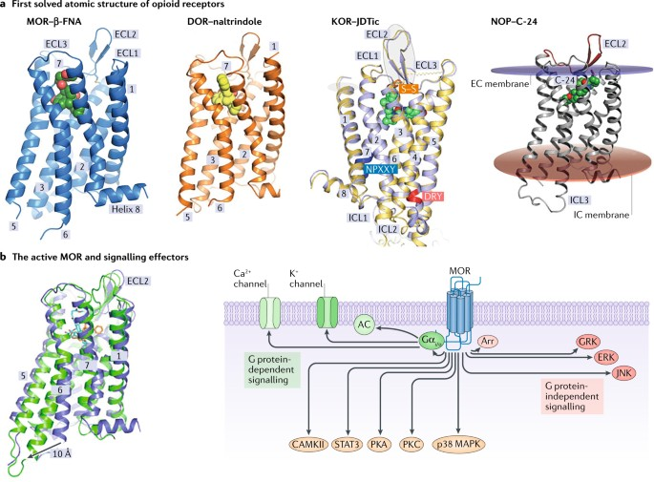

Slide 36
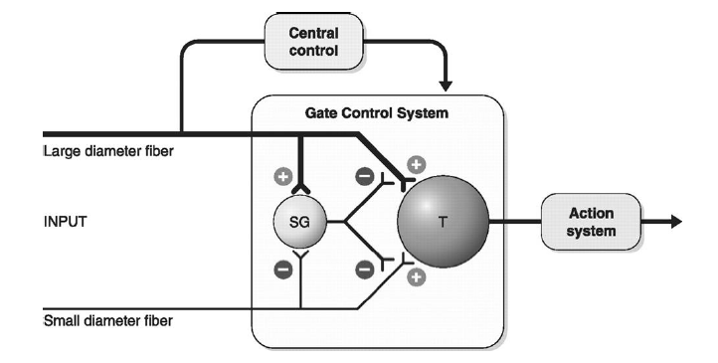
The gate control theory of pain

Slide 39
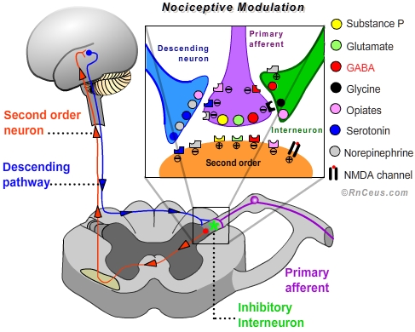

Slide 40
Lesson assignment:
Lauralee Sherwood. Fundamentals of Human Physiology.
Pages: 145 – 146.
Pages: 161 – 176.
Questions:
1. The structure of the vestibular apparatus.
2. Functioning mechanism of the Sensory hair cells of the vestibular apparatus.
3. Utricle and Saccule. The mechanism of their functioning.
4. Semicircular Canals. Its implications for vestibulation.
5. Neural pathways of the vestibular system.
6. Functional structure of the outer ear. Significance for the perception of sounds.
7. Functional structure of the middle ear. Significance for the perception of sounds.
8. Functional structure of the cochlea. Significance for the perception of sounds.
9. Structure and function spiral organ (organ of Corti).
10. The role of potassium in the mechanisms of the functioning of hair cells.
11. Concept of pain. Classification of pain
12. Modern concepts of pain sensory (nociceptive) system nociceptors.
13. Opioid Receptors and Mechanisms.
14 Modern Theories of Pain.

Slide 41
Internet Addresses and Literature used in the preparation of the lecture
Selected Lectures / M.M. lapkin, E.A. Trutneva; M.: GEOTAR-Media, 2017. – 237 pp.
Dunn R.B., Daugherty S.R. Physiology. USMLE Step 1.-Becker. Professional Education, 2013.-440 pp.
Non-respiratory functions of the lungs
https://derangedphysiology.com/main/cicm-primary-exam/required-reading/respiratory-system/Chapter%20016/non-respiratory-functions-lungs
Human Physiology
https://en.wikibooks.org/wiki/Human_Physiology
PHYSIOLOGY & RELATED SCIENCES - A SHORT GLOSSARY
https://www.ucl.ac.uk/lapt/glossph.htm

Slide 42
Thank you for attention

