Slide 1
Prof. V.F. Voino-Yasenetsky Krasnoyarsk State Medical University
Topic: Digestion of carbohydrates. Glycogen metabolism
Lecture No. 5 on the discipline "biochemistry" for 2nd year students
Lecturer: Panina Yu.A.
Krasnoyarsk, 2022

Slide 2
Lecture plan:
Relevance of the topic.
Digestion of carbohydrates in the gastrointestinal tract.
Unification of monosaccharides
The role of the liver in the metabolism of carbohydrates.
Glycogen metabolism (hydrolytic and phosphorolytic decomposition, synthesis).
Regulation of glycogen metabolism.
Pathologies of carbohydrate digestion and unification of MS.
Lysosomal storage diseases and glycogen diseases: glycogenoses, aglycogenoses, mucopolysaccharidoses.
Monomer absorption pathologies: celiac disease.
Conclusion

Slide 3
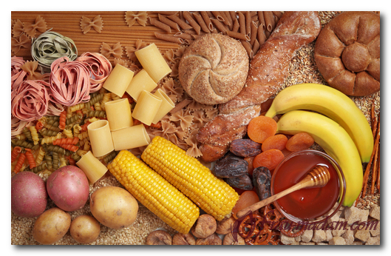
Carbohydrate metabolism

Slide 4
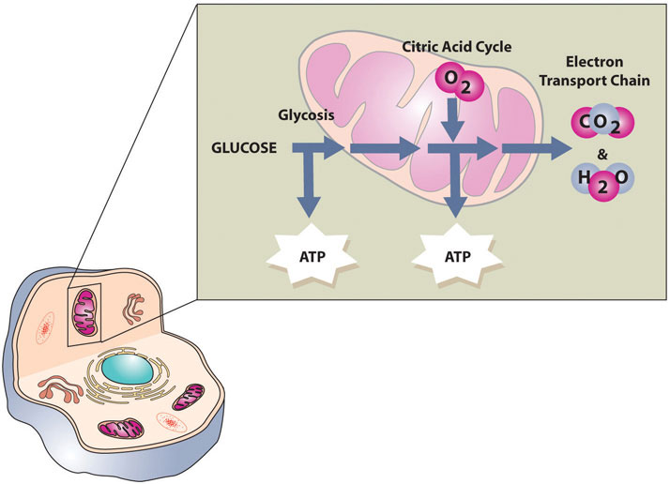
RELEVANCE OF THE TOPIC
Biomedical significance
carbohydrates are one of the most important sources of energy for all cells and tissues - from aerobic to anaerobic
https://2012books.lardbucket.org/books/an-introduction-to-nutrition/s08-03-the-functions-of-carbohydrates.html

Slide 5
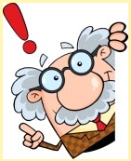
FUNCTIONS OF CARBOHYDRATES IN THE BODY
Energy Production
Oxidation of 1 g of carbohydrates releases 17.4 kJ of energy (4,1 kcal)
Building Macromolecules
participate in the construction of various molecules (glycoproteins, complex lipids, nucleic acids)
Energy Storage
carbohydrates accumulate in skeletal muscle, liver and other tissues as glycogen

Slide 6
FUNCTIONS OF CARBOHYDRATES IN THE BODY
Protective function
Сomplex carbohydrates are part of the components of the immune system
Regulatory function
dietary fiber is not digested in the intestines, but activates intestinal motor function, enzymes, improves digestion and absorption of nutrients
Specific functions
provide the specificity of blood groups, act as an anticoagulants
mucopolysaccharides are located on mucous membranes and protect against the penetration of bacteria, viruses, and mechanical damage
are receptors of a number of hormones, pharmacological substances, have an antitumor effect

Slide 8
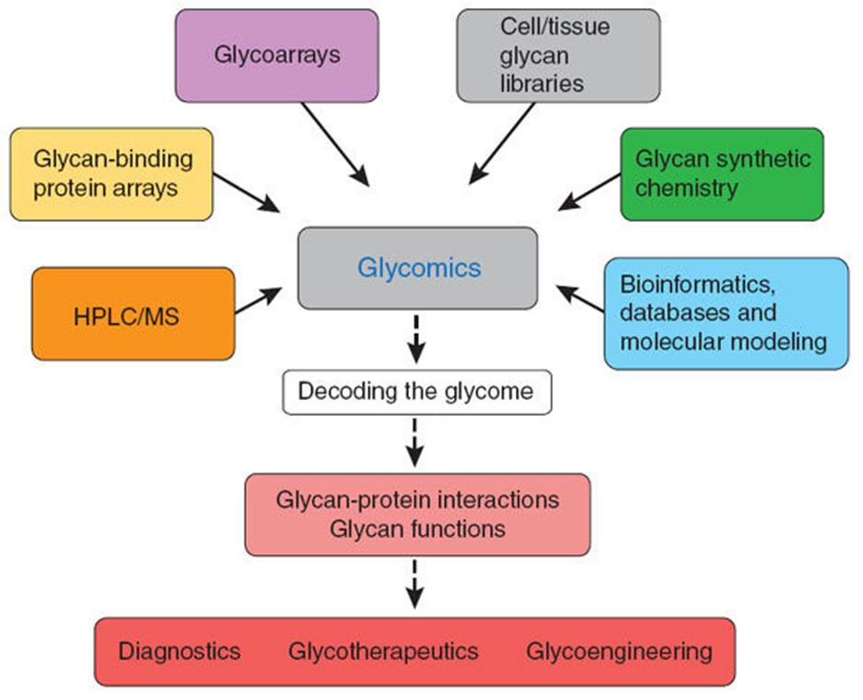
glycomicS
carbohydrate profile
Glycomics is subdivided into:
1) Structural glycomics (structure of complex carbohydrates - glycoproteins and glycolipids)
2) Functional glycomics
Glycome, like proteome and metabolome, is very dynamic

Slide 9
Metabolomics

Slide 10
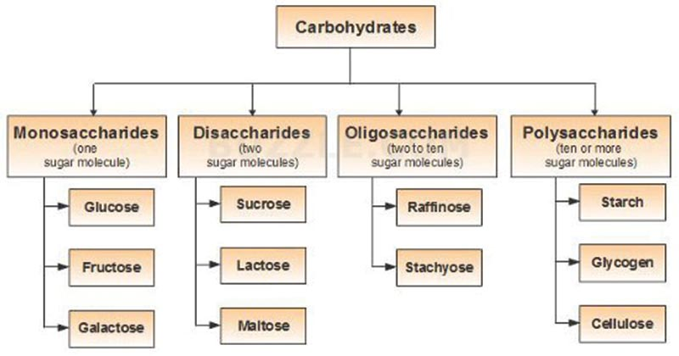
Classification of carbohydrates

Slide 11
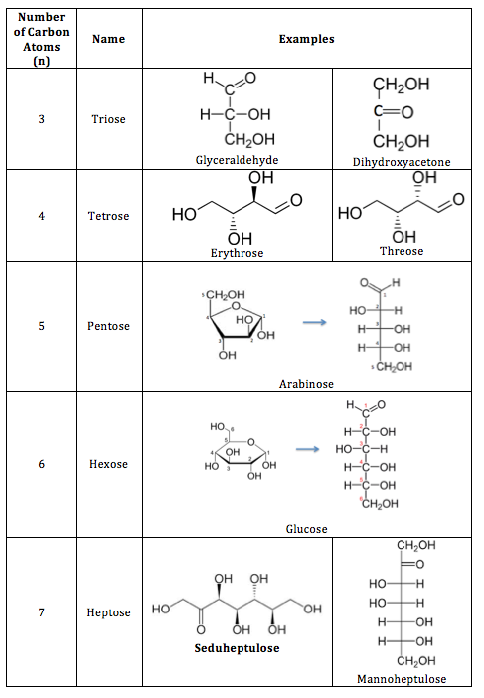
Classification of monosaccharides

Slide 12
Classification of monosaccharides

Slide 13
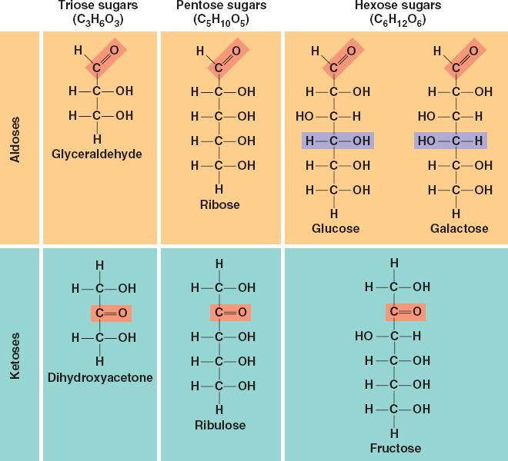
Classification of monosaccharides

Slide 14
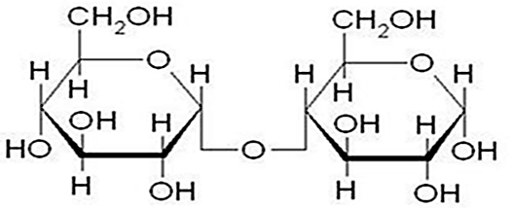
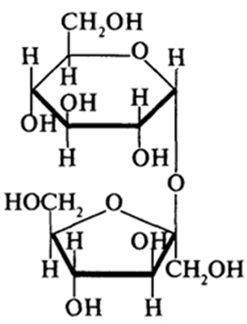
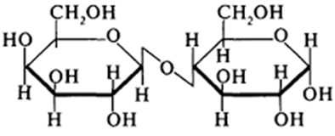
The most important disaccharides
Reducing | Non-reducing
Maltose | Sucrose
Lactose
Cellobiose

Slide 15
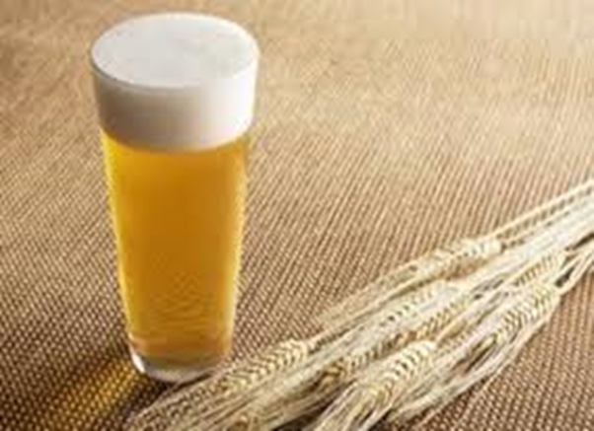
Maltose
Maltose (malt sugar) comes with products containing partially hydrolyzed starch, such as malt, beer. Maltose is also formed by the breakdown of starch in the intestines. Maltose consists of two D-glucose residues linked by an α-1,4-glycosidic bond.

Slide 16
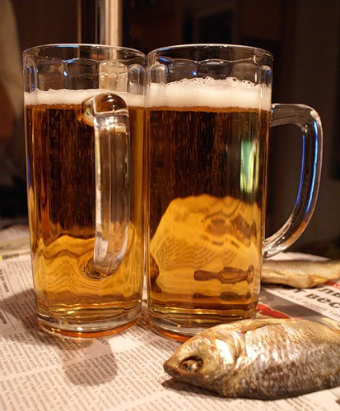
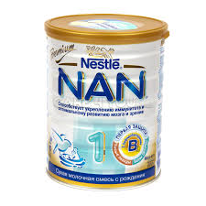
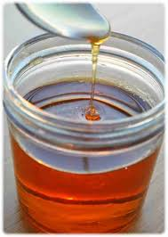
Using of maltose
Is a source of energy
Used for making homemade kvass, beer, distilling
Serves as a flavoring additive for baking bread
It is used for the manufacture of dietary food products, including children's and sports
Part of molasses

Slide 17
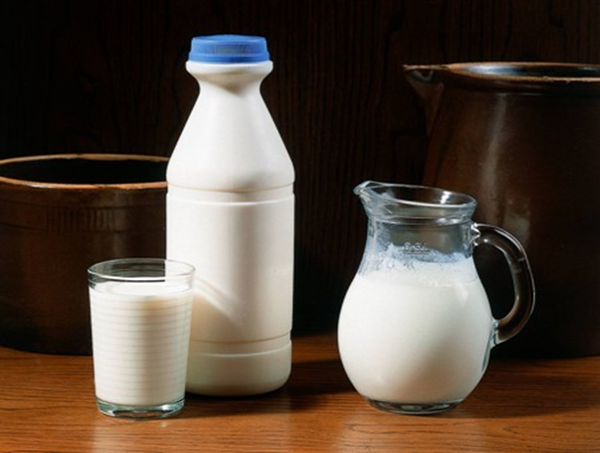
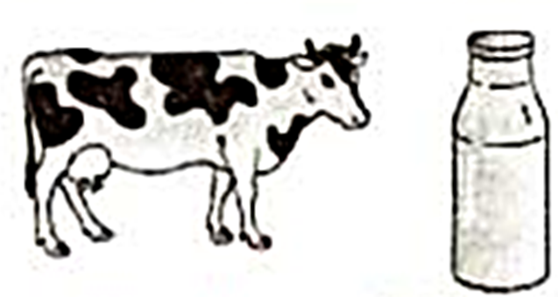
Lactose
Lactose is milk sugar; the most important disaccharide of mammalian milk. Cow's milk contains up to 5% lactose, in human milk - up to 8%. In lactose, the anomeric OH group of the first carbon atom of the D-galactose residue is linked by a β-glycosidic bond to the fourth carbon atom of D-glucose (β-1,4 bond). Lactose is a reducing sugar.

Slide 18
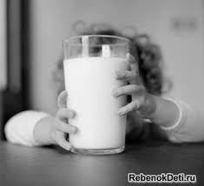
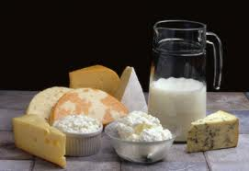
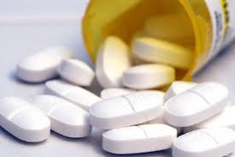
Using and properties of lactose
Essential Nutrient for Children
Lactose is a source of energy for the nervous system
Supports normal intestinal microflora (lactobacilli)
Normalizes calcium metabolism
Used in pharmaceuticals

Slide 19
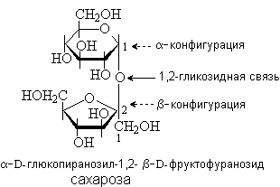
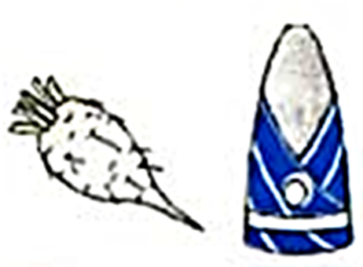
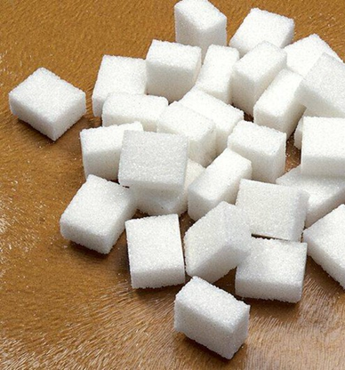
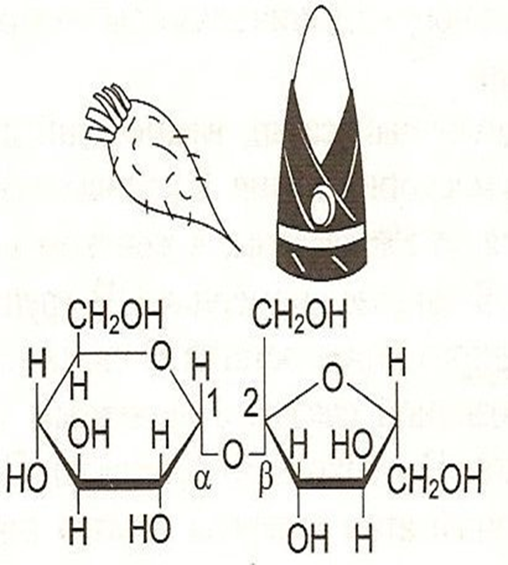
Sucrose
Sucrose (cane, beet sugar) is a disaccharide consisting of α-D-glucose and β-D-fructose, linked by an α, β-1,2-glycosidic bond. In sucrose, both anomeric OH groups of glucose and fructose residues are involved in the formation of a glycosidic bond.
Sucrose is nonreducing sugar.

Slide 20
Other sugars
Trehalose
disaccharide, "mushroom sugar"
main carbohydrate of insect hemolymph
Raffinose
trisaccharide (galactose + glucose + fructose)
found in sugar beets
Stachyose
tetrasaccharide (2 galactose + 1 glucose + 1 fructose)
found in the roots of Stachys, in the seeds of dicotyledonous plants

Slide 21
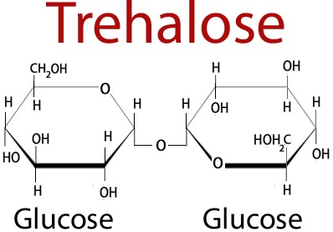
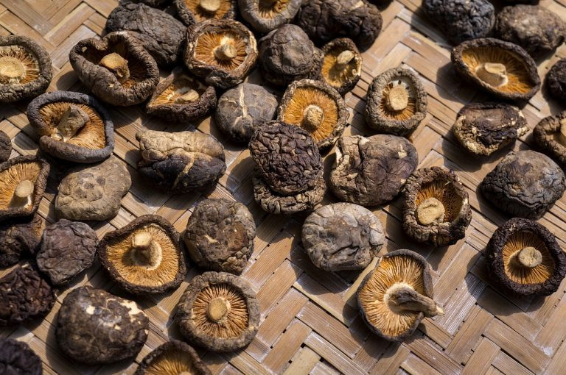
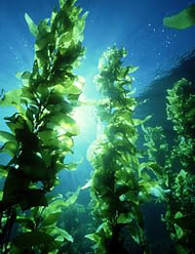
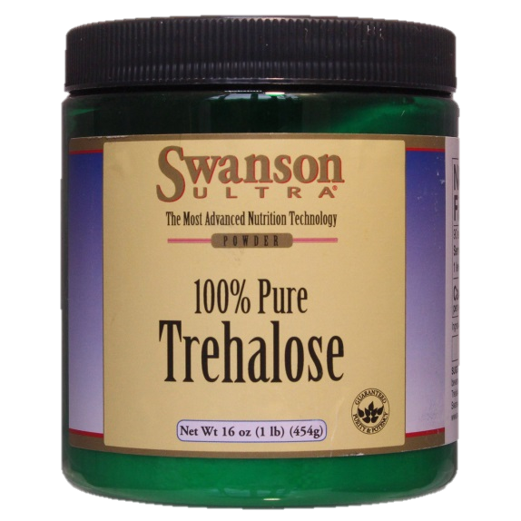
https://nestarenie.ru/tregaloza.html

Slide 24
STRUCTURE OF THE STARCH MOLECULE
Starch
Starch is a branched polysaccharide consisting of glucose residues (homoglycan). The molecular weight of starch is about 10⁵-10⁸ D. Starch consists of amylose and amylopectin.

Slide 26
BRANCHED AMYLOPECTIN MOLECULE

Slide 27
Glycogen
Glycogen - a polysaccharide of animals and humans, performs a reserve function. Food contains a small amount of glycogen; therefore, glycogen is not of great nutritional value.

Slide 28
The structure of the glycogen molecule
Glycogen is a structural analogue of starch, but it has a large degree of branching: about every 10 glucose residues there is one α-1,6-glycosidic bond.

Slide 29
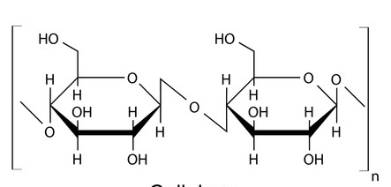
Cellulose (fiber)
Cellulose is a linear polysaccharide homoglycan built from glucose residues interconnected by β-1,4-glycosidic bonds. The human digestive system does not have enzymes that hydrolyze β-bonds in polysaccharides. Therefore, cellulose is not a used carbohydrate, but this food component is necessary for normal digestion.

Slide 30
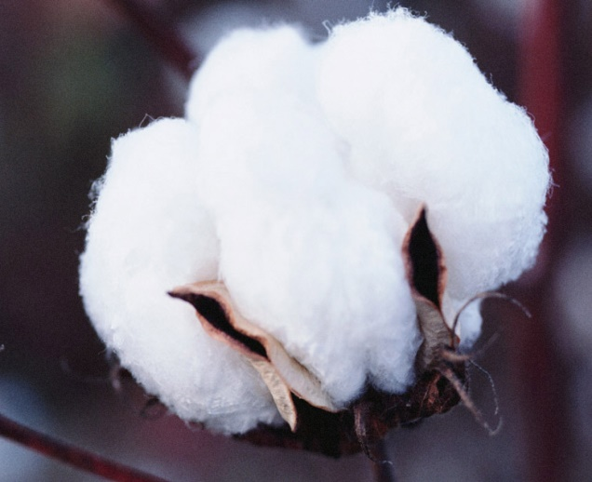
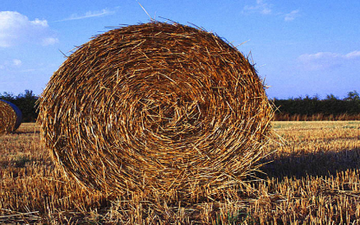
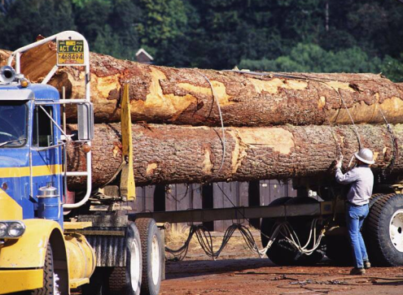
Cellulose
The main structural component of plant cell walls, provide the strength of plant cells
The wood contains about 50% cellulose, cotton is practically pure cellulose
Properties - insoluble in water, chemically inert, not degraded by enzymes of the digestive tract of animals

Slide 32
Heteropolysaccharides (acidic heteropolysaccharides - have many acid groups - gly (u) cosaminoglycans are glucose derivatives, contain amino groups)
characterized by the presence of repeating disaccharide residues (include uronic acid and amino sugar), which, duplicating, form oligo- and polysaccharide chains - glycans
proteoglycans (mucopolysaccharides)
(over 95% carbohydrates)
mucoproteins
(10-50% carbohydrates)
glycoproteins
(less than 10% carbohydrates)
complex proteins, the function of which is to fill the intercellular space and retain water here (tissue turgor and elasticity of cartilage, lubricant and structural component of joints, cartilage, skin).
In particular, hyaluronic acid is found in the vitreous humor of the eye, in the synovial fluid, in the intercellular space

Slide 33
Hyaluronic acid
Hyaluronic acid is found in many organs and tissues. In cartilage, it is associated with protein and participates in the formation of proteoglycan aggregates. Hyaluronic acid contains several thousand disaccharide units, its molecular weight reaches 105 - 107 D.
The repeating disaccharide unit in hyaluronic acid has the following structure:

Slide 34
HYALURONIC ACID
Protein content - no more than 1-2%
Properties - polyanion with a large negative charge; very hydrophilic molecule; forms very viscous gel-like solutions with water
Functions - regulation of permeability of the intercellular substance, dissolution and diffusion of salts

Slide 35
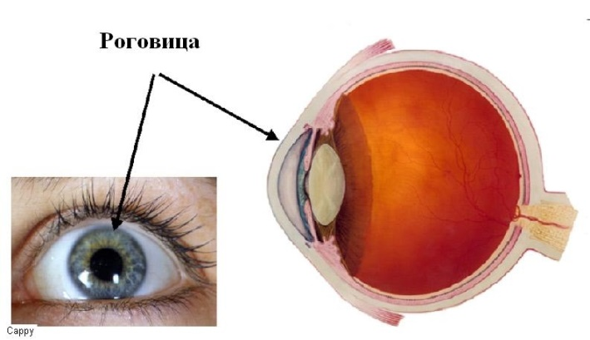
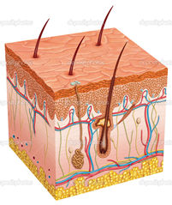
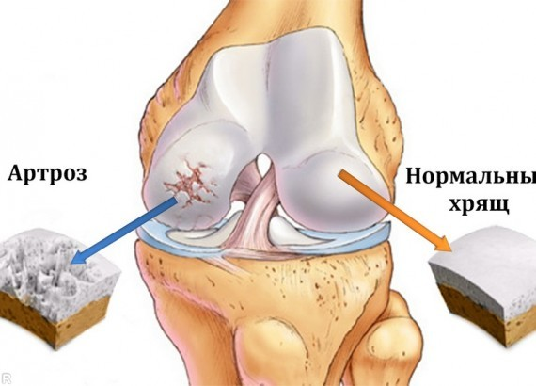
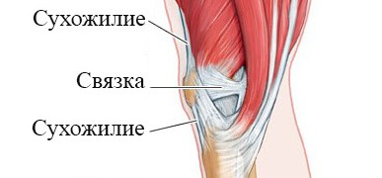
Chondroitin sulfates
Chondroitin sulfates are the most common glycosaminoglycans in the human body; they are found in cartilage, skin, tendons, ligaments, arteries, and the cornea of the eye. Chondroitin sulfates are an important component of aggrecan, the main proteoglycan of the cartilage matrix.
There are 2 types of chondroitin sulfates in the human body: chondroitin-4-sulfate and chondroitin-6-sulfate. They are built in the same way, the difference concerns only the position of the sulfate group in the N-acetylgalactosamine molecule

Slide 36
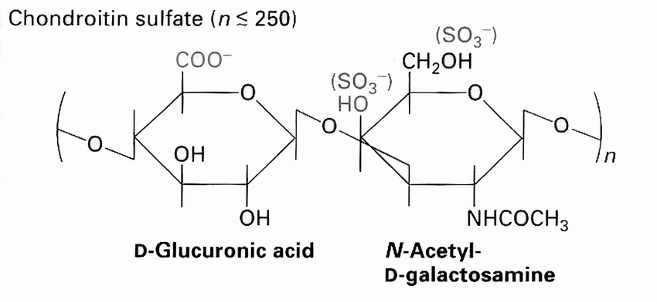
v

Slide 37
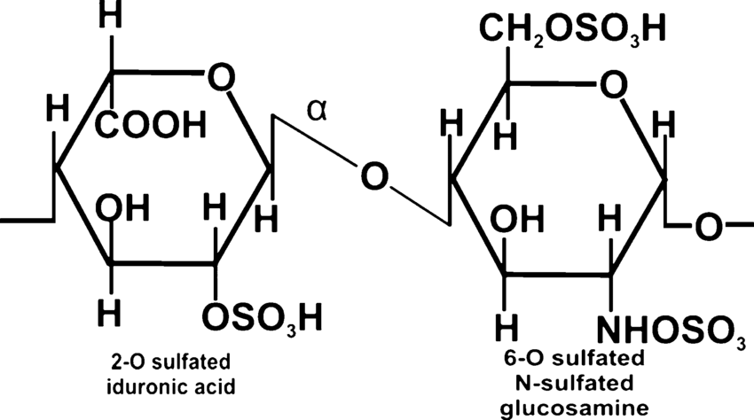
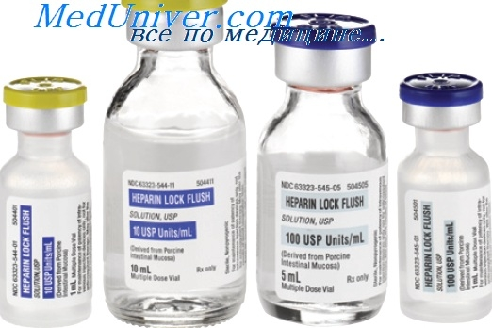
Heparin
Heparin is an important component of the blood anticoagulant system (it is used as an anticoagulant in the treatment of thrombosis). The disaccharide unit of heparin is similar to the disaccharide unit of heparan sulfate. The difference between these glycosaminoglycans is that there are more N-sulfate groups in heparin, and more N-acetyl groups in heparan sulfate. The molecular weight of heparin ranges from 6 × 10³ to 25 × 10³ D.

Slide 40
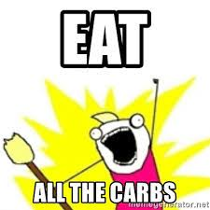
Digestion of carbohydrates in the digestive tract

Slide 42
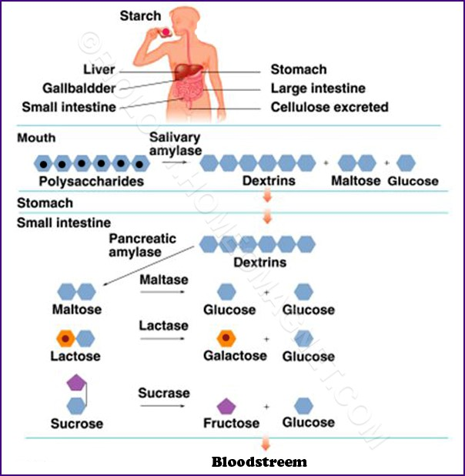

Slide 43
Oral cavity
α-amylase (salivary amylase, ptyalin) cleaves α-1,4-О-glycosidic bonds
рН6,8
hydrolysis product – amylodextrins
Stomach
рН 1,5-2,5
hydrolysis continues inside the food bolus
hydrolysis product - erythrodextrins

Slide 44
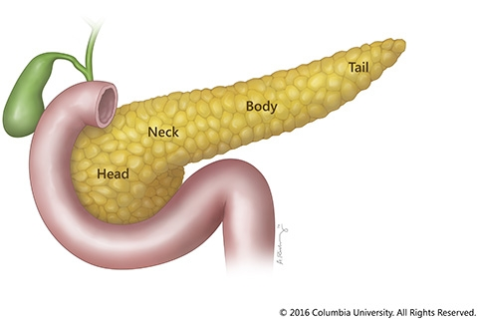
Duodenum
рН changes to 7,5-8,0
α-amylase (pancreatic amylase) cleaves α-1,4-О-glycosidic bonds in dextrins
hydrolysis product – achrodextrins

Slide 45
Amylases
glycosyl hydrolases (glycosidases) - catalyze the hydrolysis of glycosidic (α-1,4-) bonds in carbohydrate molecules
α-Amylase
(1,4-α-D-glucan glucanohydrolase)
β-Amylase
(1,4-α-D-glucan maltohydrolase)
γ-Amylase
(1,4-α-D-glycan glucohydrolase)
In the gastrointestinal tract of animals, present in bacteria, fungi and plants
present in bacteria, fungi and plants, but absent in animals
In animal lysosomes
able to hydrolyze the polysaccharide chain of carbohydrates anywhere
cleaves the second from the end α-1,4-glycosidic bond, forming the disaccharide maltose
cleaves the last α-1,4-glycosidic bond, leading to the formation of glucose
break down starch to poly- and oligosaccharides (dextrins)

Slide 46
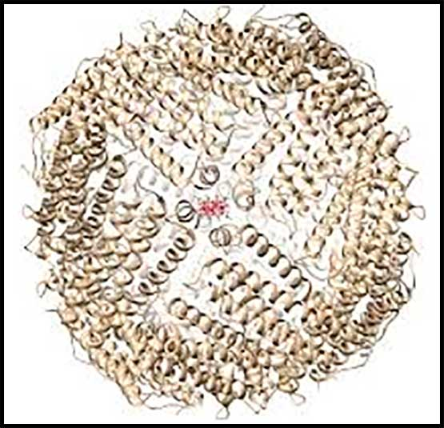
Dextrins are low molecular weight glucans that are formed as a result of partial cleavage of glycogen or starch under the action of enzymes (amylases, phosphorylases), acids or heating to 180-200 ° C
Dextrins do not have a constant chemical composition. It is variable, depending on the general form of the formula (С₆Н₁₀О₅)n and their molecular weight, which varies from 4500 to 85000
The use of dextrins in medicine and pharmacology
Surgical dressing adhesive and retainer; a source of carbohydrates for people on a special diet (free of free lactose and sucrose).
β-Cyclodextrins are capable of complexation with a variety of organic compounds, therefore they are used in the manufacture of drugs (filler in tablets and capsules, thickener in emulsions, binder during granulation, when pelleting tablets in a shell plays the role of a plasticizer and adhesive).
in cosmetics, weaving and printing.

Slide 47
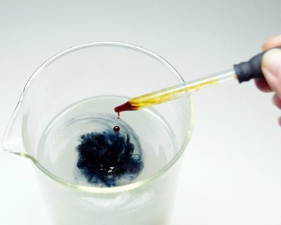
Dextrins
amylodextrins
Longest molecules (degree of polymerization n more than 47)
with iodine become blue-blue
erythrodextrins
Medium-length molecules (n = 21-29)
With iodine: n = 25-29 - red, with n = 21-24 - brown
maltodextrins (achrodextrins)
The shortest molecules
when n is less than or equal to 20, no colored complex is formed
n = 39-46 - blue-violet, at n = 30-38 - red-violet

Slide 48
Small intestine
The activity of cavity digestion is low
Enzymes actively act on the surface of intestinal epithelial cells
Amylo-1,6-glycosidase cleaves glycosidic bonds at branch points
Oligo-1,6-glycosidase - terminating enzyme
hydrolysis products - maltose, isomaltose, sucrose, lactose, triose saccharides

Slide 49
Digestion of disaccharides in the intestine (intestinal juice enzymes)

Slide 51
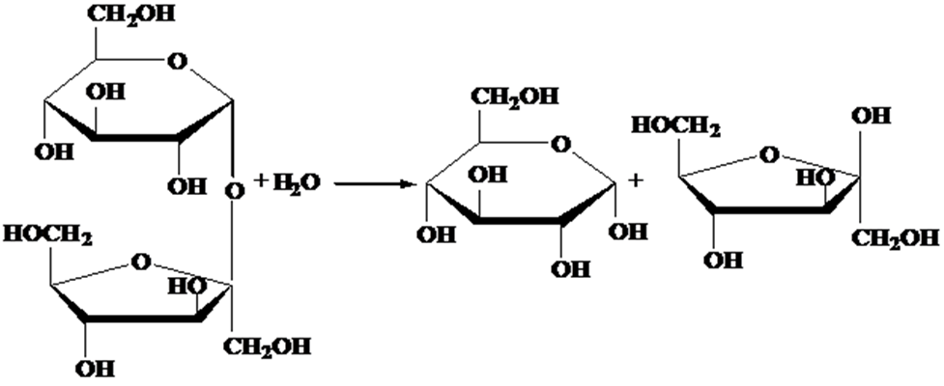
sucrase

Slide 52
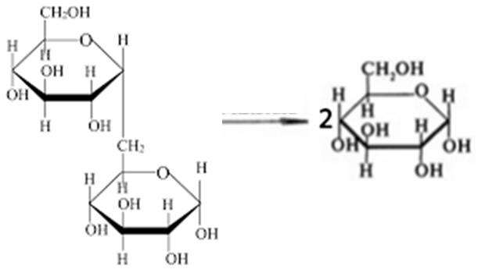
maltase
isomaltase

Slide 53
https://www.researchgate.net/figure/Glucose-intestinal-absorption-It-is-a-process-that-occurs-in-two-steps-the-first-is_fig1_221921697

Slide 54
https://courses.lumenlearning.com/suny-nutrition/chapter/4-4-carbohydrate-uptake-absorption-transport-liver-uptake/

Slide 55
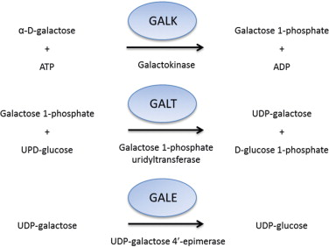
The Leloir pathway
a metabolic pathway for the catabolism of D-galactose

Slide 56
Galactose first undergoes phosphorylation at the 1st carbon atom. A distinctive feature is the conversion into glucose not directly, but through the synthesis of UDP-galactose from galactose-1-phosphate. The source of UMP is UDP-glucose, which is previously present in the cell. The formed UDP-galactose is subsequently isomerized to UDP-glucose and then its fate is different. She can:
participate in the reaction of the transfer of UMP to galactose-1-phosphate,
turn into free glucose and go out into the blood,
go to the synthesis of glycogen.

Slide 58
https://www.researchgate.net/figure/The-Leloir-pathway-and-the-second-alternative-pathway-for-D-galactose-catabo_fig1_6543793

Slide 59
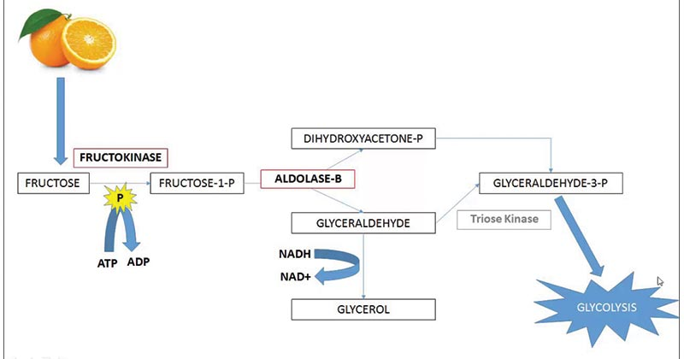
Fructolysis
https://microbenotes.com/fructose-metabolism/

Slide 60
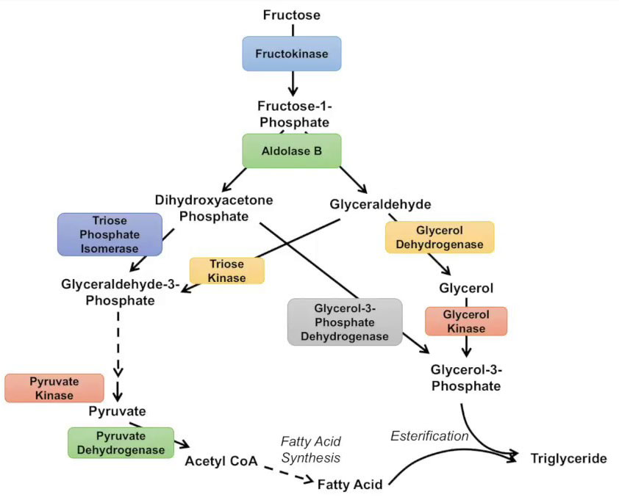
Fructolysis
https://microbenotes.com/fructose-metabolism/

Slide 61
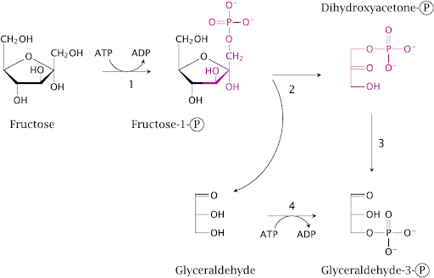
Fructolysis
Aldolase
Fructokinase
Aldolase
Triose phosphate isomerase

Slide 62
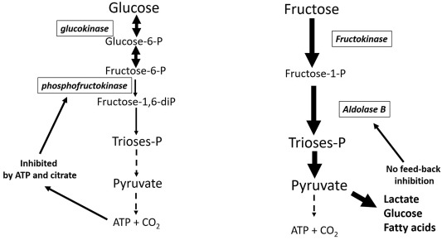
Fructolysis
The transition of fructose to glucose is carried out in two directions. First, fructose is activated by phosphorylation of either the 6th carbon atom with the participation of hexokinase, or the 1st atom with the participation of fructokinase. But hexokinase has a much lower affinity for fructose and this pathway is not expressed. Fructose-6-phosphate is further isomerized and glucose-6-phosphatase cleaves off unnecessary phosphate.
If fructose-1-phosphate is formed, under the action of the corresponding aldolase it is converted into glyceraldehyde and dioxyacetone phosphate, which in further reactions are either used in glycolysis, or in gluconeogenesis reactions are converted into fructose-6-phosphate and then into glucose.

Slide 63
https://www.mdpi.com/2072-6643/9/4/335/htm

Slide 64
Unification of monosaccharides
transformation of galactose, fructose and mannose into glucose or its metabolites.
Localization: liver
Collector value (collective): various MSs are converted into glucose - the main structural unit from which all the most important polysaccharides (fiber, starch, glycogen) and oligosaccharides (sucrose, lactose and maltose) are built, only glucose penetrates the BBB and provides energy to all tissues, including neurons

Slide 66
The role of the liver in carbohydrate metabolism
Unification of monosaccharides - the conversion of galactose and fructose into glucose or metabolites of its metabolism
Glycogenic function - with an excess of glucose in the blood, glycogen is synthesized in the liver, with a decrease in blood glucose, the liver glycogen is broken down to glucose and, thus, its concentration in the blood is restored to normal levels
Gluconeogenesis - the synthesis of carbohydrates from non-carbohydrate metabolites
Synthesis of blood glycoproteins
Formation of glucuronic acid - participates in the detoxification of exogenous and endogenous toxins (bilirubin), in the inactivation of hormones

Slide 67
Absorptive period (period of digestion, resorption, absorption, postprandial period, fed period - after eating) - the state of the body after eating (10-15 hours from the day).
In this case, the following occurs sequentially:
1) Increased blood glucose concentration (alimentary hyperglycemia)
2) Secretion of insulin by the pancreas
3) Utilization of glucose by tissues:
a) Glycogen synthesis (glycogenesis)
b) Glycolysis
c) Pentose-phosphate pathway
4) Decrease in glucose concentration to normal

Slide 69
Post-absorption period (post-resorption period, preprandial, fasted period, starvation - before meals, on an empty stomach) - the state of the body between meals (the rest of the day, goes into fasting).
In this case, the following occurs sequentially:
1) Decrease in blood glucose concentration (hypoglycemia)
2) Secretion of glucagon by the pancreas
3) Formation of glucose in the liver:
a) Breakdown of glycogen (glycogenolysis)
b) Synthesis of glucose de novo (gluconeogenesis) from amino acids and glycerol.
4) Maintaining normal glucose concentration

Slide 71
Glycogen metabolism

Slide 72
Glycogen metabolism

Slide 73
Glucose activation:
CH₂ - OH
CH₂ - O - P
H
H
H
H
hexokinase
O
H
O
H
ОН
H
ОH
H
OH
HO
OH
HO
АТP
АDP
H
OH
H
OH
Glucose
Glucose - 6 - Phosphate

Slide 77
Glycogen synthesis (glycogenogenesis)
Glycogen synthetase leads the synthesis of the amylose-type chain.
The branched structure is formed by transferring the polyglucoside chain of α-1,4-glucan from position 4 to position 6. This mechanism is carried out by an enzyme called α-1,4-glucan-branching enzyme. Transglycosylation catalyzed by this enzyme can be schematically represented as follows:

Slide 78
Hydrolysis of glycogen
in lysosomes (endogenous glycogen)

Slide 79
Hydrolysis of glycogen
in lysosomes (endogenous glycogen)

Slide 80
Glycogen phosphorylation

Slide 86
Glycogen breakdown + anaerobic glycolysis of cleaved glucose = glycogenolysis
anaerobic oxidation of glycogen to form lactic acid.
Oxidation of each glucose molecule cleaved from glycogen leads to the formation of 3 ATP molecules.
Key enzymes of glycogenolysis:
phosphorylase, phosphofructokinase and pyruvate kinase.
Glycogenolysis is enhanced by catecholamines, glucagon, cAMP, Ca2 +.

Slide 87
Regulation of glycogen metabolism
 | Key enzymes of glycogen metabolism | Activate | Inhibit
SYNTHESIS | Hexokinase (start of the chain) | Insulin (induces, i.e. increases synthesis) | Glucocorticosteroids (repress, i.e. reduce synthesis)
 | Glycogen synthase (limiting) | Insulin (induces) | Catecholamines, glucagon, cAMP, Ca2 +
decomposition | Glycogen phosphorylase (start of the chain) | Catecholamines, glucagon, cAMP | Insulin
 | Glucose-6-phosphatase (limiting) | Glucocorticosteroids (GCS) (induce) | Insulin (repress)

Slide 93
https://i.pinimg.com/236x/96/9d/73/969d734dc40acdce39dbf8f48e3e7169.jpg

Slide 97
Digestion pathologies of carbohydrates

Slide 98
https://slidetodoc.com/digestion-and-absorption-carbohydrates-dr-jariya-wajahat-biochemistry/

Slide 102
https://shsthetorch.com/wp-content/uploads/2018/12/Lactose-intolerance-coastal-urgent-care-louisiana-1-900x529.jpg

Slide 104
Treatment

Slide 106
https://memegenerator.net/img/instances/54230912.jpg
https://santacruzcore.com/wp-content/uploads/all-about-glycogen-meme_santacruzcore-683x1024.png

Slide 108
https://in.pinterest.com/pin/182677328619528190/

Slide 114
Impaired absorption of carbohydrates and other monomers

Slide 118
Conclusion
Digestion of food carbohydrates occurs partly in the oral cavity (salivary α-amylase), but mainly in the duodenum (pancreatic α-amylase, intestinal oligosaccharidase)
The end products of digestion are the monosaccharides glucose, fructose and galactose, the latter are unified in the liver to glucose
The accumulation of glycogen "in reserve" (its synthesis) in muscles and liver and its breakdown play an important role in the energy supply of cells and tissues
Disorders of exogenous carbohydrate digestion mainly include disaccharidoses, malabsorption disorders - celiac disease, disorders of MS unification - monosaccharidoses, disorders of endogenous carbohydrate metabolism - glycogen diseases, lysosomal storage diseases

Slide 119
Литература по теме лекции:

Slide 121
Question for the lecture :
Write the key enzymes of glycogenesis

