Slide 1
Medical rehabilitation for diseases of the nervous system Lecture for 3rd year students studying in the specialty 31.05.03 - Dentistry (training using an intermediary language (English))
Krasnoyarsk State Medical University named after prof. V.F. Voyno-Yasenetsky
Department of Physical and Rehabilitation Medicine with a practise course
Head of the Department, MD. Mozheyko E.Yu.
Krasnoyarsk 2023

Slide 2
LECTURE PLAN
The relevance of the Acute Cerebrovascular Accident (ACA) problem
Relevance of neurological rehabilitation
Fundamentals of neurorehabilitation: basic principles and strategies
Means of medical rehabilitation in neurology:
4.1) Neurorehabilitation in the ICU
4.2) Neurorehabilitation in case of violations of trunk position control
4.3) Postural control in neurorehabilitation
4.4) Neurorehabilitation with spasticity
4.5) Neurorehabilitation in case of sensitivity disorders
5. Clinical recommendations for medical rehabilitation in neurology
2

Slide 3
The purpose of the lecture
To introduce students to the main aspects of medical rehabilitation in neurology

Slide 4
ACA
this is an acute pathological condition of the brain, which develops in connection with a sudden violation of the blood supply to nerve cells and their death with the appearance of cerebral and /or focal neurological symptoms, which persists for more than a day or causes the death of the patient in a shorter time.

Slide 5
Transient ischemic attacks (TIA) are short (< 24 hours) episodes of completely reversible neurological deficits.

Slide 6
A "minor" stroke is an acute pathological condition as a result of ischemic or hemorrhagic type of cerebral circulation disorder, the main feature of which is a complete regression of neurological symptoms within 21 days.

Slide 7
Relevance of the topic:
Diseases of the cardiovascular system account for up to 70% of all registered pathology (more than 35% are cerebrovascular diseases);
The incidence of stroke is more than 3.0 per 1000 population per year;
400-450 thousand strokes are registered annually in Russia
Post-stroke disability ranks 1st among all causes of disability (3.2 per 10 thousand population);
Only 20% of stroke survivors (80-90 thousand people) return to work

Slide 8
Every year, several thousand new patients in need of neurorehabilitation appear in the Krasnoyarsk Territory

Slide 9
Violations that are strong points for rehabilitation
Neurological deficit (paresis, sensory deficit, ataxia);
Postural disorders;
Endurance (Functional Class);
Speech disorders (aphasia, dysarthria);
Swallowing disorders;
Contractures;
Cognitive deficits (dementia);
Depression and anxiety;
Epilepsy;
Psychotic disorders and confusion;
High risk of stroke and other vascular events;
Loss of self-service;
Loss of skills.

Slide 10
Indications for medical rehabilitation:
high risk of long-term disability;
high risk of reducing social and household activity;
formed disability.

Slide 11
Among the causes of disability of patients, diseases and injuries of the nervous system take one of the first places in terms of frequency and severity of consequences, therefore, such a section of medical rehabilitation as neurorehabilitation or rehabilitation of neurological patients began to be singled out.

Slide 12
Stages of rehabilitation
Stroke Center (stroke department from the ICU stage);
Neurorehabilitation Center;
Spa treatment;
Outpatient neurorehabilitation

Slide 13
Who should perform neurorehabilitation?
A multidisciplinary rehabilitation team, or team, includes doctors directly involved in rehabilitation treatment, consulting physicians (cardiologist, orthopedist, etc.), who are provided to the team on request, and nursing staff.

Slide 15
Rehabilitation strategies for patients with ACA:
Therapeutic strategy (reperfusion therapy,
secondary prevention, treatment of complications),
Rehabilitation strategy (patient recovery strategy),
Palliative strategy (support strategy for a severe patient).

Slide 16
Fundamental differences
treatment
Determine the level and dimensions of
damage
Minimize the extent and prevalence of
pathological process
Create conditions for
recovery
rehabilitation
Determine what has been preserved
Determine the possibility of using the remaining resources and their multiplication
Restoration and stabilization of the role function of the individual (system)

Slide 17
Stroke rehabilitation strategy based on the rehabilitation potential of the patient

Slide 18
The rehabilitation strategy should be considered in the format of separate groups of violations and restrictions:
Mobility difficulties (turns in bed, sitting down,
sitting, getting up, walking, bending, getting up from a low support,
using the hand, manipulating objects and precise palm movements, transferring objects),
Problems in the field of communication (speech perception,
speech understanding, the use of alternative and additional communication),
Difficulties in self-care (putting on clothes, washing the body and its parts, going to the toilet, eating),
Problems in everyday life (cooking, house cleaning, shopping, etc.),
Difficulties in performing work duties,
etc.

Slide 19
Rehabilitation strategy for motor disorders
Restoration of independent walking and hand use,
Movement (walking) using AT (walkers, roller skates, canes),
Patient movement with the use of a wheelchair
(independently controls the wheelchair, the patient is transported in a wheelchair, an electric wheelchair),
The patient cannot maintain a sitting position, the patient
independently or with the help takes a sitting and lying position (the use of multifunctional beds and anti-bedsore mattresses).

Slide 20
Speech and communication recovery strategy
Full
speech and
communications recovery
Partial
restoration of communication and partial
speech recovery
Using additional communication without full
recovery of
speech
Using alternative communication without speech recovery

Slide 21
Rehabilitation strategy for difficulties in implementing household skills:
Restoration of fully everyday skills in the previous volumes,
The use of additional funds to help with household skills, or the help of other people in the implementation of activities,
Complete replacement of household skills – all tasks are solved by caregivers.

Slide 22
Rehabilitation strategy for difficulties in the implementation of household self-service:
Restoration of fully self-service in the same volume,
The use of additional funds to help in self-service, or the help of other people in the implementation of activities,
Complete replacement of self–service skills - all tasks are solved by caregivers
(diapers, catheters).

Slide 23
Indications for neurorehabilitation in the acute period
Inclusion criteria for the neurology profile:
Acute period of ACA by type of ischemia or hemorrhagic type (intracerebral hemorrhage),
age over 18 years.
Non-inclusion criteria:
conducting or planning an operative intervention
Transient ischemic attack (TIA)
isolated form of subarachnoid hemorrhage;
score 0-1 on mRS before stroke;

Slide 24
Criteria for withdrawal from the further rehabilitation process in the first, second and third stages of the MO
high degree of self-service (mRS score 0-1 points);
lack of rehabilitation potential (palliative care, care).

Slide 25
Criteria for transfer from the intensive care unit to the early rehabilitation department (availability of all criteria is mandatory)
stabilization of the patient's vital signs:
the level of consciousness is not lower than stun;
spontaneous breathing, lack of indications for ventilation:
does not need inotropic support;
stability of the vegetative response to active verticalization to a sitting position or passive verticalization on a turntable up to 60 degrees;

Slide 26
Criteria for transfer from the first stage to the second of the second level (all criteria are required):
all studies have been performed in Order for ACA
the main vital functions have been stabilized
Rivermead Mobility Index 2-8 points
stable vertical position, including with the use of technical means
the degree of self-service is 3-4 points according to mRS.
the presence of positive dynamics for mRS in the presence of rehabilitation potential

Slide 27
Criteria for transfer from stage 2 to the third stage (home for independent studies):
availability of rehabilitation potential
mRS score 3-4 points
Rivermead mobility Index 5-8 points

Slide 28
Criteria for transfer to the third stage (day hospital, rehabilitation departments of sanatoriums, polyclinic rehabilitation)
availability of rehabilitation potential
degree of self-service 1-3 points on mRS
Rivermead Mobility Index 9-15 points
the need for comprehensive rehabilitation measures
the conditions for carrying out rehabilitation measures are determined by social indications (working age, socially significant categories of the population, etc.)

Slide 29
Criteria for transfer to the third stage (remotely controlled rehabilitation)
the level of consciousness of the patient that allows you to understand and follow instructions;
availability of rehabilitation potential;
the need for active continued rehabilitation in order to realize the rehabilitation potential;
the degree of self-service 1-4 points with an assessment by mRS;
availability of the technical possibility of conducting tele-rehabilitation (availability of a computer, telephone, Internet, ability to use technology).

Slide 30
Distribution of functional responsibilities for filling in the scales:
Rehabilitologist
Modified Rankin Scale
Stroke Scale of the US National Institutes of Health (NIHSS)
Rivermead Mobility Index
Modified Ashfort scale (only for patients with impaired muscle tone)
VAS (only for patients with pain) (evaluates the patient)
Resuscitator
Glasgow Coma Scale
Stroke Scale of the US National Institutes of Health (NIHSS)
Speech therapist
Dysphagia test
The scale of speech impairment
Psychologist
Montreal Mental Status Assessment Scale (MoCA),
Spielberg scale Beck scale (not allowed for patients who are in intensive care or for bedridden)
Hospital scale of anxiety and depression (for all patients) (assessed by the patient)
An ergotherapist (or a psychologist with extended competence of an ergotherapist)
Canadian Performance Assessment (COPM) (assessed by the patient together with a specialist)
Occupational therapist's scale for assessing the environment (assessed by the patient)
FIM (Functional Independence Scale)
Quality of Life Assessment (EQ-5D) (assessed by the patient)
Rivermid activity scale (assessed by the patient together with a specialist)
Physical therapy instructor
Hauser Index
Berg Balance Scale
Medical Research Council Paralysis Scale (MRC-scale)
Frenchay test (only for patients with impaired hand function)
National Institutes of Health Stroke Scale
National Institutes of Health Stroke Scale (NIHSS, Brott et al, 1989)

Slide 31
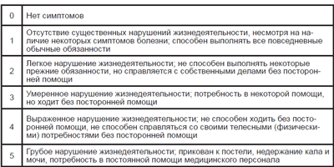
Rankin Scale

Slide 32
Stroke Scale of the National Institutes of Health National Institutes of Health Stroke Scale (NIHSS, Brott et al, 1989)
Class | Function | Degree of violations | Mark
1A | The level of consciousness | no changes stun stupor coma | 0 1 2 3
1B | Answers to questions | correctly answers 2 questions correctly answers 1 question does not answer | 0 1 2
1C | Reaction to commands | correctly executes 2 commands correctly executes 1 command does not execute commands | 0 1 2
2 | Paresis of the view | view normal partial view paresis full view paresis | 0 1 2
3 | Fields of view | Partial hemianopsia full hemianopsia bilateral hemianopsia are preserved | 0 1 2 3
4 | Paresis of facial muscles | none light partial full | 0 1 2 3

Slide 33
Stroke Scale of the National Institutes of Health National Institutes of Health Stroke Scale (NIHSS, Brott et al, 1989)
Class | Function | Degree of violations | Mark
5 | Motor functions of the upper limb: A. Left B. Right | no paresis descends slowly, in 5 sec falls quickly, in less than 5 sec cannot overcome the gravitation no movements in the hand | 0 1 2 3 4
6 | Motor functions of the lower limb: A. Left B. Right | no paresis descends slowly, in 5 sec falls quickly, in less than 5 sec cannot overcome the gravitation no movements in the hand | 0 1 2 3 4
7 | Sensitivity | not impaired hypesthesia anesthesia | 0 1 2
8 | Ataxia | none in the arm or leg in the arm and leg | 0 1 2
9 | Speech | Normal mild aphasia severe aphasia total aphasia | 0 1 2 3
10 | Dysarthria | none moderate pronounced | 0 1 2
11 | Inattention | No light heavy | 0 1 2

Slide 34
Investigation of the possibility of passive movements using the Ashworth spasticity assessment scale (Bohannon, R. and Smith, M., 1987)
Scores | Muscle tone
0 | No increase
1 | A slight increase in tone, felt when bending or extending the limb segment in the form of slight resistance at the end of the movement
2 | A more significant increase in tone in the form of resistance that occurs after performing at least half of the volume of movement
3 | Moderate increase in tone, which is detected throughout the movement, but does not complicate the performance of passive movements
4 | A significant increase in tone, making it difficult to perform passive movements
5 | The affected limb segment is fixed in the flexion or extension position

Slide 35
Rivermead Rivermead Activities of Daily Living (ADL) Scales (by: S.Whiting, N.Lincoln, 1980; Wade D., 1992)
Point | Mark 3 – independent (can use auxiliary devices) 2 – supervision is required (verbal assistance) 1 – dependent on outside help (i.e. independent execution of the action is impossible, or unsafe, or requires unreasonable time) | Auxiliary devices (used, recommended)

Slide 36
Rivermead Rivermead Activities of Daily Living (ADL) Scales (by: S.Whiting, N.Lincoln, 1980; Wade D., 1992)
Self-service
Drinking (a full cup of hot liquid, it is allowed to spill no more than 1/8 of the contents of the cup)
Brushing your teeth (squeezing out toothpaste, applying it to a brush, turning on the water tap)
Combing (achieving a well-groomed appearance)
Face/hand washing (opening the faucet, using soap, wiping)
Shaving / make-up (shaving is carried out in the way the patient is used to)
Eating (the ability to use a knife, fork, etc.)
Undressing (removing dresses, pajamas, socks and shoes)
Moving around the apartment (moving from one room to another with a distance of at least , turns)
Moving from the bed to a chair (from a lying position, being covered with a blanket, move to a chair that is nearby)
Visit to the toilet (walk to the toilet, manage clothes, perform the necessary hygiene procedures, put clothes in order)
Moving outside the apartment (overcoming distance, including inclined surfaces, moving through doorways)
Dressing up (do not mean festive outfits; clothes should be nearby,
stacked, but not in a certain order; the ability to fasten buttons, tie shoelaces)
Washing in the bath (the ability to wash the whole body; use a faucet, a plug in the bath)
Getting into and out of the tub (the tub is not filled with water)
Washing the whole body not in the bath, but using a basin of water
Moving from the floor to a chair (from a lying position to sit on a regular chair without armrests with seat height )

Slide 37
Rivermead Rivermead Activities of Daily Living (ADL) Scales (by: S.Whiting, N.Lincoln, 1980; Wade D., 1992)
Household I
Preparation of a hot drink (filling an electric kettle with water, making tea)
Preparation of a light snack
Ability to make monetary calculations (counting the money needed to pay, for example, for a loaf of bread, a package of butter and a box of sugar; receiving change)
Getting into a passenger car and getting out of the car (front seat of a car of any brand,
except for the sports model)
Cooking (peel one potato, fry a piece of sausage, defrost frozen
vegetables, open a can of canned food)
Delivery of purchases from the store home (bring butter, a jar with a weight, change)
The ability to cross the road (crossing the street to the traffic light signal, stepping over the curb of the sidewalk)
Visit to the store (walk to the store and back, overcoming the distance )
Use of public transport (bus ride for a distance of at least and at least three bus stops)
Household II
Washing (hand washing of underwear in the basin)
Ironing of linen (with an iron without steam, with the preparation of a place for ironing on a table or an ironing board surface)
Easy cleaning (wiping surfaces at a height of 30-)
Hanging out the washed laundry (on a crossbar or rope located within the apartment, do not use hooks)
Preparing the bed (making the bed with a height of about sheets and a blanket, straightening the folds)
More thorough cleaning (cleaning of a room with an area of 3 sq.m using a vacuum cleaner, sweeping with a brush and a dustpan., with the movement of chairs only)

Slide 38
Evaluation of the effectiveness of rehabilitation measures
(evaluated at the end of each stage, after 3 months):
lethality
the number of complications: pneumonia, thrombosis, contractures, urinary tract infections, bedsores,
other undesirable phenomena
repeated hospitalizations.
percentage of independent patients (percentage of patients who have reached the level of disability according to mRS 0-2 points by the end of rehabilitation)
duration of stages (at each stage and at all three stages) – achievement of routing criteria
actual costs of one case

Slide 39
Means of medical rehabilitation

Slide 40
Medical rehabilitation combines 3 directions of human impact
medicinal direction - uses the effect of one or more medicinal substances in a certain complementary set.
non-drug direction - combines various types of physical impact: reflexology, physical therapy is successfully used in almost all types of pathology. It has not only a general training, but also a special therapeutic effect, stimulating adaptation to physical exertion. A special place is occupied by spa treatment. At the resorts, all types of non-drug treatment are changing with the use of natural resort therapeutic factors of climate, balneo and mud treatment.
instrumental direction:
endoscopic sanitation with intratracheal fillings of medicines
conducting radiation therapy through an endoscope
plasma and lymphoresis
ultrasonic phonophoresis and others

Slide 41
Why does rehabilitation require the participation of all members of a multidisciplinary rehabilitation team?

Slide 42
Walking disorders in central hemiparesis syndrome are caused by the following main reasons
Disorders of vegetative functions, vascular tone, orthostatic hypotension.
Violations of the control of the vertical position of the trunk due to weakness of the extensor muscles of the back, buttocks, etc.
Displacement of the center of gravity of the body towards the healthy leg.
Syndrome of cortical astasia-abasia, subcortical-frontal dysbasia.
Spasticity.
The "hanging" foot.
Sensitivity disorders.
Cognitive and emotional-volitional disorders.

Slide 43
Causes of speech disorders in stroke patients without aphasia and dysarthria (an example of speech disorders not as a function, but as an activity)
Stress ("speechless" upon admission to the hospital)
Depression (no desire to say anything),
Anxiety and fear (fear of saying wrong),
Frontal disorders, apato-abulic syndrome,
Cognitive deficit (does not understand how to speak),
Lack of motivation (and why talk to you at all),
Pathological false attitudes (you can't talk, you have a stroke),
Overprotection on the part of relatives (why should I say if relatives will do everything for me anyway),
Problems with teeth and dentures,
Pain in the face or mouth (can't speak because of the pain),
Severe general condition (shortness of breath, impaired consciousness).
The effect of drugs (sedation or drugs with "behavioral toxicity")

Slide 44
The difficulty in establishing a rehabilitation diagnosis is that the patient can simultaneously act
there are several factors that will determine the existing problems. The task of the MDB is, if possible, to see a more complete picture by collecting information not only from a neurologist, but also from a psychologist, occupational therapist, speech therapist, nurse and
dentist.
It is the rehabilitologist at the MDB meeting who, by collecting and evaluating information from all specialists, must decide on the role of one or another factor in restoring the functions of the patient

Slide 45
Neurorehabilitation in the ICU

Slide 46
When working in the intensive care unit, we must pay great attention to the decisions made
regarding resuscitation medical activity
(respiratory support, probes, catheters, neurovegetative blockade, sedation, etc.) – many problems can be avoided by earlier
activation of the patient and prevention of secondary and
tertiary problems.

Slide 47
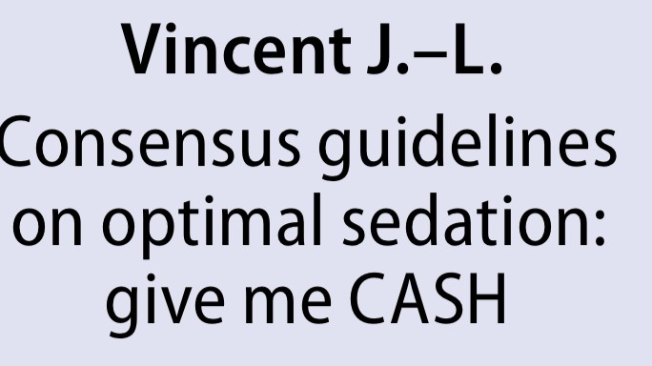
Mobilization in the ICU
Mobility
a method of activating the patient in conditions of forced immobilization and bed rest, including active or passive movements in all joints and verticalization performed by specially trained personnel.
Early mobilization is the activation of the physical activity of the ICU patient in the period from 2 to 5 days from his admission
There is no strategy for improving the results of intensive care more effective than early mobilization

Slide 48
General recommendations for the mobilization of ICU patients.
Mobility
Position | Level of evidence
Minimal but independent muscle activity prevents the development of muscle atrophy and reduces the risk of venous thrombosis in the lower extremities. | IIb-B
Mobilization optimizes respiration, central and peripheral perfusion, muscle metabolism, which reduces the time of weaning from the respirator | B
Active or passive mobilization, as well as muscle training should be started as early as the clinical condition allows, and gradually expand from "cycling" and sitting on the edge of the bed to moving around the ward with a walker, taking into account contraindications | I-C
Clinic of the Brain Institute©

Slide 49
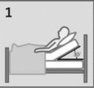
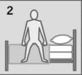
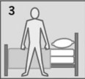
Mobilization technologies in the REHABILITATION structure at the 1st stage
Mobility
Activity | Timing
Pre - mobilisation positioning in bed with the task of lifting the head end above 45 gr | constantly
Verticalization | 45 minutes
Passive kinesotherapy | 5-7 repetitions x 6 times = 20 minutes
Active kinesotherapy | 8-12 repetitions x3 series = 20 minutes
Sitting on the edge of the bed | 10 -30 minutes
Transfer to a chair | 1-4 hours
Standing | 1-5 minutes
Bicycle kinesis | 20 minutes
Electroneuromyostimulation | 10 minutes
Breathing exercises with REER | 10 minutes
 | 10 minutes
Clinic of the Brain Institute

Slide 50
Contraindications to the mobilization of ICU patients
Mobility
ABSOLUTE
RELATIVE
High risk of pathological bone fracture (for example, a history of severe osteoporosis)
The need for a high level of oxygen supply
Femoral Arterial Shunt
ECMO with femoral catheter
The absence of a trained resuscitator, a physical therapy doctor in the multidisciplinary team, as well as the possibility of adequate hardware monitoring at the stages of rehabilitation.
Unstable clinical status of the patient – deviation from the range of acceptable values of neurological and (or) somatic status for a period of less than 6 hours before the start of mobilization
Acute myocardial infarction
Subarachnoid hemorrhage with detected (!) non-clipped aneurysm
Shock
Pulmonary embolism, increasing thrombosis according to ultrasound or the presence of a floating thrombus (in the absence of a cava filter)
Segment of unstabilized fracture or destruction (does not interfere with kinesiotherapy of intact segments)
The need for neuromuscular blockade in uncontrolled CHG, respiratory failure..
Active bleeding
External pacing
Open abdominal cavity
Patient refusal

Slide 51
Technique of passive verticalization
https: KrasSMU – For students – Video lectures and skills – "Technique of passive verticalization"
(https://krasgmu.ru/index.php?page%5Bcommon%5D=elib&cat=catalog&res_id=77422)

Slide 52
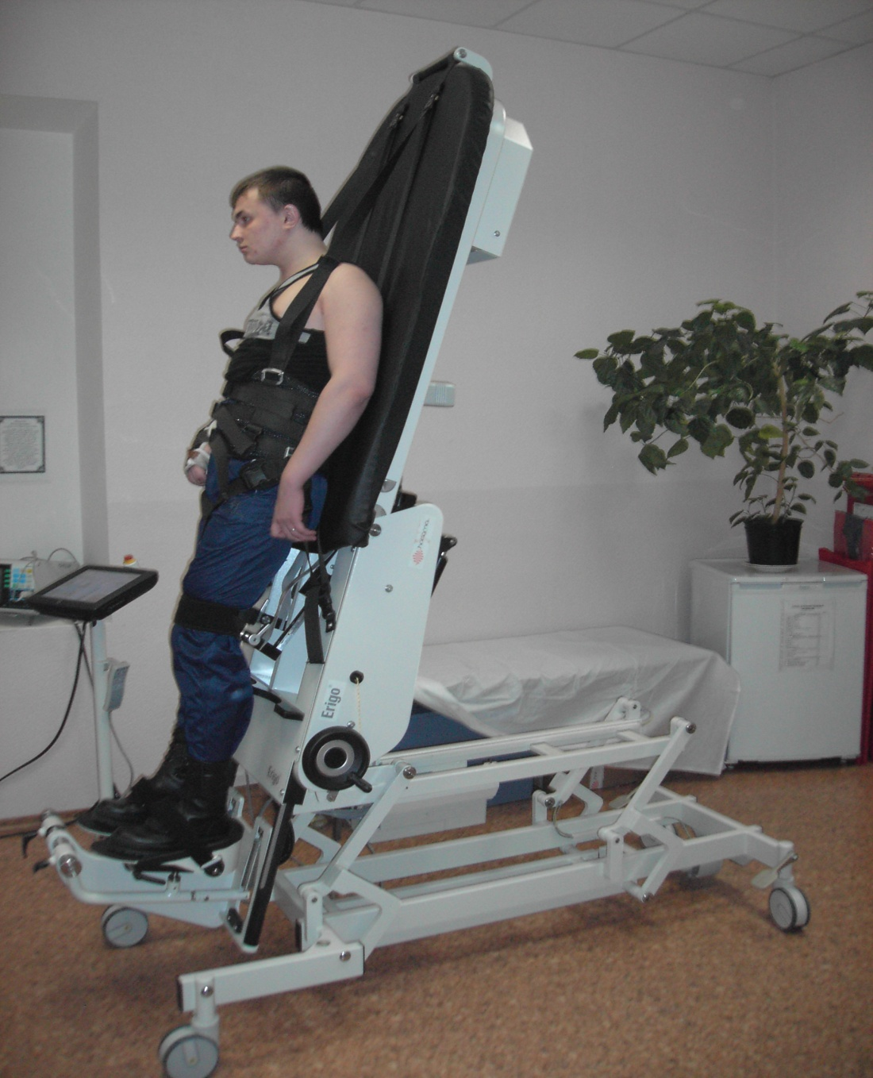
Methods and means of verticalization
The patient is transferred to an upright position on an orthostand or Gracchus table (an alternative is verticizers using the principles of robotics - "Erigo", etc.).
Classes last 1-2 weeks

Slide 53
Positioning is a therapeutic and preventive effect in which the patient is helped to take (attach) optimal postures that contribute to the prevention of complications of the period of hypomobility and stimulation of sanogenetic activation mechanisms. Positioning is a component of the recommended rehabilitation strategy.
Positioning goals:
control of activation of reflex reactions (cervical tonic reflexes, myotatic reflex
optimization of muscle tone;
sensory stimulation;
prevention of contractures;
support and stabilization of body segments, prevention of joint damage;
reduction of aspiration risk;
prevention of the development of pressure sores;
improving the perception of space;

Slide 54
Method of analytical gymnastics
Objective: to restore voluntary movements in individual joints of the limb by overcoming and actively regulating a complex of pathological conditions that occur in the affected limb after a stroke and lead to a violation of a particular function.

Slide 55
Learning to walk begins with the transfer of the patient to an upright position.
According to a number of authors, verticalization of patients, in the absence of contraindications, is advisable to carry out in the acute stage of stroke
Classes should be conducted in stages, while fixing devices and additional means of support are used.

Slide 56
Overcoming violations of trunk position control includes:
Training in the correct posture that promotes normal activity of the extensor muscles of the back.
Exercises aimed at expanding the possibilities of trunk control.

Slide 57
For example, the correct sitting posture includes:
- sitting position with a uniform distribution of pressure on the sciatic tubercles;
- neutral or slight anterior tilt of the pelvis;
- lack of pelvic rotation;
- the spine is straightened when viewed from behind;
- the physiological curves of the spine are preserved when viewed from the side;
- the shoulders are in the same plane with the pelvis, symmetrical;
- hips and knees at right angles;
- the feet under the knees, in full contact with the floor, take on the weight of the body.

Slide 58
Getting up.
When learning to get up from a sitting position, the following points are important:
- chair height: according to Bobath, the patient's training to get up from a sitting position should begin with the use of a high chair, since this requires a significantly lower level of movement in the joints, hips and knees, making getting up from a high chair not as stressful as lifting from a low seat.

Slide 59
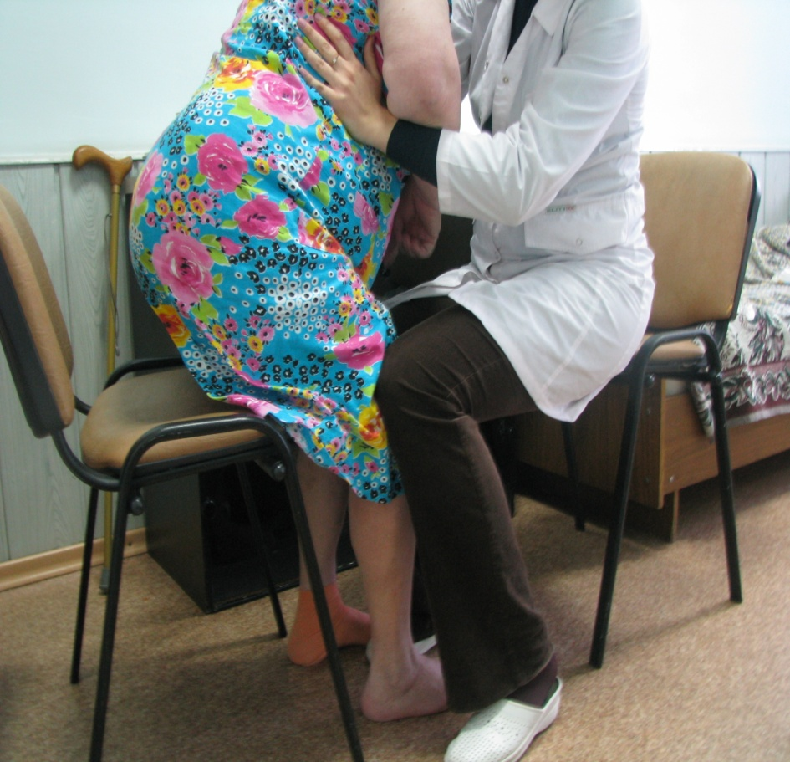
Algorithm:
- put your feet under the seat, in contact with the floor surface;
- tilt the torso forward and slightly bend the arms at the elbow joints;
- distribution of body weight on the affected limb. In this case, the kinesiotherapist can stabilize the paretic leg by sitting opposite the patient and fixing the patient's knee between his two knee joints or by applying pressure with his hand on the lower thigh of the paralyzed leg when the patient stands up;
- straighten the torso, the kinesiotherapist controls the position of the pelvis;

Slide 60
A patient with somewhat greater motor capabilities may need some direction from the kinesiotherapist in moving the body weight to the paralyzed leg, if he has a tendency to use the unaffected leg more than the paralyzed one when getting up. The kinesiotherapist acts with his hand on the lower thigh, directing the knee straight and then uses a little pressure on the knee joint when the patient stands up

Slide 61
2. Activity in the standing position
At the beginning of training, standing occupies all the patient's attention, so at first classes are conducted in conditions of minimal external distracting influence.
The patient is instructed to transfer the body weight to the paretic leg and back.
Trainings are held for 20 minutes 1-3 times a day, gradually the session time is increased (every 3 days), at the end of the stage it is 1 hour.
The tasks of neurorehabilitation at this stage are gravity training, adjustment of the equilibrium point of the body in the anterior-posterior and lateral directions, stability training, passive load on the supporting joints and joint closure.

Slide 62
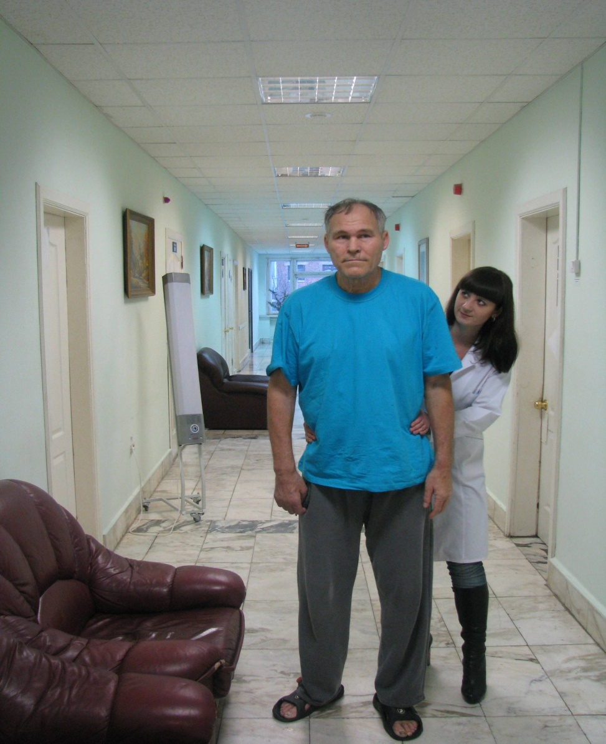
As the standing skills expand, more complex tasks can be used:
standing, moving weight from one leg to the other (with the support of a kinesiotherapist - fixes the pelvis from both sides from behind) while the patient should look around the room
The kinesiotherapist causes the movement of the body weight while the patient is standing, while the patient is asked to look around the surrounding objects in the room.
Standing with looking around the room is an independent exercise that can improve the ability to stand in the initial stage of skill recovery.

Slide 63
At the next stages, diverse foot movements are practiced.
Classes should begin no earlier than 6-8 weeks after a stroke. By this time, the muscles should already be strong enough under the influence of exercise therapy.
Classes are held on gymnastic bars for 1-1.5 hours 2 times a day for 1 month.
Perform exercises aimed at increasing the activity of extensors that provide a force field of walking, stimulation of flexors that create a voltage drop at the boundaries of the reference and portable step periods, standing on one leg.
Next, the legs are pulled up alternately with simultaneous contraction of the gluteal muscles, alternate movement of the legs with side steps forward, backward and to the side and walking on the spot.
Considering that in the future, when walking, the patient will have to use improvised means, include exercises to strengthen the muscles of the shoulder girdle: simultaneous transfer of two legs forward and backward with emphasis on the hands.

Slide 64
Postural control in rehabilitation

Slide 65
Walking disorders in stroke patients may be associated with impaired postural control
Maintaining balance in a vertical position is carried out when the person's center of gravity is projected onto the area of his support.
This state is provided due to the constant vibrations of the body due to mobility in the ankle (ankle balance strategy) and hip (hip strategy) joints.

Slide 66
Postural control
• Postural control - automatic posture control.
• The ability to maintain a sitting and standing posture provides most of the physiological and mental processes in the human body.
• For example: -breathing, communication, cognitive processes, eating and drinking, digestion and excretion require sitting and standing postures. In the supine position, these processes are unsafe, ineffective or less effective, have a risk of developing complications (pneumonia, constipation, kidney failure, cognitive deficits, depression, etc.)
• Ability to maintain standing posture provides walking.

Slide 67
Motor functions
Are divided into two types:
• maintaining body position (posture).
• actual movement.
Under normal conditions, these two types complement and continue each other and it is impossible to separate them. However, when analyzing motor activity, it is useful to distinguish between postural functions
that help maintain the body in a certain position and, in particular, maintain a vertical position in a gravitational field, and purposeful movements.

Slide 68
Ankle strategy
The ankle strategy is used to control small, short steps.
To assess the state of the ankle strategy, the patient is placed on a stable surface, feet at a small distance from each other, socks apart. The kinesiotherapist observes fluctuations in the ankle joints. If the patient is able to perform this exercise, the difficulty of the task is increased by reducing the area of ​​support. The doctor asks to bring the feet closer, which reduces the stability of the posture and increases the requirements for controlling the center of gravity. The clinician may note an increase in the use of the ankle strategy.
Normally, the individual is able to balance in this position using the ankle strategy or with minimal use of the hip strategy.

Slide 69
Hip Strategy
It is most effective with a small area of ​​support (for example, standing on stilts), in cases where the support surface is pliable, or the ankle strategy is ineffective.
The doctor may ask the patient to stand on a short platform so that only the middle part of the sole rests on the surface. At the same time, the ankle strategy is ineffective due to the short area of ​​​​support, the kinesiotherapist can observe the forward and backward movements characteristic of the anterior-posterior hip strategy. An attempt to maintain balance using an ankle strategy or a walking strategy is indicative of dysfunction of the hip strategy.
Another way to assess hip strategy is to use a soft support, such as a medium-density foam mat.

Slide 70
Step Strategy
The use of the stepping strategy can be assessed in the stance with the feet shifted or in the tandem stance on a soft platform. Failure to use the stepping strategy indicates a violation of postural control.

Slide 71
The program of rehabilitation measures for violations of postural control:
use of biofeedback methods based on computer stabilometry and posturography

Slide 72
Neurorehabilitation based on the principle of biofeedback
The goal is to shift the patient's center of gravity towards the paretic limb (approximation of the real center of gravity to the "ideal" one);
The number of sessions with each patient is 8-10;
The duration of 1 lesson is from 20 to 30 minutes.

Slide 73
BOS training based on stabilometric parameters
In the first lessons, most of the load falls on the “healthy limb”
then proceed to a gradual increase in the load of the opposite side
It is not advisable to immediately fully include the paretic limb into work.
This can lead to decompensation of the patient.

Slide 74
BOS training based on sensory organization parameters
The Smart Equitest Balance Manager complex is used to correct balance in patients with more severe body imbalances.
During the training, the patient is fastened with seat belts, which eliminates the risk of falling

Slide 75
BOS training based on sensory organization parameters

Slide 76
Graphic image of the COP
Before course After course
of rehabilitation of rehabilitation

Slide 77
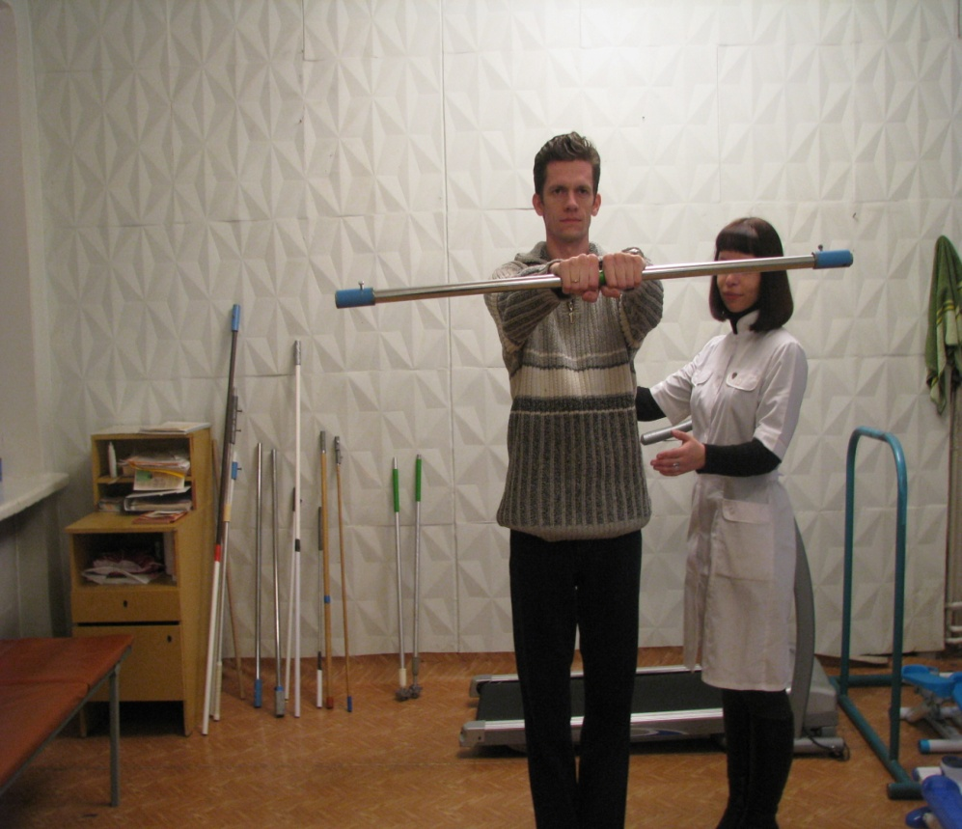
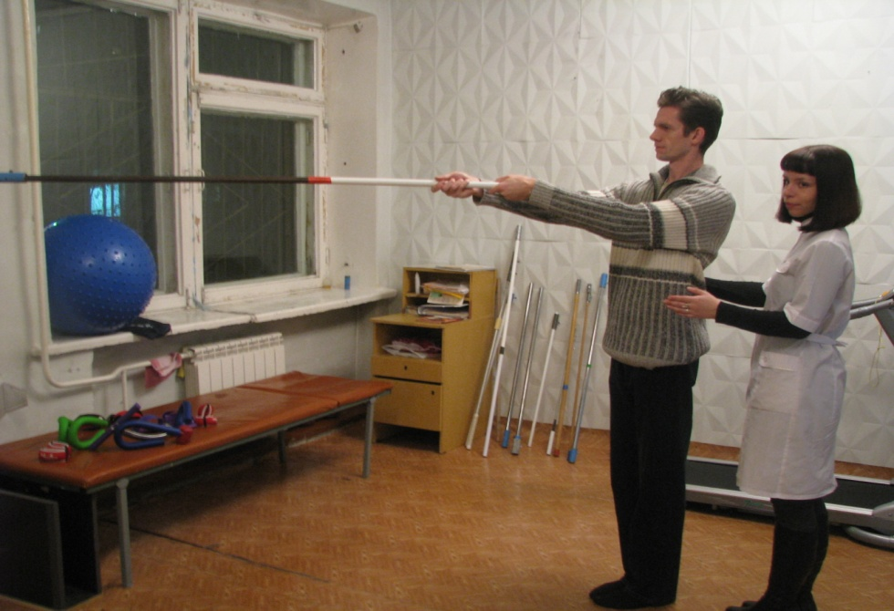
gymnastics that provokes a shift in the center of gravity

Slide 78
walking using corrective stabilizing and destabilizing platforms.

Slide 79
spasticity

Slide 80
Spasticity is a motor dysfunction characterized by a rate-dependent increase in tonic reflexes by
stretching and affecting certain muscle groups that occurs
as a result of abnormal intra-spinal processing of the primary afferent signal
(Jung, 1994)

Slide 81
Pathological patterns in spasticity of the hand
• Adduction and internal rotation of the shoulder
• Flexion at the elbow joint,
• Pronated forearm,
• Bent palm
• curled fingers,
• Deformity of the hand "thumb in the palm".
Focal brain damage in adults spasticity syndrome, 2016

Slide 82
Pathological patterns in leg spasticity
• Flexion at the hip
• hip adduction,
• "Frozen" knee,
• Flexion at the knee joint
• Equinovar deformity of the foot, flexion of the toes,
• Hyperextension of the big toe.
Focal brain damage in adults spasticity syndrome, 2016

Slide 83
Typical Factors Influencing the Appearance of Spasticity

Slide 84
Pathological (pseudo-compensatory) patterns are "simple" decisions in the patient, which "intuitively" come to his mind, but which
exacerbate the pathology and disable the patient.
Pathological patterns should be avoided

Slide 85
Pathological patterns associated with spasticity - 1:
• Wernicke-Mann Pose,
• Raising the leg with paresis of the foot,
• Swinging when getting up and when moving,
• Increasing the number of steps
• Slouching after a stroke
• Blockade of hip flexion
• Side step when walking up the stairs,
• Not turning on protective reflexes when falling,
• Not using your hand to balance
• Looks down at his feet.
24

Slide 86
Pathological patterns associated with spasticity - 2:
• Leaving the arm to the side (especially when using a cane),
• Head tilt to the side
• Not using the thumb
• Not using the wrist for grips
• "Squishing Wrist",
• Not turning on the scapula in motion,
• Not using your hand to balance.

Slide 87
Common mistakes in the treatment of spasticity:
!!! DO NOT
• Using balls in the spastic hand,
• The use of posture treatment,
• Stretching spastic muscles through pain,
• Spastic muscle massage

Slide 88
Treatment of spasticity
Intrathecal injection of baclofen using a pump, .
Physiotherapy and therapeutic exercises are most effective in the early phase (thermal and cold procedures, phonophoresis, transcutaneous electrical nerve stimulation, etc.).
Use of botulinum toxin preparations. The effect of the drug administration lasts an average of 2-6 months. It should be noted that the use of botulinum toxin preparations is largely limited due to their high cost.
In practice, muscle relaxants are most widely used - baclofen, tizanidine, diazepam, dantrolene, tolperisone.

Slide 89
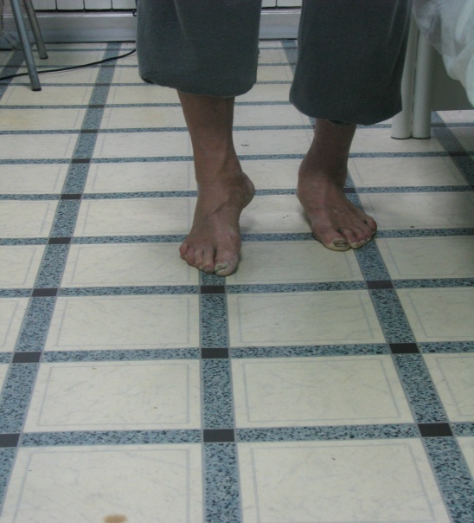
Techniques to correct foot malposition include:
Botulinum toxin injections
Training in lifting the foot using the "triple shortening" reflex. In a patient with no dorsiflexion of the foot, a protective reflex is induced by mechanical stimulation of the sole. In this case, flexion of the leg at the knee and hip joints and dorsiflexion of the foot occur.

Slide 90
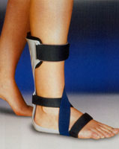
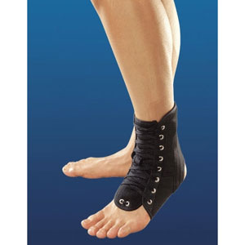
The use of orthoses.
Orthopedic devices are classified into 4 categories:
Stabilizing, prevents unwanted movements such as plantar flexion at the ankle joint or hyperextension at the knee
Functional, they have a component in the mechanism of action that compensates for muscle strength and assists in the execution of a particular movement
Corrective - used in pediatric practice to correct skeletal deformities
Protective - protect the limb from the effects of a damaging factor (for example, abnormal redistribution of body weight)

Slide 91
Sensory disturbance

Slide 92
Decreased sensation after a stroke may complement motor deficits.
Decreased proprioception can significantly impair motor recovery after a stroke.
Stroke in the basin of the middle cerebral artery can disrupt the cortical level of the proprioceptive sensitivity pathway.
Along with vision and the vestibular system, proprioception is required to be able to maintain a stable, correct posture.
In addition, impaired perception of the surface or changes in the quality of the ground underfoot increases the risk of falls in patients.

Slide 93
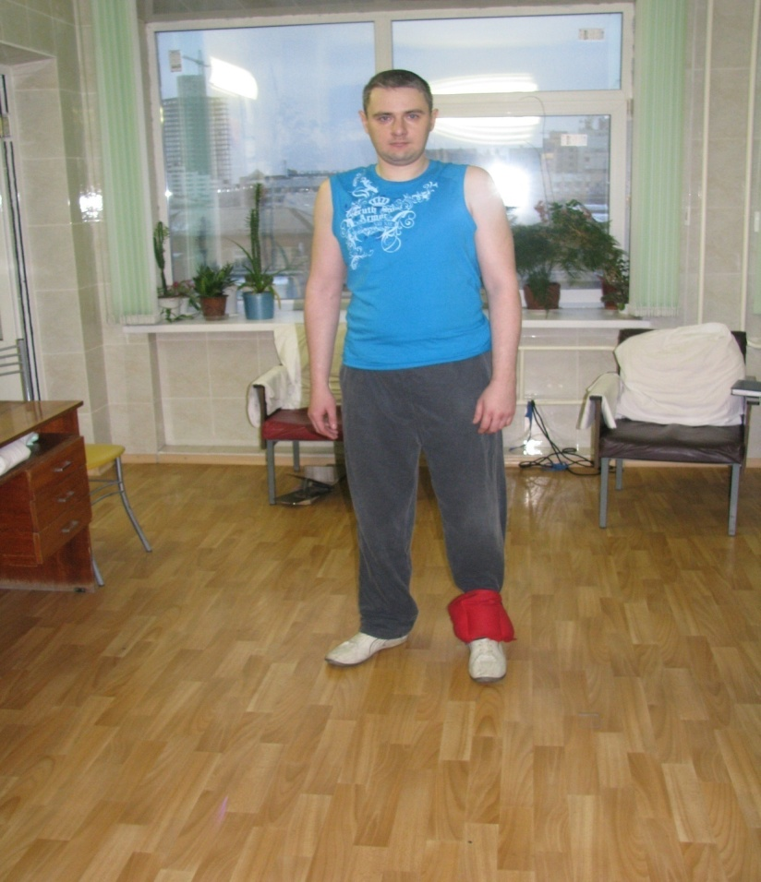
Restoration of proprioception is achieved by using a complex of methods, including:
Vibromassage of extremities.
Weighted walking with impaired sensory input (Figure).
The use of biofeedback methods, including using mirrors that use vision control to compensate for a sensitive defect; biofeedback through acoustic perception is possible.
One type of biofeedback device is based on the sound signal when the foot is in contact with the support.
Behavioral correction techniques are possible based on biofeedback, which visualizes the strength of muscle contraction during movement.
A correction technique is applied using biofeedback based on computer stabilometry.

Slide 94
Selective vibration stimulation
multi-point stimulating vibration impact on the support zones of the feet in the normal walking mode in the absence or limitation of motor function (modeling the sensory image of walking)

Slide 95
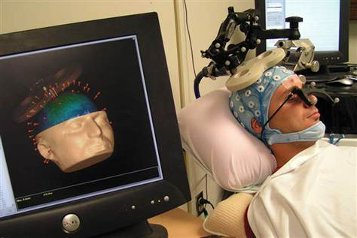
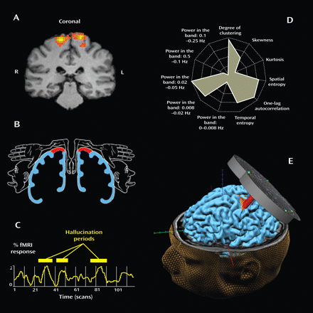
Transcranial magnetic brain stimulation
It is assumed that TMS causes synaptic potentiation or synaptic depression as a result of repeated stimulation. And this has been shown to make learning easier for people.

Slide 96
CI therapy
A rehabilitation approach involving the forced use of a paralyzed arm by a patient. At the same time, a healthy hand is limited in movement using gloves or bandages
The review included 19 studies, 619 patients
The study included patients who had remnants of motor activity in the arm after a stroke, the potential for recovery and without pronounced pain or spasticity, but inclined not to use the affected limb
Conclusion of the authors
The use of forced shutdown from motor activity of a healthy limb in combination with exercises on the affected limb leads to a moderate decrease in the degree of disability at the end of the therapeutic course. However, an assessment of the degree of disability 6 months after the end of the course of treatment did not show an advantage in maintaining the effect.
[Sirtori V, Corbetta D, Moja L, Gatti R. Constraint-induced movement therapy for upper extremities in stroke patients. Cochrane Database of Systematic Reviews 2009, Issue 4]

Slide 97
Electromechanical and robotic devices in restoring the functional and daily activity of the hand and hand.
Mechanotherapy and robotics involves the use of special mechanisms in the rehabilitation of hand function.
The review pooled 11 studies that included 328 participants.
It has been found that training using mechanical and robotic therapy improves the motor functions of the arm, increases muscle strength in the paretic limb, but does not affect daily activity.
There is also insufficient data on when and how best to apply these methods
[J, Platz T, Kugler J, Pohl M., Cochrane Database of Systematic Reviews 2008]

Slide 98
Electromyographic feedback
EMG biofeedback uses electrodes placed on the patient's muscles that generate a feedback signal (visual or auditory) in response to muscle activity.
Among 13 selected studies, including 269 patients, in a small number of separate studies, data were obtained on the advantage of EMG-BOS in comparison with conventional physiotherapy methods in improving motor strength, functional recovery and walking quality. However, routine use cannot be recommended as no effect was noted among the other studies included in the review.
[Woodford HJ, Price CIM. EMG biofeedback for the recovery of motor function after stroke. Cochrane Database of Systematic Reviews 2007, Issue 2]

Slide 99
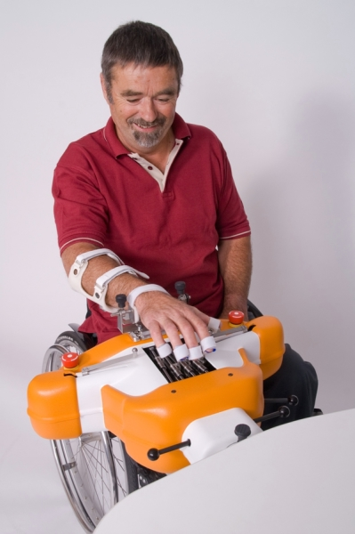
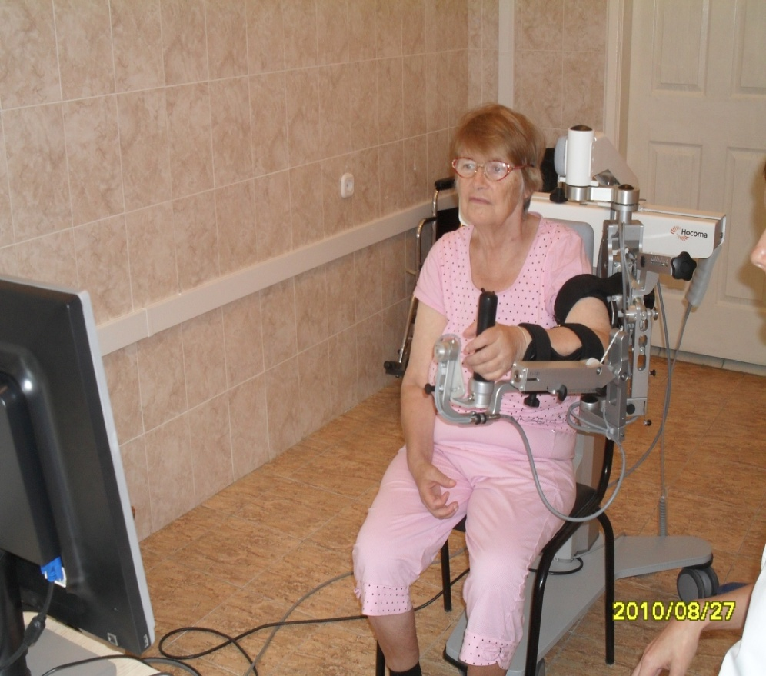
Robotic devices for upper limb rehabilitation:
Armeo, HOCOMA
Amadeo System

Slide 100
Mental practice
-rehabilitation method, which is the process of mentally conducting a movement or performing a task with a paralyzed limb without actual movement in it
The review included 6 studies, 119 participants, who used MP in addition to standard therapy versus traditional treatment without MP.
The data obtained allowed us to judge the improvement in the performance of some specific skills (for example, drinking from a cup, manipulating a door handle)
There are no answers to the questions yet:
How many classes do I need to assign?
When is it possible to perform from the moment of a stroke?
How long should one session last? etc.
[Barclay-Goddard RE, Stevenson TJ, Poluha W, Thalman L. Mental practice for treating upper extremity deficits in individuals with hemiparesis after stroke. Cochrane Database of Systematic Reviews 2011, Issue 5]

Slide 101
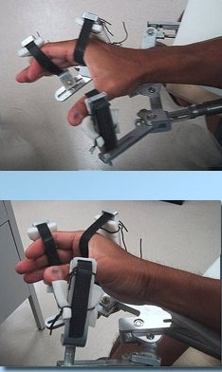
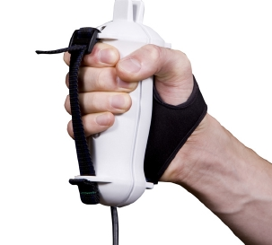
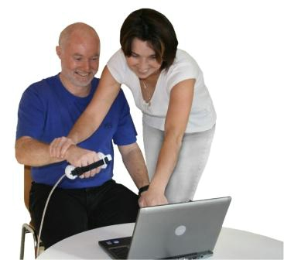
H.W.A.R.D. System
Pablo System

Slide 102
RESTORATION OF MOTOR SKILLS USING COMPUTER GAMES
Using Virtual Reality with Nintendo WII Technology in Stroke Rehabilitation
A Pilot Randomized Clinical Trial and Proof of Principle
G. Saposnik, R. Teasell, M. Mamdani, J. Hall, et al. Stroke. 2010
VR Wii gaming technologies have shown safety, potential effectiveness as alternative possibilities for rehabilitation therapy and acceleration of motor recovery after a stroke.

Slide 103
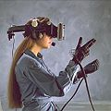
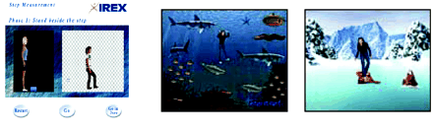
Using Virtual Reality
Virtual reality, VR, artificial reality, electronic reality, computer model of reality - a world created by technical means, transmitted to a person through his senses: sight, hearing, smell, and others.
Virtual reality simulates both exposure and reactions to exposure. To create a convincing complex of sensations of reality, computer synthesis of the properties and reactions of virtual reality is performed in real time.
Training using virtual reality has shown effectiveness in restoring the function of both the upper and lower extremities in the subacute and chronic stages of a stroke (Jang S. H., 2005).
Studies focusing on walking recovery using virtual reality (Deutsch J. E., 2007) have shown improvements in speed performance, walking distance, stair-walking ability, muscle activity, coordination, and walking symmetry after exercise. These results of improving walking speed and distance persisted for up to 3 months.

Slide 104
Question:
List the observed parameters of the body during passive verticalization.

Slide 105
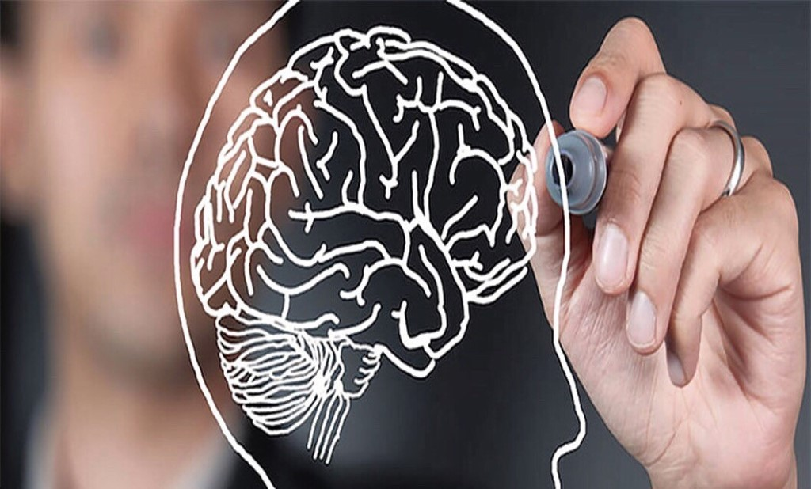
Thank you for your attention!

