Slide 1
Federal State Budgetary Educational Institutionof Higher Education"Krasnoyarsk State Medical Universitynamed after Professor V.F. Voino-Yasenetsky"of the Ministry of Health of the Russian FederationFaculty of DentistryDepartment of Orthopedic Dentistry
Lecture topic: Selective grinding of hard dental tissues.
Medical and diagnostic devices.
Associate Professor of the Department of Orthopedic Dentistry O.Y. Kostenko

Slide 2
The purpose of the lecture: To define selective tooth grinding. To study situations when it is necessary to apply grinding of hard tissues of teeth. To determine indications and contraindications for selective grinding of teeth. To analyze the methods of selective grinding of teeth.

Slide 3
Lecture plan: 1. Components of the chewing system and their functional interaction 2.The definition of selective polishing, the purpose, the situation when it is advisable to apply this method of treatment. 3. IP techniques 4. Medical and diagnostic devices

Slide 4
The dental system, like other biosystems, functions due to the close interaction of all its components. The movements of the mandible occur as a result of the complex interaction of muscles, joints, teeth and periodontium, coordinated and controlled by the central nervous system.

Slide 5
According to the concepts of the general laws of physiologicalregulation processes, all body systems work according to uniform laws, the most important of which is self-regulation. The process of self-regulation is triggered whenever there are any deviations or violations of the integral system of activity.

Slide 6
At the same time, the deviation of the regulated process from the proper parameters acts as a factor initiating an immediate restructuring of the activity of the central and peripheral components of the system, which in turn provides compensation for the deviation that has arisen. With that said, it becomes obvious that success inproviding assistance in cases of certain pathological conditions largely depends on the doctor's ability to recognize in local, particularmanifestations of functional insufficiency of the process (visible signsof the disease) compensatory reactions of the system as a whole.

Slide 7
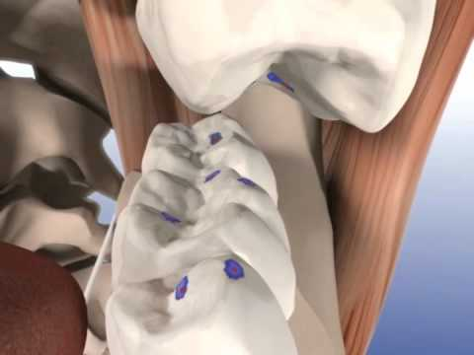
Selective grinding of teeth — a method of treating periodontal diseases, especially often used in periodontitis as an effective procedure as part of an integrated approach. It implies the correction of articulation, as well as occlusion, the restoration of uniformity in the distribution of load on teeth, both natural and artificial. It is used at any stage of pathology development — initial or active.

Slide 8
The method of selective grinding of teeth It involves the correction of functional occlusion by grinding the identified supercontacts on natural and artificial teeth. Grinding can be started only after analyzing the dental system and occlusion, establishing a diagnosis, drawing up a plan for occlusive correction, in difficult cases, diagnostic grinding of teeth is performed on jaw models installed in the articulator. The basic principle is to preserve or create a stable occlusion, i.e. the presence of fissure-tubercular contacts of the lateral teeth with minimal removal of hard tissues If stable occlusion cannot be achieved in this way, then other methods of occlusal correction are chosen

Slide 9
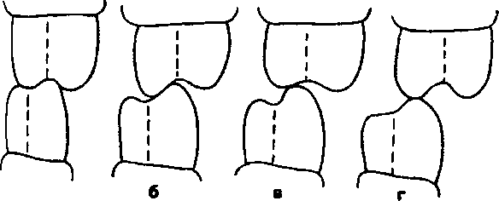
Perfect tooth contact (a) Minor occlusal correction is required to achieve perfect contact (6) Significant occlusal correction is required to stabilize occlusal contacts (c) Occlusal stability cannot be achieved by selective tooth grinding (d)

Slide 10
To carry out treatment, the patient must be prepared: informed about the purpose of grinding teeth, that in the absence of an effect, other methods of occlusal correction will be necessary. For agitated patients, premedication is indicated an hour before treatment.

Slide 11
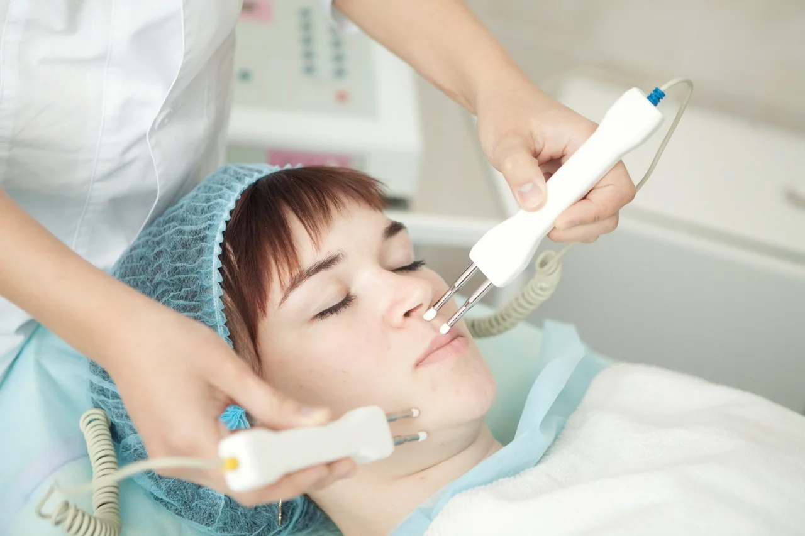
In case of pain and restriction of jaw movement, it is indicated to carry out:
-physical therapy;
-use of relaxation tires.

Slide 12
Electrotherapy – a procedure that demonstrates high effectiveness in the treatment of edema of the tongue, as well as in the presence of wounds and ulcers in the oral cavity. This type of physiotherapy procedure occurs with the use of various types of currents. A lead or rubberized electrode with a special gasket soaked in water is used. In some cases, special solutions, medicines and vitamins are used instead of water. This procedure is called electrophoresis.

Slide 13
Electromagnetic fields they are used in two types of physiotherapy: These are microwave and UHF procedures. Small capacitor plates are used for UHF procedures. They are placed on the skin and a weak current is applied until the patient feels a slight warmth and tingling. The procedure is not used in the presence of purulent and inflammatory processes in the body. Microwave procedures are aimed at warming tissues and improving blood circulation, as well as stimulating immunity.

Slide 14
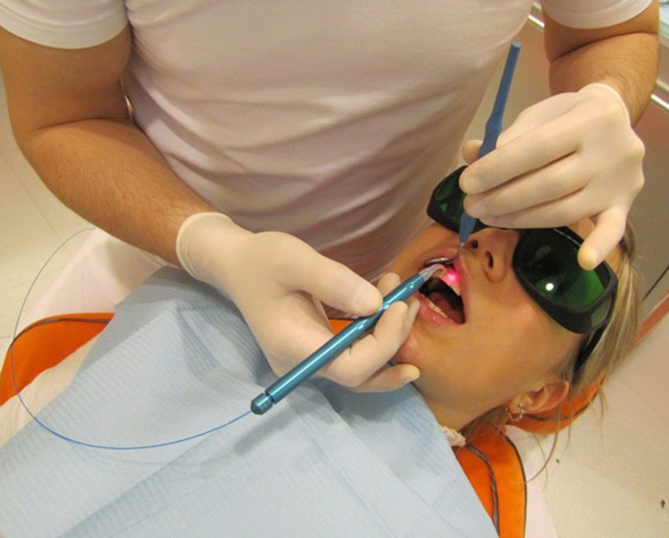
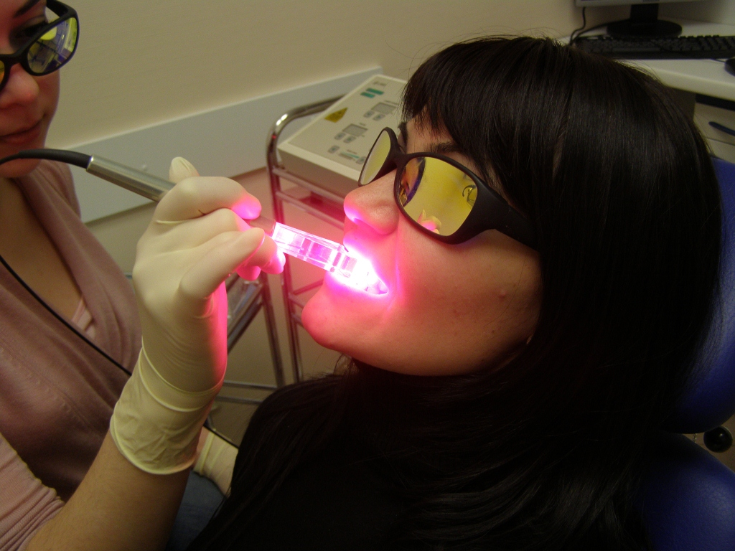
Phototherapy is a procedure that is divided into three types:
Laser therapy is a type of phototherapy in which the oral mucosa is exposed to infrared radiation. Indications for the procedure: lymphadenitis, ulcerative gingivitis and ulcers on the mucous membrane of the mouth.
IF therapy is used as an effective remedy for the treatment of inflammation, frostbite, burns, to alleviate the condition after an injury.
UV radiation is a procedure used in the presence of ulcers, purulent and erysipelas due to its highly effective antibacterial effect.

Slide 15
The goals of selective tooth grinding can be formulated as follows.
Elimination of a traumatic periodontal situation by distributing the functional load on as many teeth as possible.
Removal of injury to hard tissues of teeth and pulp.
Load distribution along the axis of the teeth.
Removal of pathological activity of the chewing muscles.
Elimination of balancing and hyperbalancing super contacts.
Creating a stable, stable central occlusion.
Elimination of occlusion disorders before orthopedic treatment.
Restoration of functional occlusion after orthodontic treatment.
Prevention and treatment of periodontal pathology, masticatory muscles and TMJ during lactic, removable and permanent bite.
When grinding teeth of complete removable dentures, the creation of multiple bilateral contacts with all types of occlusion (to stabilize the prostheses), while maintaining the tubercle overlap of the lateral teeth (to prevent biting of the cheek mucosa).

Slide 16
Selective tooth grinding is a complex procedure that requires a strictly individual approach to each patient. In some cases, it is impossible to achieve an ideal ratio due to the peculiarities of the structure of the jaw and individual teeth. In this case, the procedure is carried out in order to get as close as possible to the desired result.

Slide 17
Occlusion therapy is indicated in the presence of the following conditions:
– pain as a result of exposure to traumatic occlusion;
– the tendency to increase the mobility of teeth;
– formation of intraosseous defects and intraosseous pocketsas a result of occlusive injury;
– cases where correction of occlusive relationships canlead to normalization of chewing function;
– TMJ pathology as a result of traumatic occlusion.

Slide 18
Contraindications to selective grinding of teeth are:
– severe inflammation of periodontal tissues. In such cases, preparatory therapeutic measures should be carried out before grinding. However, in some cases, premature occlusive contacts can support an inflammatory response, and then bothtypes of therapy should be carried out simultaneously;
– pronounced anomalies and deformities of the maxillary system that are subject to orthodontic, orthopedic, surgical orcomplex treatment;
– acute and chronic TMJ diseases accompanied by pain dysfunction syndrome.

Slide 19
As a result of selective grinding of teeth, the following complications may occur:
– reduction of interclusal height;
– orthopedic effect of tooth movement;
– hyperesthesia of hard dental tissues;
– removal of some teeth from the contacts and overload of the periodontal of others;
– overheating of the tooth pulp.

Slide 20
METHODS FOR DETECTING PREMATUREOCCLUSIVE CONTACTS
Indicative signs of premature dental contacts are detected already during a routine examination of the dentition. Most often, there is a violation of the physiological age-related erasability of the hard tissues of the teeth, expressed in a delay in the erasability of the tubercles of the teeth. Non-erased teeth are the first to come into occlusal contact with antagonistic teeth inthe central and transversal occlusions, which leads to the formationof occlusal trauma, overload of the periodontal complex and the appearanceof mobility.

Slide 21
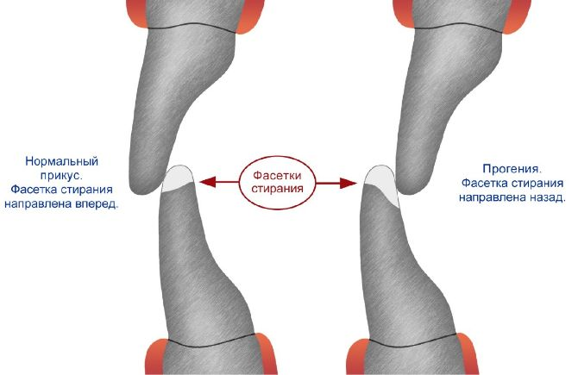
With certain skills, premature tooth contacts can be detected by auscultation, because in the presence of supracontact teeth, the closure of the dentition is accompanied by a dull, forked sound.With the chronic nature of traumatic occlusion, premature contacts are detected upon examination in the form of so-called occlusive facets (erasability facets). Occlusal facets are flattened areas on a convex dental surface formed by abrasion of hard tooth tissues. Occlusal contacts on the periphery of these wide facets have an oblique direction and lead to traumatic periodontal stress.

Slide 22
In addition to the usual examination methods, specialtechniques are used: analysis of occludograms, diagnostic models of jaws, marking of supracontacts using carbon (articulation) paper

Slide 23
More precisely, supracontacts are detected on survey occludograms or by prints from carbon paper. An occludogram is a relief impression of the occlusal contacts of the dentition on a wax plate. To obtain anoccludogram, a thin plate of wax is placed between the dentitions, covered with aluminum foil from the lower surface. This method allows you to register the occlusalrelationships of both dentitions simultaneously. It is quite accurate,facilitates the work of the doctor, saves his time.

Slide 24
If there are no standard blanks, then you can use a plate of bugle wax, cut according to the shape and size of the dentition. Such a plate is applied to the lower dentition, and the patient is offered to close the lateral teeth tightly. Then the patient is asked to open his mouth, the plate is removed from the oral cavity, washed, dried and analyzedin bright light or in a negatoscope. Premature contacts are detected as locally thinned or perforated places in the wax plate. In some cases, the wax may not perforate, but thin out and gather into folds along the periphery of the contact. The revealed marks of wax perforations on the occludogram correspond exactly to the location of premature contacts on the surfaces of the teeth.
Overview occludograms serve primarily for the diagnosis of traumatic occlusion and localization of the affected area of the dentition, as well as for monitoring changes in occlusion during the grinding period.
1 — нормальные окклюзионные контакты;
2 — преждевременные контакты

Slide 25
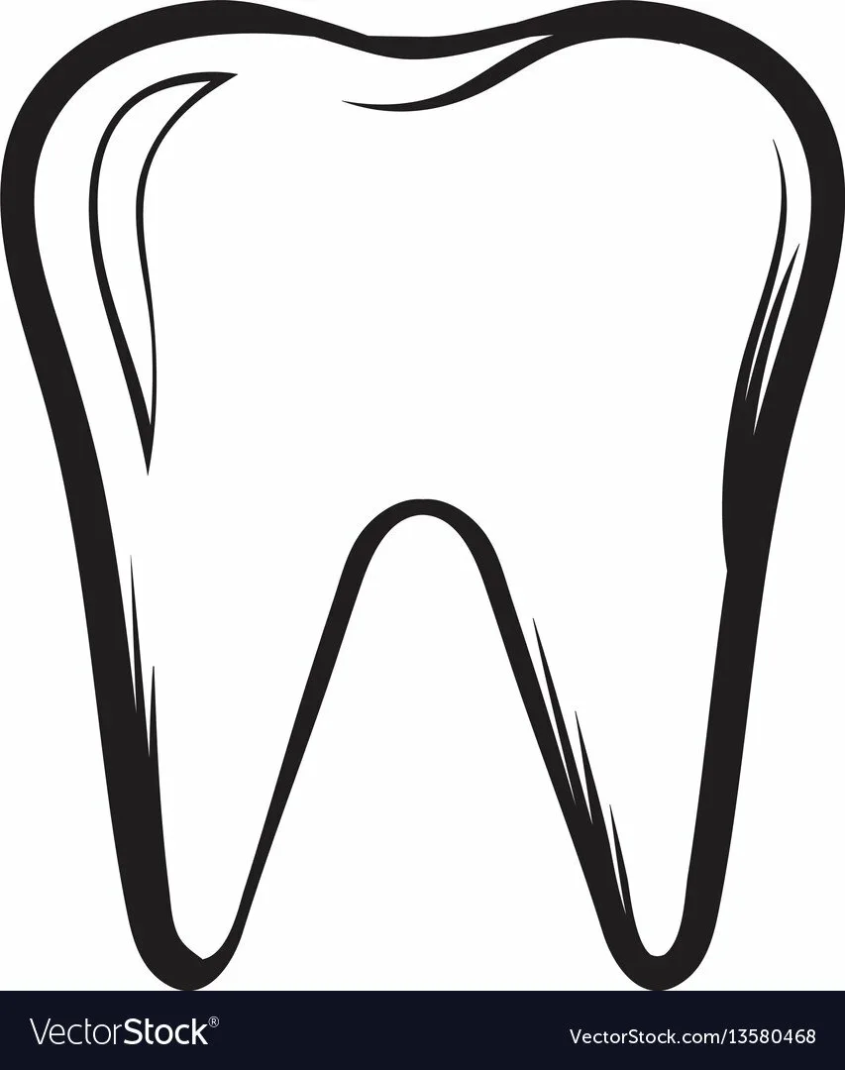
However, at the stages of systematic selective grinding, working occludograms are more often used, which are rectangular wax plates measuring 3-4 cm. Occlusion is analyzed on this plate directly in the oral cavity and premature tooth contacts are indicated through it with a special pencil(a colored pencil of great softness, a glassgraph, etc.).

Slide 26
Articulation paper is used in practical dentistry to determine occlusive contacts. Previously, articulation paper of only one thickness, about 30 microns, was proposed for use. At the end of the 90s of the last century, the German company Bausch developed a technology for the consistent use of articulation paper of various thicknesses and colors. This technology is used today by the vast majority of practitioners.

Slide 27
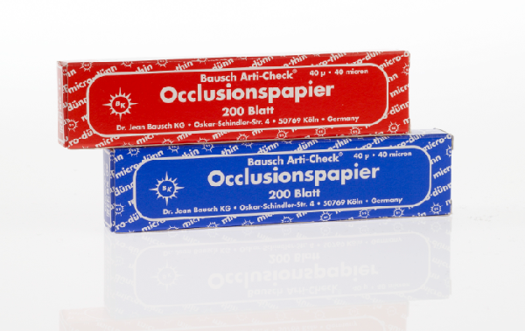
Bausch ProductsBausch paper is available in different colors with a thickness of 40 to 200 microns: blue and red, foil and film with a thickness of 8 to 16 microns available in black, green, blue, red.
The paper is 200 microns.
The paper is 100 microns.
The paper is 40 microns.
The paper is 60 microns.
The foil is 12 microns.
The foil is 8 microns.
The film is 16 microns.

Slide 28
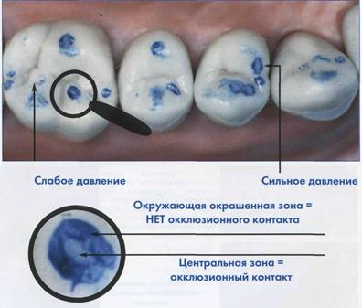

Slide 29
T-Scan Core is a digital registration and digital occlusion analysis system, consisting of a patented sensor, an ergonomic tip and software developed by Tekscan Inc., USA. The device is supplied with simplified software, without in-depth analysis.
The diagnosis of occlusion by the T-scan Core device is extremely simple and absolutely painless. To determine occlusal efforts, the patient needs to bite an individual plate – an ultrathin sensor. At the same time, all micro-movements of the teeth detected by the sensor are displayed on the computer monitor. The obtained data are displayed on two-dimensional and three-dimensional active diagrams, with the help of which a specialist can not only quickly and accurately identify the problem points necessary for the further formation of an ideal occlusion, but also visually show the patient the cause of the pathology.

Slide 31
For the successful implementation of complex treatment, the patient musthave informed consent — he must be notified ofthe purpose of grinding the hard tissues of the teeth, that if there is no effect, other therapies will need to be applied.

Slide 32
Before the procedure of selective grinding, each patient should find out his attitude to dental interventions. For some of them, an explanatory conversation aboutthe safety and usefulness of the procedure is enough. Others need psychomedicamental correction. The range of psychotropic drugsprescribed to patients is quite wide. At one pole there are valerian and motherwort drugs, at the other — strong benzodiazepine-type tranquilizers, sometimes potentiated by small dosesof antipsychotics or antidepressants.

Slide 33
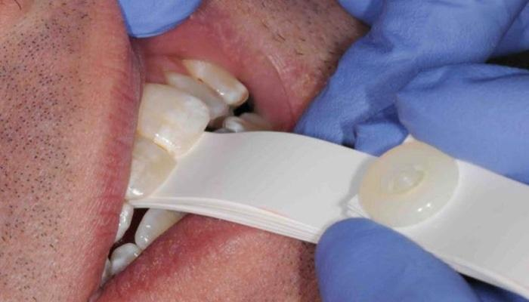
The contacts are in the central occlusion position. Prematurecontacts in the central occlusion position can be determined using a tapping test (a symptom of shaking). The index finger or thumb is applied to the vestibular surface of the examined group of teeth, and when they close briefly and quickly with antagonists, an increased vibration of the prematurely contacting tooth is felt.

Slide 34
The contacts are on the work side. The purpose of selective grinding in the lateral segments of the dentition is to create unhindered movements of the lower jaw in the presence of canine contact during lateral movements and the elimination of wide guiding surfaces, which are areas of parafunction.
The contact of the tooth group on the working side is left unchanged.
This situation can be characterized as a group function.
Obstacles are usually eliminated by selectively grinding and smoothing the prematurely contacting slopes of the tubercles. The goal is, if possible, to achieve a canine guide with lateral movements of the lower jaw

Slide 35
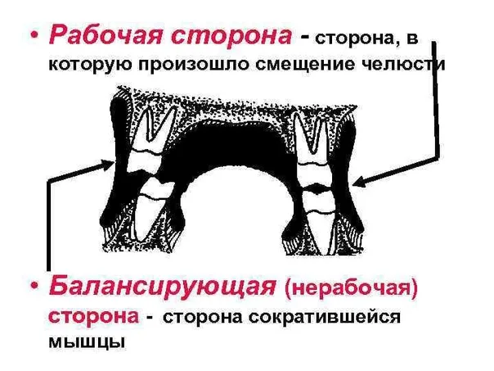
The contacts are on the balancing side. In the area of the naturaldentition, the presence of balancing contacts is not necessaryor desirable. Moreover, such contacts can lead tothe development of pathology. They cause paralysis, in particular, lead tohypertonicity of the chewing muscles.The antagonists of balancing contacts are usually the secondor third molars, which are erased or become mobile, since they are under traumatic stress.All obstacles on the balancing side must be eliminated,however, the central and guide contacts on the working side mustto be saved. The presence of pronounced balancing contacts in the area of the third molar may be an indication for its extraction.

Slide 37
GENERAL PRINCIPLES OF ELECTORAL LAWGRINDING TEETH
The method of selective grinding of teeth involves the correction of functional occlusion by grinding identifiedpremature contacts on natural and artificial teeth. Its main principle is the preservation or creation of stable occlusion, i.e. ensuring fissure-tubercle contacts of teeth with minimal removal of hard tissues.

Slide 38
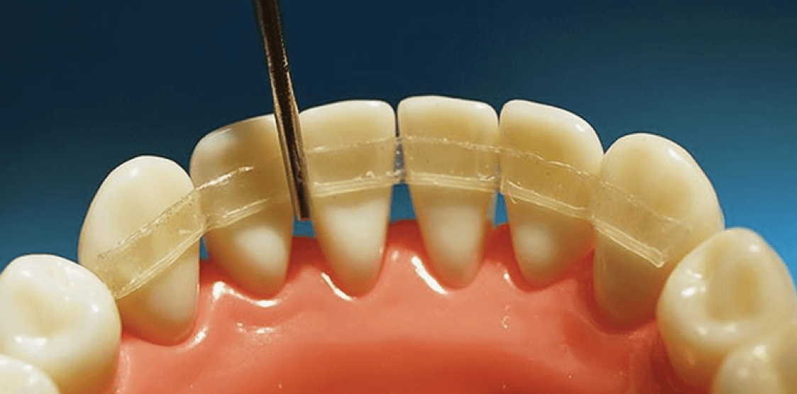
In severe periodontal pathology, with pronounced tooth mobility, significant migration, defects and deformations of the dentition, selective grinding should be preceded by the elimination of hypermobility of the teeth by temporary splinting.

Slide 39
At the same time, selective grinding is not carried out simultaneously, but for the purpose of adaptation in several stages, usually 3-5, with an interval of 5-7 days. Each session should not exceed 30 minutes. During the first visit, the occlusal-articulatory relationships are carefully studied. During the same visit, supracontacts in the position of the central occlusion can be eliminated. On the second visit, contacts are corrected for anterior and lateral occlusions.
On the third visit and at each subsequent one, careful monitoring of previously eliminated supracontacts is carried out to identify and eliminate residual occlusive obstacles.

Slide 40
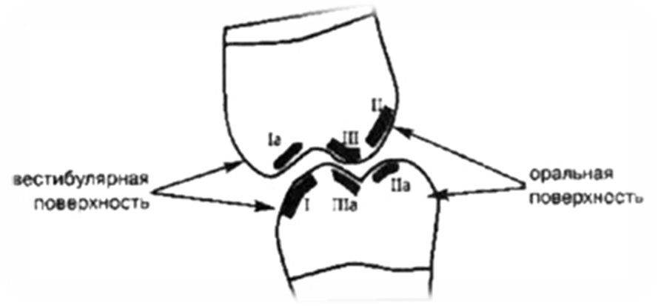
Classification of premature dental contacts by Jankelson
Class I — vestibular slopes of the buccal tubercles of the lower molars, premolars and the vestibular surface of the lower front teeth.
Class Ia — oral slopes of the buccal tubercles of the upper molars, premolars and the oral surface of the anterior upper teeth.
Class II — oral slopes of the palatine tubercles of the upper molars and premolars.
Class IIa — vestibular slopes of the lingual tubercles of the lower molars and premolars.
Class III — vestibular slopes of the palatine tubercles of the upper molars and premolars.
Class IIIa — oral slopes of the buccal tubercles of the lower molars and premolars.

Slide 41
The preparatory stage of grinding
Pre-grinding phase, elimination of gross occlusal disharmony
a - minor correction by grinding the contact (approximal) surfaces of the lower front teeth, which can help eliminate their crowding;
b - incorrect position of the lateral teeth leads to the formation of retention points;
c - before replacing the defect of the dentition, the elongated molar of the upper jaw must be sanded at the level of the occlusal surface;
d - an elongated tooth at the end of the dentition, which does not have an antagonist, must be sanded, since it prevents articulation;
e - shortening of the distal tubercle of the upper molar allows the lower tooth to align;
f - shortening of individual displaced teeth

Slide 42
THE TECHNIQUE OF SELECTIVE GRINDING OF TEETHACCORDING TO JENKELSON
B. Jenkelson's method is based on the fact that with various chewing movements there is no dense constant contact of antagonist teeth, it is carried out indirectly through a food lump, and the dentition closes only in the final stageof food processing in the position of central occlusion, which is the most common functional position of the lower jaw. Therefore, selective grinding of teeth is aimed at eliminating prematureocclusal contacts only in the central occlusion.

Slide 43
This technique involves a phased intervention (5 patient visits) with a frequency of 5 to 10-12 days. In case of urgent need (preoperative period), the time between visits can be reduced by 3-7 days, but it is contraindicated to arbitrarily change the sequence of interventions.

Slide 44
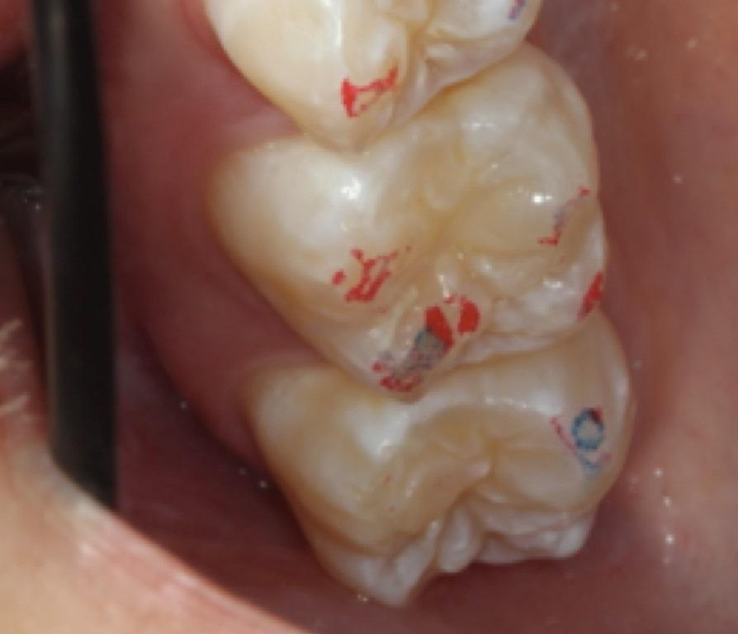
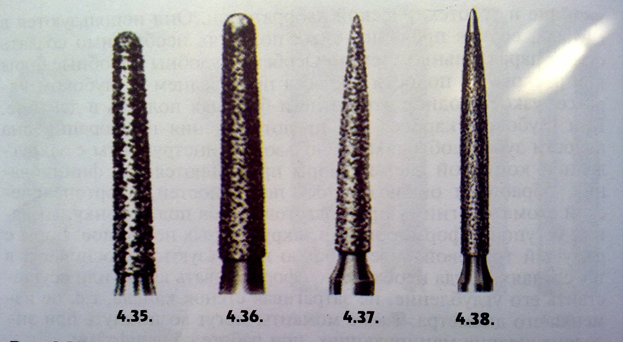
During the first visit, the above-described technique is usedto identify and label Class III premature contacts in distal occlusion (with maximum mandibular retraction). To thisend, the patient is asked to close and open the jaws several times torelieve the tension of the chewing muscles. At the final stage, the lower jaw is fixed in the distal position ("holding the chin" until the jaws are completely closed). In this case, a wax plate with copy paper is placed on the upper dentition. Prematureocclusal contacts are revealed in the form of colored cheek slopesof the palatine tubercles of the upper molars and premolars. With preserved fissure-tubercle contacts, which ensure the correct relationship between the teeth of the upper and lower jaws, only the tops of the tubercles are colored.Premature contacts of Class III are corrected with a cone-shaped diamond boron

Slide 46
Boron is injected into the fissures of the chewing surface of the tooth, medial and distal to the marked premature contact. The latter is reduced by light movements of the boron (without pressure), while the contours of the palatine hillock are sharpened and the contact is transferredto its tip
At the end of each session, the treated teeth are coated with fluoride-containing preparations in the form of varnish or gel (to prevent possible complications). The next stage of selective polishing is carried out 3-5 days after the adaptation period.

Slide 47
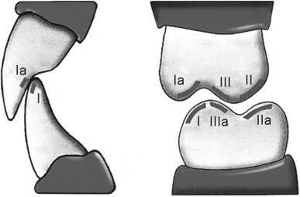
During the second visit, the results of the grinding of the previous stage are checked and corrected. Then the wax plate with copy paper is transferred to the lower dentition, having previously dried it with a stream of air or cotton swabs, otherwise, due to the wet surface of the enamel, clear prints of prematurecontacts. The patient, after swallowing saliva, closes his jaws in the most familiar occlusion for him. At this stage of selective grinding, premature class I contacts are eliminated, localized on the vestibular surface of the buccal tubercles of the lower molars and premolars, as well as on the vestibular surface of the crowns of incisors and canines.
The task of the second stage is to give the flattened vestibular surfaces of the lower molars and premolars a spheroidal shape sothat the equator of the crown is more pronounced, and its diameter in the buccal-lingual direction is larger than the diameter of the chewing surface of the crown.

Slide 48
Correction of premature class I contacts begins with deepening of the fissure on the vestibular surface of the molars. The diamond boron is placed 2-3 mm below the premature contact at an angle of 45 to the diameter of the crown, in the area of the equator. By movements of the boron from the fissure in the medio-distal and distal directions, with gradual movement towards the tip of the hillock without pressure, premature contacts are smoothed out very easily.
Then the doctor turns his attention to the central group of lower teeth: incisors and canines. Their correction begins with the alignment of the occlusal curve, shortening of the protruding sections of the incisor crowns. On the vestibular surface of the crowns, premature contacts are smoothed in the medial direction while maintaining the convex shape of the teeth.
Significant changes in the usual occlusal ratios after the second stage of selective polishing require a longer period of adaptation compared to the previous visit. Therefore, it is advisable to perform the third stage of grinding after 10 days.

Slide 49
During the third visit, the results of selective polishing of the second stage are checked — premature contacts of the first class.After that, a wax plate with carbon paper is transferred to the upper dentition and premature class II occlusal contacts are detected, localized on the palatine surface of the palatine tubercles of the upper molars and premolars. The grinding is carried out with light smoothing movements of the boron, located at an angle of 45 to the equator of the crown, in the direction from the equator to the tip, the height of which remains unchanged. Class II contacts are detected in the usual occlusion. At the end of grinding, the teeth are coated with a fluoride-containing varnish or gel. The patient's adaptation period after the third stage of grinding is completed by the 3rd-5th day.

Slide 50
During the fourth visit, Class II occlusal contacts are checked in the usual occlusion using a wax plate with carbon paper. Then the doctor switches his attention to the buccal surface of the palatine tubercles, where premature contacts are localized.class. The grinding of these areas was carried out on the first visit, but then premature contacts were detected and eliminated in distal occlusion (with maximum displacement of the lower jaw backwards). At the fourth stage, class III contacts are detected in the usual (central) occlusion. Premature contacts on the buccal surface of the palatine tubercles are reduced in the same way as on the first visit.

Slide 51
The fifth visit is a control visit, patients are invited no earlier than 10-14 days after the fourth visit. During this period, there is a complete adaptation to the new occlusive relationships andcontracts that have arisen as a result of the manipulations carried out

Slide 52
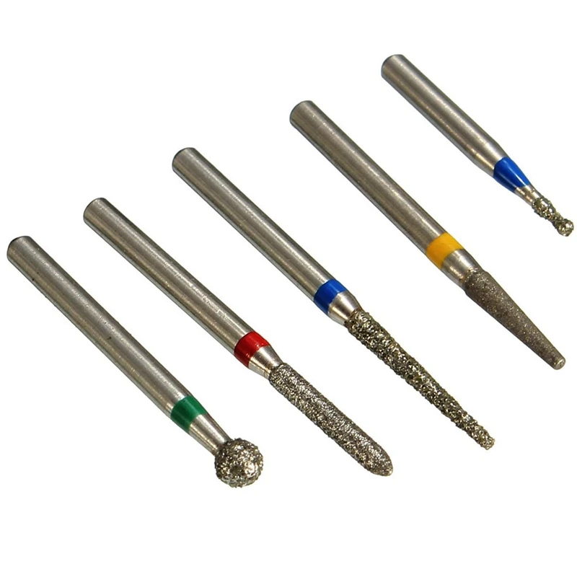
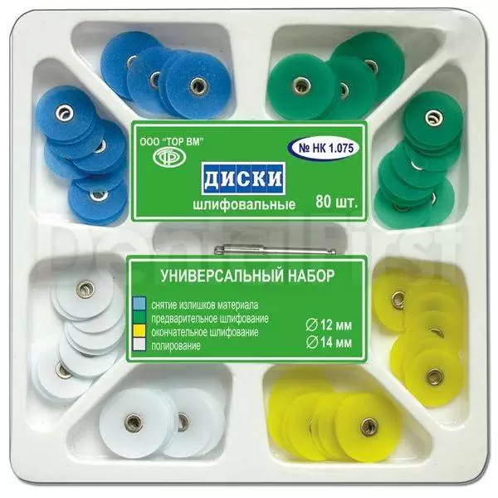
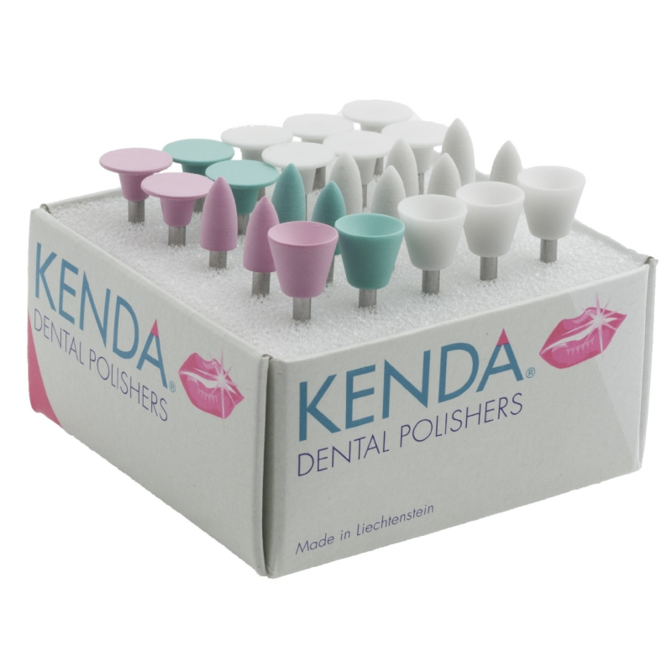
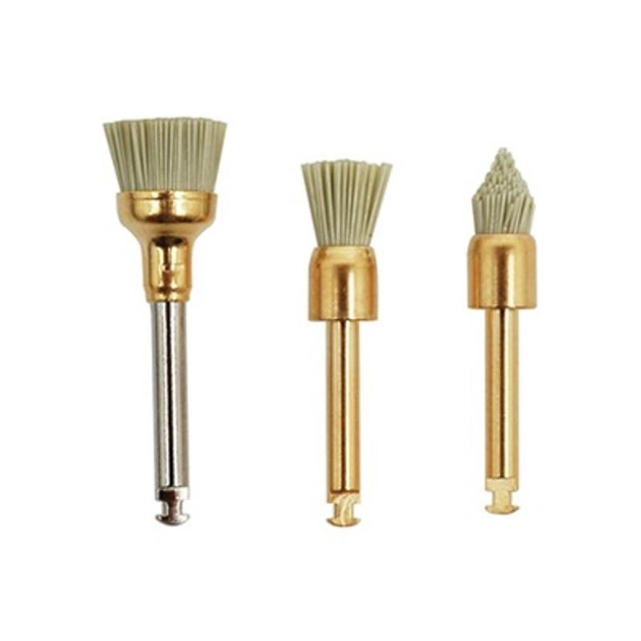

Slide 53
The patient is monitored for six months, because during this period, the adaptation processes in the TMJ, occlusal relationships are stabilized. The control and correction of occlusive contacts must be repeated after surgical interventions and orthopedic treatment.

Slide 54
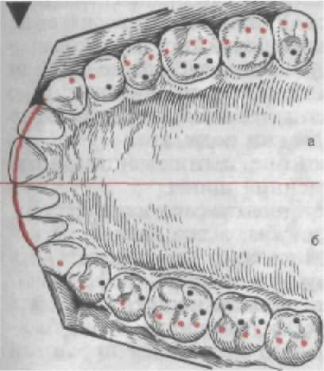

Slide 55
Thus, the technique of selective functional grinding of teeth in patients with periodontal diseases makes it possible to establish the most physiologically sparing occlusal interaction, prevent the appearance of overload in certain areas of the periodontium, restore the erased contours of teeth, giving them the correct anatomical shape, and at the same time maintain the normal height of occlusion.

Slide 56
Grinding of the enamel of the lateral teeth of the tooth surfaces when they are crowded.

Slide 59
In the presence of premature contact on the lower, mesially inclined molars (for example, with a defect in the dentition), it is eliminated by grinding their central fissure, but not the supporting hillock of the upper molar

Slide 60
There are three types of therapeutic and diagnostic devices, depending on :
the degree of overlap of the chewing surface of the teeth;
the material they are made of;
the purpose of the device.

Slide 61
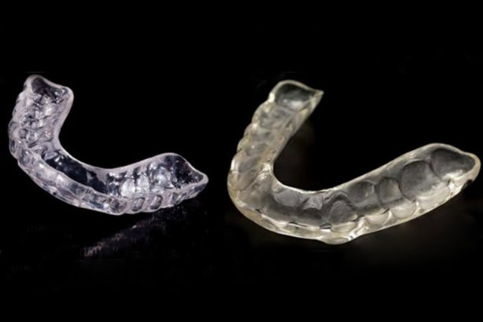
Occlusal splint
This is a removable plate made of transparent plastic for the upper or lower jaw, covering partially or completely the occlusal surface of the teeth (part of the tooth surface from the tops of the tubercles to the deepest part of the central fissure).

Slide 62
Currently, there are a large number of designs. Let's consider 4 main types of structures that perform different functions and are used depending on the design of the occlusal surface:
Uncoupling – used for bruxism and reduction of interalveolar height to protect teeth and soft tissues.
Relaxation – provides a decrease in muscle tone with the establishment of joint heads in a centric position.
Stabilizing – stabilizes the position of the lower jaw after normalization of muscle tone.
Repositional – sets the articular heads of the lower jaw in the correct position.

Slide 63
Tire Manufacturing
Occlusal tires are made of different materials and according to different methods:
The manufacture of tires from light-polymerizing plastic. As a result, soft plates are obtained, which are compressed on the teeth (pre-filled with wax and soaked in water);Modeling from wax and converting it into plastic – during production, the upper part of the jaw model is installed between the articulator frames using facial arches and interclusal blocks;
The manufacture of a tire based on a vacuum mouthguard requires two supergypse models: one is fixed in the articulator, and the second with a low base is designed to fit the mouthguard in a vacuum device.
Applying plastic to the model – to obtain a flat relief, it is necessary to block the fissures with silicone, then smooth it out and apply an insulating varnish.

Slide 64
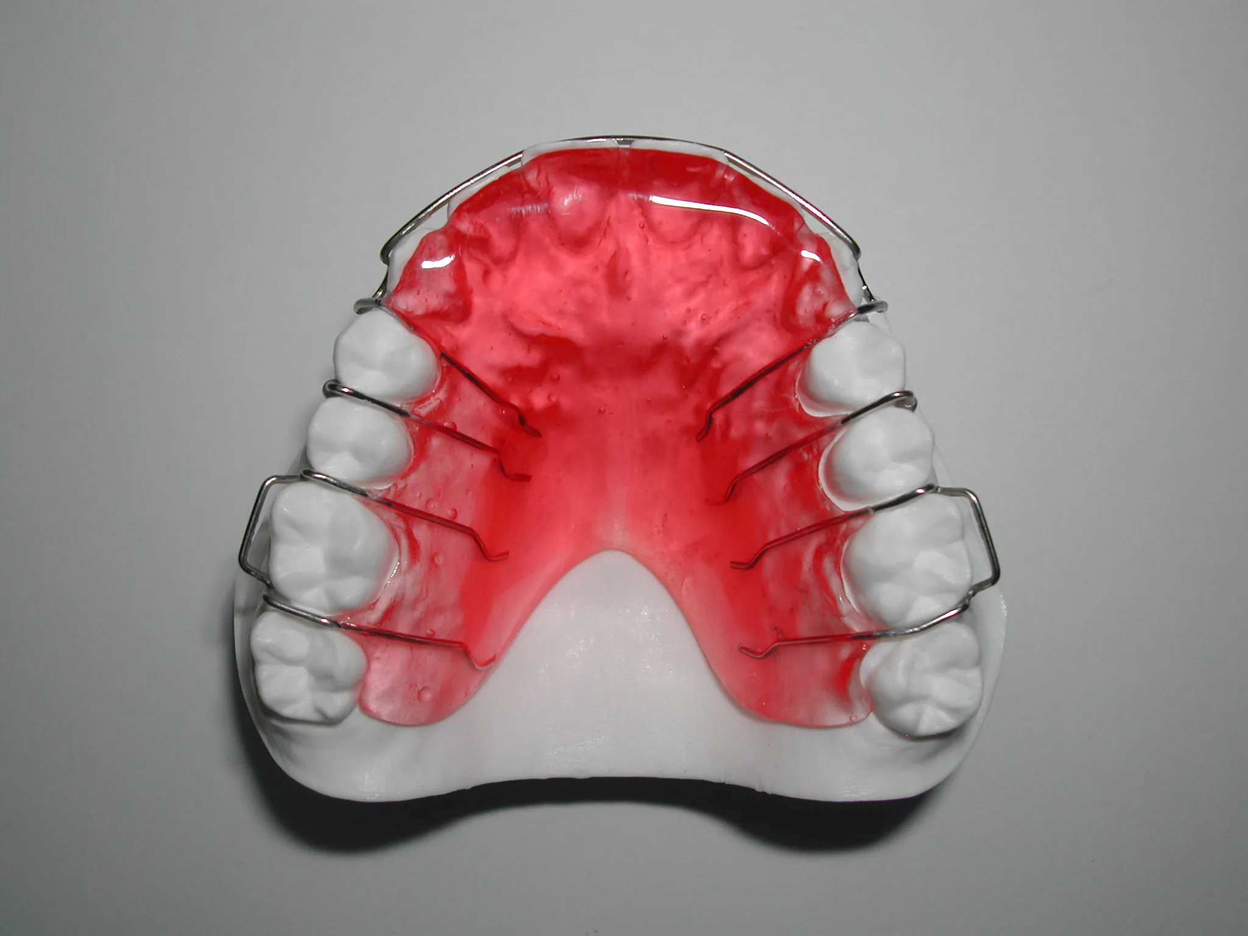
Relaxation bite plates. Unlike centering and disconnecting splints, these devices provide symptomatic treatment — pain relief and muscle relaxation.
They are indicated in cases where causal factors have not been identified in pain syndrome or occlusive disorders cannot be quickly eliminated (for example, with a large length of fixed structures).
As relaxation bite plates are used:
palatine plates with a bite pad near the front teeth. They are made for the upper jaw. They have a horizontal or inclined platform on which the lower front teeth rest, and all other teeth are separated;palatal plates with clasps.

Slide 65
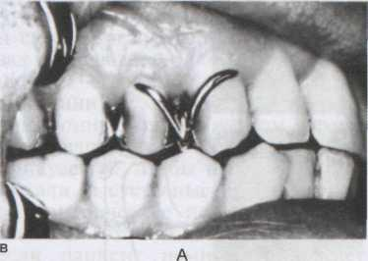
A typical representative is a relaxation palatine plate with folding wire clamps with a diameter of 0.8 mm passing between the canines and premolars or between premolars on their vestibular surface. The folding parts of the clasps are in contact with the distal surfaces of the lower premolars, therefore, when closing the mouth, the lower jaw shifts somewhat mesially. Clamps are placed on the teeth on both sides symmetrically and separate the dental

Slide 66
Katz's record
A plastic plate in contact in the area of the lateral dental units with their necks. It is strengthened on the upper jaw by means of clamps. The purpose of the device is the treatment of prognathia.

Slide 67
Klammt Activator
This is a two-jaw removable structure that is fixed from the incisors to the first molars. There is no plastic in the area of the palatine arch and frontal teeth. This increases the space for the language.
Indications:
open and distal occlusion;mesial occlusion on the background of reverse incisor overlap.
Depending on the specific clinical case, the duration of wearing the system ranges from 1 year to 2 years.

Slide 68
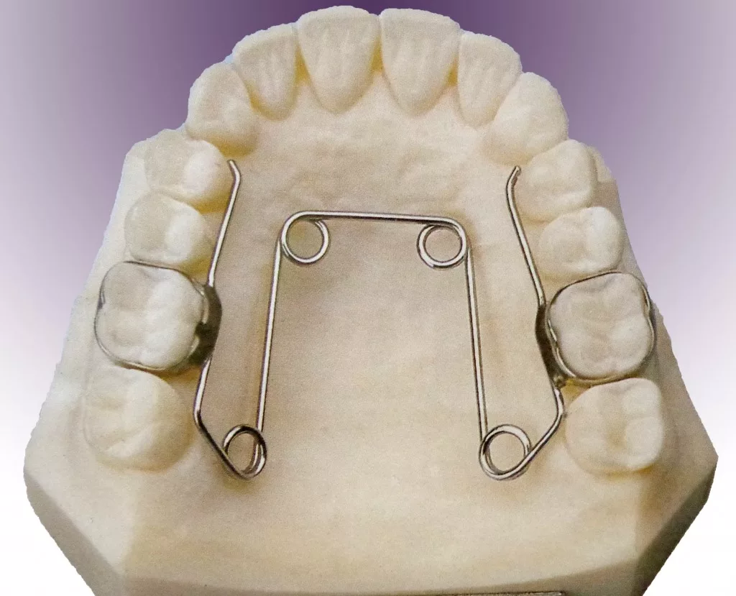
Quadrohelix
The product is a type of palatal dilator. It is fixed in the oral cavity on a permanent basis.
Indications:
correction of the location of the lateral teeth;
correction of malocclusion at any age;
increasing the space between the teeth;
expansion of the upper jaw.
The minimum duration of therapy is 3 months.

Slide 69
The Mershon apparatus
A non-removable product that is used to expand the dental arch. Among the disadvantages, it should be noted a weak impact force and a long correction period.
Indications:
an overly developed upper jaw;
the rotation of the dental unit around its axis;
crowding of teeth;deep, distal and mesial occlusion.

Slide 70
Engle's apparatus
A universal orthodontic design that is used in the presence of a variety of malocclusion defects and individual dental units. This is a springy arc that changes the position of the teeth and aligns the row with the help of traction.
Indications:
teeth displacement around their axis;
cross, distal, open and mesial occlusion;
displacement of dental units in a row;
deviations of the teeth (outward or towards the tongue).
An individual approach is used in the manufacture of the product. A wax impression of the patient's teeth is pre-performed, taking into account all the structural features.

Slide 71
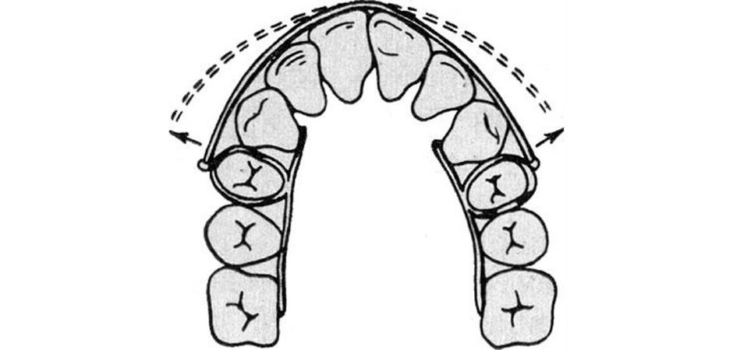
The Ainsworth apparatus
The design has a simple device. It consists of a vestibular arch, which is reinforced by support rings. It is used to narrow the jaws in the area of canines and premolars.

