Slide 1
Prof. V.F. Voino-Yasenetsky Krasnoyarsk State Medical University
Topic: Enzymes. Regulation of their action.
Lecture No. 2 on the discipline "biochemistry" for 2nd year students
Lecturer: Panina Yu.A.
Krasnoyarsk, 2023

Slide 2
Lecture plan:
Relevance of the topic.
Dependence of enzyme activity
Qualitative regulation
Quantitative regulation
Types of inhibition
Enzyme chain reaction and key enzymes
Medical enzymology
Conclusion

Slide 3
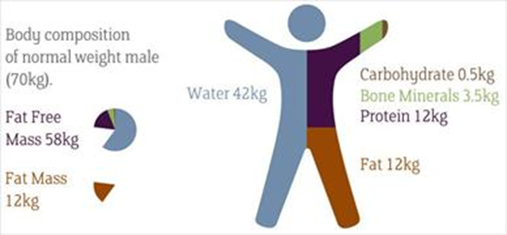
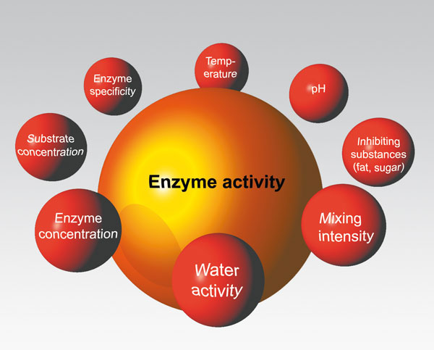
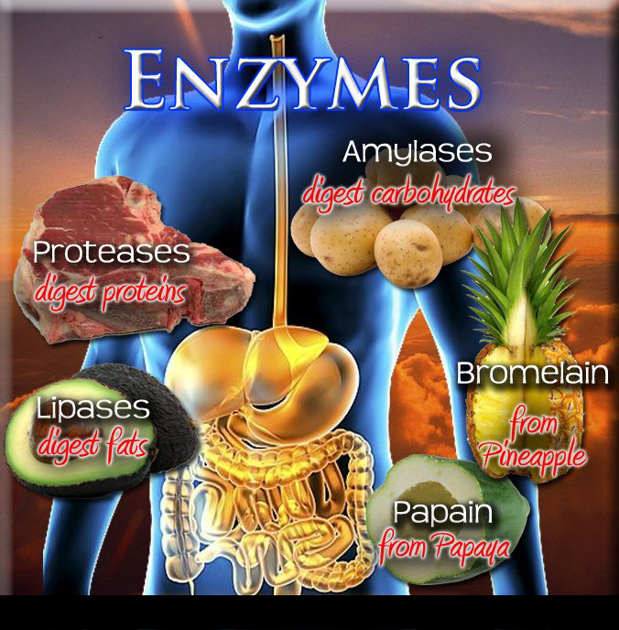
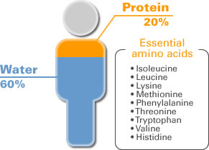
RELEVANCE OF THE TOPIC
Biomedical significance

Slide 4
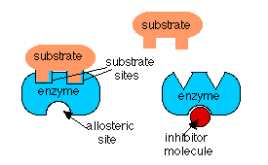
Regulation of biochemical reactions

Slide 6
Dependence of enzyme activity on the concentration of effectors (regulators, ligands)
"Quantitative" effect
"Qualitative" effect
Alteration of protein-enzyme biosynthesis
Change in the activity of the enzyme protein
Increase
Decrease
Increase
(activation)
Decrease
(inactivation, inhibition)
Depends on the concentration of regulators and substrate
Volatile process
Long process (it takes some time to complete)
Depends on the concentration of regulators (inhibitors or activators) and substrate
More often non-volatile process
Fast process (usually implemented quickly)

Slide 8
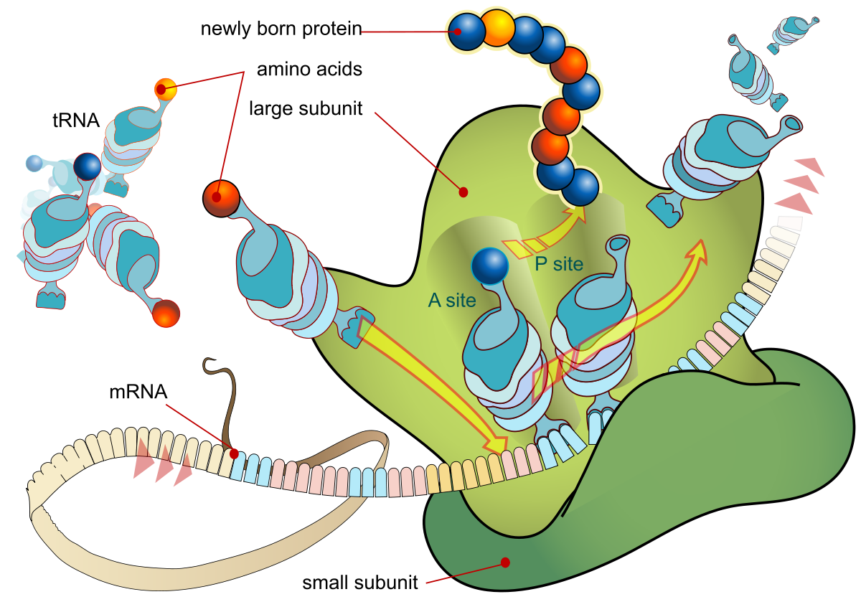
Regulation by changing the amount of enzyme (quantitative regulation)

Slide 9
Regulation by changing the amount of enzyme (quantitative regulation)
Inductors
Repressors
biosynthesis
hydrolysis
Amino acids
Protein enzyme
Amino acids
Types of signals:
- inducers / repressors of protein biosynthesis
-energy (ATP / ADP, NADH * H + / NAD),
-metabolic (intermediate products of metabolism),
- hormonal (transmit information using secondary mediators - cAMP, cGMP, Ca2 + ions, inositol-3-phosphate, diglyceride),
- reaction products of the metabolic pathway (various substances blocking enzymes - regulation according to the principle of negative feedback).

Slide 10
The mechanism of action of steroid hormones: enhancing protein biosynthesis
www.sitemaker.umich.edu

Slide 11
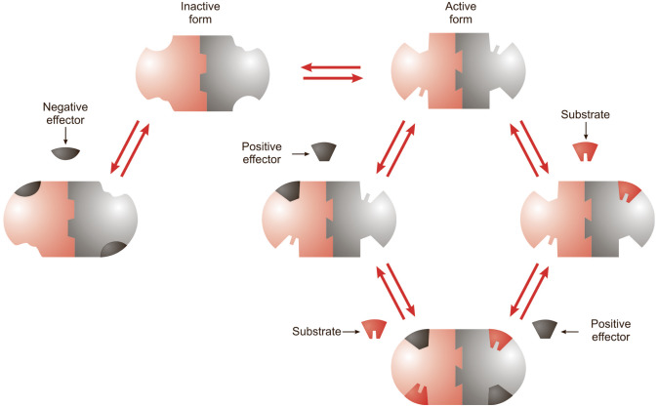
Regulation without changing the amount of enzyme (qualitative regulation)
Types of effectors (ligands):
-positive (activators)
-negative (inhibitors, blockers, inactivators).

Slide 12
NON-SPECIFIC MECHANISMS OF REGULATION OF ENZYME ACTIVITY IN THE CELL
AVAILABILITY OF SUBSTRATE AND / OR COFACTOR. At a constant temperature, the rate of a chemical reaction is proportional to the product of the concentration of the reactants.
CHANGE IN THE QUANTITY OF ENZYME - may occur as a result of an increase or decrease in its synthesis. The change in the rate of enzyme synthesis usually depends on the amount of certain hormones or the reaction substrate.

Slide 13
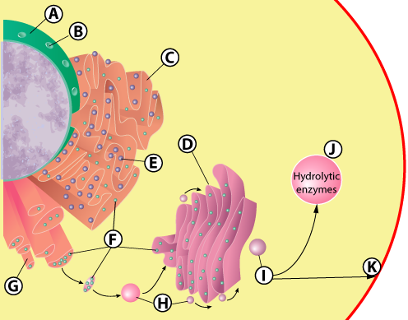
COMPARTMENTALIZATION
localization of enzymes and their substrates in one compartment - in the endoplasmic reticulum, mitochondria, lysosomes.

Slide 14
SPECIFIC MECHANISMS OF REGULATION OF ENZYME ACTIVITY IN THE CELL
1. ALLOSTERIC REGULATION
2. COVALENT (CHEMICAL) MODIFICATION
3.LIMITED (PARTIAL) PROZYME PROTEOLYSIS
4. PROTEIN-PROTEIN INTERACTION

Slide 15
CHANGES IN ENZYME ACTIVITY OCCURRING WITH ANY OF SPECIFIC MECHANISMS
-Specific action of the regulatory mechanism
-There is a change in the conformation of the enzyme as a whole
- therefore, the conformation of the active center of the enzyme, which
↑ affinity of E for S
(activation E)
↓ affinity of E for S
(inhibition E)

Slide 16
CHANGES IN ENZYME ACTIVITY AT ALLOSTERIC MECHANISM
-Allosteric regulator binds to the regulatory (allosteric) site
-There is a change in the conformation of the enzyme as a whole
-therefore, the conformation of the active site of the enzyme, which
↑ affinity of E for S
(activation E)
↓ affinity of E for S
(inhibition E)

Slide 18
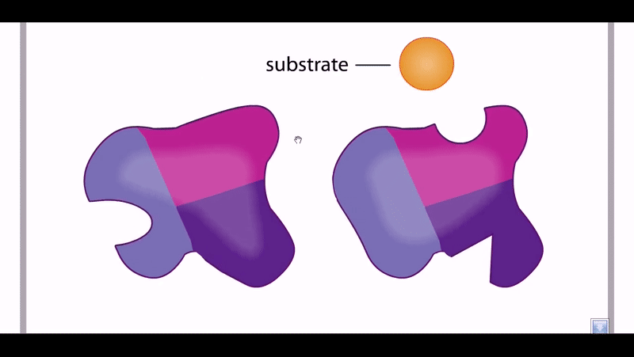
ALLOSTERIC ACTIVATION

Slide 19
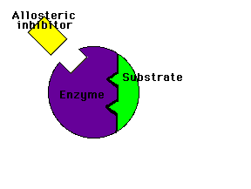
ALLOSTERIC INHIBITION

Slide 20
Allosteric site - regulatory site:
The regulatory (allosteric) site binds the effectors.
Effectors can either facilitate the binding of the substrate to the active site, or hinder it.
Enzymes of this type are called allosteric.

Slide 21
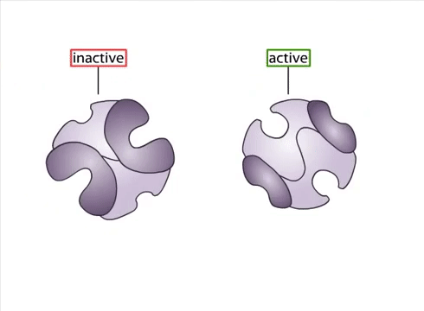
ALLOSTERIC REGULATION: the effect of cooperative interaction

Slide 22
Allosteric mechanism of regulation of enzyme activity
Heterotropic regulation
Homotropic regulation
substrate - an activator for the "other" enzyme (most often located at the end of the enzymatic chain)
substrate - activator for "own" enzyme
Foractivation (positive feedback)
product - an inhibitor of the reaction for the "other" enzyme (most often for the "initial")
Allosteric enzymes in the enzymatic chain are most often the "key" enzymes (the course of many subsequent reactions depends on their activity)
Retroinhibition (negative feedback)

Slide 23
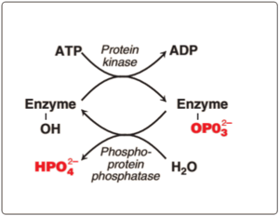
COVALENT (CHEMICAL) MODIFICATION
consists in the reversible attachment or cleavage of a certain group, due to which the conformation of the enzyme as a whole, its active center changes, and the activity of the enzyme changes (increases or is blocked). Most often, such a group is phosphoric acid, less often methyl groups. Enzymes can be phosphorylated or dephosphorylated.

Slide 24
Chemical modification
Covalent modification
Н
О
glycogen phosphorylase is active in a phosphorylated state,
glycogen synthase - active in a dephosphorylated state
S
Н₂О₃Р
Protein kinase
О
S
Н₃РО₄
АТP
АDP
phosphorylation
dephosphorylation

Slide 26
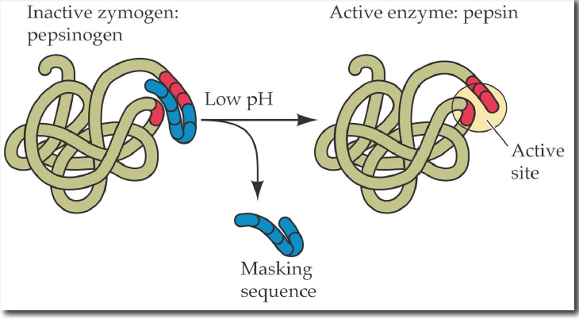
LIMITED (PARTIAL) PROTEOLYSIS
The type of regulation typical of zymoenzymes (inactive enzymes)
the synthesis of enzymes occurs in the form of a larger precursor and when it enters the right place, this enzyme is activated through the cleavage of one or more peptide fragments from it
an example of enzymes - enzymes of the gastrointestinal tract:
inactive prepepsin (pepsinogen) → active pepsin
inactive protrypsin (trypsinogen) → active trypsin

Slide 28
Limited (partial) proteolysis
Peptidase
Oligopeptide (polypeptide)

Slide 29
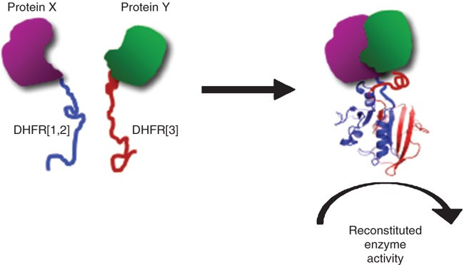
PROTEIN-PROTEIN INTERACTION
it is not metabolites of biochemical processes that act as a regulator, but specific proteins. For example, the regulation of the activity of protein kinase A.
Most often characteristic of enzymes with a quaternary protein structure, which are multimers

Slide 30
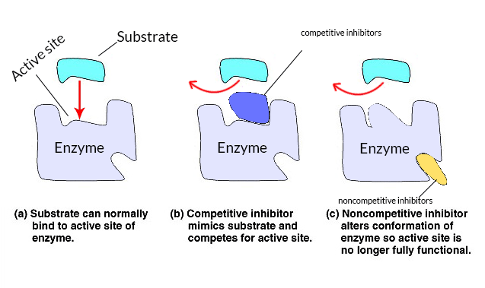
INHIBITION
Irreversible
Reversible
Enzyme Poisons
Competitive
Non-competitive
Uncompetitive

Slide 32
Irreversible inhibition
With irreversible inhibition, binding or destruction of the functional groups of the enzyme necessary for the manifestation of its activity occurs.

Slide 33
Irreversible inhibition options
Denature the enzyme (nonspecific inhibitors)
Form very strong complexes with the active or allosteric center of the enzyme (more specific irreversible inhibitors)

Slide 34
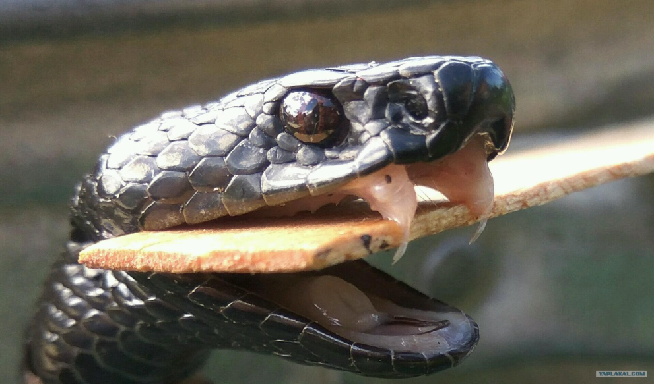
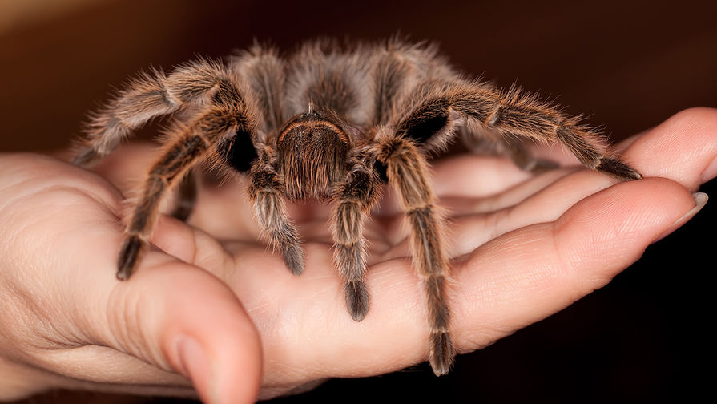
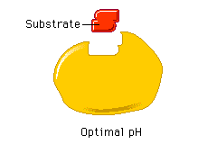
Irreversible inhibition

Slide 35
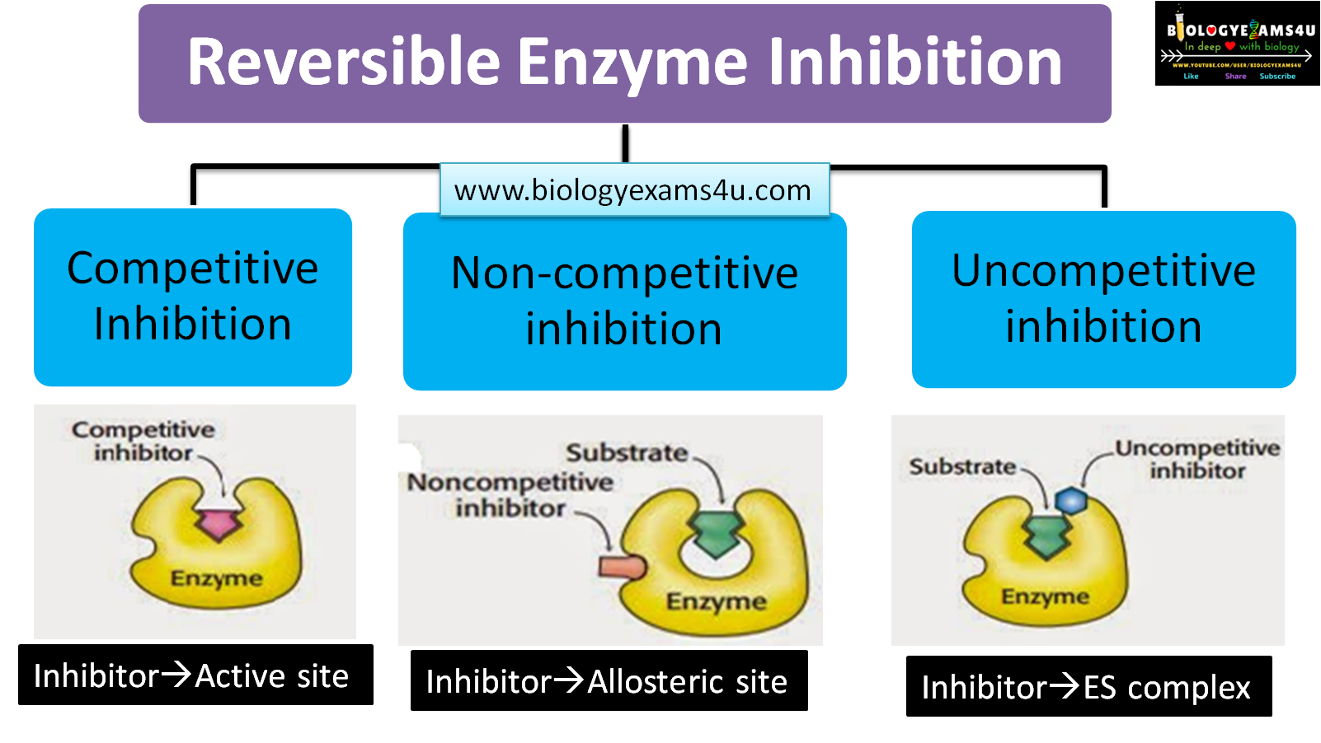
REVERSIBLE INHIBITION
With reversible inhibition, a loose binding of the inhibitor to the functional groups of the enzyme occurs, as a result of which the activity of the enzyme can be gradually restored.

Slide 36
REVERSIBLE INHIBITION
With reversible inhibition, a loose binding of the inhibitor to the functional groups of the enzyme occurs, as a result of which the activity of the enzyme can be gradually restored.
with an excess of substrate, the activity of E is fully or partially restored

Slide 37
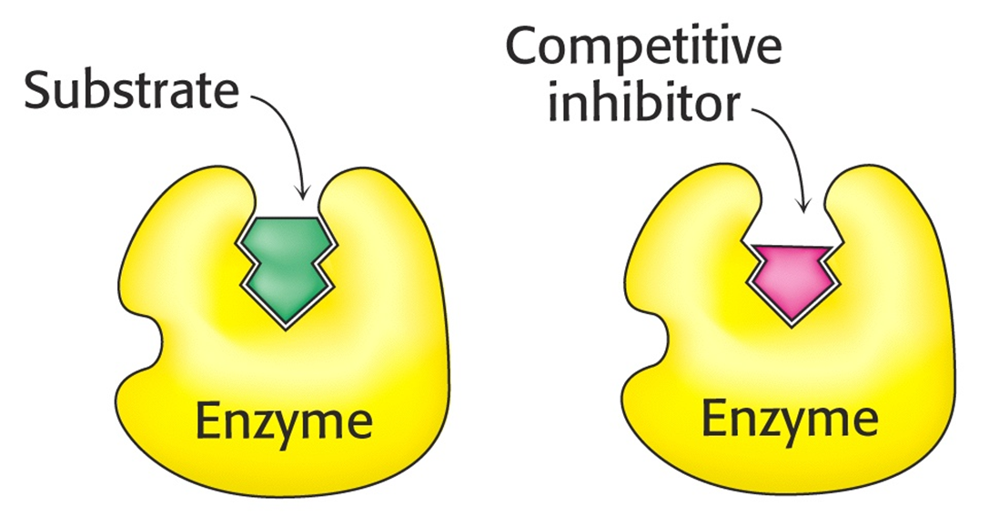
COMPETITIVE INHIBITION
With this type of inhibition, the inhibitor is structurally similar to the enzyme substrate. Therefore, it competes with the substrate for the active center. This leads to a decrease in the binding of the substrate to the enzyme and disruption of catalysis.

Slide 38
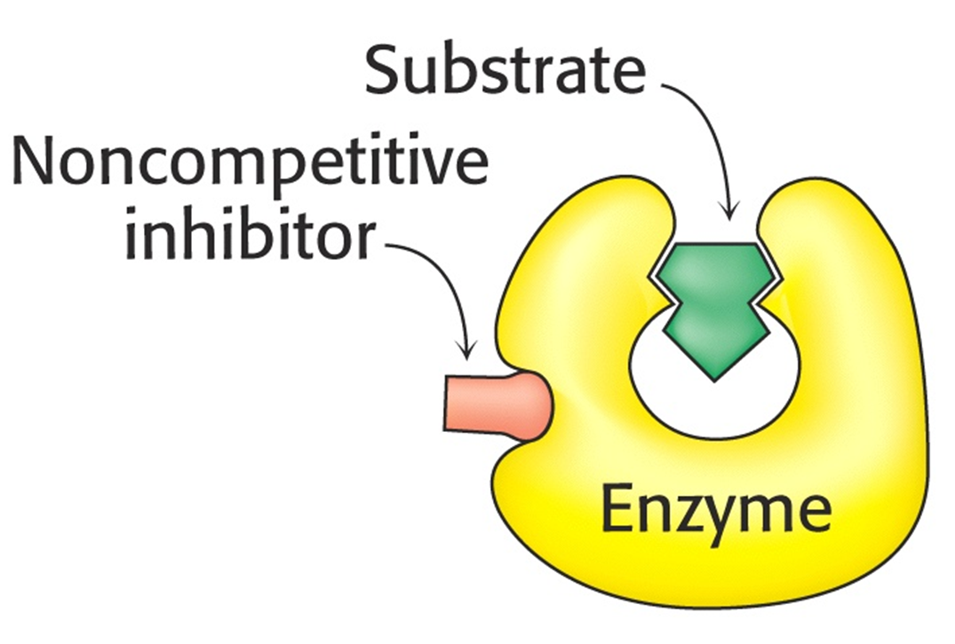
NON-COMPETITIVE (ALLOSTERIC) INHIBITION
This type of inhibition is associated with the attachment of the inhibitor not to the active site, but to another site of the molecule. This can be allosteric inhibition, when the activity of the enzyme is reduced by natural modulators, or the binding of any toxins to the enzyme.
For example, hydrocyanic acid (cyanides) binds to the heme iron of the respiratory chain enzymes and blocks cellular respiration.

Slide 39
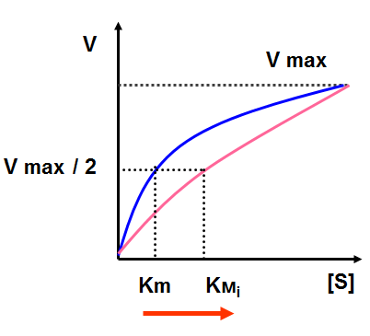
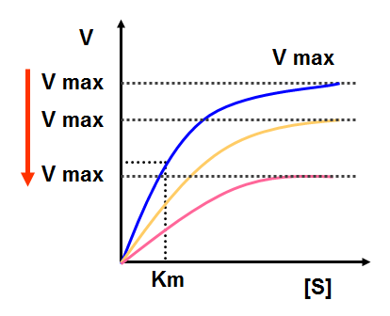
COMPETITIVE AND NON-COMPETITIVE (ALLOSTERIC) INHIBITION
Competitive type of inhibition
Non-competitive type of inhibition

Slide 40
Reversible competitive inhibition
O
O
C
O
Enzyme (succinate dehydrogenase)
C
O
CH₂
CH
CH₂
CH
C
O
C
O
O
O
Fumarate
Succinate
O
O
C
O
C
O
Enzyme (succinate dehydrogenase)
CH₂
C
O
CH₂
CH
C
O
C
O
O
O
Oxaloacetate

Slide 41
Uncompetitive inhibition

Slide 42
Uncompetitive inhibition
modifying reagent (compounds of an inhibitor with a complex [ES] to form an inactive or slowly reacting ternary complex [E / S])
inhibition by excess substrate
Suicidal substrate

Slide 44
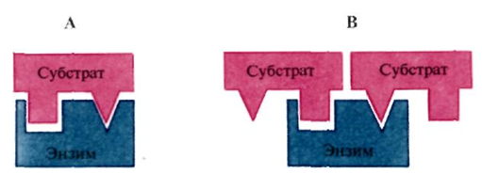
Dependence of enzyme activity on substrate concentration
inhibition by excess substrate

Slide 45
- "suicidal" substrate
an analogue of a substrate for a specific enzyme, which contains an additional reactive group: establishes an irreversible covalent bond with the active center of the enzyme, preventing access to it by other substrates

Slide 46
Regulation of enzyme chains
Е₁
Е2
Е3
А
В
С
Д
Е4
Key enzymes:
a) an enzyme at the beginning of the chain (E1);
b) limiting enzyme (has the lowest speed in the chain);
c) enzymes at the fork in the chain.
К

Slide 48
Medical Enzymology

Slide 49
Parts of medical enzymology
Enzymopathology - studies the importance of violations of enzyme activity in the development of diseases.
Enzymodiagnostics
a) the use of enzymes for the determination of various substances in biological fluids;
b) measuring the activity of enzymes or isoenzymes in blood and urine to diagnose diseases accompanied by cell destruction.
Enzyme therapy - the use of enzymes as medicines

Slide 50
Why enzymes are good markers of pathological conditions?
Enzymodiagnostics
Enzymes have specificity: tissue-organ or subcellular (cellular)
The minimum amount of enzyme can be determined by its specific catalytic action
A change in the functional state of cells is accompanied by a change in the activity or expression of enzymes

Slide 52
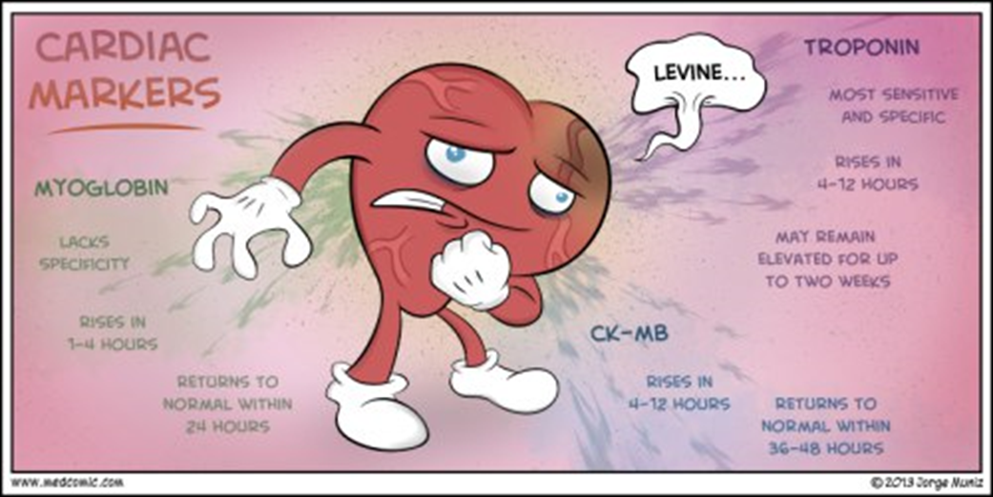

Slide 53
https://en.wikipedia.org/wiki/Cardiac_marker

Slide 54
https://medicallabtechnology.com/liver-function-test-normal-range-chart/

Slide 55
Enzymes-markers of pathological processes
Components of Plasma Proteolytic Systems
Enzymes released from destroyed tissue cells → hyperenzymemia
The rate of release of enzymes from cells is influenced by the concentration gradient of the enzyme, its molecular weight, and intracellular localization of the enzyme.

Slide 56
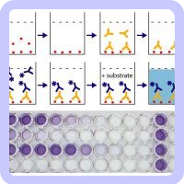
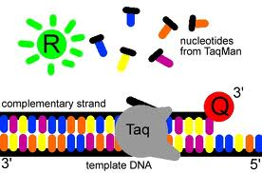
Enzymes in analytical systems
Immunoassay (the enzyme visualizes the result of the reaction)
Polymerase chain reaction (enzyme catalyzes DNA amplification in vitro)

Slide 57
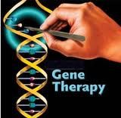
Enzymes in biotechnology

Slide 58
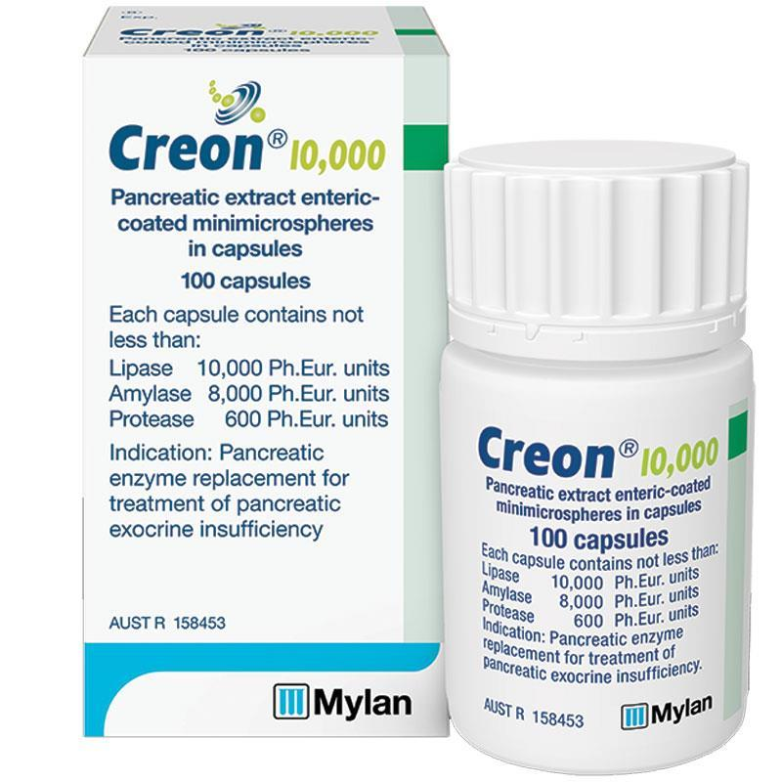
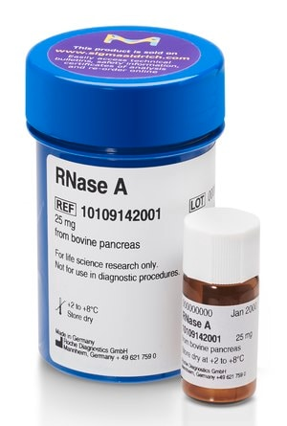
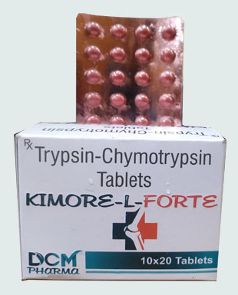
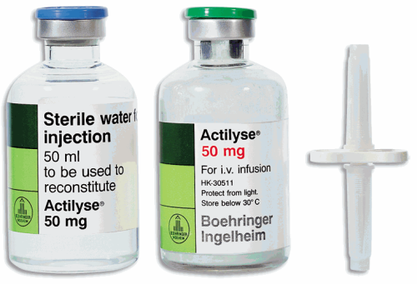
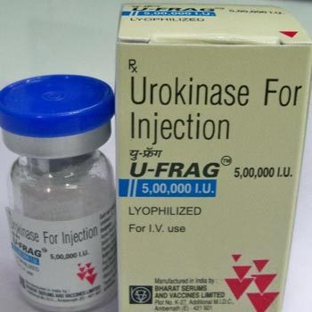
Enzyme therapy
Examples of the use of enzymes as medicines:
a) with digestive disorders and cystic fibrosis (creon, pancreatin, mezim, etc.);
b) for cleaning purulent wounds, thinning sputum, treatment and prevention of ulcers and pressure sores (trypsin);
c) for the treatment of viral diseases (DNase, RNAase),
d) Thrombolysis (actilyse, urokinase, purolase)

Slide 59
Conclusion
1. Regulation of enzyme activity is carried out by special ligand molecules (regulators, effectors: inhibitors or activators), substrate, reaction products, cofactors
2. Nonspecific mechanisms of regulation of enzyme activity in the cell are compartmentalization, availability of substrate and / or cofactor, change in the amount of enzyme
3. Allosteric regulation, covalent (chemical) modification, limited (partial) proteolysis and protein-protein interaction are specific mechanisms of regulation ("qualitative") activity of enzymes in the cell.
4.Enzymes are used in medicine for diagnostics and therapy

Slide 60
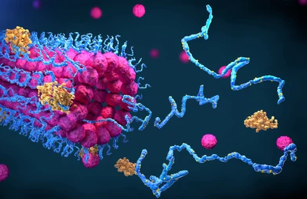
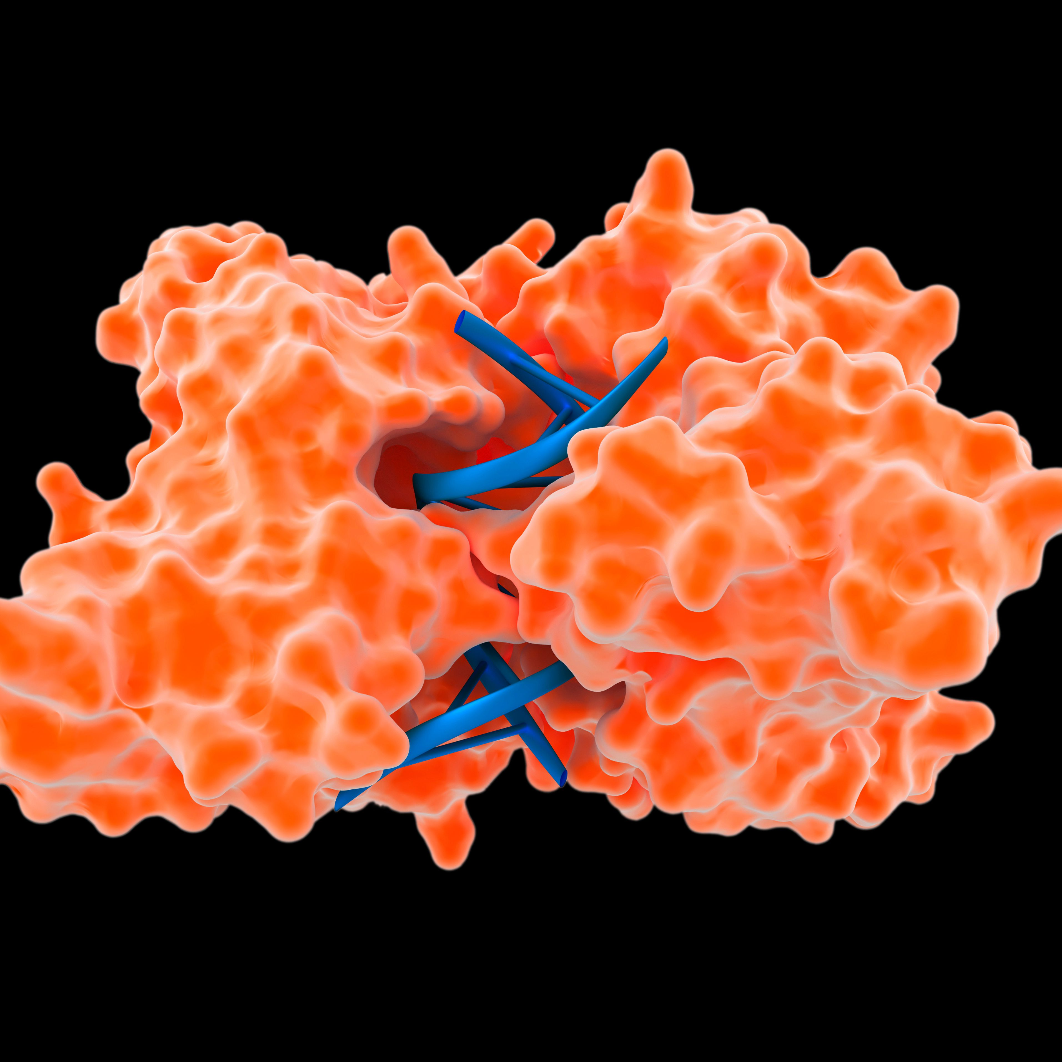
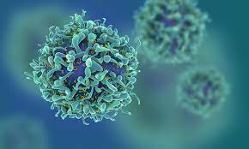
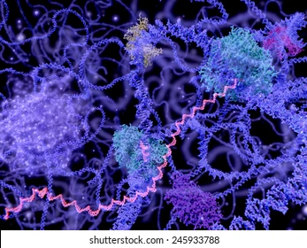
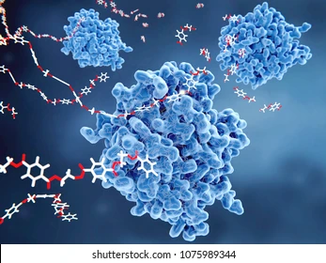
THANK YOU FOR THE ATTENTION!

Slide 61
What is the covalent modification?

