Slide 1
Medical education in Switzerland

Slide 2
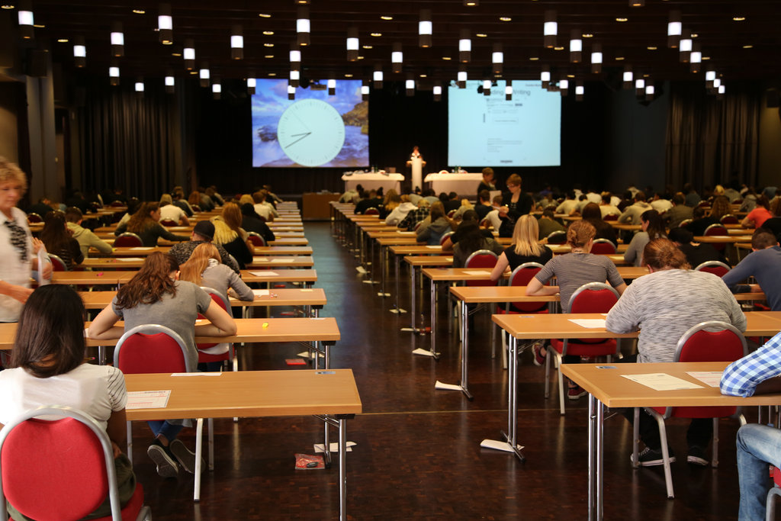
Admission
Entrance examinations: foreign language, maths, history, biology and chemistry.
The education costs about 1000-2500€ for year.

Slide 3
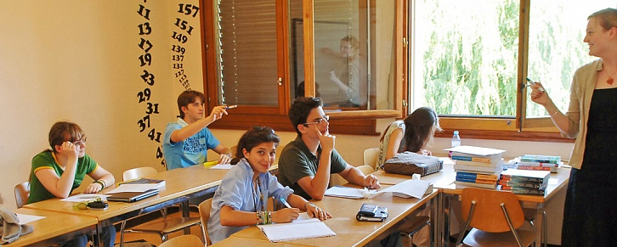
Academic year
Starts in September, finishes in June.
Divides into 3 terms.

Slide 4
Scholarships
It’s received by masters.

Slide 5
Learning process
Basic level
profile study of the selected disciplines and directions
additional courses, practice
narrow medical specialization

Slide 6
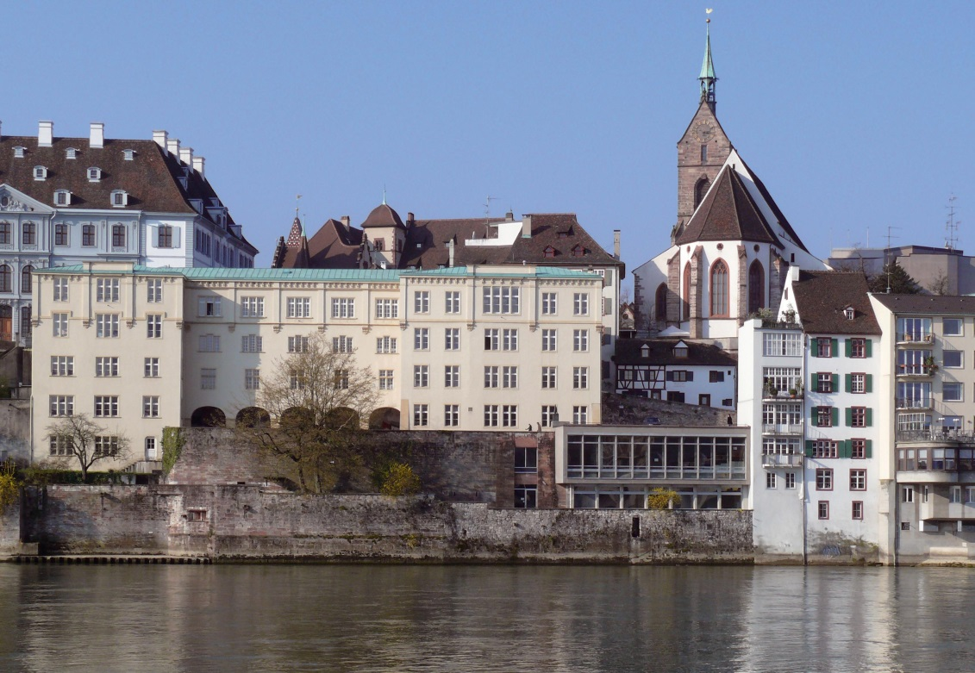
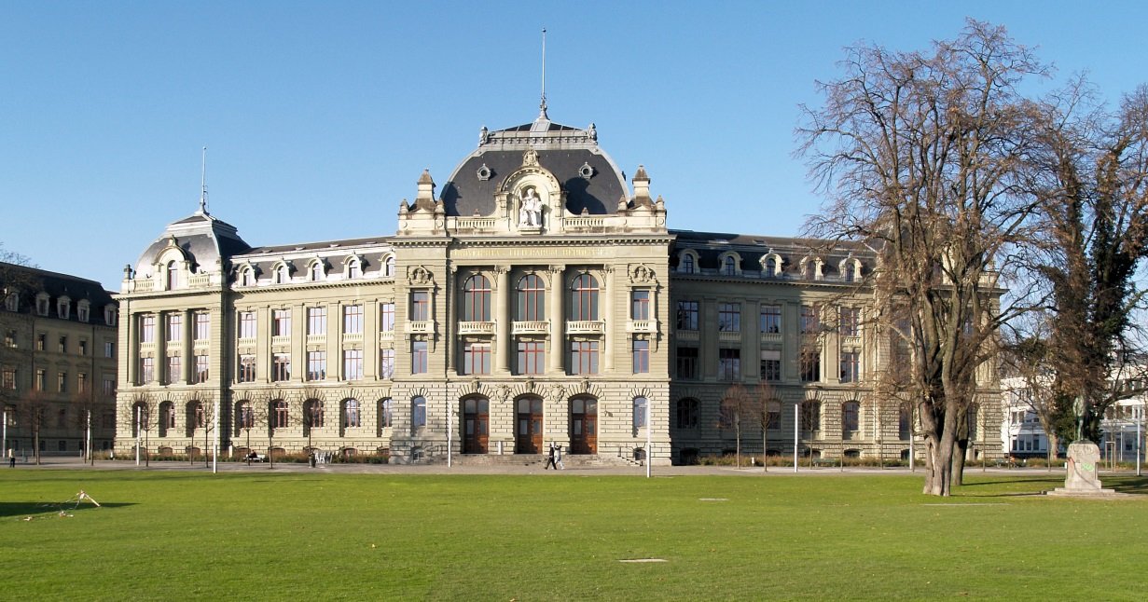
Most popular universities
University of Basel
University of Bern

Slide 7
Thank you for attention

