Slide 1
FGBOU VO Krasnoyarsk State Medical University named after prof. V.F. Voyno-Yasenetsky Ministry of Health of Russia
Department of Physical and Rehabilitation Medicine with a practise course
Topic: Medical rehabilitation in
diseases of the cardiovascular system
lecture No. 4 for 3rd year students studying in the specialty 31.05.03 - Dentistry (training using an intermediary language (English))
Head of the Department, MD. Mozheyko E.Yu. Krasnoyarsk 2023

Slide 2
Lecture plan
Medical rehabilitation in cardiology:
The prevalence of cardiovascular diseases
The concept of cardiological rehabilitation
Goals, objectives, contraindications to medical rehabilitation after myocardial infarction
The relevance of rehabilitation measures after Coronary artery bypass grafting

Slide 3
The purpose of the lecture:
To introduce students to the concept of medical rehabilitation in cardiology.

Slide 4
Relevance
Rehabilitation of patients with coronary artery disease who have undergone coronary artery bypass grafting (CABG) or coronary artery stenting is a complex of medical and social measures aimed at restoring their health, labor and psychological status.

Slide 5
Cardiological rehabilitation.
⦿ Cardiological rehabilitation is understood as a set of measures carried out under medical supervision (supervision) aimed at helping a patient who has suffered a myocardial infarction or a severe cardiological disease, as well as after cardiac surgery, for a better and faster recovery of physical parameters to the maximum possible level of activity.

Slide 6
Comprehensive cardiological rehabilitation -
this is a process that should:
start immediately;
go on uninterrupted;
be carried out in stages;
based on the individual characteristics of the patient;
to be carried out in a way acceptable to the patient and his environment.

Slide 7
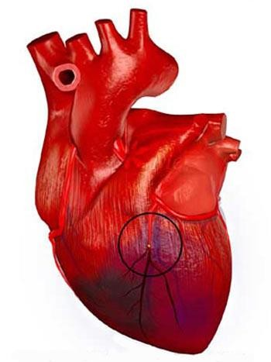
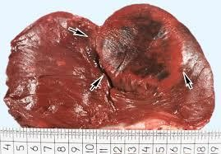
Myocardial infarction is one of the clinical forms of ischemic
diseases
of a heart,
with
passing
the development of ischemic necrosis of the area of the myocardium due to absolute or relative insufficiency of its blood supply.

Slide 8
Rehabilitation after myocardial infarction includes the following points:
Diet Therapy
Drug rehabilitation after myocardial infarction (correction of dyslipidemia, possible complications).
Metered physical activity.
Therapeutic gymnastics.
Psychological rehabilitation

Slide 9
Goals rehabilitation:
⦿ The opportunity to avoid disability and return to normal work
⦿ reduce the risk of repeated heart attacks and
other cardiovascular events
⦿ reduce the risk of death from heart disease
⦿ improve the physical condition of the patient
⦿ reduce the need for medicines
⦿ reduce blood pressure
⦿ slow down the progression of atherosclerosis
⦿ weight loss
⦿ improving the quality of life.

Slide 10
At the stage of rehabilitation , the following tasks are set:
Physical
Psychological
Social
Restoration to the maximum possible level of CCC functions and restoration of physical performance of patients
Preparation for independent life and industrial activity
Fear of repeated
heart attack

Slide 11
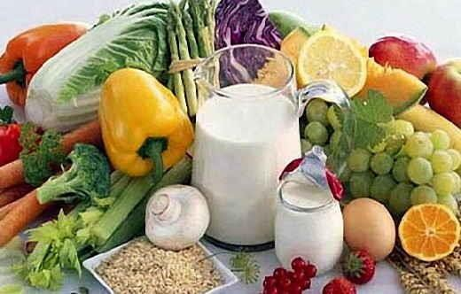
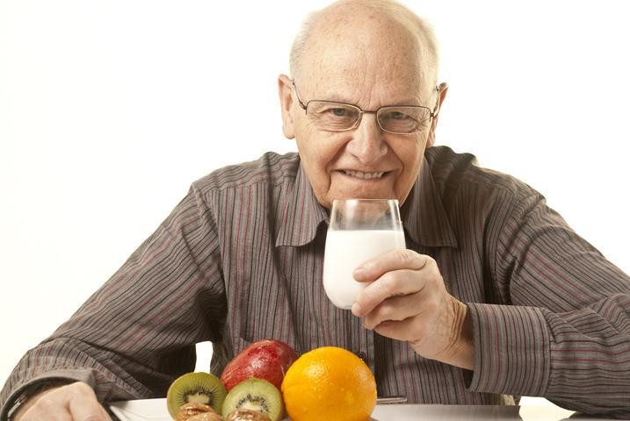
Diet after myocardial infarction makes it possible to normalize or at least reduce the phenomena of atherogenic
dyslipidemia, and therefore effective as a primary prevention of recurrent myocardial infarction.

Slide 12
6 "golden rules" of diet after myocardial infarction
⦿ reduce fat intake;
⦿ drastically reduce the consumption of foods containing saturated fatty acids (animal fats, butter, cream, eggs), as they contribute to hyperlipidemia;
⦿ increase the consumption of polyunsaturated fatty acids, which are contained in the following products: liquid vegetable oils, fish, poultry, marine products, polyunsaturated fatty acids reduce the level of lipids in the blood;
⦿ it is necessary to increase the consumption of fiber and complex carbohydrates (vegetables and fruits);
⦿ completely replace butter with vegetable oil when cooking
⦿ limit the amount of table salt in food to 3–5g per day.

Slide 13
Contraindications of physical therapy:
acute infectious diseases, mental and oncological diseases, venereal diseases, blood diseases in acute stages and stages of exacerbation;
circulatory insufficiency of stage 2B and above;
severe degrees of coronary insufficiency;
recurrent course of myocardial infarction;
severe degrees of conduction and heart rhythm disorders;
hypertension III FC;
cardiac aneurysm (acute or chronic) with detections circulatory insufficiency above stage I;
aortic aneurysm;
violation of cerebral circulation in the acute or subacute stage;
recurrent thromboembolic complications;
decompensated diabetes mellitus.

Slide 14
Stationary stage
Assign the following motor modes:
Bed (strictly bed and light bed)
Ward
Free.

Slide 15
The main tasks of physical therapy at the stationary stage are:
⦿ — prevention and elimination of complications of hypodynamia syndrome (hypostatic pneumonia, thrombosis, intestinal atony, muscle weakness, etc.), limiting restorative measures;
stabilization of the main clinical, instrumental and laboratory parameters;
formation of an adequate psychological
patient's reactions;
formation of such a level of physical activity of the patient, at which he could serve himself.

Slide 16
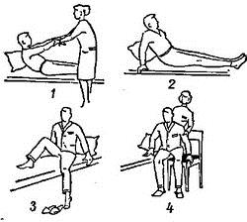
At the beginning of the activation of patients with pulmonary hypertension, it is recommended to carry out in the initial position lying in bed, then sitting on a chair, and when the patient begins to walk, standing. The duration of the Therapeutic gymnastics procedure increases from 7-10 to 15-20 minutes.
⦿ Exercises should be easily accessible, familiar, mostly isotonic in nature.
⦿ They are performed slowly, then at an average pace, often with an incomplete range of movements, with mandatory inclusion in the DU procedure and relaxation.

Slide 17
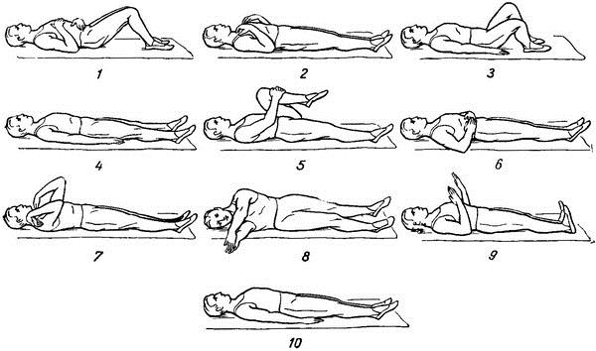

Slide 18
⦿ Objective data (heart rate, blood pressure, frequency and nature of respiration, skin coloration, sweating, etc.) are carefully evaluated.,
⦿ patient complaints (fatigue, pain, interruptions, brain symptoms, dry mouth, discomfort).
⦿ In the 1st week, the heart rate should not be increased, the maximum allowable deviation is 10 beats per minute. The Therapeutic gymnastics complex is performed 2-3 times a day, 1.5— 2 hours after meals, under the control of heart rate.

Slide 19
Sanatorium stage:
The following motor modes are used in sanatoriums and dispensaries:
⦿ gentle,
⦿ gentle-training
⦿ coaching.

Slide 20
Tasks of the sanatorium stage:
⦿ restoration of physical performance of patients;
⦿ psychological readaptation of patients;
preparation of patients for independent life and industrial activity.

Slide 21
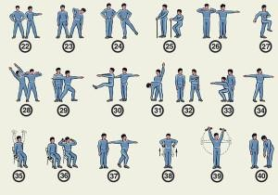

Slide 22
The main means are aerobic loads: therapeutic gymnastics, metered training walking (terrenkur), training on simulators
⦿ Therapeutic walking can be performed at a walking pace (20— 40 steps per minute), at a slow pace (50-70 steps)

Slide 23
Outpatient-polyclinic stage of rehabilitation
⦿ The main goals of rehabilitation are the completion of the period of temporary disability, the restoration of lost working capacity, the implementation of measures for the secondary prevention of myocardial infarction

Slide 24
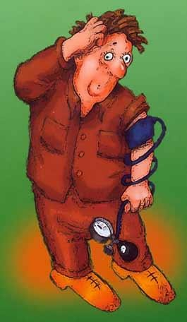
Arterial systolic hypertension (ASH) – condition, in which BP composes 140 mmHg. and more and/or diastolic blood pressure is 90 mmHg or more, provided that these values are obtained as a result of at least three measurements made at different times in a calm environment, and the patient did not take drugs that change blood pressure that day.

Slide 25
Non - drug methods include:
Quitting smoking;
Diet therapy ;
Reducing the consumption of alcoholic beverages < 30 g of alcohol per day in men and 20 g/day in women;
Physical therapy;
Physiotherapy;
Massage

Slide 26
Stage I Hypertension:
The rehabilitation program for stage patients has a preventive and curative orientation and includes:
Therapeutic gymnastics, walking, running, swimming, terrancourt, skiing, hiking, volleyball. Therapeutic gymnastics is performed by the group method in I.P. lying, sitting, standing.
Exercises are used for all muscle groups at an average pace. The duration of classes is 25 – 30 minutes.

Slide 27
Stage II – III Hypertension
The rehabilitation program of patients depends on the patient's condition, the severity of existing complications and the degree of adaptation of the patient to physical exertion. The stationary stage of rehabilitation is built according to three modes:
⦿ Strict bedding, extended bedding.
⦿ Ward.
⦿ Free.
Physical therapy is not carried out on strict bed rest.

Slide 28
Functional Efficiency (FE)
⦿ FE = 1550 – 8.2 age + 5.23 height –7.36 HRd – 5.44 HRs
⦿ Age – in years, height – in cm, blood pressure – in mmHg

Slide 29
Depending on the level of physical performance, 4 functional classes of patients are distinguished.
⦿ I – high physical performance (men 1350 kgm/min, women 1200 kgm/min).
⦿ II – satisfactory physical performance (men 1200-750 kgm/min, women 1050-600 kgm/min).
⦿ III – low physical performance (men 600-450 kgm/min, women 450 kgm/min).
⦿ IV – very low (men and women 300 kgm/min).

Slide 30
Recommendations:
⦿ I – recommend an active motor mode, long walking at a fast pace, skiing, cycling, cycling, swimming.
⦿ II – recommend walking at an average and fast pace, increasing the distance, swimming, skiing, exercise bike, UGG.
⦿ III – Therapeutic gymnastics according to the traditional method, Morning hygienic gymnastics.
⦿ IV – over time, walking turns on with a gradual increase in speed and distance. Patients require careful medical supervision.

Slide 31
Rehabilitation after coronary artery bypass grafting and stenting

Slide 32
Relevance
⦿ Today in cardiac surgery there are effective ways
to win over CHD is significant
to extend life human.
⦿ The two most common methods of restoring blood flow through narrowed heart arteries are:
Angioplasty and artery stenting;
Coronary artery bypass grafting (CABG).

Slide 33
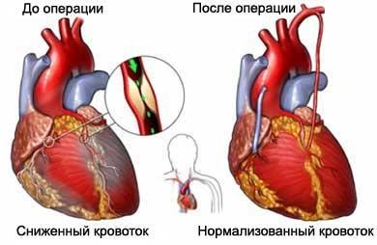
Coronary artery bypass grafting (CABG)
⦿ CABG is a surgical intervention, as a result of which the blood flow of the heart is restored below the site of narrowing of the vessel.
With this surgical manipulation, another pathway for blood flow to the part of the heart that was not supplied with blood is created around the narrowing site.

Slide 34
Types of coronary bypass surgery
⦿ With the use of artificial blood circulation;
⦿ Without artificial blood circulation with the use of a "stabilizer" for bypass surgery;
⦿ The use of minimal surgical incisions, including endoscopic operations.

Slide 35
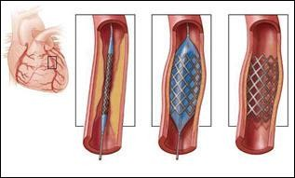
Stenting
⦿ endovascular intervention on the coronary arteries for the purpose of implantation into a narrowed segment of the cardiac artery of the stent, as a result, the blood supply to the area of the heart muscle below the site of vessel constriction is restored

Slide 36
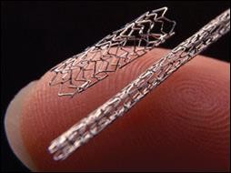
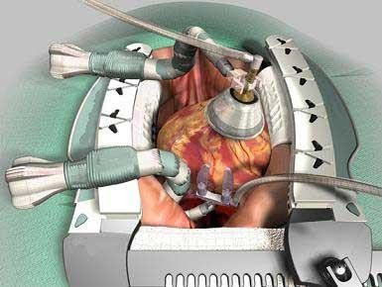
The main differences of the methods
The CABG method is more
complex and
is accompanied by
temporary disability due to the application of the operating
chest injuries
⦿ Coronary stenting method is low-traumatic and allows early
start physical activity and get down to normal work

Slide 37
⦿ Patients who have undergone CABG surgery must undergo three stages of rehabilitation:
Inpatient, includes cardiac surgery and rehabilitation department;
Sanatorium;
Dispensary.

Slide 38
Prognosis of patients who underwent
coronary artery bypass grafting (CABG), depends on a number of circumstances
⦿ The first is the "technical" features of the performed surgical intervention (for example, autoarterial bypass surgery is characterized by better patency of shunts and a lower risk of recurrent exacerbations of coronary artery disease compared to autovenous bypass surgery).
⦿ The second is the presence of concomitant diseases before the operation (previously suffered myocardial infarction, diabetes mellitus, heart failure, age, etc.).
⦿ The third is a direct dependence on the efforts of the patient and the doctor aimed at preventing and preventing early complications of CABG (atrial fibrillation, heart failure, venous thrombosis and thromboembolism), preventing further progression of atherosclerosis and coronary artery disease.

Slide 39
⦿ The duration of rehabilitation at all stages is from 6 to 8 weeks. The first stage (in a cardiac surgery clinic) is 10-14 days. Duration of the second stage (cardiology department or rehabilitation department)
– 2-3 weeks, the third (sanatorium treatment) – up to 3-4 weeks. Full recovery can take from 4-6 months.

Slide 40
Stationary stage of rehabilitation
⦿ Begins with preoperative preparation of patients and includes medical, physical, mental aspects and continues to the intensive care unit after surgery, in the cardiac surgery department (before removal of stitches) for 10-14 days, then the rehabilitation department of the inpatient type for 3-4 weeks

Slide 41
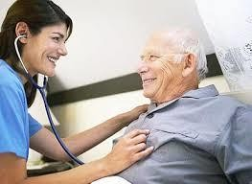
The peculiarity of the recovery period in patients who underwent stenting
⦿ The patient can be discharged from the clinic the very next day after the operation.

Slide 42
Physical rehabilitation
Absolute contraindications:
⦿ Angina pectoris IV functional class;
⦿ Severe postoperative pericarditis;
⦿ Heart failure 2B - 3 stages;
⦿ Inadequate blood pressure response to physical activity;
⦿ Cardiac arrhythmias;
⦿ Thrombophlebitis and other inflammatory diseases of organs and systems;
⦿ Atherosclerosis of extracranial vessels of the brain with
transient ischemic attacks in the anamnesis;
⦿ Atherosclerosis of the vessels of the lower extremities with ischemia of the lower extremities 2B - 3 stages;
⦿ Pronounced diastasis of the sternum (contraindications for physical activity of the upper extremities).

Slide 43
Goals of physical rehabilitation
⦿ Restore the functions of the cardiovascular system, physical performance and maintain it at the achieved level
⦿ To return the patient to professional activity
⦿ To stop the progression of atherosclerosis, coronary heart disease and the development of ACS
⦿ Improve psychological status
⦿ Increase life expectancy

Slide 44
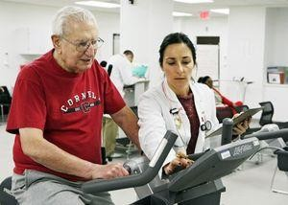
⦿ Physical rehabilitation begins from the first day after the surgical intervention.

Slide 45
⦿ Motor load is used as the main means for the recovery of patients after CABG.
⦿ On the first day, you can already sit on the bed, reach for a chair, performing several attempts.
⦿ On the second day, you can already get out of bed and move around the ward with the help of a nurse,
and also start performing simple exercises of physical therapy for hands and feet.

Slide 46
⦿ After the healing of the sternum suture, the patient is allowed to move on to more complex exercises (usually after five to six weeks).
⦿ The most important rule is the dosing of physical activity, restriction in lifting weights. The main types of exercise during this period include walking, light running, various exercise equipment, swimming. During physical exercises, starting from the first day after surgery and as the patient recovers, the most important indicators of the cardiovascular system are monitored - blood pressure, pulse rate, ECG.

Slide 47
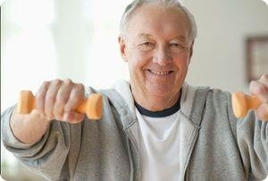
The training session includes:
⦿ Therapeutic gymnastics
– 15-20min.
⦿ Training on a bicycle ergometer - 20 - 30min.
⦿ Walking – 10min.
⦿ The duration of one lesson is 45- 60 minutes. Classes are held 24-30 days

Slide 48
Therapeutic gymnastics
⦿ The choice of exercises and duration depends on the group of physical activity and the patient's condition.
⦿ The objectives of the Therapeutic gymnastics: prevention of cardiorespiratory complications, the development of adhesions, posture disorders, gradual adaptation of the cardiovascular system to physical exertion, increasing the psychoemotional status of the patient.

Slide 49
The Therapeutic gymnastics procedure uses:
⦿ General developmental exercises for upper and lower limbs, neck and trunk;
⦿ Static and dynamic breathing exercises;
⦿ Diaphragmatic breathing;
⦿ Exercises for relaxation of skeletal muscles;
⦿ Coordination and balance exercises;
⦿ Exercises for training muscle strength and endurance.

Slide 50
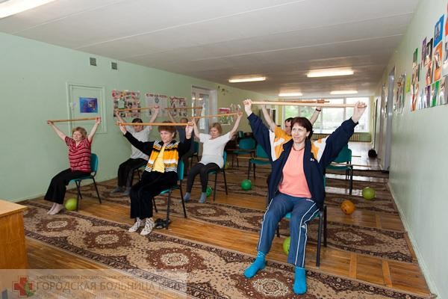

Slide 51
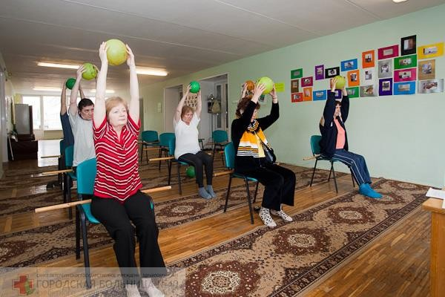

Slide 53
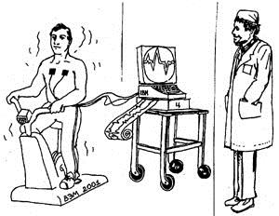
Veloergometry
⦿ Tasks
bicycle ergometry: improving physical performance by increasing the coronary reserve, improving the functional state of the cardiovascular system (increased myocardial contractility, normalization of vascular tone, activation of anticoagulants
blood systems), normalization of the central nervous system, normalization of metabolism, elimination of muscle imbalance.

Slide 54
Stages of bicycle ergometry:
⦿ Each of which lasts from 5 to 10 days. Duration 20-30minutes.
Stage 1 and 2 includes a five-minute warm-up and a training part alternating with rest. Stage 3 the training load time increases to 10 minutes with 1 minute of rest. Stage 4 20-minute load, without rest with a gradual decrease in load.

Slide 55
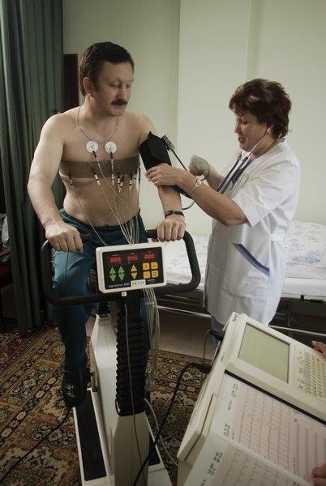
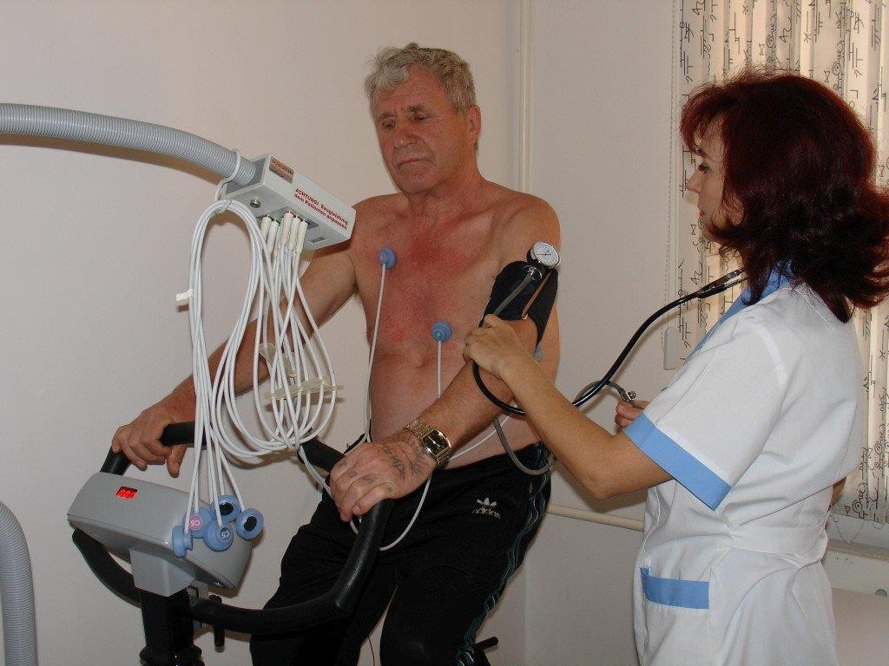

Slide 56
The scheme of training on an exercise bike at home
⦿ The training begins with a load level of less than 50% of the achieved power during the VEM test. Within 5 minutes, it gradually increases to a load equal to 50%.
⦿ Main phase- intensity remains at the achieved level or increases to 60%. Duration - at least 30 minutes.
⦿ The lesson ends with a gradual decrease in the load during 5-10 minutes.

Slide 57
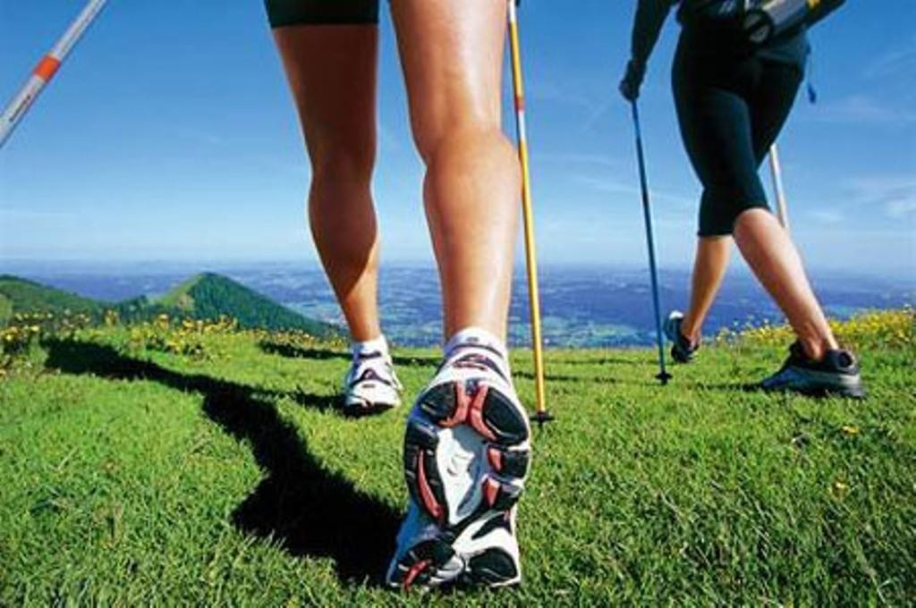
Dosed walking
⦿ Increases the vitality of the body, strengthens the muscles of the heart, improves blood circulation, breathing and leads to increased physical performance.
Duration 20 –
30 minutes.
⦿ Upon discharge from the surgical department , the patient passes through
the corridor is 200-400 meters in for 10 minutes, at a speed of 70-60 steps in 1 minute. Upon discharge from the hospital: 20-30 minutes, at a speed of 90-100 steps in 1 minute.

Slide 58
Walking pace
⦿ D.M. Aronov's formula: X = 0.042M + 0.15h + 65.5
⦿ X - the desired walking pace (steps/min)
⦿ M - threshold load power at the VEM test (in kgm/min)
⦿ H - HR at the load height in the VEM sample

Slide 59
Therapeutic massage
⦿ improves vascular tone
⦿ normalizes blood pressure
⦿ eliminates the phenomenon of stagnation
⦿ activates metabolic processes.
⦿ The technique is gentle without vigorous impact, at a slow pace, pain is not allowed.
Massage begins in the back and collar area, ends in the heart area.

Slide 60
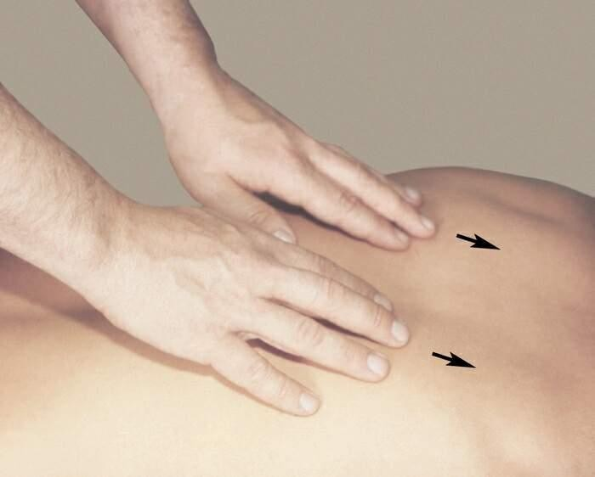
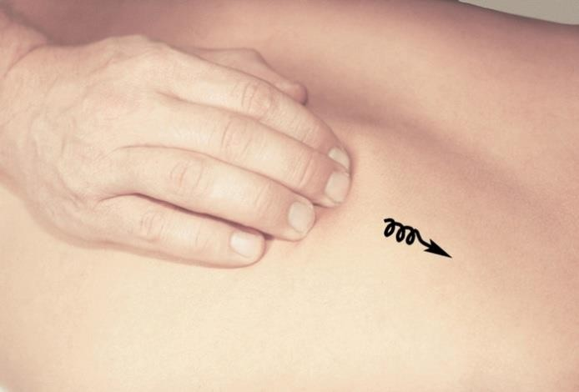
⦿ The duration of the event is 15-20 minutes.
⦿ The first 3-5 procedures – no more than 10 minutes. Only 10-15 procedures are performed every other day.

Slide 61
Mental rehabilitation
⦿ Due to prolonged surgery, extensive chest trauma and postoperative brain hypoxia, many patients experience temporary psychoemotional disorders. They worry about their condition, are anxious, do not believe in the possibility of recovery, do not sleep well, complain of headaches, dizziness. In such situations, psychological rehabilitation is necessary.

Slide 62
Goal
Formation of an adequate attitude to their condition in patients
⦿ Removal of psychoemotional stress
⦿ Increasing the patient's commitment to the implementation of medical recommendations
Full participation of the patient in cardiorehabilitation and secondary prevention programs.

Slide 63
Diet therapy
Goals:
Get rid of excess weight
Reduce blood pressure
Reduce the level of cholesterol in the blood

Slide 64
Diet therapy
⦿ Restriction of consumption of animal products rich in cholesterol and unsaturated fatty acids
⦿ Fish consumption
⦿ Increased consumption of plant-based products
-dietary fiber not less than 30g/day
-pectin substances not less than 15g/ day
⦿ Limit salt intake

Slide 65
⦿ At the end of treatment in the rehabilitation department, the patient is individually selected a training regime and, having received appropriate recommendations, is sent to the sanatorium stage-lasting at least 24 days.

Slide 66
Spa treatment
⦿ To fully restore the body, as well as strengthen it, it is necessary to undergo a rehabilitation course in a cardiorheumatology sanatorium.
The course of treatment is 4-8 weeks. It is advisable to hold it every year. In such sanatoriums, general strengthening physiotherapy procedures, therapeutic gymnastics and massage are carried out.

Slide 67
Dispensary stage of rehabilitation
⦿ At this stage, therapeutic and preventive measures and physical rehabilitation are continuing on the basis of recommendations received at the inpatient stage. The control is carried out by cardiologists at the place of residence. The physical aspect of rehabilitation should take place in the department of rehabilitation treatment in the polyclinic under the supervision of a cardiologist and a rehabilitologist.

