Slide 1
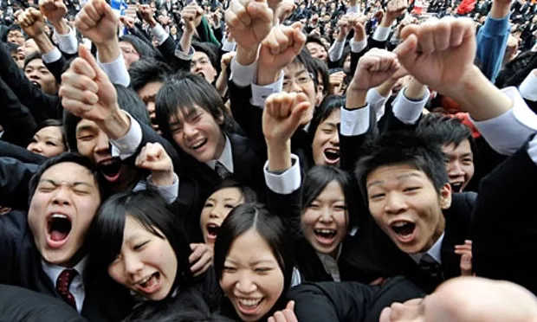
Medical education in Japan

Slide 3
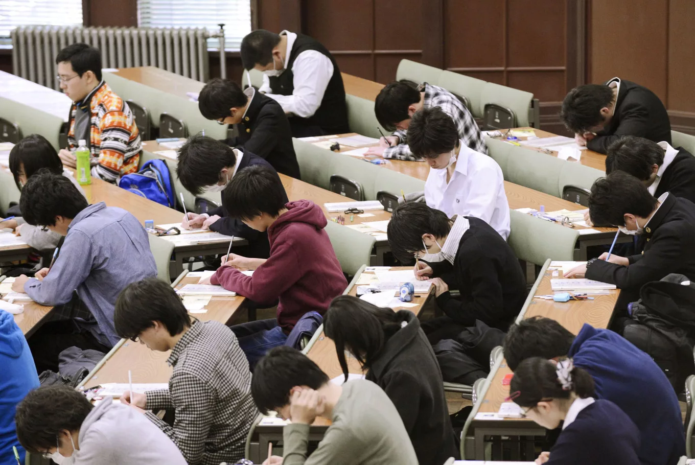
These are Future students

Slide 5
Test for knowledge of Japanes

