Slide 1
Sights of Krasnoyarsk

Slide 2
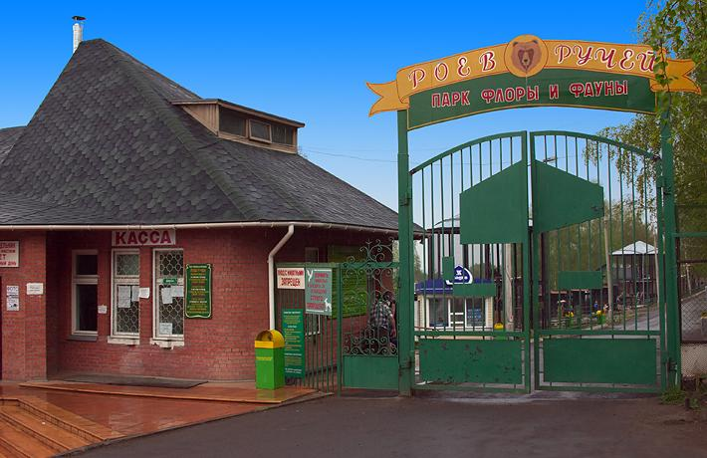
The Park flora and fauna «Roev Ruchey»
Area: 54 hectares.
The zoo is home to 6764 species of fauna of 720 species.
In the Park there are more than 946 species, 400 varieties and 140 thousand specimens of plants.

Slide 3
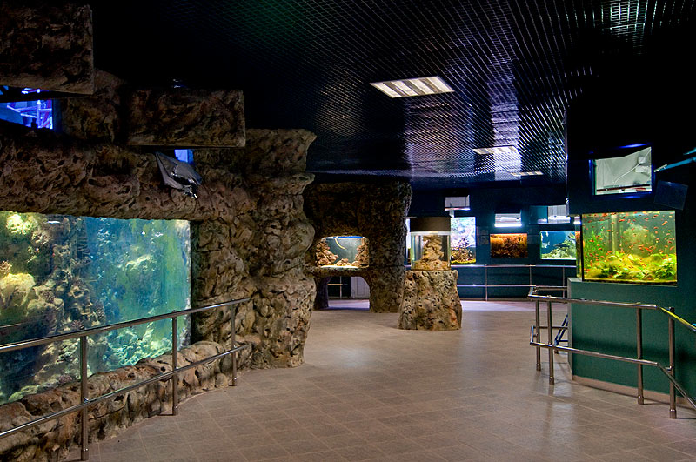
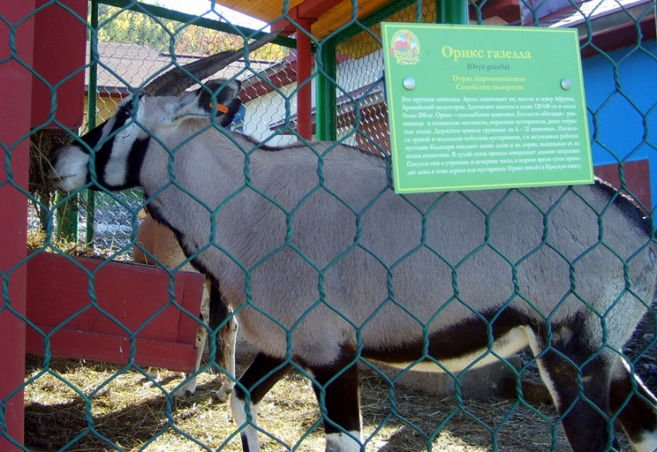
The Park flora and fauna «Roev Ruchey»

Slide 4
Embankment of the Yenisei River

Slide 5
Organ hall
Built in 1911.
The length of the largest pipe is almost 5 meters.
At the same time serves as an active Catholic Church of the Transfiguration.

Slide 6
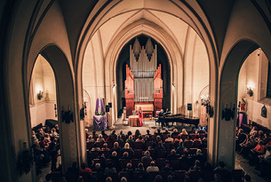
Organ hall

Slide 7
Thank you for your attention!

