Slide 1
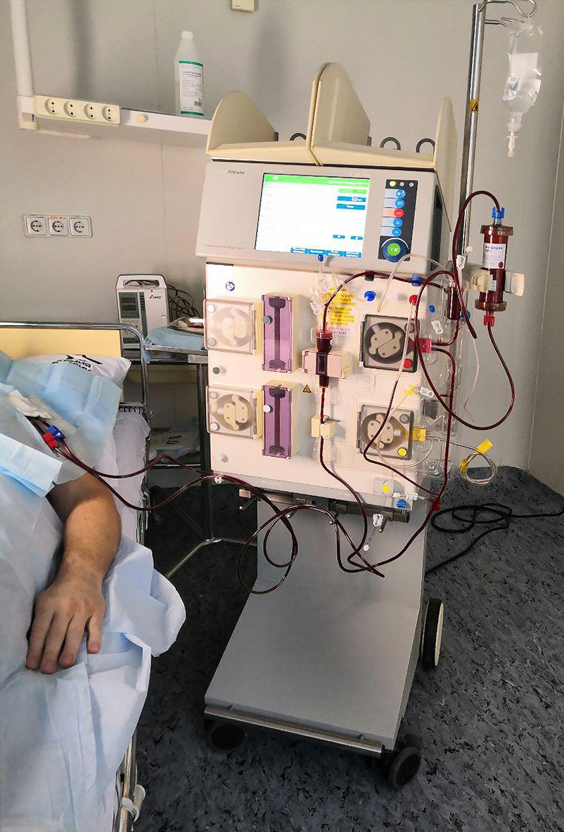
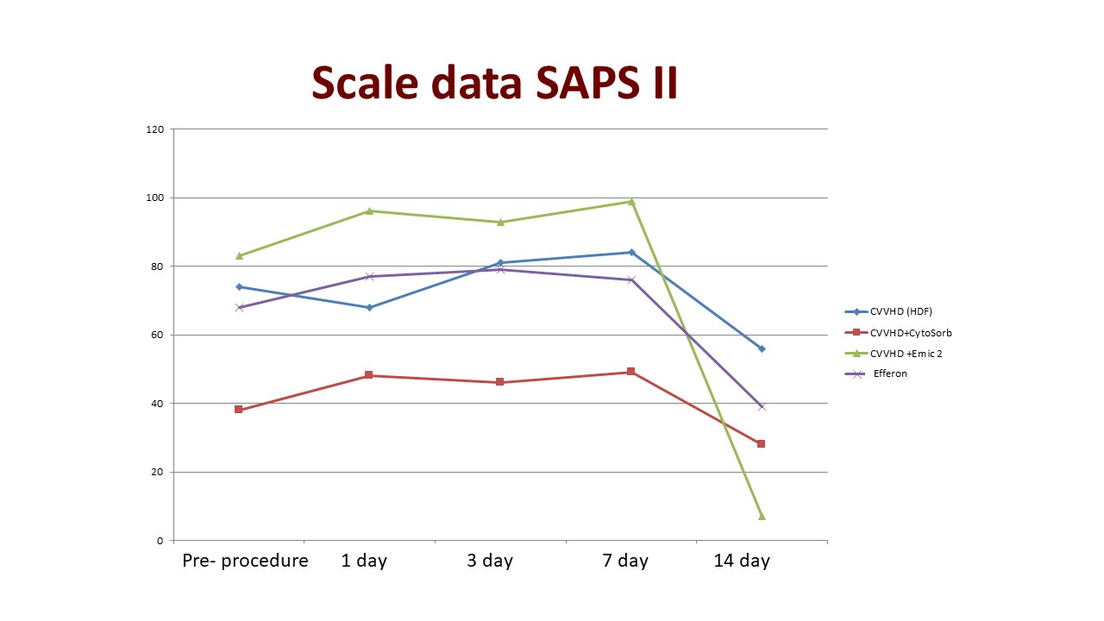
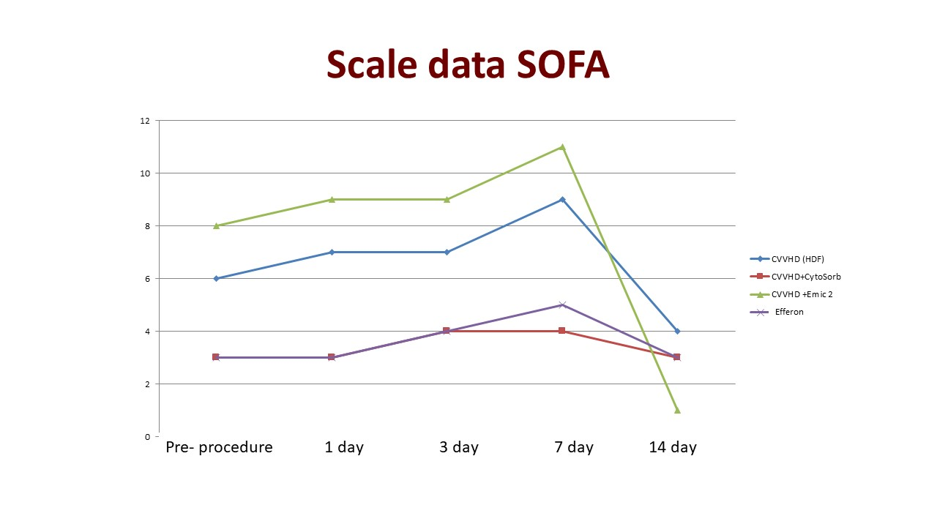
Efferent methods of detoxification - hurry without being late
The use of Efferent Methods of Detoxification in Sepsis Against the Background of Coronavirus Infection COVID - 19
A. Gritsan¹; D. Dzhabrailov¹; V. Ishutin²; V. Novokreshchennykh² ; V.Smimova¹
¹Anaesthesiology and Intensive Сare , V.F. Volno - Yasenetsky Krasnoyarsk State Medical University, Regional Clinical Hospital, Krasnoyarsk, Russia;
²Anaesthesiology and Intensive Care , Krasnoyarsk Regional Clinical Hospital, Krasnoyarsk, Russia
INTRODUCTION
Methods of efferent detoxification are widely used in sepsis and septic shock. However, when searching the PubMed database for the keywords "covid - 19 haemodialysis" and "cytosorb covid - 19" for the period 01/01/2020 - 09/30/2021, 113 and 19 publications were found, respectively.
OBJECTIVES
To evaluate the results of the use of efferent detoxification methods in patients with sepsis against the background of a new coronavirus infection COVID – 19.
METHODS
A retrospective study was conducted, which included 173 patients with sepsis on the background of COVID - 19, who were treated with efferent methods of detoxification under ICU conditions for the period from April 01, 2020 to August 30, 2021. The patients were divided into 4 groups : group 1 CVVDHD (n = 95) , group 2 - CVVHD + CytoSorb (n =36) , group 3 - CVVHD + Emic2 (n = 39) , group 4 - Efferon CT/LPS (n = 12) .
The severity of the condition was assessed in patients according to the SOFA , SAPS II scale, laboratory parameters (CRP , PCT , creatinine , D - dimers , leukocytes , lactate, platelets ) . The study was carried out at the following stages : I - before the first procedure , II - after 24 hours , III - after 3 days , IV - 7 days from its onset . The duration of NIV , MV , the duration of treatment in the ICU, and mortality were also assessed . Data are given as M [ 25 % ; 75 % ] , absolute values and percentages .
CONCLUSIONS
The survival rate of patients with sepsis and COVID - 19 using efferent detoxification methods was 24.8 %, of which : CVVHD - 22.2 %, CVVHD + Cytosorb - 27.8 %, CVVHD + Emic2 - 4 %, Efferon CT / LPS - 41.7 %. The study has limitations. Further studies are required, including multicenter.
CONTACT INFORMATION
Alexey Gritsan - Doctor of Medical Sciences, Professor, Head of the Department of Anaesthesiology and Intensive Care, V.F. Voino-Yasenetsky Krasnoyarsk State Medical University, e-mail: gritsan67@mail.ru
RESULTS
The results are presented in table 1. After 24 hours ( stage II ) from the start of detoxification , the level of CRP in group 1 decreased by 18.8 % , in the 2nd - by 18.6%, in the third - by 19.7%, in the 4th - by 19.2 % compared to baseline, respectively. In the future (stages III , IV), there was no significant dynamics in comparison with stage II. Also , in the study groups in the process of conducting statistically significant changes in the level of leukocytes in all groups at the stages of the study ( in comparison with baseline levels ) were not observed .
Table1 . Comparative characteristics of the studied groups
Parameters | 1 group ( n = 95 ) | 2 group ( n = 36 ) | 3 group ( n = 30 ) | 4 group ( n = 12 )
Age , years | 64 [ 56;69 ] | 4 [ 51; 5 ] | 65 [59 ; 66 ] | 57 [48;64 ]
SAPS II , points | 74 [ 54:89 ] | 38 [ 19:47 ] | 83 [ 81;86 ] | 68 [58;80 ]
SOFA , points | 6 [ 4:10 ] | 3 [ 2 ; 5 ] | 8 [ 6 ; 10 ] | 3 [ 3 ; 7 ]
CRP , mg / l | 112[ 54; 211] | 81[19; 156] | 117[72;137] | 172[95; 232]
Leucocytes, 10⁹/l | 13 [ 11 ; 19 ] | 8 [ 7 ; 11 ] | 13 [ 7 ; 20 ] | 10 [ 8 ; 14 ]
Length of stay in the ICU , day | 9 [ 7; 12 ] | 9 [ 8 ; 18 ] | 7 [ 4 ; 10 ] | 14 [ 7 ; 19 ]
Mortality , abs / % | 74 / 77.8 | 26 / 7.7 | 96.6 / 29 | 7 / 58.3

