Slide 1
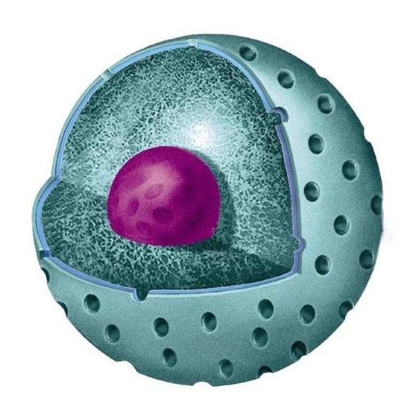
Topic: The nucleus, structural components of the nucleus. Reproduction cells.
Krasnoyarsk State Medical University named after
professor V.F. Voino-Yasenetsky
Department of Biology and Ecology
Candidate of biological sciences, associate professor
Zubareva Ekaterina
Vladislavovna
Krasnoyarsk, 2020

Slide 2
Lesson plan:
1. Structure of the nucleus 2. Characteristics of the structural components of the nucleus. 3. The nucleus functions. 4. Cell cycle.

Slide 3
The purpose of the lesson is
To study the structure of the nucleus, its functions and the cell cycle as a process of transferring hereditary information.

Slide 4
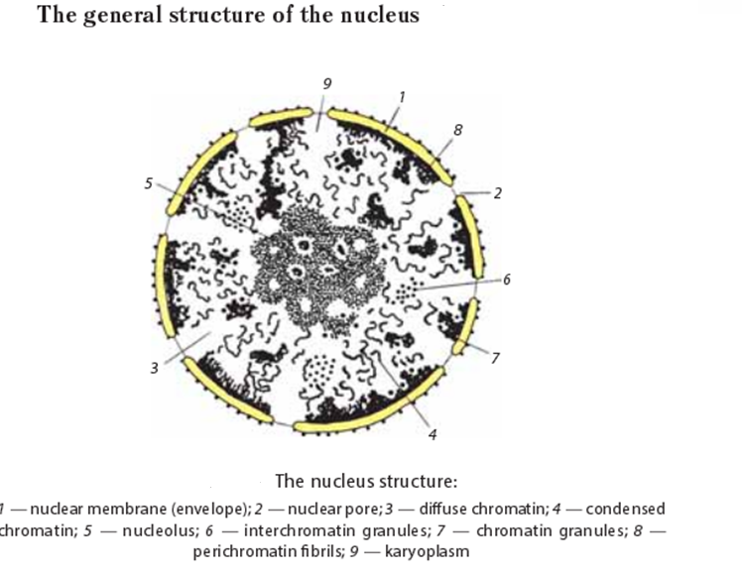

Slide 5
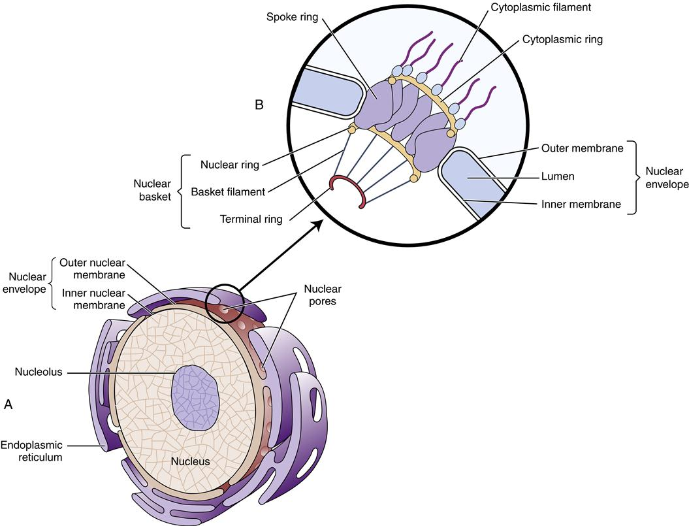
The nuclear pore is the complex of peripheral and central protein molecules, providing transport into and out of the nucleus.
The pore is a hole with the diameter of around 100 nm. The number of nuclear pores is unstable and may change depending on the functional activity of the nucleus. It may increase while the nucleus reaches the top of its activity.

Slide 6
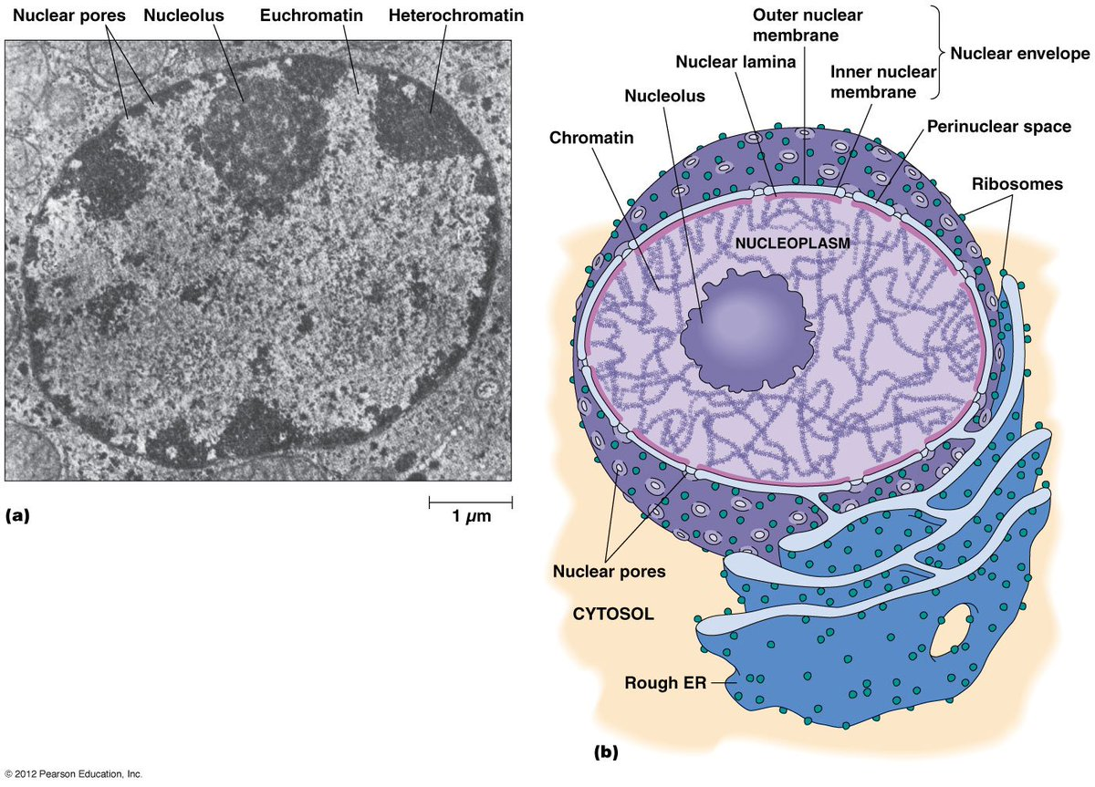

Slide 7
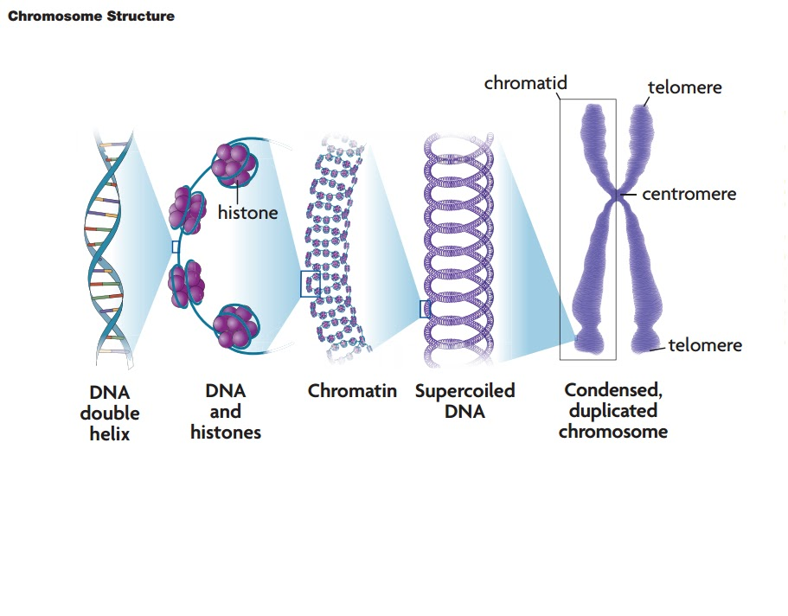
Chromatin is well stained with basic dyes. Chromatin includes DNA, associated with proteins (histones and non-histones).

Slide 8
The diameter of double-stranded DNA is 2 nm. The chromatin and chromosome are the structures to make DNA compact.
There are two types of chromatin depending on functional conditions. Heterochromatin is genetically non-functional fragments of chromatin.
Notes:
Диаметр двухцепочечной ДНК составляет 2 нм. Хромосома - это структура, делающая ДНК компактной.
Молекула ДНК, связанная с гистонами, образует сложную структуру нуклеопротеина, известную как нуклеосома. В зависимости от функциональных условий существует два типа хроматина. Гетерохроматин - это генетически нефункциональные фрагменты хроматина.
Он интенсивно окрашен, хорошо виден в световой микроскоп, существует в виде гранул или комков и сильно уплотнен (спирализован). Эухроматин - это генетически активные фрагменты хроматина, слабо окрашенные, невидимые в световом микроскопе, деконденсированные. Хромосомы (от греч. Chroma - пигмент, а некоторые - тело; термин был предложен немецким ученым Генрихом Вальдейером в 1888 г.) - это конденсированный хроматин во время митоза или мейоза.

Slide 9
Heterochromatin is intensively stained, well visible through the light microscope and highly condensed (spiralized). Euchromatin is genetically active fragments of chromatin, weak stained, invisible in the light microscope, decondensed.

Slide 10
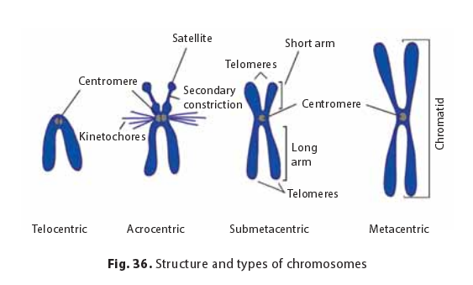
Chromosome Types
Chromosome classification was developed by Russian scientist Sergei Navashin in 1912–1914. There are four types of chromosomes. Metacentric (equal arms) - a centromere is in the middle of the chromosome. Submetacentric (non-equal arms) - a centromere is shifted from the central region of the chromosome. Acrocentric chromosomes have a very short second arm (a centromere is placed close to the edge of the chromosome). Telocentric chromosomes carry only one arm (a rare type of chromosomes).

Slide 11
The nucleus functions are
the storage of genetic information and its transfer to daughter cells while division;
control and regulation of cellular activity;
participation in biosynthesis;
the place where ribosomal subunits are constructed.

Slide 12
Cell division

Slide 13
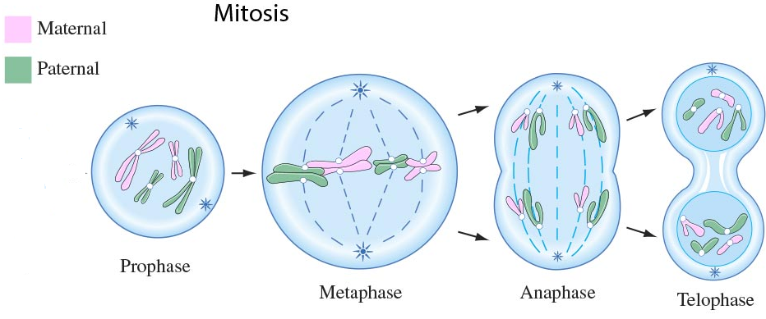
Mitosis
1. Prophase (2n4c). The longest phase of mitosis. Chromosomes’ condensation; mitotic apparatus formation: chromosomes spiralization; the nuclear envelope and nucleoli fragmentation; the centrioles move toward the cellular poles; the cell spindle composed of microtubules are formed between them.
Notes:
Профаза (2n4c). Самая продолжительная фаза митоза. Конденсация хромосом; формирование митотического аппарата: спирализация хромосом; ядерная оболочка и фрагментация ядрышек; центриоли движутся к полюсам клеток; Между ними образуются клеточное веретено, состоящее из микротрубочек.

Slide 14
Mitosis
2. Metaphase (2n4c).
The metaphase plate formation. Sister chromatids are placed in the equatorial region of a cell. Kinetochores attach to microtubules of the cell spindle. Chromosomes are placed in the equatorial region; centromeres are arranged precisely in equatorial plate.
3. Anaphase (4n4c). Chromatids movement to poles. Centromeres’ division. Chromatids are moving toward the poles. Chromatids become chromosomes of a single chromatid. There are two diploid sets in one cell.
Notes:
Метафаза (2n4c). Формирование метафазной пластинки. Сестринские хроматиды располагаются в экваториальной области клетки. Кинетохоры прикрепляются к микротрубочкам веретена клетки. Хромосомы расположены в экваториальной области; центромеры расположены точно в экваториальной пластине.
Анафаза (4n4c). Движение хроматид к полюсам. Деление Центромер. Хроматиды движутся к полюсам. Хроматиды становятся хромосомами одной хроматиды. В одной ячейке два диплоидных набора.

Slide 15
Mitosis
4. Telophase (4n4c–2n2c). Mitotic apparatus deconstruction. Cytokinesis. Sister chromatids despiralized. Nuclear envelopes reconstructed. Nucleoli reconstructed.
Notes:
Телофаза (4n4c – 2n2c). Деконструкция митотического аппарата. Цитокинез. Сестринские хроматиды деспирализованы. Реконструкция ядерных оболочек. Ядрышки реконструированы.

Slide 16
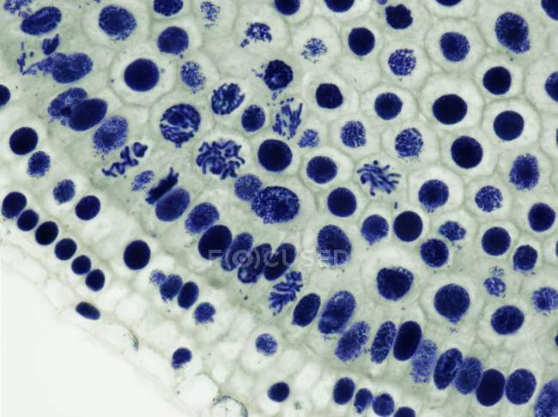
In animal cells, the membrane folds inside from the periphery to the center and the division groove is formed.
In plant cells, the membrane is formed from the center to periphery in the equatorial region of the cell.
As a result, from the cell with the genetic set of 4n4c, two daughter cells with 2n2c are formed.
The plant cell
The animal cell
Biological importance of mitosis is to transfer equal genetic information to each of daughter nuclei. The chromosomal set in daughter cells is precisely the same as in mother cells.
Notes:
В клетках животных мембрана загибается внутрь от периферии к центру и образуется бороздка деления. В растительных клетках мембрана формируется от центра к периферии в экваториальной области клетки. В результате из клетки с генетическим набором 4n4c образуются две дочерние клетки с 2n2c.
Значение митоза. Стабильность хромосомного набора на протяжении поколений. Точная передача генетической информации. Рост и развитие клеток (увеличение популяции клеток). Способ регенерации клеток. Основа для бесполого размножения.

Slide 17
Now you need to solve this test. There are three questions on the screen. You need to choose the letter of the correct answer in each of them and write the letters of the correct answers to me by a message to the phone number 89069146212 within 30 minutes after the end of the lesson, write your name in English by Watsapp. Take a screenshot.
1. What phase (period) is DNA 2n4c in?
A. The G1-period of interphase
B. anaphase of mitosis
C. telophase of mitosis
D. the G2-period of interphase
2. What is the name of the chromosome with only one arm?
A. metacentric chromosome
B. submetacentric chromosome
C. acrocentric chromosome
D. telocentric chromosome
3. What happens in anaphase of mitosis?
A. the formation of the nucleus membrane
B. the nuclear membrane dissolves
C. сhromosomes are found at the equator of the cell
D. chromatids diverge to different poles of the cell

Slide 18
Your homework is (take a screenshot):
1. Fill in the workbook for lesson №3. You need to download the notebook from the folder Departmen of Biology and Ecology – Documents – Biology distabtly – Biology for foreign students – Lesson 3. You can find pictures for filling out a workbook on the Internet. Attach a workbook on the distance education website before November 26, 2020.
2. Compile a dictionary of new terms (20 words) and learn them. I'll check it.
3. You shloud watch the video lecture №2 and four short videos for it.

Slide 19
Thank you for your attantion!

