Slide 1
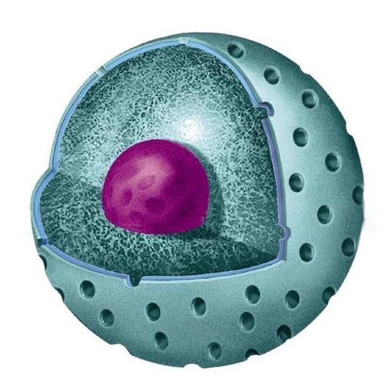
Topic: Genetic material and its characteristics.
Federal State Budgetary Educational Institution of Higher Education “Professor V.F. Voino-Yasenetsky Krasnoyarsk State Medical University”
Department of Biology and Ecology
Discipline: Biology , Lecture № 2
for 1st year students studying in the specialty
Candidate of biological sciences, associate professor
Zubareva Ekaterina
Vladislavovna.
Krasnoyarsk, 2020

Slide 2
Lecture plan:
1. Structure of the nucleus 2. Characteristics of the structural components of the nucleus. 3. The nucleus functions. 4. Cell cycle.

Slide 3
The purpose of the lesson is
To study the structure of the nucleus, its functions, genetic material and the cell cycle as a process of transferring hereditary information.

Slide 4
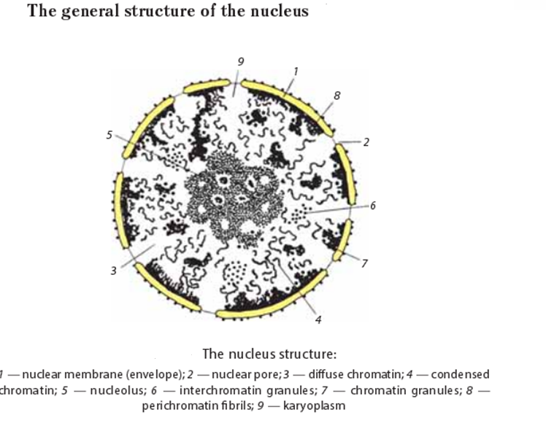

Slide 5
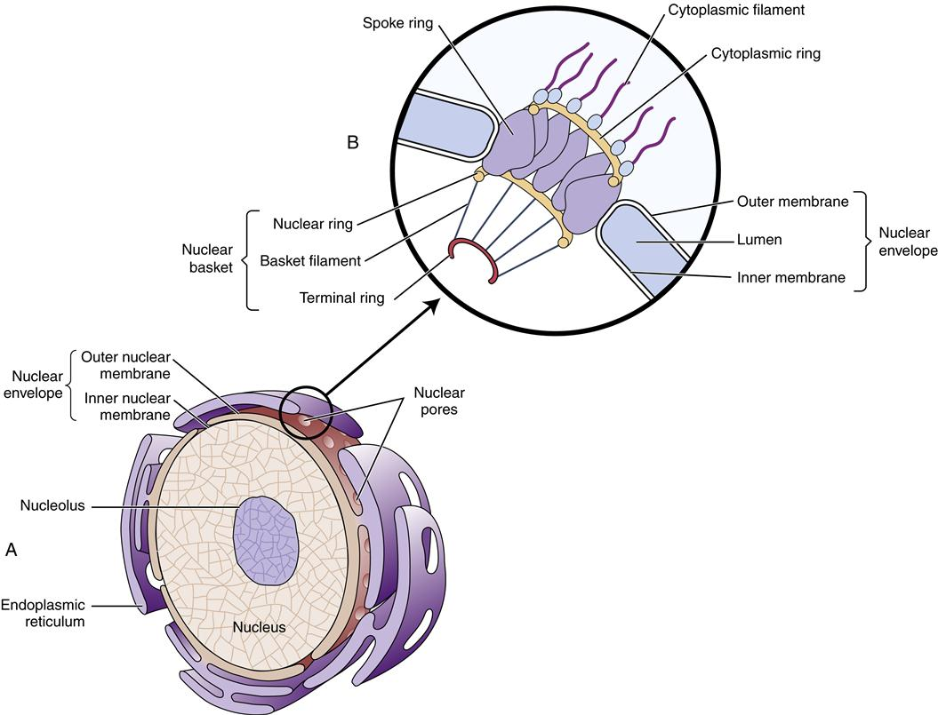
The nuclear membrane (karyolemma) is composed of two membranes with narrow gap between (a perinuclear space).
The pore is a hole with the diameter of around 100 nm. The number of nuclear pores is unstable and may change depending on the functional activity of the nucleus. It may increase while the nucleus reaches the top of its activity.

Slide 6
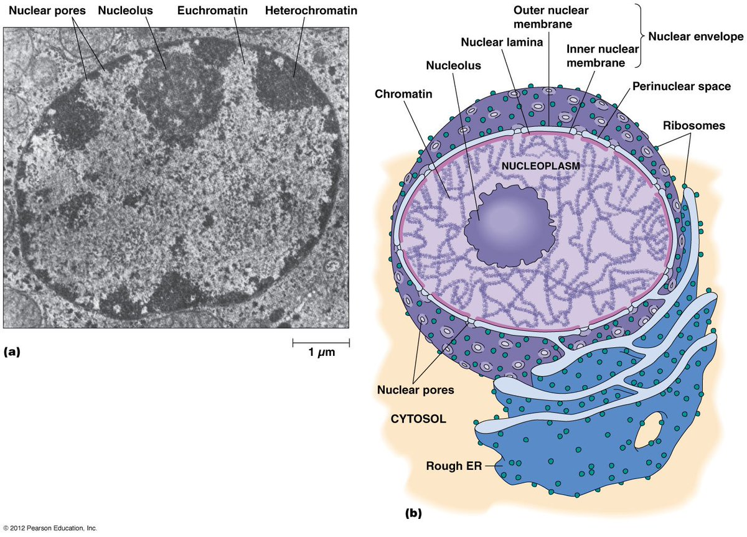

Slide 7
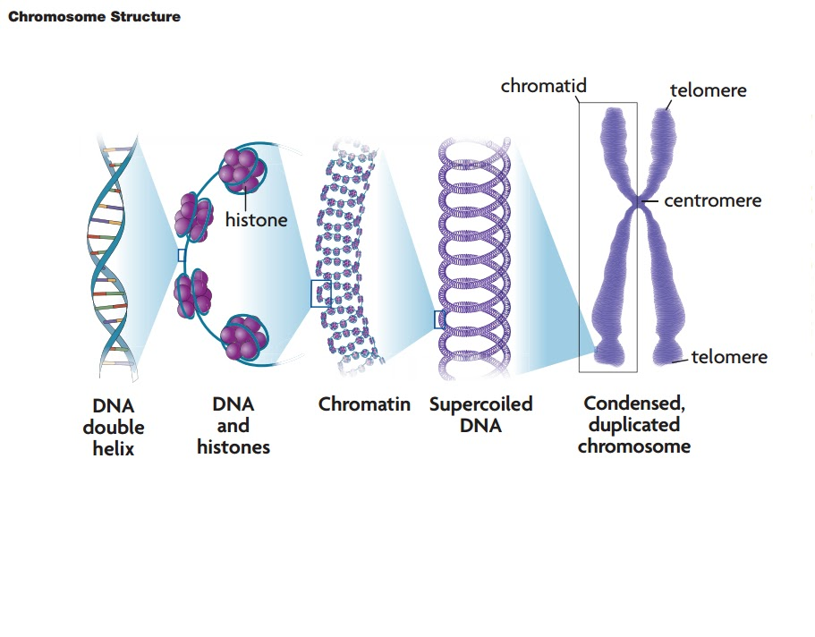
Chromatin is well stained with basic dyes. Chromatin includes DNA, associated with proteins (histones and non-histones).

Slide 8
The diameter of double-stranded DNA is 2 nm. The chromatin and chromosome are the structures to make DNA compact.
There are two types of chromatin depending on functional conditions. Heterochromatin is genetically non-functional fragments of chromatin.
Notes:
Диаметр двухцепочечной ДНК составляет 2 нм. Хромосома - это структура, делающая ДНК компактной.
Молекула ДНК, связанная с гистонами, образует сложную структуру нуклеопротеина, известную как нуклеосома. В зависимости от функциональных условий существует два типа хроматина. Гетерохроматин - это генетически нефункциональные фрагменты хроматина.
Он интенсивно окрашен, хорошо виден в световой микроскоп, существует в виде гранул или комков и сильно уплотнен (спирализован). Эухроматин - это генетически активные фрагменты хроматина, слабо окрашенные, невидимые в световом микроскопе, деконденсированные. Хромосомы (от греч. Chroma - пигмент, а некоторые - тело; термин был предложен немецким ученым Генрихом Вальдейером в 1888 г.) - это конденсированный хроматин во время митоза или мейоза.

Slide 9
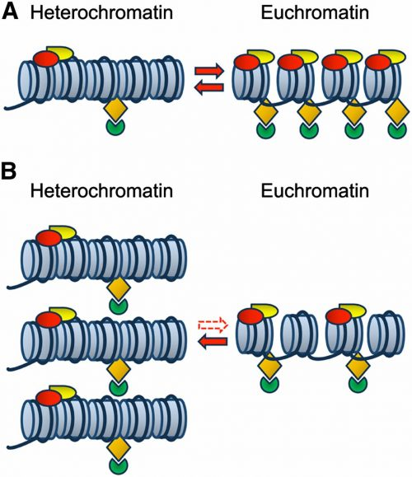
Heterochromatin is intensively stained, well visible through the light microscope and highly condensed (spiralized). Euchromatin is genetically active fragments of chromatin, weak stained, invisible in the light microscope, decondensed.

Slide 10
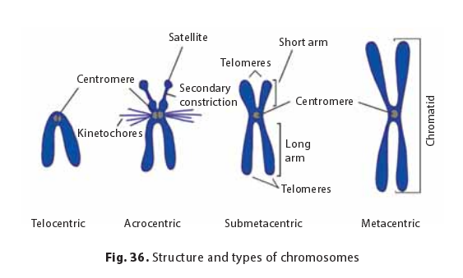
Chromosome Types
Chromosome classification was developed by Russian scientist Sergei Navashin in 1912–1914. There are four types of chromosomes. Metacentric (equal arms) - a centromere is in the middle of the chromosome. Submetacentric (non-equal arms) - a centromere is shifted from the central region of the chromosome. Acrocentric chromosomes have a very short second arm (a centromere is placed close to the edge of the chromosome). Telocentric chromosomes carry only one arm (a rare type of chromosomes).

Slide 11
The nucleus functions are
the storage of genetic information and its transfer to daughter cells while division;
control and regulation of cellular activity;
participation in biosynthesis;
the place where ribosomal subunits are constructed.

Slide 13
ДНК – дезоксирибонуклеиновая кислота
DNA is deoxyribonucleic acid.
Первичная структура – полинуклеотидная цепь, мономеры-нуклеотиды. Нуклеотид = азотистое основание (пуриновые А,Г и пиримидиновые Ц, Т) + сахар дезоксирибоза + остаток фосфорной кислоты. Нуклеотиды соединяются фосфодиэфирными связями (сборка цепи за счет фермента ДНК-зависимой ДНК-полимеразы).
Наращивание цепи идет в направлении
5/ --------3/
DNA is a polymeric molecule that consists of two anti-parallel polynucleotide strands. Each strand consists of different monomers - nucleotides. In a DNA molecule, there can be several hundred thousand or millions of nucleotides. Each monomer or nucleotide consists of three components: a nitrogenous base (one of four) - adenine, guanine, cytosine, and thymine, then sugar - deoxyribose and a phosphoric acid residue. Each thread has ends 3 / and 5 / open for the formation of bonds. The nucleotides of one chain are connected by phosphodiester bonds between the sugar of one nucleotide and the acid residue of another.

Slide 14
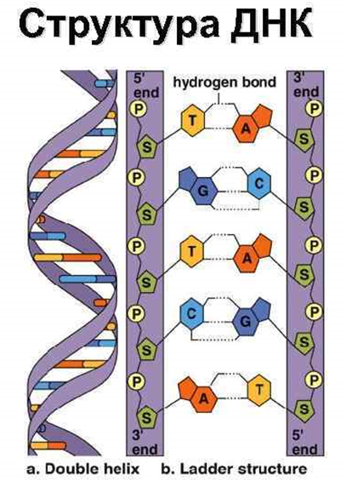
The threads are connected by hydrogen bonds according to the principle of complementarity. That is, two hydrogen bonds are formed between thymine (T) of one strand and adenine (A), and triple hydrogen bonds between cytosine (C) and guanine (G). Guanine and adenine are purine nitrogenous bases, and thymine, cytosine and uracil (only in RNA) are pyrimidine bases.
This is how the primary structure of DNA is formed. Further, the secondary structure of DNA is formed as follows: a double-stranded DNA molecule is twisted into a spiral. The pitch of the spiral is 3.4 nanometers.

Slide 16
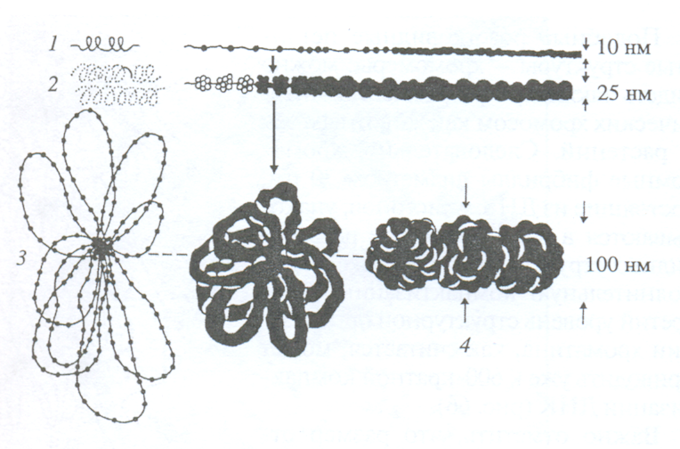
Уровни компактизации ДНК (упаковка)
нуклеосомный
нуклеомерный
хромонемный
хромомерный

Slide 17
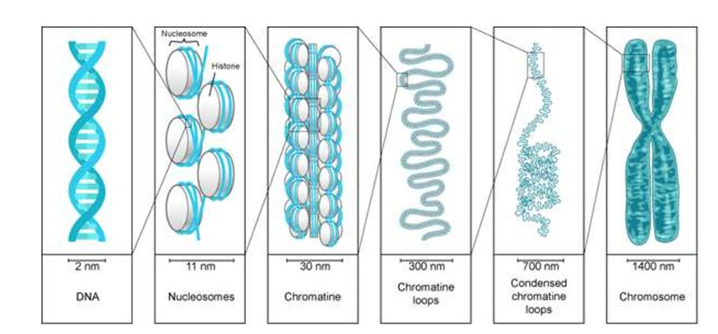
Then the packaging of the DNA molecule continues with the help of histone, and then non-histone proteins. And we're going to look at these levels of DNA packaging now.
1 level of packaging - nucleosome. The double-stranded, twisted DNA is called a linker strand. This thread is wound around the octamers of histone proteins (8 proteins) in the form of "beads" and shortened. 146 nucleotide pairs are wound around the octamer. One such "bead" is called a nucleosome. This level allows you to compress DNA 7 times.

Slide 18
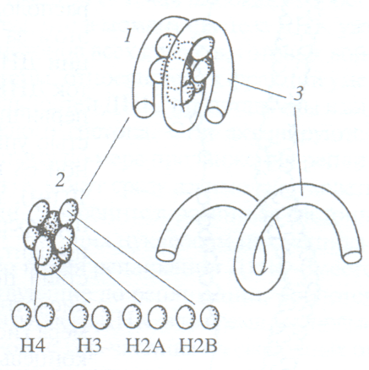
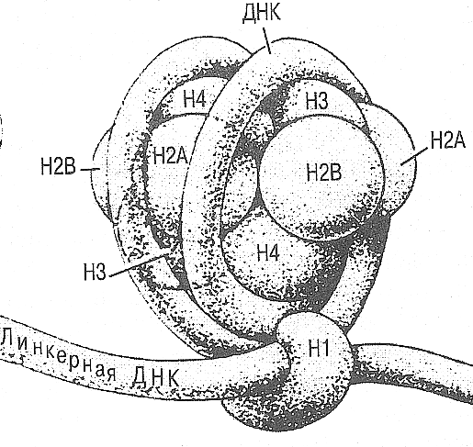
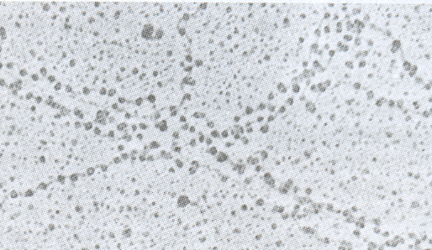
1. НУКЛЕОСОМА – дискретная единица хроматина
4 пары
гистонов
Нуклеосомы в виде «бусин на нити» уплотнение ДНК в 7 раз

Slide 19
Level 2 - nucleomeric. Several nucleosomes approach each other, are fixed with the help of other histone proteins, nucleomers are formed and form a supersperal with a cavity inside - a solenoid. This is already the formation of a chromatin fibril. DNA is compressed approximately 40-70 times.

Slide 20
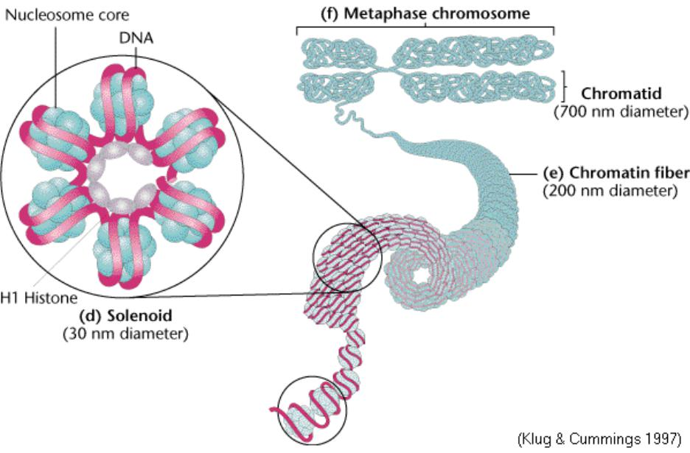

Slide 21
Level 3 - loop or domain or chromomeric. Packaging takes place with the participation of non-histone proteins. The chromatin thread forms a loop system with a diameter of 300 nanometers. DNA is compressed, shortened 600-700 times

Slide 22
Уровени компактизации ДНК (упаковка)
нуклеосомный
нуклеомерный
хромонемный
хромомерный

Slide 23
Level 4 - chronomeric. Now the formation of globules occurs - compression by several thousand times.
Level 5 - condensed metaphase chromosome. Ultra-compact chromatin level. We can see independent chromosomes during mitosis.

Slide 24
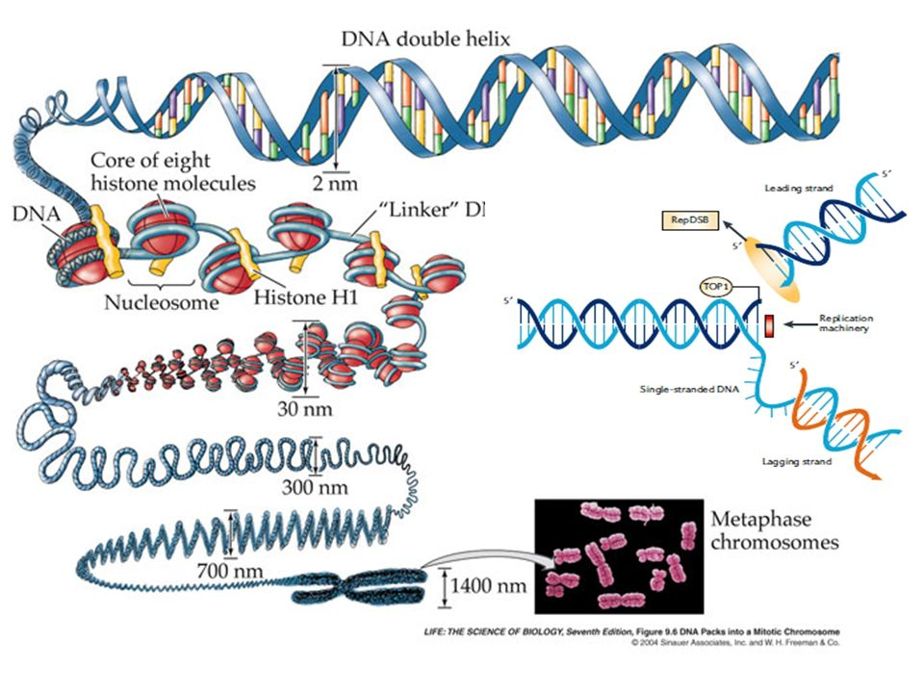

Slide 25
Свойства ДНК. DNA properties:
1. Репликация
2. Репарация
3. Мутация
4. Транскрипция
5. Рекомбинация
1. Replication
2. Reparation
3. Mutation
4. Transcription
5. Recombination

Slide 26
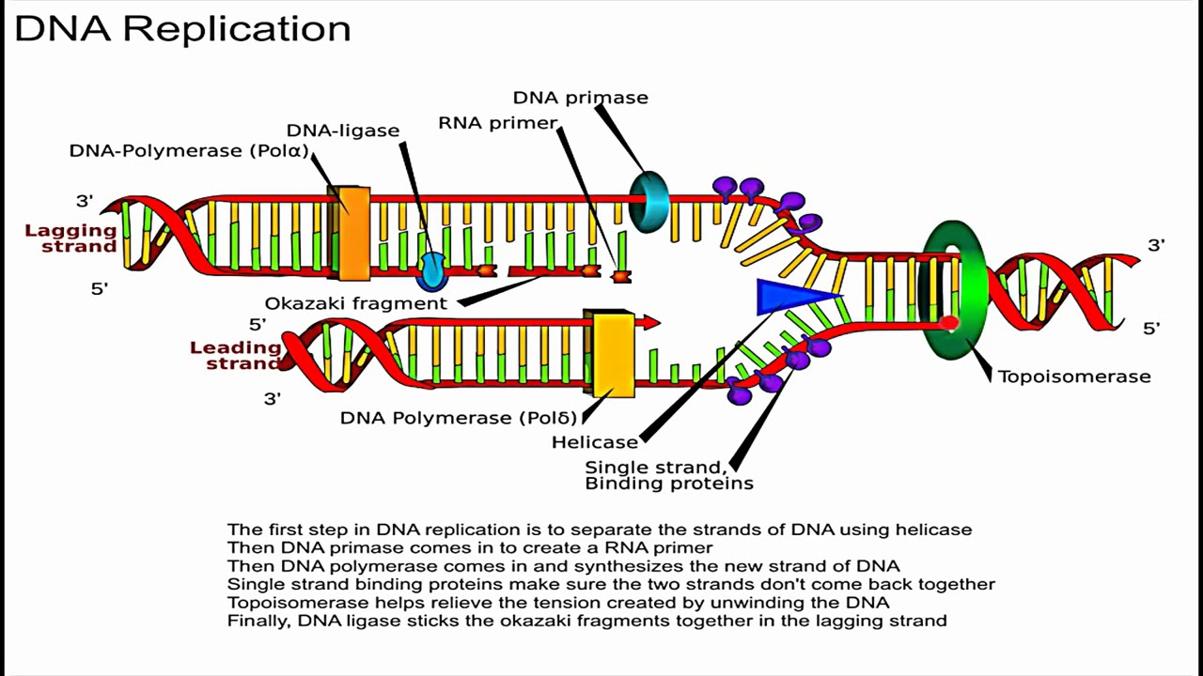

Slide 27
2. Repair is the property of DNA to restore its integrity, i.e. repair damage. The transmission of hereditary information in an undistorted form is the most important condition for the survival of both an individual organism and a species as a whole.
A disturbance in the repair system can lead to premature aging, the development of oncological diseases, diseases of the autoimmune system, cell or body death.

Slide 28
3. DNA mutation - the property of DNA to change its structure under the influence of mutagens. The minimum mutation unit is a muton - a pair of nucleotides. Mutations can be harmful, beneficial, or neutral.
4. Transcription is the process of synthesizing an RNA molecule on a piece of DNA used as a template. The meaning of transcription is the transfer of genetic information from DNA to RNA.
5. DNA recombination - the redistribution of the genetic material DNA by breaking and joining different molecules, leading to the emergence of new combinations of genes or other nucleotide sequences. Crossover is the exchange of sections of homologous chromosomes. This is the norm.

Slide 29
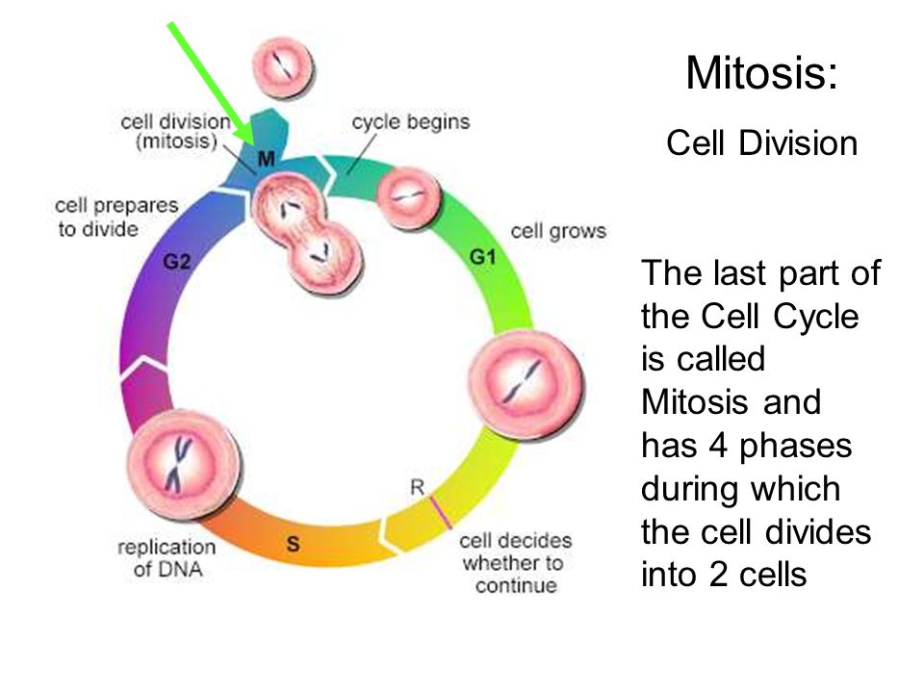
Cell division
https://yandex.ru/video/preview?filmId=9287486862639815898&from=tabbar&parent-reqid=1583674432779536-1304241484028178022100067-sas3-5220&text=the+cell+cycle

Slide 30
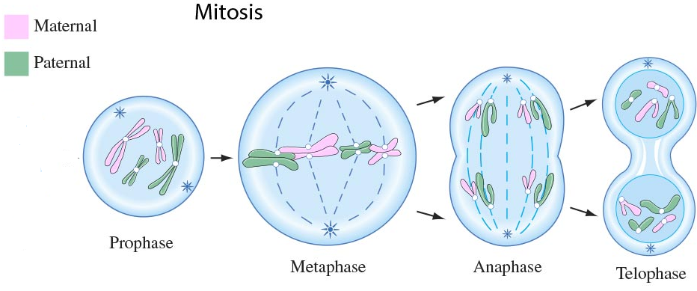
Mitosis
1. Prophase (2n4c). The longest phase of mitosis. Chromosomes’ condensation; mitotic apparatus formation: chromosomes spiralization; the nuclear envelope and nucleoli fragmentation; the centrioles move toward the cellular poles; the cell spindle composed of microtubules are formed between them.
Notes:
Профаза (2n4c). Самая продолжительная фаза митоза. Конденсация хромосом; формирование митотического аппарата: спирализация хромосом; ядерная оболочка и фрагментация ядрышек; центриоли движутся к полюсам клеток; Между ними образуются клеточное веретено, состоящее из микротрубочек.

Slide 31
Mitosis
2. Metaphase (2n4c).
The metaphase plate formation. Sister chromatids are placed in the equatorial region of a cell. Kinetochores attach to microtubules of the cell spindle. Chromosomes are placed in the equatorial region; centromeres are arranged precisely in equatorial plate.
3. Anaphase (4n4c). Chromatids movement to poles. Centromeres’ division. Chromatids are moving toward the poles. Chromatids become chromosomes of a single chromatid. There are two diploid sets in one cell.
Notes:
Метафаза (2n4c). Формирование метафазной пластинки. Сестринские хроматиды располагаются в экваториальной области клетки. Кинетохоры прикрепляются к микротрубочкам веретена клетки. Хромосомы расположены в экваториальной области; центромеры расположены точно в экваториальной пластине.
Анафаза (4n4c). Движение хроматид к полюсам. Деление Центромер. Хроматиды движутся к полюсам. Хроматиды становятся хромосомами одной хроматиды. В одной ячейке два диплоидных набора.

Slide 32
Mitosis
4. Telophase (4n4c–2n2c). Mitotic apparatus deconstruction. Cytokinesis. Sister chromatids despiralized. Nuclear envelopes reconstructed. Nucleoli reconstructed.
Notes:
Телофаза (4n4c – 2n2c). Деконструкция митотического аппарата. Цитокинез. Сестринские хроматиды деспирализованы. Реконструкция ядерных оболочек. Ядрышки реконструированы.

Slide 33
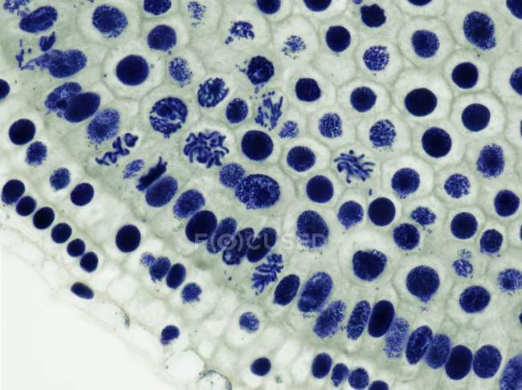
In animal cells, the membrane folds inside from the periphery to the center and the division groove is formed.
In plant cells, the membrane is formed from the center to periphery in the equatorial region of the cell.
As a result, from the cell with the genetic set of 4n4c, two daughter cells with 2n2c are formed.
The plant cell
The animal cell
Biological importance of mitosis is to transfer equal genetic information to each of daughter nuclei. The chromosomal set in daughter cells is precisely the same as in mother cells.
Notes:
В клетках животных мембрана загибается внутрь от периферии к центру и образуется бороздка деления. В растительных клетках мембрана формируется от центра к периферии в экваториальной области клетки. В результате из клетки с генетическим набором 4n4c образуются две дочерние клетки с 2n2c.
Значение митоза. Стабильность хромосомного набора на протяжении поколений. Точная передача генетической информации. Рост и развитие клеток (увеличение популяции клеток). Способ регенерации клеток. Основа для бесполого размножения.

Slide 34
Thank you for your attention!

