Slide 1
List of your group
PLAN
Log in to the site using your password.
You need to find the Distance Tasks page.
You need to find the subject PHYSICS, MATH.
You need to find the topic of the practice.
Read the assignment carefully.
Do everything according to plan.
ПЛАН
Авторизуйтесь на сайте под своим паролем.
Вам нужно найти страницу с дистанционными задачами.
Вам нужно найти предмет ФИЗИКА, МАТЕМАТИКА.
Вам нужно найти тему практики.
Внимательно прочтите задание.
Все делайте по плану.

Slide 2
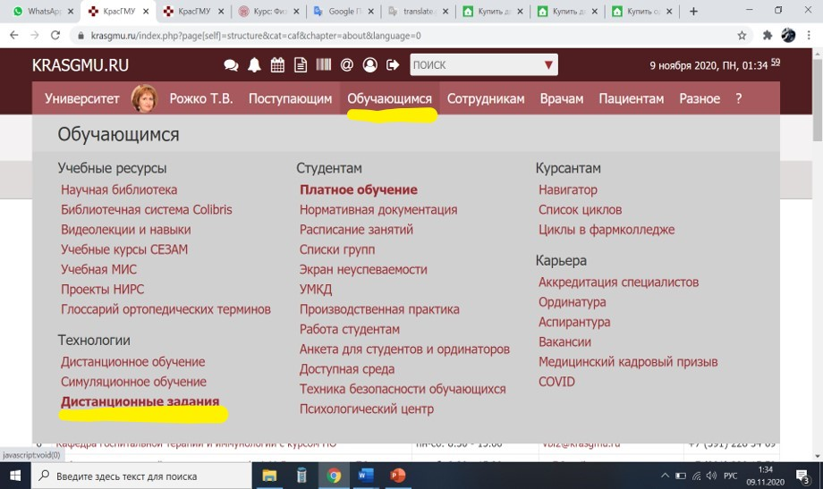
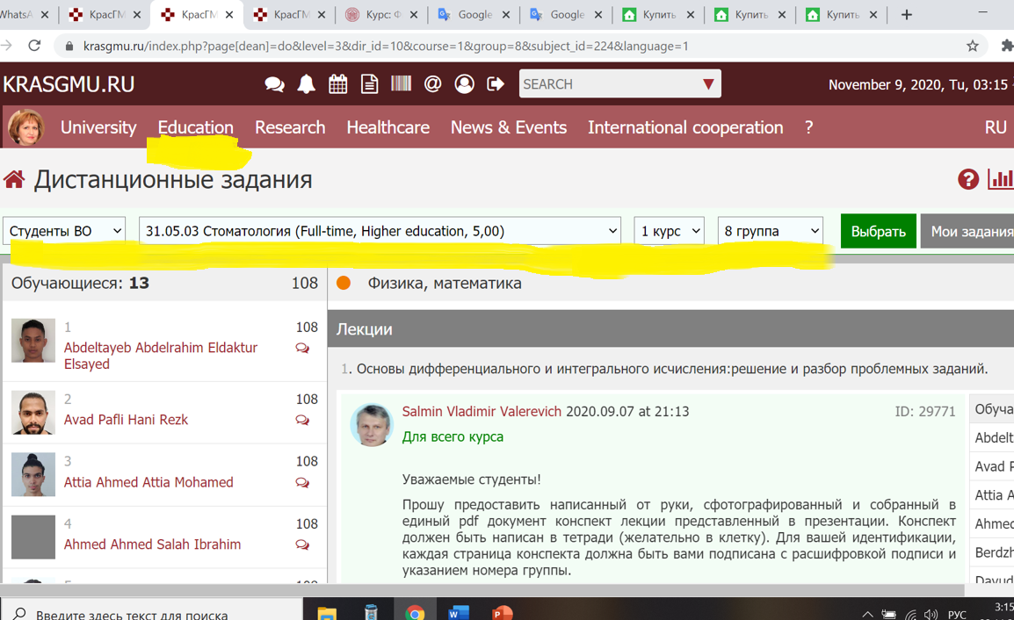
You need to find the distance tasks page
https://krasgmu.ru/index.php?page[dean]=do&level=3&dir_id=10&course=1&group=10&subject_id=224

Slide 3
You need to find the subject
For group c110
https://krasgmu.ru/index.php?page[dean]=do&level=3&dir_id=10&course=1&group=10&language=1

Slide 4
You need to find the distance tasks page

Slide 5
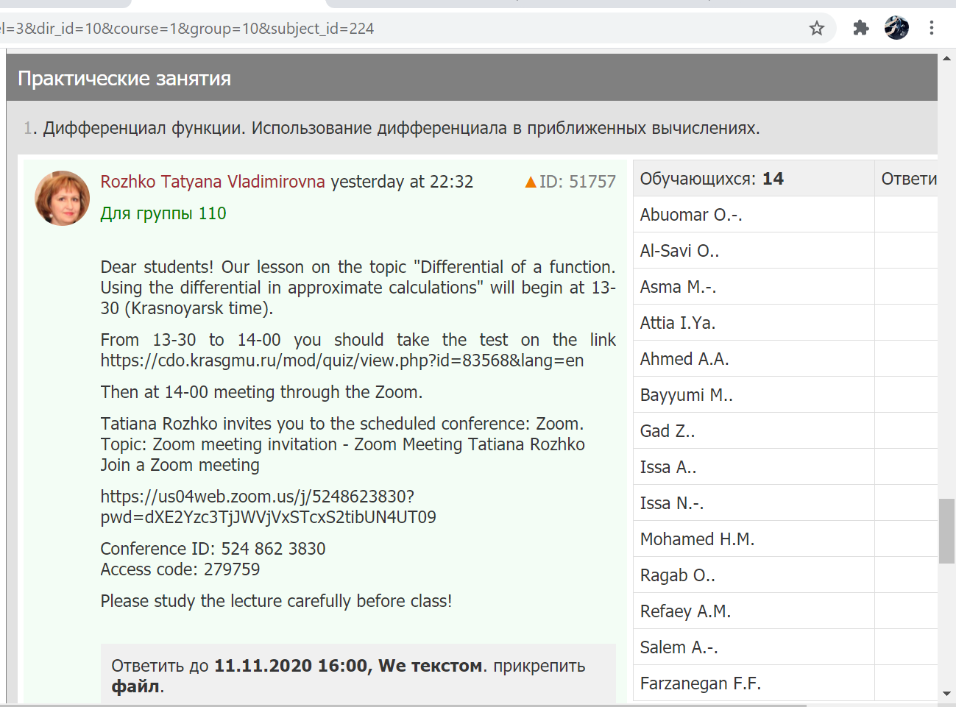
Attach completed tasks.
This is a task and an invitation to ZOOM.
You need to attach your answers here.
One file in PDF or Word format.

Slide 6
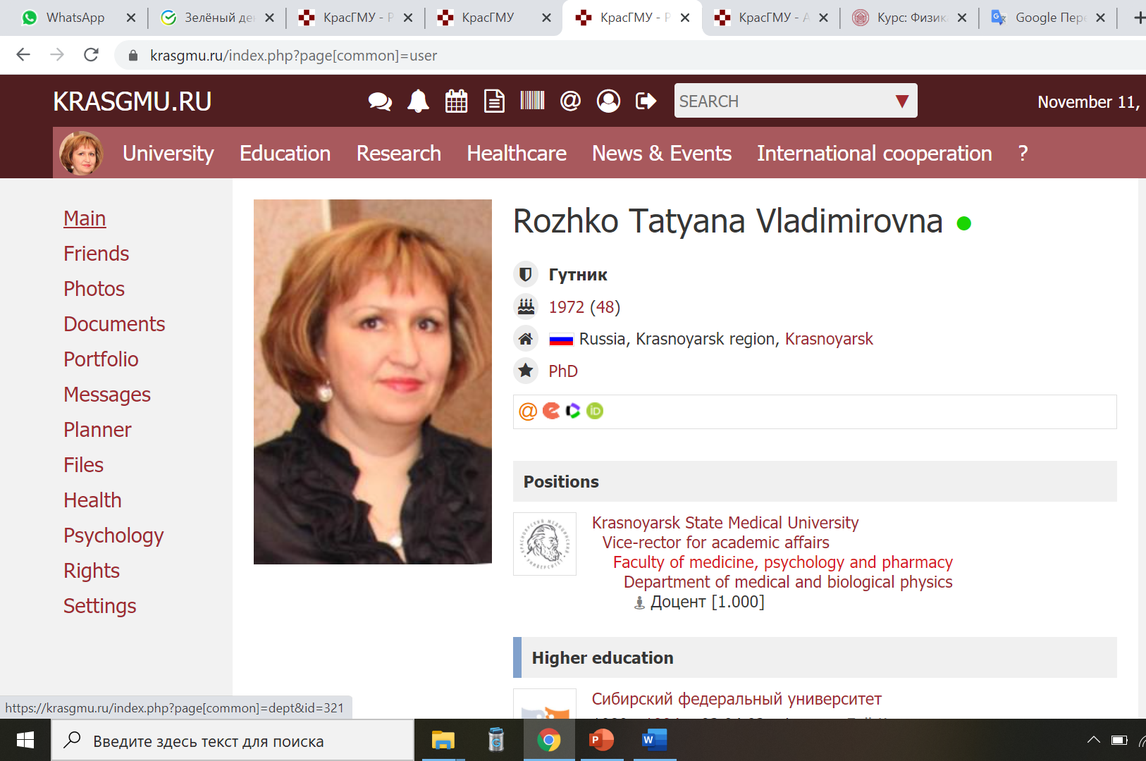
Where can I get the task?
You can find your assignments in different ways. I will post tasks for you on my page in the folder «documents»

Slide 7
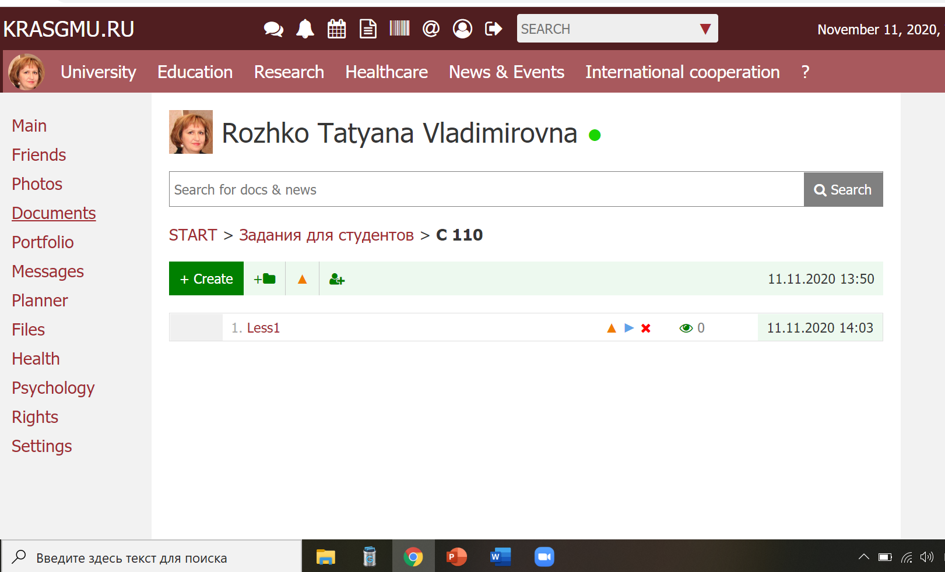
Where can I get the task?

