Slide 1
Prof. V.F. Voino-Yasenetsky Krasnoyarsk State Medical University
Topic: Metabolism of glucose.
Regulation of blood glucose levels.
Lecture No. 6 on the discipline "biochemistry" for 2nd year students
Lecturer: Panina Yu.A.
Krasnoyarsk, 2023

Slide 2
Lecture plan:
Relevance of the topic.
The concept of glycolysis. Types of glycolysis, their differences and significance.
Glycolysis reactions. Key enzymes, regulation. Tissue features of glycolysis.
Gluconeogenesis. Concept, significance, reactions.
Glucose-lactate cycle (Corey cycle).
Pentose phosphate pathway
Blood glucose, its regulation.
Heteropolysaccharides
Conclusion

Slide 3
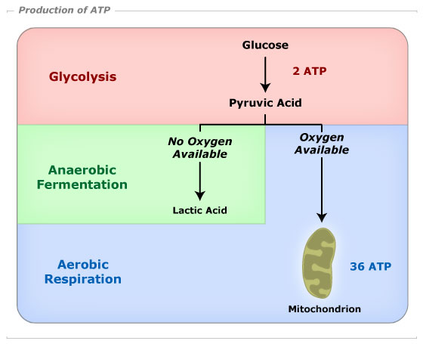
RELEVANCE OF THE TOPIC
Biomedical significance
carbohydrates are one of the most important sources of energy for all cells and tissues - from aerobic to anaerobic

Slide 4
https://www.slideserve.com/zola/oxidative-decarboxylation-of-pyruvate

Slide 5
Glycolysis
anaerobic
breakdown of glucose
aerobic
to lactate (lactic acid)
to CO₂ and H₂O (KC+ETC)
in anaerobic (anoxic) conditions
in aerobic (oxygen) conditions
in the cytoplasm of cells (glycolysis), mitochondria (KC - in the matrix, ETC - in cristae)
in the cytoplasm of cells
energy output -
2 ATP molecules
energy output -
38 ATP molecules

Slide 6
The progress of glycolysis reactions
1)
CH₂ - OH
CH₂ - O - P
H
*
H
H
H
hexokinase
O
O
H
H
H
OH
H
OH
OH
АТP
АDP
HO
OH
HO
H
OH
H
OH
Mg²⁺
Glucose
Glucose - 6 - Phosphate
2)
CH₂ - O - P
P - O H₂C
CH₂OH
Phosphohexoisomerase (glucose phosphate isomerase)
O
H
H
O
H
H
HO
OH
H
H
OH
HO
OH
OH
H
H
OH
Glucose - 6 - Phosphate
Fructose - 6 - Phosphate

Slide 7
The progress of glycolysis reactions
3)
P - O H₂C
CH₂OH
P - O H₂C
CH₂O - P
O
O
*
Phosphofructokinase
H
HO
H
HO
H
OH
H
OH
OH
H
АТP
АDP
OH
H
Fructose - 6 - Phosphate
Fructose – 1,6 - bisphosphate
CH₂O - P
P - O H₂C
CH₂O - P
С
O
O
HO
С
H
H
HO
H
OH
H
С
OH
OH
H
H
С
OH
Fructose – 1,6 - bisphosphate
CH₂O - P
Fructose – 1,6 - bisphosphate

Slide 8
The progress of glycolysis reactions
4)
CH₂O - P
Aldolase
(fructose-1,6-bisphosphataldolase)
С
O
С
O
HO
С
H
СH₂OH
H
С
OH
dihydroxyacetone phosphate
Triose phosphate isomerase
H
С
OH
H
CH₂O - P
С
O
Fructose – 1,6 - bisphosphate
H
С
OH
CH₂O - P
glyceraldehyde 3-phosphate

Slide 9
The progress of glycolysis reactions
Glyceraldehyde-3-phosphate dehydrogenase (GAPDH)
O
5)
H
H O
С
O ~ P
С
O
+
HO
P
OH
2
H
С
OH
2
С
OH
2
H
O
CH₂O - P
CH₂O - P
2NAD⁺
2NADН + H⁺
glyceraldehyde 3-phosphate
1,3-bisphosphoglycerate
6)
O
Phosphoglycerate kinase
СOOH
С
O ~ P
2
H
С
OH
H
С
OH
2
CH₂O - P
CH₂O - P
2АDP
2АТP
3-phosphoglycerate
1,3-bisphosphoglycerate

Slide 10
The progress of glycolysis reactions
7)
СOOH
СOOH
phosphoglycero mutase
2
H
С
OH
H
С
O P
2
CH₂O - P
CH₂OН
3-phosphoglycerate
2-phosphoglycerate
8)
СOOH
enolase
СOOH
2
2
H
С
O P
С
O ~ P
CH₂OН
CH₂
2Н₂О
2-phosphoglycerate
phosphoenolpyruvic acid (PEP)

Slide 11
The progress of glycolysis reactions
9)
СOOH
*
СOOH
COOH
pyruvate kinase
2
2
2
С
O ~ P
С
OH
С
O
CH₂
2АDP
2АТP
CH₂
CH₃
enolpyruvate
pyruvate
phosphoenolpyruvic acid (PEP)
10)
COOH
Lactate dehydrogenase
COOH
2
O
2
С
H
С OH
CH₃
2NADН + H⁺
2NAD⁺
CH₃
pyruvate
Lactate

Slide 13
Remember!
The NAD⁺ that is consumed in the glyceraldehyde 3-phosphate reaction is produced in the lactate DH reaction. Thus, redox balance is maintained.
The NADH that is produced in the glyceraldehyde 3-phosphate reaction is consumed in the lactate DH reaction. Thus, redox balance is maintained.
Glucose + 2 P_{i} +2 ADP → 2 lactate + 2 ATP + 2 H₂O

Slide 14
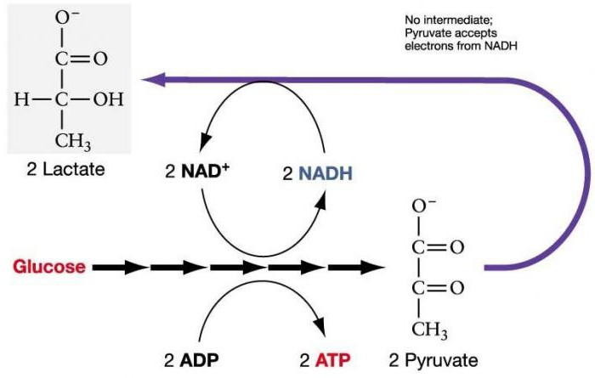
The progress of glycolysis reactions in the absence of oxygen
http://fb.ru/Fhn550kO5/ec8e63HS/_PQ4qv/Rnz75zSY/O_EOv/kGbJY?SqQ_b=LgLiJxqpT&6uj=dGAIQl&2HiVQ

Slide 15
Glycolytic oxidoreduction (Embden-Meyerhof Pathway.)
Glyceraldehyde-3-phosphate dehydrogenase (GAPDH)
glyceraldehyde 3-phosphate (GAP)
1,3-bisphosphoglycerate
NAD⁺
NADН + H⁺
Lactate
Pyruvate
Lactate dehydrogenase

Slide 16
Regulation of glycolysis
Key enzymes | Activators | Inhibitors
Hexokinase (initial) | Insulin (induces) | Glucose-6-phosphate
Phosphofructokinase (limiting, at the fork) | AMP, ADP | ATP, NADH, citrate
Pyruvate kinase (at the fork) |  | ATP, NADH, acetyl-CoA
Pasteur effect - inhibition of anaerobic glycolysis by metabolites of tissue respiration (by inhibiting phosphofructokinase with citrate and ATP)

Slide 17
Significance of glycolysis
energy (the formation of ATP by substrate phosphorylation)
Other functions of glycolysis:
-glycolysis is the main and phylogenetically the most ancient way of glucose utilization in cells,
-glycolysis is a unique pathway because it can use oxygen if the latter is available (aerobic conditions), but it can also proceed in the absence of oxygen (anaerobic conditions)
- under anaerobic conditions, glycolysis is the only process in the body that supplies energy
- under aerobic conditions, glycolysis removes lactate from tissues
- the possibility of the transition of glycolysis at any time in the GNG - the implementation of homeostasis of glucose in the blood
-intermediate metabolites - precursors of the synthesis of amino acids (via GNG), nitrogenous bases, lipids (interrelation of metabolism)

Slide 18
Advantages and Disadvantages of Glycolysis
 | Aerobic | Anaerobic
Advantages | highly efficient process (38 ATP) does not accumulate products (lactate) that cause metabolic acidosis | fast process no oxygen needed
Disadvantages | slow process need oxygen | ineffective process (2 ATP) glycolysis product is lactate, the accumulation of which causes metabolic acidosis

Slide 19
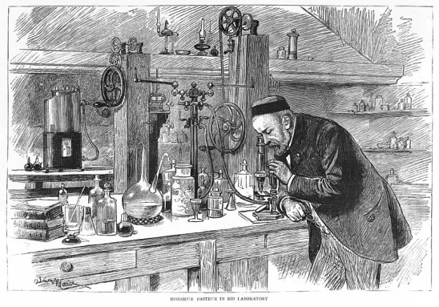
Pasteur effect
Inhibition of anaerobic glycolysis by metabolites of tissue respiration (by allosteric inhibition of phosphofructokinase by citrate and ATP) in the presence of oxygen.
Significance - to prevent excess energy production, due to the presence of competition between the enzymes of aerobic and anaerobic glycolysis for common metabolites (pyruvate and NADH2)

Slide 20
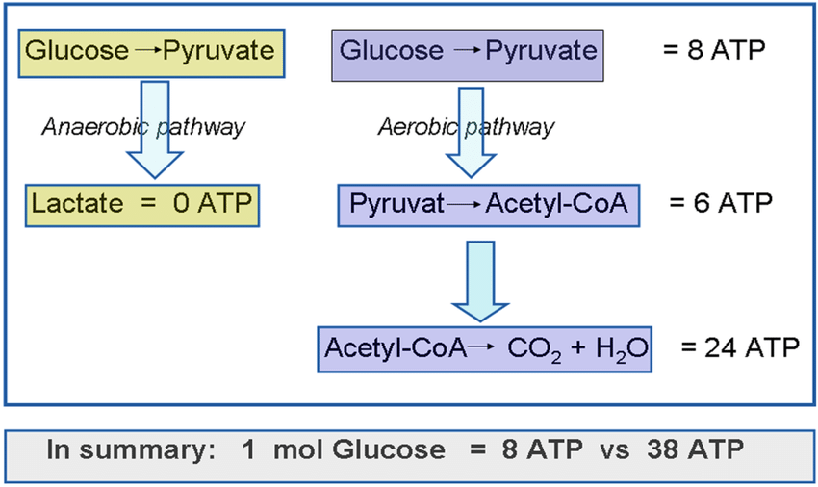
Glycolysis summary

Slide 21
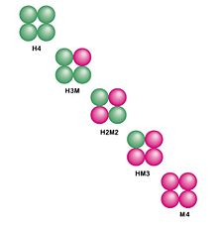

Slide 22
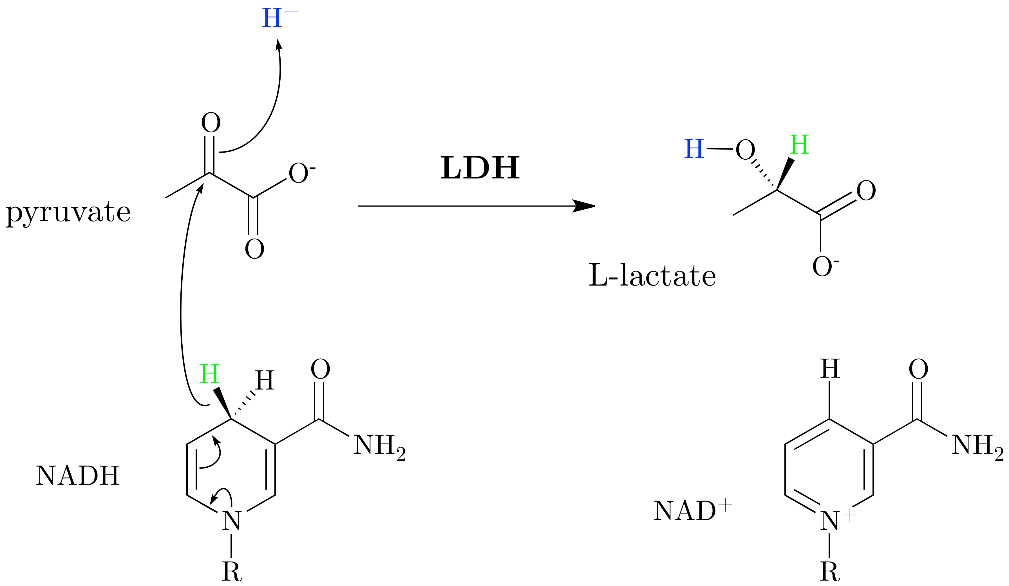
Cell sensitivity to lack of oxygen
Normally, the work of the cells of the nervous system (neurons) and the myocardium under aerobic conditions is provided by a large number of mitochondria and the supply of substrates from the blood for oxidation - glucose, ketone bodies, fatty acids (only for the myocardium), lactate, which is converted into pyruvate.
The high sensitivity of these organs to the lack of oxygen is based on the difference between the isoenzymes of lactate dehydrogenase (LDH) from each other.

Slide 23
Cell sensitivity to lack of oxygen
The cardiac isoenzyme LDH-1, having a high affinity for lactic acid, converts it to pyruvic acid, "seeking" to raise the concentration of pyruvate in order to include it in the tricarboxylic acid cycle (only under aerobic conditions) and obtain energy to the cardiomyocyte contraction
In the absence of oxygen, the properties of LDH-1 will not change; it will continue to shift the reaction towards the production of pyruvic acid ("right-to-left"). However, without oxygen, pyruvate cannot "burn" in the CTC and cannot leave the cell either, because cell membranes are impervious to him. As an acid, it acidifies the cytosol, altering the activity of enzymes and, possibly, somehow still exhibits toxicity. Thus, irreversible damage to the cardiomyocyte and neuron occurs.

Slide 24
Cell sensitivity to lack of oxygen
At the same time, the isoenzyme of skeletal muscle (and brain astrocytes) LDH-5 has a high affinity for pyruvate, in the absence of oxygen in the cell it quickly and efficiently converts it into lactic acid, while the reverse reaction practically does not take place. Acidification of the sarcoplasm reduces the efficiency of the myocyte, but lactic acid does not accumulate - it easily passes through the cell membranes and is quickly removed from the muscle and astrocyte. Skeletal muscle or astrocyte becomes
workable.
However, lactate accumulates in the intercellular space (in the brain tissue) and in the blood, leading to metabolic acidosis
Under anaerobic conditions, the heart muscle and nervous system will suffer the most, which is observed in medical practice (the period of anoxia for neurons is no more than 7 minutes, for cardiomyocytes - no more than 20 minutes)

Slide 25
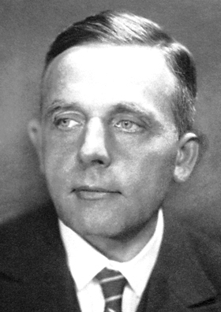
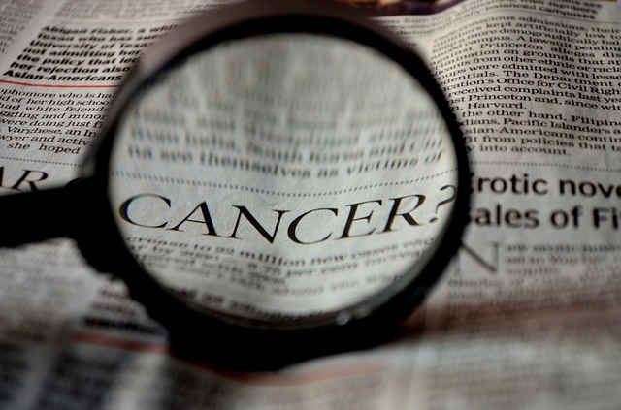
Warburg effect
two unrelated biochemical phenomena (from the field of plant physiology and from oncology), discovered by Nobel laureate Otto Warburg
Otto Heinrich Warburg (1883-1970)
For the discovery of the nature and functions of "respiratory enzymes" Warburg was awarded the Nobel Prize in Physiology or Medicine in 1931

Slide 26
Warburg effect
decrease in the rate of photosynthesis at high oxygen concentration
the tendency of most cancer cells to produce energy primarily through anaerobic glycolysis rather than through slow glycolysis, even when oxygen is abundant
oxygen is a competitive inhibitor with respect to carbon dioxide and competes with it for the active site of Rubisco, reducing carbon fixation and forming by-products. As a result, photorespiration is activated, which reduces the overall yield of photosynthesis.
now the Warburg effect in oncology is considered not a root cause, but simply a consequence of mutations in malignant cells (a consequence of mitochondrial damage during malignancy, adaptation to low oxygen content, or the result of turning off mitochondrial genes, since many of them are involved in triggering apoptosis)

Slide 28
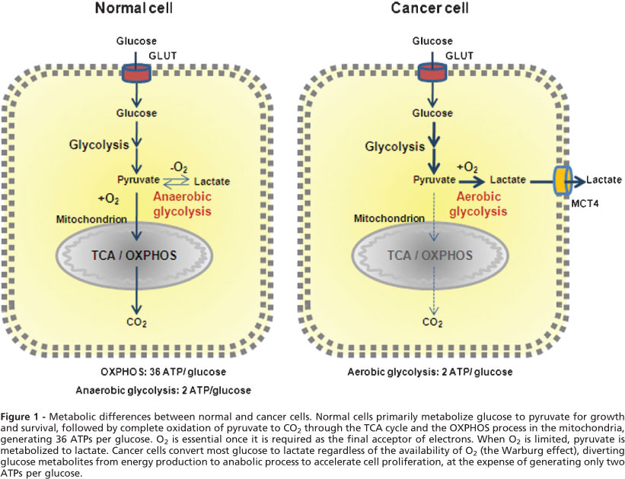
Warburg effect in oncology

Slide 29
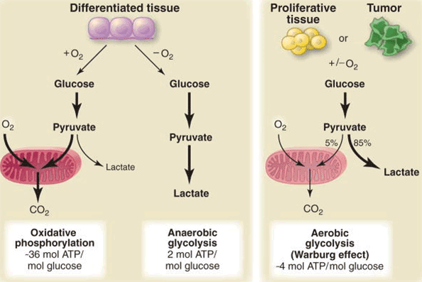
During hypoxia and inflammatory reactions in tissues, anaerobic mechanisms of ATP regeneration dominate

Slide 30
Glycolysis inhibitors
Many substances that inhibit glycolysis are currently the subject of intense research as anticancer agents:
SB-204990,
2-deoxy-D-glucose,
3-bromopyruvate,
5-thioglucose,
dichloroacetic acid (an inhibitor of mitochondrial pyruvate DG)
alpha-cyano-4-hydroxycinnamic acid (inhibitor of monocarboxylate transporters - prevents the accumulation of lactate in tumors) has been successfully used to treat brain tumors in preclinical studies

Slide 31
Tissues with a predominance of glycolysis
anaerobic
aerobic
"Mixed"
muscles, gastrointestinal tract, renal medulla, retina, skin
brain, heart tissue, kidney
red blood cells (no mitochondria)
the liver, kidneys and heart usually utilize lactate, but under conditions of hypoxia form it
In tissues with aerobic metabolism, LDH1 and LDH2 predominate - they are inhibited even by small concentrations of pyruvate, which prevents the formation of lactate and promotes more complete oxidation of pyruvate in KC
In tissues with anaerobic and "mixed" metabolism, LDH4 and LDH5 predominate - it causes intense anaerobic glycolysis with rapid conversion of pyruvate into lactate
In many human tissues (tissues of the spleen, pancreas and thyroid glands, adrenal glands, lymph nodes) and in the embryo, LDH3 isoenzyme predominates

Slide 32
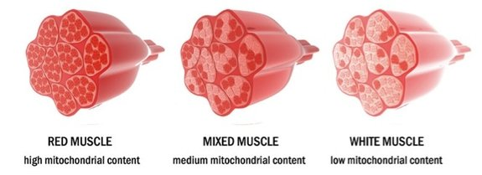
Glycolysis in skeletal muscle
"Slow" (oxidative) muscle fibers
"Fast" (glycolytic) muscle fibers
endurance, work in "normal" mode
strength, speed, "explosive" movement
load below 30% of a one-time maximum, slowly hypertrophied
load over 30% of a one-time maximum, quickly hypertrophied
glycogen and lipids are used,
no lactate is formed
glycogen is used, lactate is formed

Slide 33
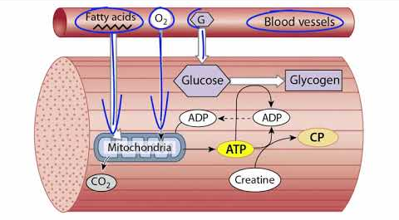
Resistance to hypoxia of skeletal muscles
Three types of anaerobic and only one aerobic pathway of ATP regeneration have been identified in skeletal muscles. Anaerobic:
Creatine phosphatase (phosphogenic or alactate) mechanism - rephosphorylation between creatine phosphate and ADP
Myokinase - synthesis (aka resynthesis) of ATP in the reaction of transphosphorylation of 2 ADP molecules (adenylate cyclase)
Glycolytic - anaerobic breakdown of blood glucose or glycogen storage, resulting in the formation of lactic acid (otherwise referred to as "lactate")

Slide 35
Gluconeogenesis
Gluconeogenesis is the synthesis of glucose from non-carbohydrate precursors (lactate, pyruvate, oxaloacetate, glycerol, amino acids).
In the direction of the reactions, gluconeogenesis (GNG) resembles glycolysis in reverse, except for "detours".
Key enzymes: pyruvate carboxylase; phosphoenolpyruvate carboxykinase (PEPCK); fructose-1,6-diphosphatase; glucose-6-phosphatase.
The formation of 1 glucose molecule consumes 6 macroergs (4 ATP and 2 GTP).
GNG is localized in the cytoplasm of hepatocytes of the liver (since it is in the liver that there is an enzyme glucose-6-phosphatase, which catalyzes the conversion of glucose-6-phosphate into glucose), in the cells of the kidney cortex and the mucous membrane of the small intestine.
About 90% of the lactate used in gluconeogenesis goes to the liver, 10% to the kidneys and small intestine.

Slide 36
Gluconeogenesis
Gluconeogenesis is the de novo synthesis of glucose from non-carbohydrate substrates:
-Amino acids (during fasting)
-Glycerol (during fasting)
-Lactate (during exercise)
Gluconeogenesis is a source of glucose for tissues during fasting.
First of all, this is important for the brain (it cannot provide energy needs due to the oxidation of fatty acids) and red blood cells - in them an aerobic pathway for the decay of substances is impossible due to the absence of mitochondria

Slide 37
The importance of gluconeogenesis
It is an important source of glucose in the body: for many tissues, glucose is the main (nervous tissue), and for some the only (red blood cells) source of energy; under conditions of prolonged fasting (more than a day) gluconeogenesis is the only source of glucose in the body
Removes most of the lactate from cells and tissues that work under anaerobic conditions, which protects them from metabolic acidosis
"Disadvantage" of GNG: glucose synthesis is energetically "expensive"

Slide 39
"Workarounds" of glycolysis
The GNG has special “workarounds”, i. E. it does not completely replicate the glucose oxidation reaction.
Its reactions can occur in all tissues, except for the last glucose-6-phosphatase reaction, which occurs only in the liver, kidneys and small intestine. Therefore, strictly speaking, gluconeogenesis occurs mainly in the liver, partly in the kidneys and small intestine.

Slide 40
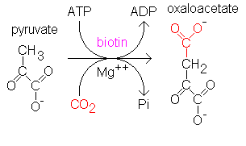
1st workaround of the GNG
Pyruvate
Carboxylase
Pyruvate Carboxylase fixes CO₂. Enzymes which fix CO₂. require the cofactor BIOTIN. Biotin is a vitamin and is always involved in CO₂ fixation.
This reaction takes place in the mitochondrial matrix.

Slide 41
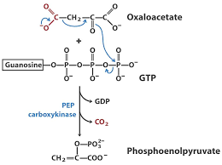
1st workaround of the GNG
This reaction takes place in the cytosol

Slide 42
A simplified version of the 10th glycolysis reaction bypass
Mitochondria
Cytosol
GTP
ATP
ADP+Pi
GDP
pyruvate
carboxylase
phosphoenolpyruvate carboxykinase
Biotin
Phosphoenol
pyruvate
pyruvate
oxaloacetate
However, the fact is that pyruvate carboxylase is located in the mitochondria, and phosphoenolpyruvate carboxykinase is in the cytosol. The impermeability of the mitochondrial membrane to oxaloacetate adds to the problem.
But malate can pass through the membrane, precursor of oxaloacetate by KC

Slide 43
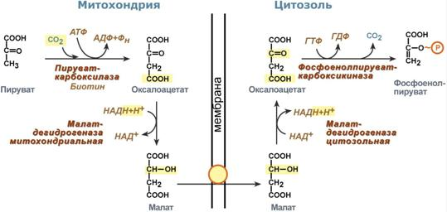
A real version of the bypass of the 10th glycolysis reaction
Mitochondria
Cytosol
ATP
ADP+Pi
GTP
GDP
pyruvate
carboxylase
phosphoenolpyruvate carboxykinase
pyruvate
Phosphoenol
pyruvate
oxaloacetate
oxaloacetate
NADH+ H⁺
membrane
NADH+ H⁺
Malate dehydrogenase (mitochondrial)
Malate dehydrogenase (cytosolic)
NAD⁺
NAD⁺
An excess of NADH in mitochondria (from β-oxidation of fatty acids activated under conditions of glucose deficiency in the hepatocyte) allows the malate dehydrogenase reaction of the KC to be reversed.
malate
malate
anaplerotic (replenishing) KC reaction

Slide 44
2nd workaround of the GNG
P - O H₂C
CH2O - P
P - O H₂C
CH₂OН
O
O
Fructose-1,6-bisphosphatase
H
HO
H
HO
H
OH
H
OH
OH
H
- Н3РО4
OH
H
Fructose - 1, 6 - bisphosphate
Fructose - 6 - Phosphate

Slide 45
3rd workaround of the GNG
CH2 - O - P
CH₂ - OН
H
Glucose-6-phosphatase
H
H
H
O
O
ОH
H
ОH
H
OH
HO
OH
HO
- Н3РО4
H
OH
H
OH
Glucose - 6 - Phosphate
Glucose

Slide 46
The reactions of gluconeogenesis
0)
COOH
COOH
2
Lactate dehydrogenase
2
H
С OH
С
O
CH₃
CH₃
Lactate
2NAD⁺
2(NADН + H⁺)
Pyruvate
COOH
COOH
СOOH
1)
*
2
pyruvate carboxylase
*
С
PEP-carboxykinase
С
O
O
2
С
O ~ P
CH₃
2АТP
2АDP + 2Pi
CH₂
CH₂
2GTP
2GDP
HCO₃⁻
COOH
2CO₂
Pyruvate
Oxaloacetate
Phosphoenol pyruvate

Slide 47
The reactions of gluconeogenesis
2)
СOOH
Enolase
СOOH
2
2
С
O ~ P
H
С
O P
CH₂
2Н₂О
CH₂OН
Phosphoenolpyruvate
2-phosphoglycerate
СOOH
СOOH
3)
2
H
С
O P
Phosphoglycerate mutase
2
H
С
OH
CH₂OН
CH₂O - P
2-phosphoglycerate
3-phosphoglycerate

Slide 48
The reactions of gluconeogenesis
O
4)
СOOH
phosphoglycerate kinase
С
O ~ P
H
С
OH
2
2
H
С
OH
CH₂O - P
2АТP
2АDP
CH₂O - P
3-phosphoglycerate
1,3-bisphosphoglycerate
5)
O
H
H O
С
O ~ P
Glyceraldehyde-3-phosphate dehydrogenase
С
O
2
+
HO
P
OH
2
С
OH
2
H
С
OH
H
O
CH₂O - P
2(NADН + H⁺)
2NAD⁺
CH₂O - P
1,3-bisphosphoglycerate
glyceraldehyde
3-phosphate

Slide 49
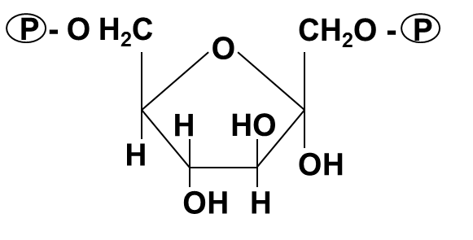
The reactions of gluconeogenesis
6)
CH₂O - P
CH₂O - P
Aldolase
С
O
С
O
СH₂OH
H
HO
С
Triose phosphate isomerase
dihydroxyacetone phosphate
H
С
OH
H
H
С
OH
С
O
CH₂O - P
H
С
OH
glyceraldehyde 3-phosphate
fructose- 1,6-bisphosphate
CH₂O - P
7)
P - O H₂C
CH₂O - P
P - O H₂C
CH₂OH
O
O
*
Fructose 1,6-bisphosphatase
H
HO
H
HO
H
OH
H
OH
OH
H
Pi
OH
H
Fructose - 1.6 - bisphosphate
fructose-6-phosphate

Slide 50
The reactions of gluconeogenesis
P - O H₂C
CH₂OH
CH₂ - O - P
8)
O
H
H
Phosphohexaisomerase (glucose phosphate isomerase)
O
H
HO
H
H
OH
H
OH
OH
H
HO
OH
H
OH
fructose-6-phosphate
Glucose - 6 - Phosphate
CH₂ - O - P
CH₂ - OH
9)
H
H
Glucose-6-phosphatase
H
H
O
*
O
H
H
H
OH
H
OH
HO
OH
Фн
HO
OH
H
OH
H
OH
Glucose - 6 - Phosphate
Glucose

Slide 51
Regulation of gluconeogenesis
Key enzymes | Activators | Inhibitors
Pyruvate carboxylase (initial) | Glucagon, catecholamines, GCS, cAMP, acetyl-CoA, ATP | ADP
Phosphoenolpyruvate carboxykinase (PEPCK) (limiting) | Glucagon, catecholamines, GCS, cAMP, ATP | Insulin (repression)
Fructose-1,6-bisphosphatase (limiting) | GCS (induction) | AMP
Glucose-6-phosphatase (limiting) | GCS (induction) | Insulin (repression)
Ethanol inhibits gluconeogenesis

Slide 52
Gluconeogenesis from glycerol

Slide 53
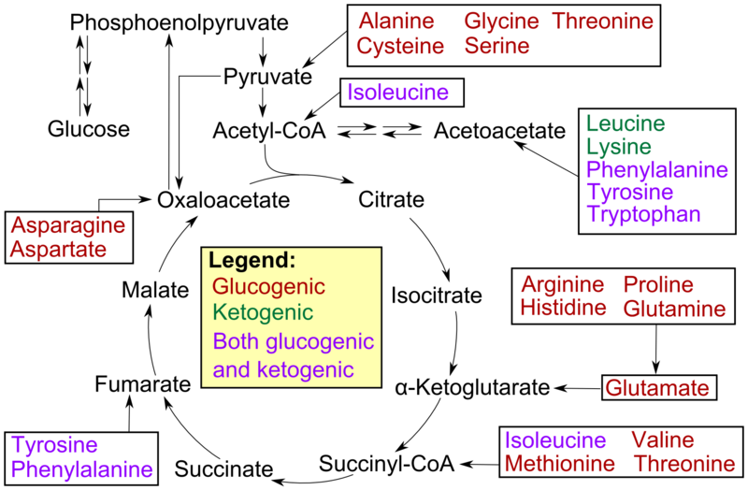
Gluconeogenesis from amino acids
All amino acids, except for the ketogenic leucine and lysine, are able to participate in glucose synthesis. The carbon atoms of some of them (gly (u) cogenous) are completely included in the glucose molecule, some (mixed) - partially

Slide 54
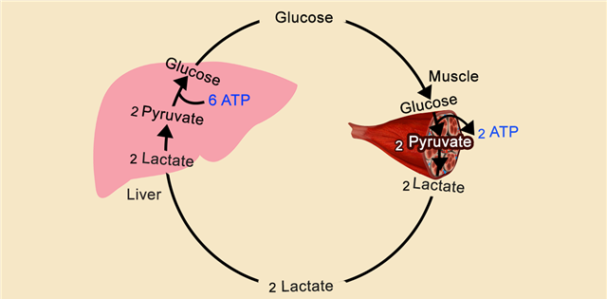
Glucose-lactate cycle (lactate cycle, Cori cycle)

Slide 55
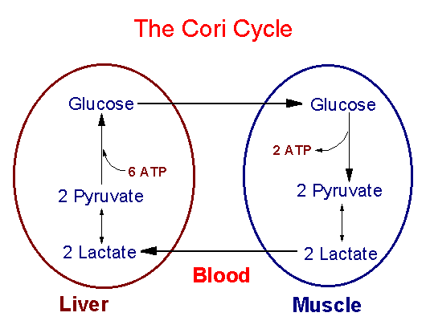
Glucose-lactate cycle (lactate cycle, Cori cycle)
http://helpiks.org/helpiksorg/baza7/1017425536827.files/image010.gif

Slide 56
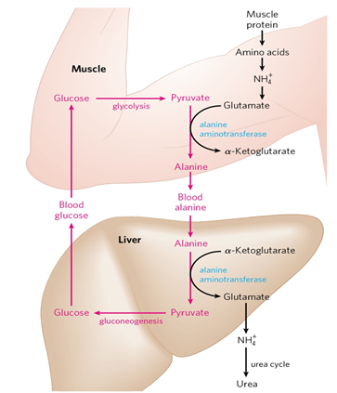
Glucose-Alanine Cycle

Slide 57
The conversion processes of carbohydrates provide 60% of the total energy exchange:
Direct heat / energy source (glucose-6-phosphate), energy reserve (glycogen);
About 70% of food carbohydrates are oxidized in tissues to water and carbon dioxide;
25% of blood glucose is converted to fat;
From 2 - 5% glycogen is synthesized in the liver and muscles.

Slide 58
Distribution of glucose transporter proteins (GLUT)
https://ask.exprto.com/t/glucose-transporter/731

Slide 59
https://es.slideshare.net/AlejandroChavez12/diabetes-presentacin-1

Slide 60
Sodium-glucose transport proteins/sodium-glucose linked transporter, SGLT
https://slideplayer.com/slide/10415128/

Slide 61
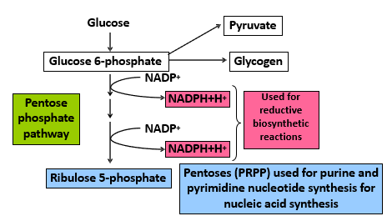
Pentose phosphate pathway (PPP, pentose pathway / cycle, hexose monophosphate shunt, Warburg-Dickens-Horeker pathway)
direct oxidation of glucose-6-phosphate
alternative pathway for glucose oxidation

Slide 62
Reactions of the oxidative phase of PPP
CH₂ - O - P
6
CH₂ - O - P
H
H
Glucose - 6 - phosphate - dehydrogenase
H
lactonase
(gluconolactone hydratase)
O
5
O
H
H
H
OH
4
OH
H
1
O
HO
OH
3
2
NADP⁺
NADPН+Н⁺
HO
H
OH
H
OH
HOH
Glucose - 6 - phosphate
6 - phosphogluconolactone
1
Xylulose - 5 - phosphate
COOH
1 (2)
СH₂OH
epimerase
H
2
OH
6 - phosphogluconate - dehydrogenase
С
2 (3)
С
O
indirect conversion via ribulose 5-phosphate
HO
3
H
С
3 (4)
H
С
OH
4
H
С
OH
NADPН+Н⁺
4 (5)
NADP⁺
H
С
OH
isomerase
5
H
С
OH
5 (6)
Ribose - 5 - phosphate
СО₂
СH₂ - O - P
6
СH₂ - O - P
6 - phosphogluconate
Ribulose-5-phosphate

Slide 63
Reactions of the oxidative phase of PPP
1
СH₂OH
2
С
O
3
H
HО
С
epimerase
4
H
С
OH
1
5
СH₂OH
СH₂ - O - P
2
Xylulose - 5 - phosphate
С
O
3
OH
indirect conversion via ribulose 5-phosphate
H
С
4
H
С
OH
5
СH₂ - O - P
H
1
Ribulose - 5 - phosphate
С
O
isomerase
2
H
С
OH
3
OH
H
С
4
H
С
OH
5
СH₂ - O - P
Ribose - 5 - phosphate

Slide 64
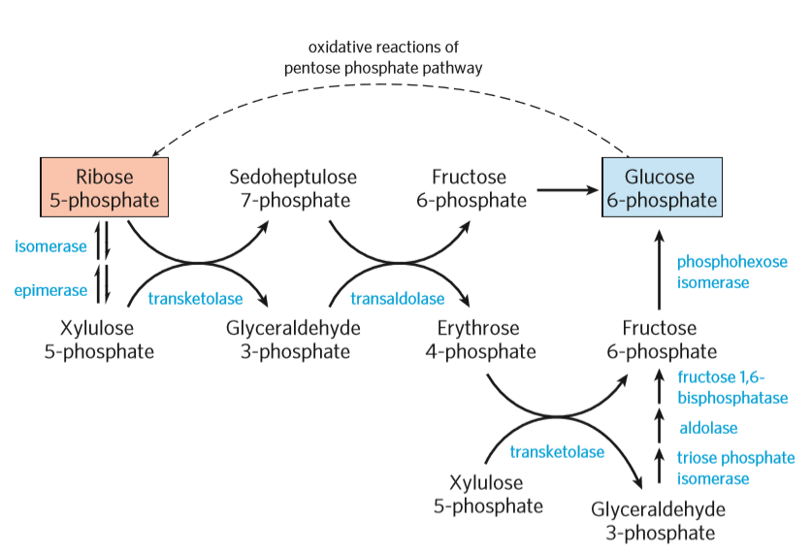
non-oxidative phase of PPP

Slide 65
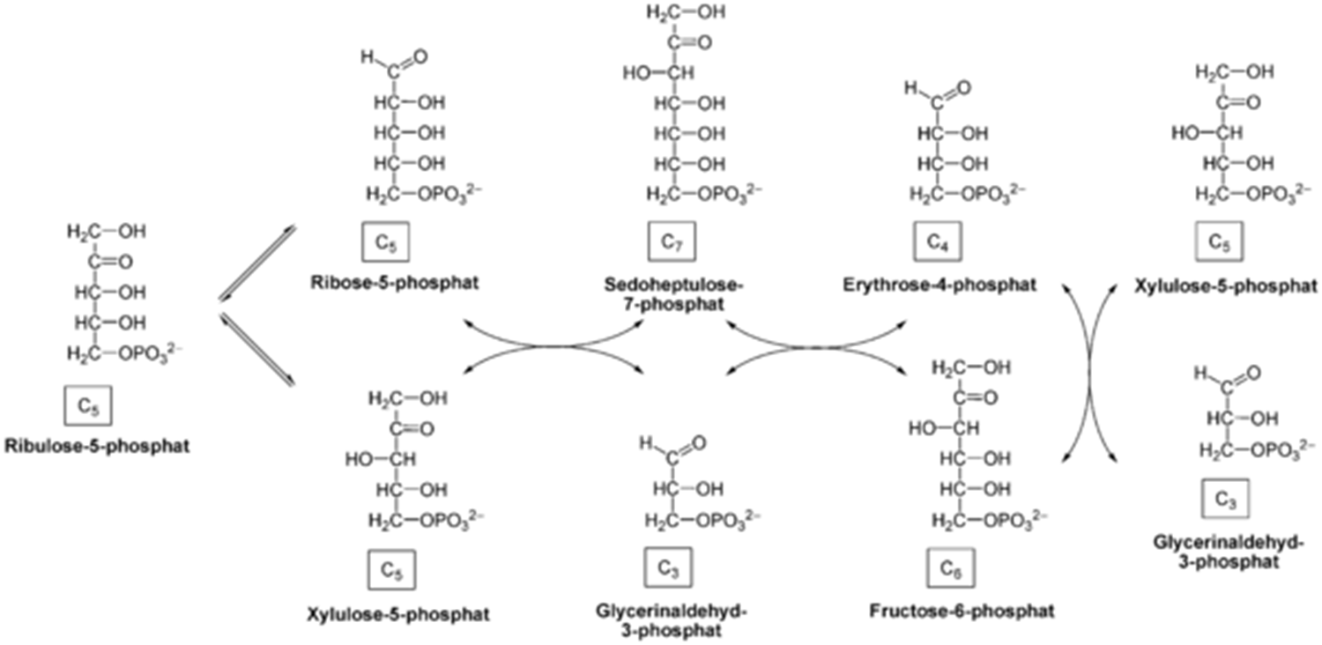
non-oxidative phase of PPP

Slide 66
non-oxidative phase of PPP
Glucose-6-phosphate
glycolysis / GNG
Xylulose-5-phosphate
Sedoheptulose-7-phosphate
Fructose-6-phosphate
Xylulose-5-phosphate
С5
С7
С6
С5
+
transketolase
+
transaldolase
+
transketolase
+
С5
С3
С4
С3
Ribose-5-phosphate
Glyceraldehyde-3-phosphate
Erythroso-4-phosphate
Glyceraldehyde-3-phosphate
Fructose-6-phosphate
glycolysis / GNG
Glucose-6-phosphate
GNG
(closure in a loop)

Slide 67
Switching metabolic pathways
With a balanced cell demand for NADPH and ribose-5-phosphate, PPP ends at the oxidative stage
If the need for ribose-5-phosphate exceeds the need for NADPH, then ribose-5-phosphate is formed as a result of reversible reactions of the nonoxidative stage of PPP, using glycolysis metabolites - glyceraldehyde-3-phosphate and fructose-6-phosphate as starting substances.

Slide 68
Switching metabolic pathways
With an increased need for NADPH:
With a high energy status of the cell: ribose-5-phosphate is converted into glyceraldehyde-3-phosphate and fructose-6-phosphate, which go to the path of gluconeogenesis, because no need for ATP generation
With a low energy status of the cell: the resulting glyceraldehyde-3-phosphate and fructose-6-phosphate are included in glycolysis and converted into pyruvate, etc.

Slide 69
Pentose phosphate pathway (PPP)
3 glucose-6-phosphate
6 NADP⁺
3 CO₂
6 NADPН+Н⁺
3 ribose 5-phosphate
Pentose cycle
2 fructose-6-phosphate
1 3-phosphoglycerol
aldehyde
Glycolysis
GNG

Slide 70
Regulation of the pentose phosphate pathway
Key PPP enzymes | Activate | Inhibit
glucose-6-phosphate dehydrogenase (initial) | -increase in the ratio NADP+/NADPH+H +, -insulin - iodothyronines | glucocorticoids (GCS)
6-phosphogluconate dehydrogenase (at the fork)
transketolase (limiting)

Slide 71
Significance of the pentose phosphate pathway
1) Energy - the resulting metabolites of the oxidative part can be used in glycolysis.
2) Synthetic - associated with the use of ribose-5-phosphate and NADPH.
- Ribose-5-phosphate is used for the synthesis of nucleotides, which are necessary for the formation of coenzymes, macroergs, nucleic acids.
- NADPH is necessary for reductive biosynthesis (for the work of reductases in the synthesis of cholesterol and fatty acids; in the formation of deoxyribose from ribose; for the reduction of glutathione, in the formation of glutamate from 2-oxoglutarate);
-necessary for the work of hydroxylases involved in the synthesis of catecholamines, serotonin, steroid hormones, bile acids, the active form of vitamin D, collagen synthesis, neutralization of xenobiotics;
-necessary for the reduction of iron (III) in methemoglobin to iron (II) normal hemoglobin (erythrocytes), for the reactivation of folic acid and vitamin K;
-used in transhydrogenase reaction.
3) Provides the metabolism of "unusual sugars"
4) "Pentose phosphate shunt" - "backup" way of glucose utilization

Slide 72
PPP in cells and tissues
Active in cells and tissues
Low activity in cells and tissues
In tissues where biosynthesis of fatty acids and
steroids (testes, adipose tissue, leukocytes, cortex
adrenal glands, mammary gland), the proportion of PPP in the oxidative
glucose metabolism is very significant
The intensity of PPP depends on the functional state of the tissue and
from hormonal status (for example, in the liver it sharply decreases with
starvation due to inactivation of PPP dehydrogenases and is restored
shortly after feeding)

Slide 73
Intracellular and tissue localization of the FPP
in the cytosol of cells
Very active
Active
Low active
in the tissues of the embryo and fetus, lymphoid and myeloid tissues, mucous membrane of the small intestine, adipose tissue, endocrine glands (adrenal glands, reproductive glands), mammary glands (during lactation), liver, erythrocytes, tooth pulp, tooth enamel rudiments, with organ hypertrophy
- promotes the transparency of the lens of the eye;
- prevents hemolysis of erythrocytes;
- part of the system of protection against free radicals and reactive oxygen species
in the nervous, muscle and connective tissues

Slide 74
Feature of PPP in proliferating cells
If a cell grows and divides, then it needs NADPH and ribose-5-phosphate.
In this case, the 2nd stage will not go, all the ribulose-5-phosphate formed at the 1st stage will turn into ribose-5-phosphate, which is used for the synthesis of nucleotides.
NADPH will be spent on the synthesis of deoxyribonucleotides

Slide 75
Feature of PPP in adipocytes
If the cell needs large amounts of NADPH (for example, the synthesis of fatty acids in the liver or adipocytes or the synthesis of cholesterol), then both the 1st and 2nd stages will actively go. The formed fructose-6-phosphate and glyceraldehyde phosphate in the reactions of gluconeogenesis will turn into glucose-6-phosphate, and the cycle will begin again.

Slide 76
Feature of PPP in erythrocytes
If the cell needs NADPH and ATP energy (as in an erythrocyte), then fructose-6-phosphate and glyceraldehyde phosphate at the exit from the 2nd stage "fall through" into glycolytic reactions

Slide 77
Biochemical basis for the functioning of red blood cells
In the process of maturation, the erythrocyte loses its nucleus, ribosomes, the Golgi apparatus, mitochondria, and, consequently, the ability to biosynthesize protein (there is no synthesis of heme, lipids, proteins CK, ETC are not required), DNA, RNA and oxidative phosphorylation.
ATP is formed during anaerobic glycolysis (90% of consumed glucose) and goes mainly to ensure the work of Na + / K + -ATPase, which maintains the ionic composition of the erythrocyte.
A small amount of energy is spent on the preservation of heme iron in a reduced form and, apparently, on the renewal of membrane lipids.
Approximately 10% of glucose consumed by an erythrocyte is metabolized by the pentose phosphate pathway (PPP protects hemoglobin and erythrocyte membrane from exogenous oxidants, including some drugs).

Slide 78
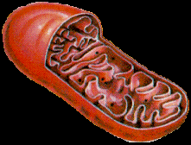
Why are there no mitochondria in red blood cells?
Possible decrease in oxygen delivery to organs and tissues
Red blood cells do not need a lot of ATP, which is synthesized by mitochondria
Increase in usable erythrocyte volume, i.e. stroma filled with hemoglobin
In the absence of mitochondria, the cost of resources for their renewal, repair of their membranes, synthesis of mitochondrial proteins, etc., decreases.

Slide 79
Brain tissue carbohydrates
Glucose
Glycogen (about 0.1%)
Hexose phosphates (glucose-6-phosphate, fructose-6-phosphate)
Triose phosphates (glyceraldehyde-3-phosphate, dioxyacetone phosphate)

Slide 80
Features of carbohydrate metabolism in the brain
There is no store of glycogen, so the brain needs a constant supply of glucose.
Carbohydrates are the only source that normally covers the energy expenditure of the brain.
The brain tissue absorbs about 70% of the glucose secreted by the liver.
Brain hexokinase has a high affinity for glucose, which allows the brain to use glucose efficiently. The activity of glycolysis enzymes is high.

Slide 81
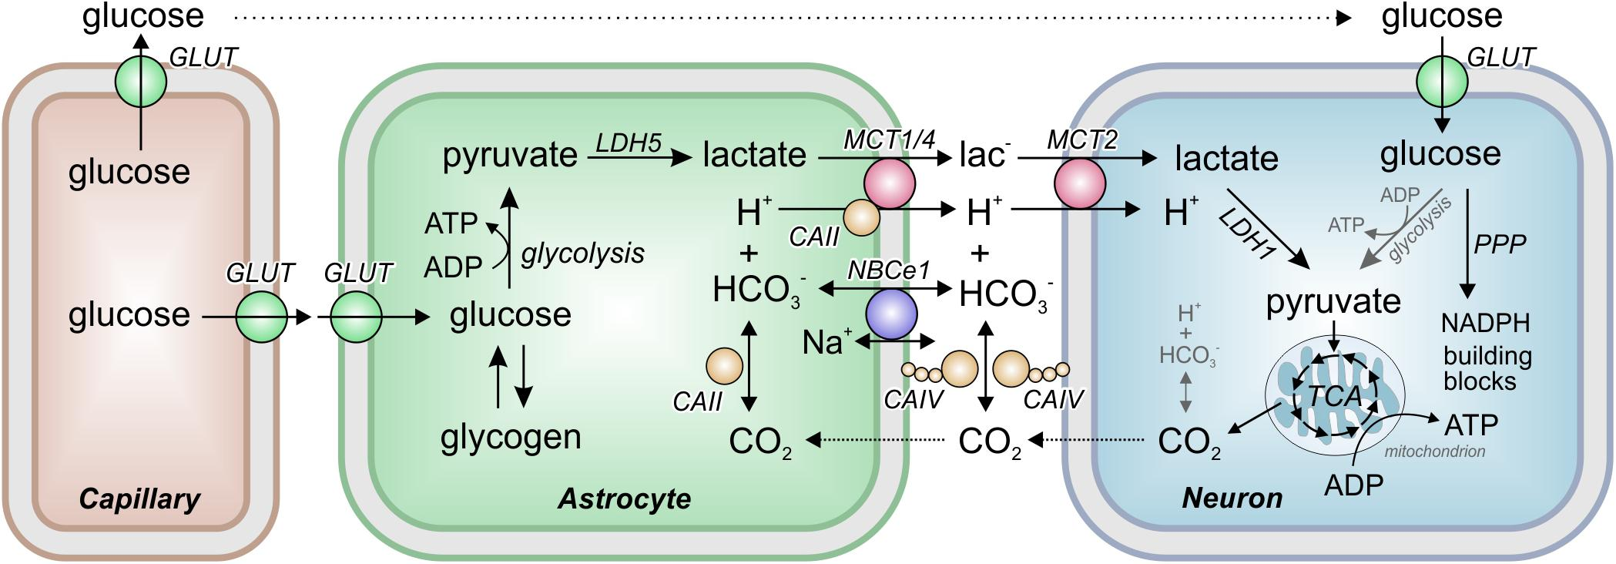
Features of carbohydrate metabolism in the brain
In neurons, PPP is not significantly expressed
Glia - PPP is one of the main uses of glucose

Slide 82
Features of carbohydrate metabolism in muscle tissue
There are reserves of glycogen
The breakdown of glycogen and subsequent glycolysis is one of the sources of energy for muscle contraction
In the resting phase in the muscles, glycogen is synthesized again
The total content of glycogen in muscles is 1–2% of the total muscle mass.
A large amount of glucose goes to the formation of amino acids - aspartate and glutamate

Slide 83
Features of carbohydrate metabolism in adipose tissue
In adipocytes, to ensure the reactions of fat synthesis, the breakdown of glucose occurs in two ways: glycolysis, which ensures the formation of glycerol-3-phosphate and acetyl-CoA, and the pentose phosphate pathway.

Slide 84
Blood glucose homeostasis

Slide 85
Blood glucose
The normal blood glucose concentration is 3.3 - 5.5 mmol / L.
The constancy of glucose is provided by two oppositely directed processes:
1. supplying glucose to the blood (digestion of carbohydrates in the gastrointestinal tract, GNG, breakdown of liver glycogen);
2. using glucose in tissues (glycolysis, glycogen synthesis, PPP, fat synthesis).
3. at a very high concentration of glucose in the blood (> 9 - 10 mmol / l), it can be reduced by excreting it in the urine. This phenomenon is called glucosuria. Normally, the concentration of glucose in the urine is 0.2 - 1.2 mmol / l.

Slide 87
Regulation of blood glucose by hormones
Hyperglycemic hormones | Hyporglycemic hormone
glucagon, catecholamines, glucocorticosteroids, somatotropin | insulin
Increase blood glucose due to: | Reduces blood glucose due to:
1) activation of processes that supply glucose (GNG, glycogen breakdown, unification of MS); 2) inhibition of processes using glucose (glycolysis, glycogen synthesis, PPP, fat synthesis) | 1) increasing the permeability of cell membranes for glucose; 2) inhibition of processes that supply glucose (GNG, glycogen breakdown, unification of MS); 3) enhancement of processes using glucose (glycolysis, glycogen synthesis, PPP, fat synthesis)

Slide 88
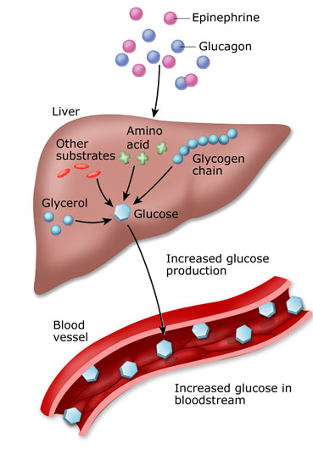
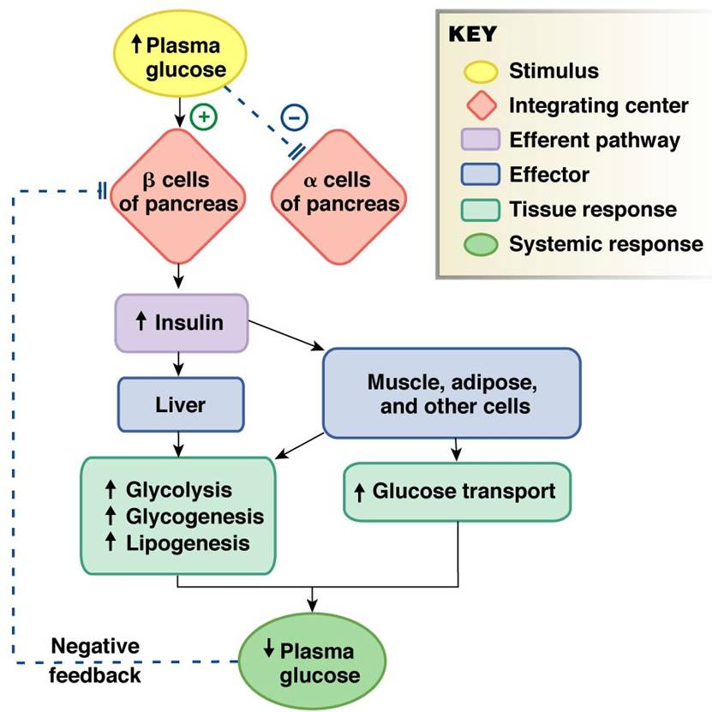
Regulation of blood glucose by hormones

Slide 91
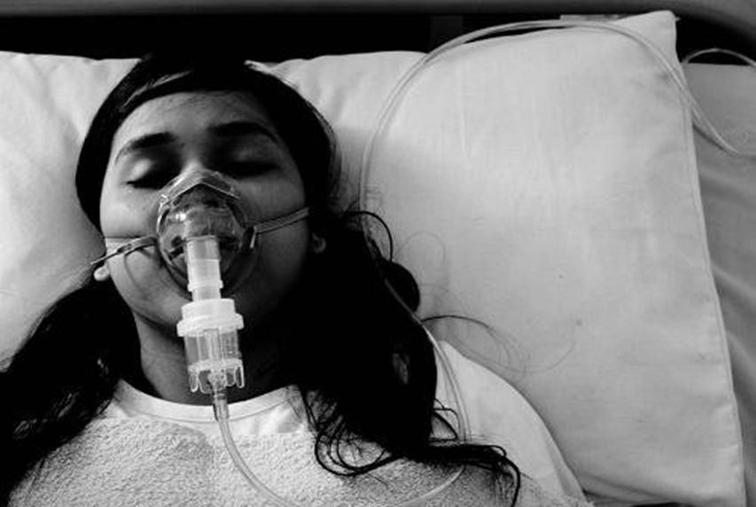
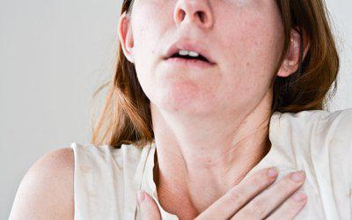
Diseases associated with the action of insulin
Insulinoma is a benign tumor made from the beta cells of the pancreas that produces excess insulin. The clinical picture is characterized by episodic hypoglycemic conditions.
Insulin shock is a symptom complex that develops with a single excess dose of insulin injected.
Chronic insulin overdose syndrome (Somoji syndrome) is a symptom complex that develops with prolonged excessive administration of insulin preparations.

Slide 92
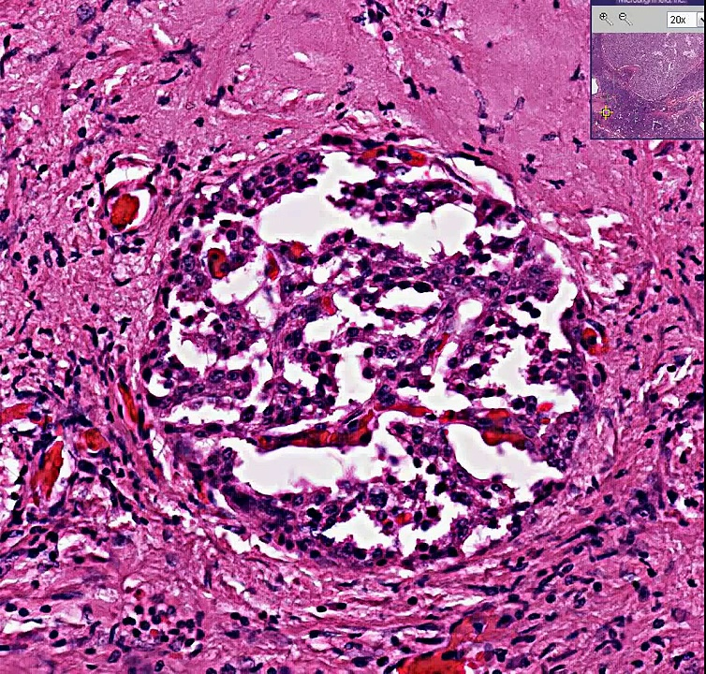
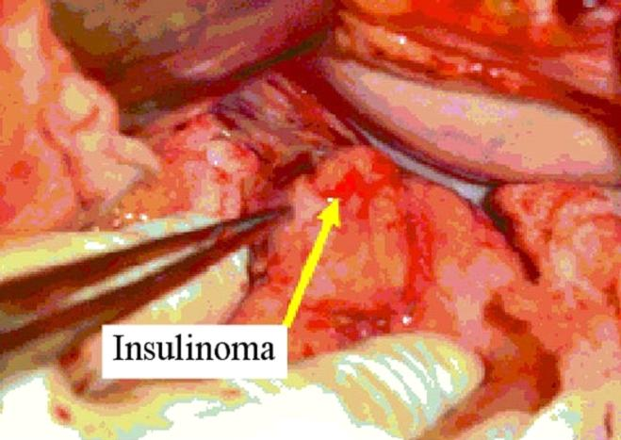

Slide 94
https://www.slideserve.com/harmon/managing-hypoglycemia-and-hyperglycemia

Slide 95
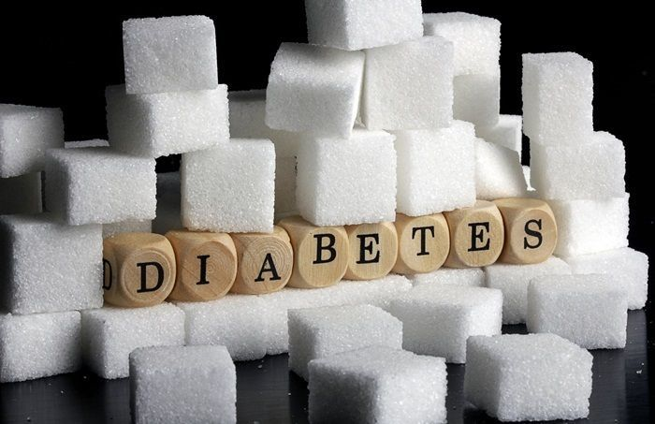
Diabetes mellitus, its complications and diagnosis

Slide 96
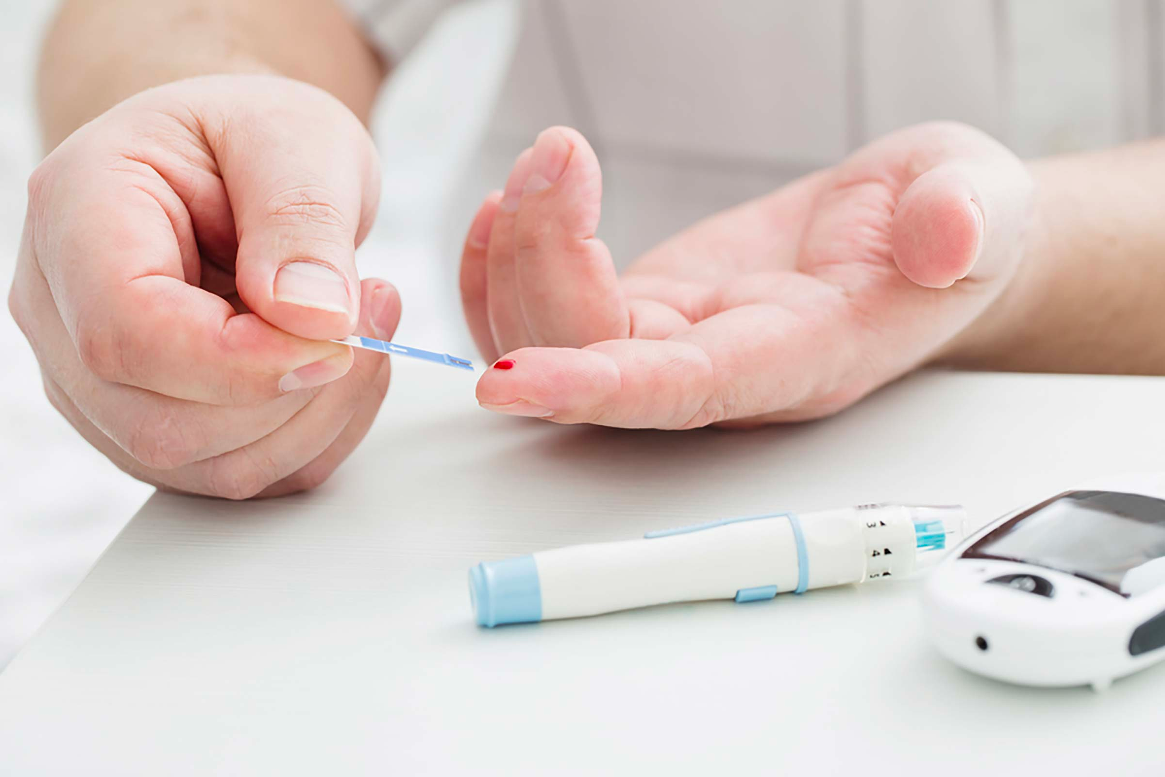
Diabetes

Slide 97
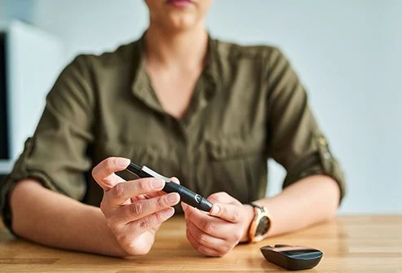
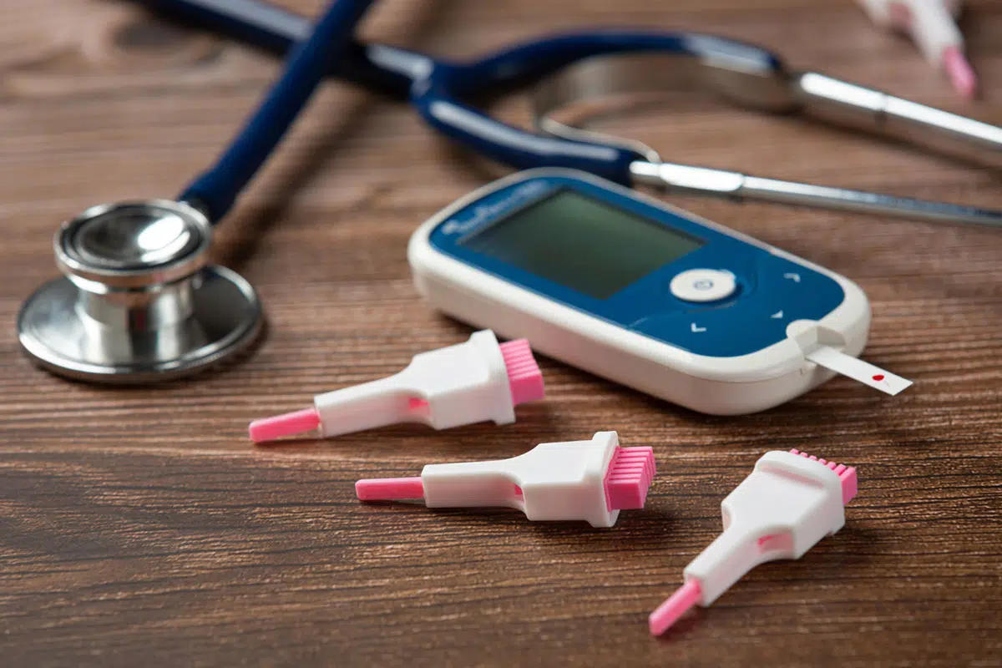
Diabetes mellitus - long-term and persistent hyperglycemia due to absolute or relative insulin deficiency
Absolute: impaired synthesis and secretion of insulin, destruction of insulin → insulin-dependent diabetes mellitus (IDDM, type I diabetes)
Relative: impaired activity and expression of insulin receptors and corresponding intracellular signaling molecules → insulin-independent diabetes mellitus (NIDDM, type II diabetes)

Slide 99
Diabetes
Type 1 | Type 2
Insulin-dependent (adolescent, juvenile, IDDM) | Insulin-independent (stable, elderly, NIDDM)
The reason is the absolute lack of insulin (autoimmune damage to the pancreas) | The reason is the relative lack of insulin (insulin resistance)
Properties: 10-20% seasonality of onset (infection) more often in men, age of debut - up to 30 years reduced or normal body weight insulin sensitivity of cells is preserved abrupt start and development microangiopathies prevail | Properties: 80-90% no seasonality start more often in women, age of debut - after 30 years body weight increased insulin sensitivity of cells is reduced gradual start and development macroangiopathies prevail
Diagnostic features: insulin (and C-peptide) production is sharply reduced or absent ↑ antibodies to ß-cells pancreas high tendency to ketoacidosis | Diagnostic features: insulin (and C-peptide) production is preserved, but below normal N antibodies to ß-cells of pancreas low tendency to ketoacidosis
Treatment features: insulin injections (long and short acting) + diet | Treatment features: hypoglycemic drugs + diet

Slide 100
The causes of diabetes
Damage to pancreatic cells or genetic defect in synthesis and secretion → absolute insufficiency of insulin (viruses, xenobiotics, autoantibodies, mutations of genes encoding insulin or enzymes that synthesize it)
Inactivation of receptors, conjugated signaling molecules or an excess of insulin antagonists → relative insufficiency of insulin (antibodies to insulin receptors, impaired expression of receptors and IRS, mutations of genes encoding GLUT, excess of leptin, resistin, contrainsular hormones)

Slide 101
Endocrinopathies
Hyperfunction of the thyroid gland (thyrotoxicosis)
Itsenko-Cushing's syndrome (tumor of the adrenal cortex)
Tumor of the anterior pituitary (acromegaly)
Glucagonoma (tumor of the pancreas made from alpha cells that produce glucagon)
Pheochromocytoma (tumors of the adrenal medulla)
Aldosteroma (tumors of the adrenal cortex)
Somatostatinoma (somatostatin-producing tumor)

Slide 103
Pathobiochemistry of diabetes mellitus
Hyperglycemia (more than 5.5 mmol / L)
Glucosuria (if blood glucose is> 7 mmol / L)
Dehydration
Hyperlactacidemia
Hyperketonemia and ketonuria (violation of FA utilization)
Hypercholesterolemia (impaired utilization of fatty acids)
Hyperazotemia and hyperazoturia (increased protein catabolism, impaired neutralization of ammonia)

Slide 104
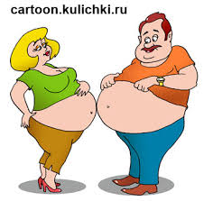
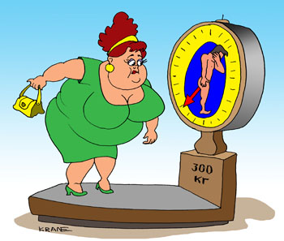
Metabolic syndrome

Slide 105
Metabolic syndrome
synonyms: Reaven syndrome, insulin resistance syndrome, metabolic syndrome X - an increase in visceral fat mass, a decrease in the sensitivity of peripheral tissues to insulin and hyperinsulinemia, which cause the development of disorders of carbohydrate, lipid, purine metabolism and arterial hypertension
"Deadly quartet":
diabetes mellitus + obesity + hypertension + ischemic heart disease

Slide 107
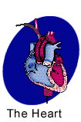
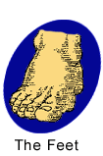
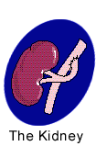
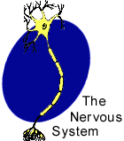
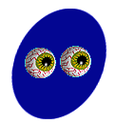
Complications of diabetes mellitus
Target organs

Slide 108
Complications of diabetes mellitus
Acute (coma) | Chronic
Diabetic (hyperglycemic, ketoacidotic) coma Signs: hyperglycemia (14-16 mmol / l), a sharp increase in the content of ketone bodies, an increase in cholesterol, LDL, blood pH shifts to 6.8 | Microangiopathies: glycosylation of proteins Lesion of small vessels: retina (reduces visual acuity), development of cataracts, renal vessels (leading to severe renal failure) polyneuropathies
Hyperosmolar coma Signs: at a blood glucose concentration of 50-60 mmol / l. As a result, the osmotic pressure of the blood rises, which leads to dehydration of the body.
Hypoglycemic coma Signs: when the blood glucose concentration is below 1.38-1.65 mmol / l. Occurs with insulin overdose and pancreatic tumors (insulinomas) | Macroangiopathies: development of atherosclerosis The defeat of large and medium vessels: lower limbs aorta

Slide 109
Heteropolysaccharides (acidic heteropolysaccharides - have many acid groups - gly (u) cosaminoglycans are glucose derivatives, contain amino groups)
characterized by the presence of repeating disaccharide residues (include uronic acid and amino sugar), which, duplicating, form oligo- and polysaccharide chains - glycans
proteoglycans (mucopolysaccharides)
(over 95% carbohydrates)
mucoproteins
(10-50% carbohydrates)
glycoproteins
(less than 10% carbohydrates)
complex proteins, the function of which is to fill the intercellular space and retain water here (tissue turgor and elasticity of cartilage, lubricant and structural component of joints, cartilage, skin).
In particular, hyaluronic acid is found in the vitreous humor of the eye, in the synovial fluid, in the intercellular space

Slide 111
Hyaluronic acid
Contained in the intercellular substance of the connective tissue, in the cell membranes, in the synovial fluid and in the vitreous body of the eye
Functions - regulation of permeability of the intercellular substance, dissolution and diffusion of salts
http://umedp.ru/articles/preparaty_gialuronovoy_kisloty_v_terapii_osteoartroza_fokus_na_khondroreparant_gialripayer.html

Slide 112
HYALURONIC ACID
Protein content - no more than 1-2%
Properties - polyanion with a large negative charge; very hydrophilic molecule; forms very viscous gel-like solutions with water
Functions - regulation of permeability of the intercellular substance, dissolution and diffusion of salts

Slide 113
Chondroitin sulfates
form aggregates with a large polypeptide chain, are able to bind cations, for example, calcium cations

Slide 114
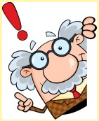
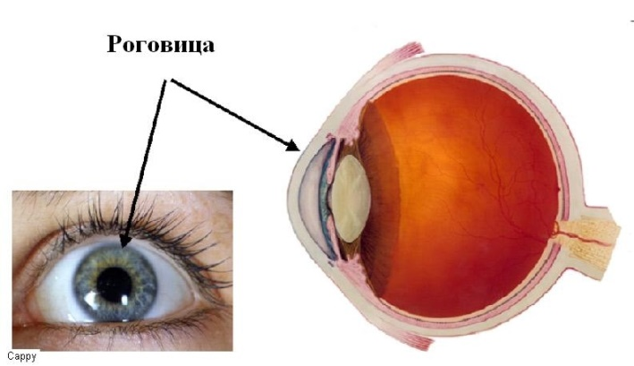
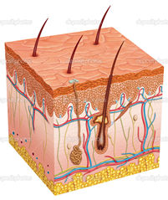
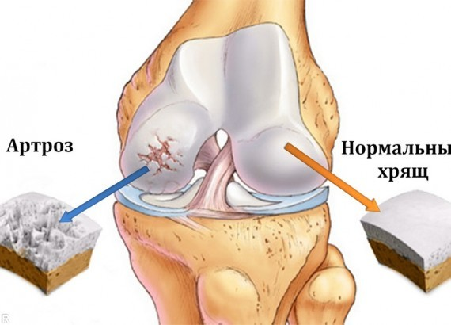
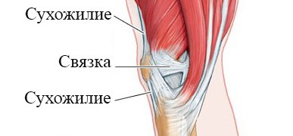
Chondroitin sulfates
Chondroitin sulfates are the most common glycosaminoglycans in the human body; they are found in cartilage, skin, tendons, ligaments, arteries, and the cornea of the eye. Chondroitin sulfates are an important component of aggrecan, the main proteoglycan of the cartilage matrix.
There are 2 types of chondroitin sulfates in the human body: chondroitin-4-sulfate and chondroitin-6-sulfate. They are built in the same way, the difference concerns only the position of the sulfate group in the N-acetylgalactosamine molecule

Slide 115
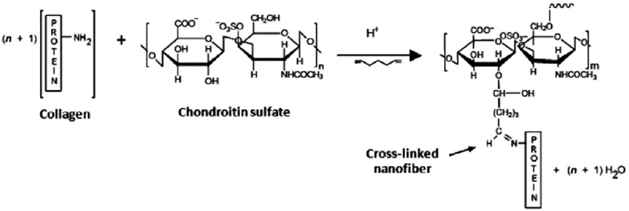

Slide 116
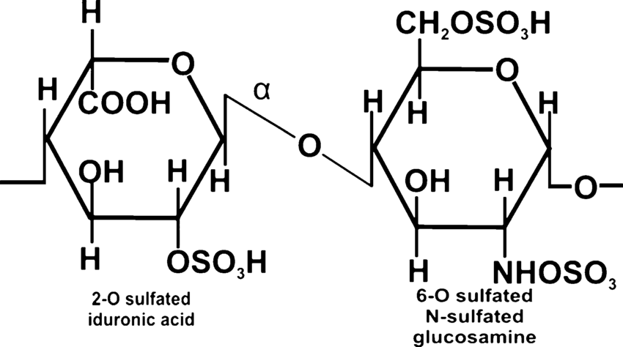
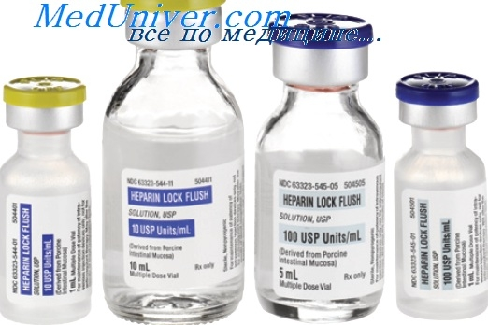
Heparin
Heparin is an important component of the blood anticoagulant system (it is used as an anticoagulant in the treatment of thrombosis). The disaccharide unit of heparin is similar to the disaccharide unit of heparan sulfate. The difference between these glycosaminoglycans is that there are more N-sulfate groups in heparin, and more N-acetyl groups in heparan sulfate. The molecular weight of heparin ranges from 6 × 10³ to 25 × 10³ D.

Slide 117
Heparin
Direct anticoagulant and lipoprotein lipase activator (responsible for the absorption of blood lipids)

Slide 119
Keratan sulfate
part of the cell surface; component of the extracellular matrix.
In case of tissue damage or other pathological process, the production of keratan sulfate is reduced or stopped.
Microglia also reduce keratan sulfate synthesis in inflammation; one study noted the loss of keratan sulfate in Alzheimer's disease.
In other studies, on the contrary, an increase in the expression of KS by microglia during injury was noted. Changes occur under the influence of pro-inflammatory cytokines.
The role of KS in the formation of glial scars in brain damage has been described.

Slide 120
Signs of lysosomal diseases
Impaired mental and physical development, skeletal deformation
Enlarged abdomen (hepatosplenomegaly)
Coarsening of facial features (gargoilism)
The appearance of changes on the skin (angiokeratomas)

Slide 121
Appearance of patients - “brothers” and “sisters”

Slide 122
https://image.slidesharecdn.com/gargoylism-150721164046-lva1-app6892/95/gargoylism-6-638.jpg?cb=1437497037

Slide 123
Lysosomal storage diseases
Disorders of heteropolysaccharide metabolism:
1. Gargoylism (Pfaundler-Gundler disease): substances accumulate in the liver, spleen, connective tissue, brain and cornea, giving toluidine blue staining characteristic of mucopolysaccharides. The chemical composition of mucopolysaccharides differs from normal; large amounts of chondroitin sulfate B and heparan sulfate are excreted in the urine. The diagnosis is based on the detection of large amounts of acidic mucopolysaccharides in leukocytes.
2. Morquio-Ulrich disease is distinguished by the fact that predominantly keratan sulfate is excreted in the urine.

Slide 127
Conclusion
Glycolysis, especially aerobic glycolysis, plays an important role as a source of energy in all organs and tissues
Gluconeogenesis is an important source of glucose for tissues during fasting or intense muscle work (which is especially important for brain cells and red blood cells) and removes most of the lactate from cells and tissues, preventing the development of metabolic acidosis
From a medical point of view, the Warburg effect in the mischievous person is interesting. tumors, explaining the increased consumption of glucose by these cells even in normoxia; and the use of glycolysis inhibitors as potential antineoplastic agents
The Cori cycle is a cycle of glucose and lactate exchange between working muscles and the liver, provided by the processes of glycolysis and gluconeogenesis

Slide 128
Conclusion
5. Glucose-6-phosphate is an active form of glucose that is formed (breakdown of glycogen, unification of MS, GNG, formation from glucose) and is used (synthesis of glycogen, PPP, glycolysis, the last stages of GNG) in various processes.
6. PPP plays a very important role in erythrocytes, maintaining their functional activity and protecting them from hemolysis; also PPP promotes transparency of the lens of the eye and is part of the defense system (antioxidant system of cells) from free radicals and reactive oxygen species.
7. In the regulation of blood glucose levels, two pancreatic hormones (insulin and glucagon) play the greatest role, which maintain glucose homeostasis. Violation of this regulation can manifest itself in the form of hypoglycemia (can manifest itself in the form of a coma) and hyperglycemia (long-term persistent hyperglycemia - diabetes mellitus - leads to the development of complications: coma, micro- and macroangiopathies).

Slide 130
How many ATPs you may receive from the anaerobic glycolysis?

